Slide 1

Cite Them Right Zhihua Wang

Slide 2
Bibliography management
Conference paper
Journal paper
Book (Chapter)
Incollection
PhdThesis
Website

Slide 3

Conference Citation
Format
@inproceedings{prashnani2018pieapp,
title={{PieAPP}: {Perceptual} image-error assessment through pairwise preference},
author={Prashnani, Ekta and Cai, Hong and Mostofi, Yasamin and Sen, Pradeep},
booktitle={IEEE Conference on Computer Vision and Pattern Recognition},
pages={1808--1817},
year={2018}}
Output:
E. Prashnani, H. Cai, Y. Mostofi, and P. Sen, “PieAPP: Perceptual image-error assessment through pairwise preference,” in IEEE Conference on Computer Vision and Pattern Recognition, 2018, pp. 1808–1817.
Notes:
PieAPP should be enclosed in curly brackets
The word after the colon should be enclosed in curly brackets
The conference names are all the full names or abbreviations
Capitalize the first letter of each word of the conference name
Notes:
PieAPP 这种算法名称，尊重原文的大写情况
：冒号后面首字母要大写
会议或者期刊首字母要大写
页码，有的可能不提供页码，比如ICLR， 可以是pp.1-13或者省略

Slide 4
Conference Citation
Wrong Citations
E. Prashnani, H. Cai, Y. Mostofi, and P. Sen, “PieAPP: Perceptual image-error assessment through pairwise preference,” in Proceeding of IEEE Conference on Computer Vision and Pattern Recognition, 2018, pp. 1808–1817.
E. Prashnani, H. Cai, Y. Mostofi, and P. Sen, “PieAPP: Perceptual image-error assessment through pairwise preference,” in IEEE 20-th Conference on Computer Vision and Pattern Recognition, 2018, pp. 1808–1817.
E. Prashnani, H. Cai, Y. Mostofi, and P. Sen, “Pieapp: Perceptual image-error assessment through pairwise preference,” in IEEE Conference on Computer Vision and Pattern Recognition, 2018, pp. 1808–1817.
E. Prashnani, H. Cai, Y. Mostofi, and P. Sen, “PieAPP: perceptual image-error assessment through pairwise preference,” in IEEE Conference on Computer Vision and Pattern Recognition, 2018, pp. 1808–1817.
E. Prashnani, H. Cai, Y. Mostofi, and P. Sen, “PieAPP: Perceptual image-error assessment through pairwise preference,” in Ieee conference on computer vision and pattern recognition, 2018, pp. 1808–1817.
E. Prashnani, H. Cai, Y. Mostofi, and P. Sen, “PieAPP: Perceptual image-error assessment through pairwise preference,” in IEEE Conference on Computer Vision and Pattern Recognition (CVPR), 2018, pp. 1808–1817.
E. Prashnani, H. Cai, Y. Mostofi, and P. Sen, “PieAPP: Perceptual image-error assessment through pairwise preference,” in IEEE/CVF Conference on Computer Vision and Pattern Recognition, 2018, pp. 1808–1817.
E. Prashnani, H. Cai, Y. Mostofi, and P. Sen, “PieAPP: Perceptual image-error assessment through pairwise preference,” in IEEE Conference on Computer Vision and Pattern Recognition, 2018.
Notes:
Preceeding of 要去掉
加了第几届
APP没有大写 -> 加大括号
perceptual 冒号首字母一定要大写
会议IEEE一定要大写， 会议名称首字母也要大写
全称和缩写保留一个
CVF去掉
没有页码，注意只有一个会议可以不加页码， ICLR

Slide 5
Journal Paper Citation
Format
@article{he2015spatial,
title={Spatial pyramid pooling in deep convolutional networks for visual recognition},
author={He, Kaiming and Zhang, Xiangyu and Ren, Shaoqing and Sun, Jian},
journal={IEEE Transactions on Pattern Analysis and Machine Intelligence},
volume={37},
number={9},
pages={1904--1916},
year={2015}}
Output:
K. He, X. Zhang, S. Ren, and J. Sun, “Spatial pyramid pooling in deep convolutional networks for visual recognition,” IEEE Transactions on Pattern Analysis and Machine Intelligence, vol. 37, no. 9, pp. 1904--1916, 2015.
K. He, X. Zhang, S. Ren, and J. Sun, “Spatial pyramid pooling in deep convolutional networks for visual recognition,” IEEE Transactions on Pattern Analysis and Machine Intelligence, 2023, to appear.
Notes:
The word after the colon should be enclosed in curly brackets
The journal names are all the full names or abbreviations
Capitalize the first letter of each word of the journal name
Notes:
期刊文章， 有7相
冒号后第一个单词要大写
期刊名称要么大写，要么缩写
期刊名称第一个字母要大写

Slide 6
Journal Paper Citation
Wrong Citations
K. He, Xiangyu Z., S. Ren, and J. Sun, “Spatial pyramid pooling in deep convolutional networks for visual recognition,” IEEE Transactions on Pattern Analysis and Machine Intelligence, vol. 37, no. 9, pp. 1904--1916, 2015.
K. He, X. Zhang, S. Ren, and J. Sun, “Spatial pyramid pooling in deep convolutional networks for visual recognition,” IEEE Transactions on Pattern Analysis and Machine Intelligence (TPAMI), vol. 37, no. 9, pp. 1904--1916, 2015.
K. He, X. Zhang, S. Ren, and J. Sun, “Spatial pyramid pooling in deep convolutional networks for visual recognition,” IEEE transactions on pattern analysis and machine intelligence, 2015.
K. Ding, K. Ma, S. Wang, and E. P. Simoncelli, “Image quality assessment: unifying structure and texture similarity.” IEEE Transactions on Pattern Analysis and Machine Intelligence, vol. 44, no. 5, pp. 2567–2581, 2020.
K. Ding, K. Ma, S. Wang, and E. P. Simoncelli, “Image quality assessment: Unifying structure and texture similarity.” IEEE Transactions on Pattern Analysis and Machine Intelligence, vol. 44, no. 5, pp. 2567–, 2020.
S. M. Newhall, D. Nickerson, and D. B. Judd, “Final report of the osa subcommittee on the spacing of the Munsell colors,” Journal of the Optical Society of America, vol. 33, no. 7, pp. 385–418, 1943.
Notes:
中文名字出错
有全拼，还有缩写
：后面没有大写
页码有起始页，没有终止页
缩写没有大写
怎么避免: 个人经验，从google scholar复制citations，一定要打开文章check一下

Slide 7
Other Citation
Format
@book{wang2006modern,
title={{Modern Image Quality Assessment}},
author={Wang, Zhou and Bovik, Alan C},
year={2006},
publisher={Morgan \& Claypool Publishers}}
Output:
Z. Wang and A. C. Bovik, Modern Image Quality Assessment. Morgan & Claypool Publishers, 2006.
Notes:
Capitalize the first letter of each word in book title
The publisher should not be empty
Capitalize the first letter of each word in the publisher's name
Notes:
书名，作者，出版商，时间
书本的第一个大写，可以包含在大括号内
出版商不能shenglue
出版商的第一个字母也要大写

Slide 8
Other Citation
Format
@book{texbook,
author = {Donald E. Knuth},
year = {1986},
title = {The {\TeX} Book},
publisher = {Addison-Wesley Professional} }
@book{latex:companion,
author = {Frank Mittelbach and Michel Gossens and Johannes Braams and David Carlisle and Chris Rowley},
year = {2004},
title = {The {\LaTeX} Companion},
publisher = {Addison-Wesley Professional},
edition = {2} }
@book{latex2e,
author = {Leslie Lamport},
year = {1994},
title = {{\LaTeX}: a Document Preparation System},
publisher = {Addison Wesley},
address = {Massachusetts},
edition = {2} }
Notes:
初次之外，还有以下方式引用

Slide 9
Other Citation
Format
@inbook{peyret2012:ch7,
title={Computational Methods for Fluid Flow},
edition={2},
author={Peyret, Roger and Taylor, Thomas D},
year={1983},
publisher={Springer-Verlag},
address={New York},
chapter={7, 14} }
@misc{dxomark,
url = {https://www.dxomark.com/}, year = {2020},
urldate = {January 21, 2022},
title = {{DXOMARK} Camera test protocol version 4 brings trustability, preview, and more},
author = {Lars Rehm}}
@Phdthesis{ timothy2005advances
author = {Timothy M. Toolan},
title= {{Advances in Sliding Window Subspace Tracking}},
school = {University of Rhode Island},
year = {2005}}

Slide 10

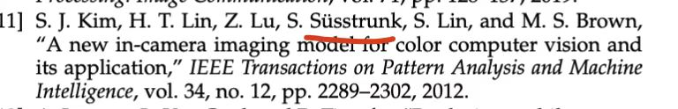
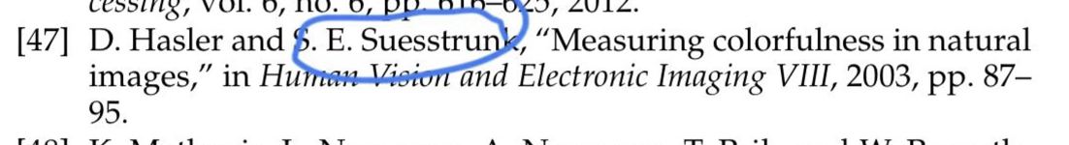
Reference Checking
Format
Conference
A. Ignatov, L. Van Gool, and R. Timofte, “Replacing mobile camera ISP with a single deep learning model,” in IEEE Conference on Computer Vision and Pattern Recognition Workshops, 2020, pp. 536–537.
Journal
M. Delbracio, D. Kelly, M. S. Brown, and P. Milanfar, “Mobile computational photography: A tour,” Annual Review of Vision Science, vol. 7, no. 1, pp. 571–604, 2021.
Book
Z. Wang and A. C. Bovik, Modern Image Quality Assessment. Morgan & Claypool Publishers, 2006.
Commission Internationale de l’Èclairage, Colorimetry. CIE Publication, 2004.
G. Kühni, Color Space and Its Divisions: Color Order from Antiquity to the Present. John Wiley & Sons, Ltd, 2003, ch. 6.
Incollection
M. R. Luo and C. Li, “CIECAM02 and its recent developments,” in Advanced Color Image Processing and Analysis, 2013, ch. 2, pp. 19–58.
Link
L. Rehm, “DXOMARK camera test protocol version 4 brings trustability, preview, and more,” 2020. [Online]. Available: https://www.dxomark.com/
Apple Developer Documentation, “DisplayP3-CGColorSpace,” 2017. [Online]. Available: https://developer.apple.com/documentation/
Same researcher with different name abbreviations
Check the volume, number, pages, and year, one by one
Notes:
主要是格式
同一个研究者，缩写不一样，或者姓名不一样，比如说德文，挪威问，瑞典文等等，都有一些特殊字符
期刊一定要一个一个检查volume, number, pages, 和年龄，一个一个检查
引用前面的空格，不要空格，要用~格式，这样可以避免两个空格

Slide 11
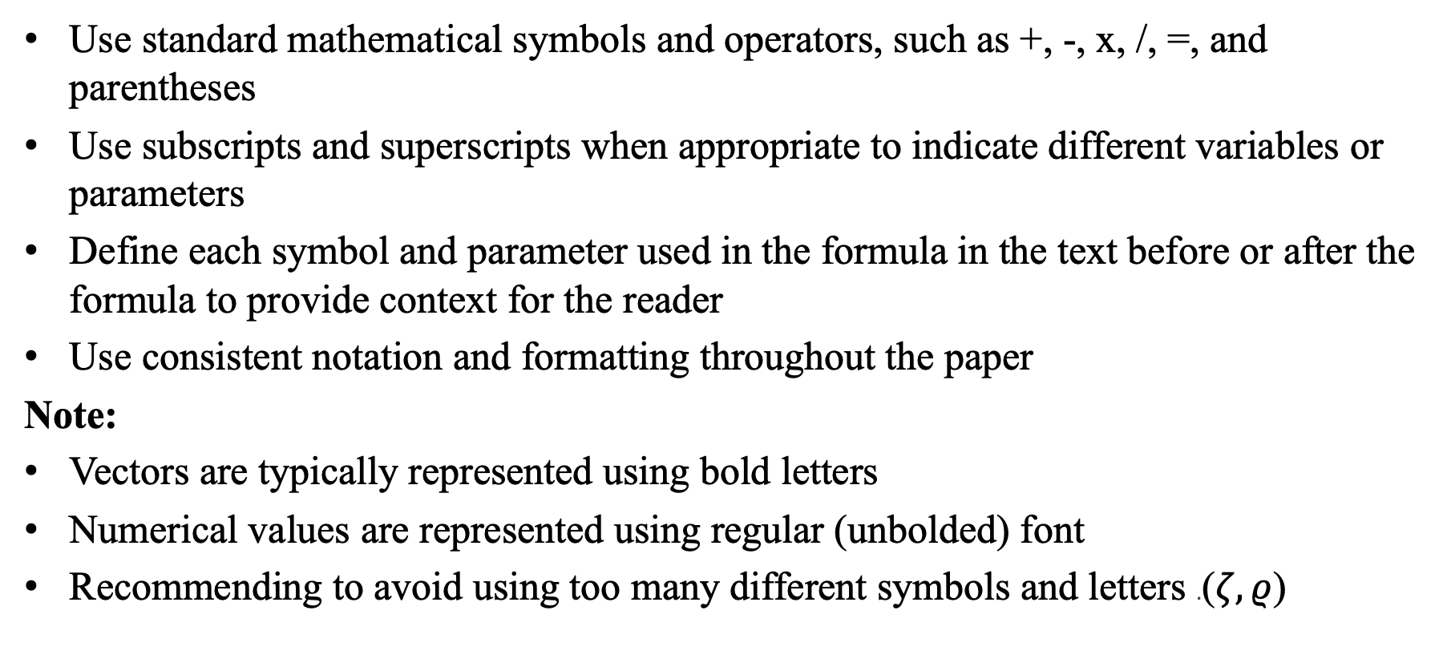
Equation Checking
Use standard mathematical symbols and operators, such as +, -, x, /, =, and parentheses
Use subscripts and superscripts when appropriate to indicate different variables or parameters
Define each symbol and parameter used in the formula in the text before or after the formula to provide context for the reader
Use consistent notation and formatting throughout the paper
Note:
Vectors are typically represented using bold letters
Numerical values are represented using regular (unbolded) font
Recommending to avoid using too many different symbols and letters .($ζ,ρ$)

Slide 12
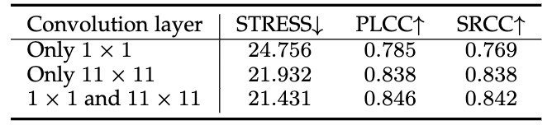
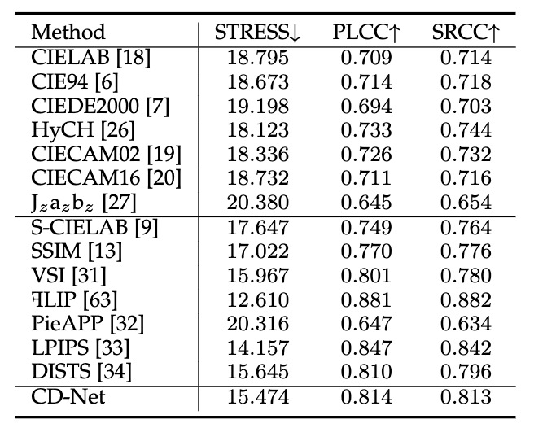
Table Checking
Remove period ”.” at the end of the table title
Check each value in the table and indicate the best and second best values in bold.
Leverage down/up arrows to indicate the preferable direction, where down arrow represents a lower value is better, and up arrow represents a higher value is better.
Check each value in tables
Add reference to each method

Slide 13
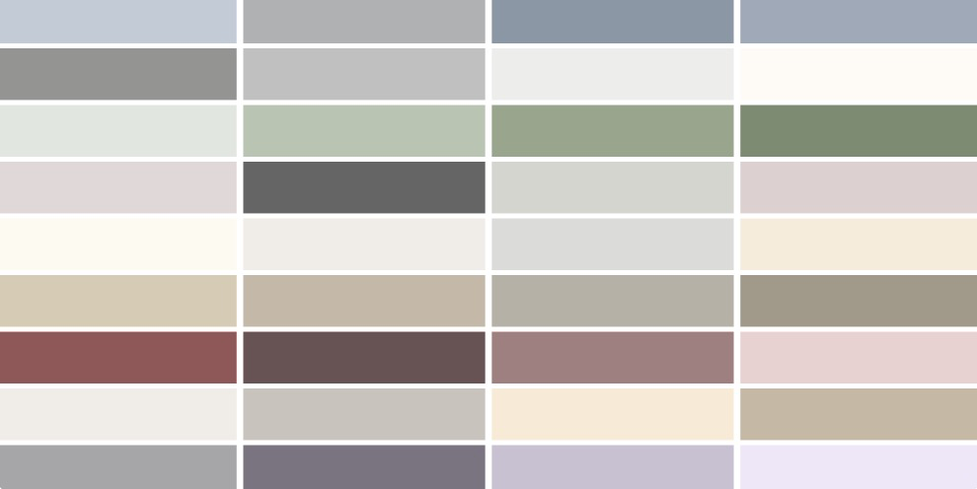
Figure Checking
Figures should be clear and easy to read. Use a clear and legible font, and make sure that any labels or annotations are large enough to be read clearly
The font used in the figure should match the font used in the paper
The colors used should be visually appealing and consistent with the color scheme of the paper (nature, science)
The font size used in the figure should be the same as the font size used in the title of the paper
Note:
Make sure that any labels, titles, or captions are legible and properly placed
Ensure that the font size and style used in the figure are consistent with the rest of the paper
Check that the figure is high-resolution and that all lines and labels are crisp and clear
Notes:
莫兰迪色系

