Slide 1
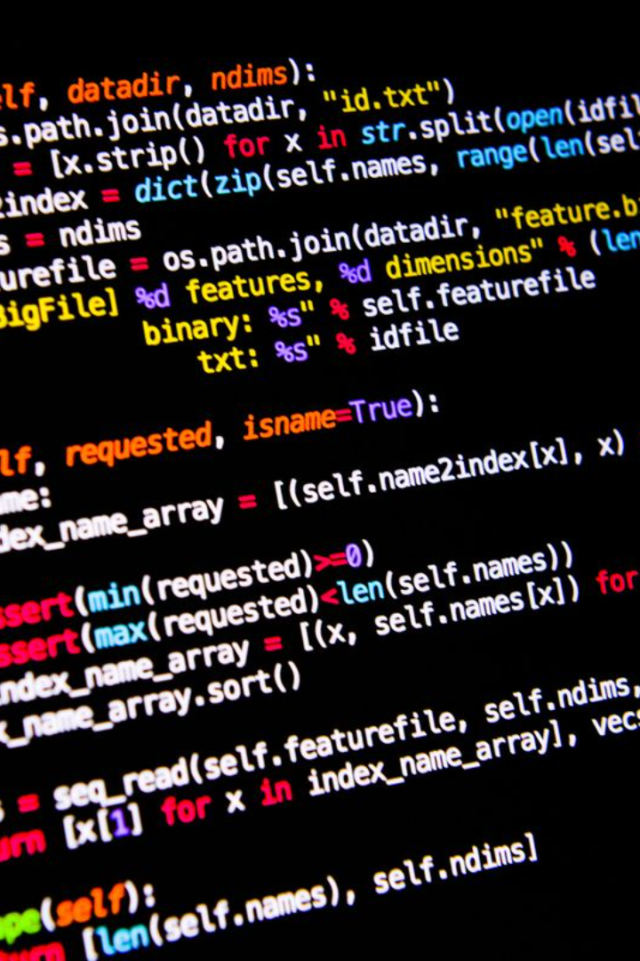

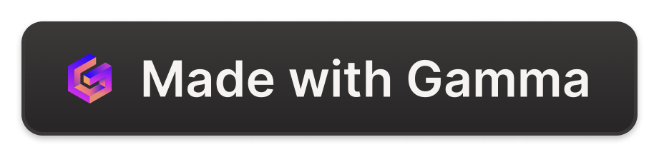
Employee Management System Using Python
This presentation will explore the benefits of using Python for building employee management systems and the features and functionality it can offer.
by BA1-13 Navneet Sankaran. U

Slide 2

Introduction
An introduction to employee management systems, the challenges they aim to solve, and why Python is a suitable choice.
Challenges
Benefits of Python
Managing employee data, attendance, leave, and performance can be time-consuming and inefficient if done manually.
Python is a popular language for building web applications and has a rich set of libraries for data processing and visualization.
Overview
This presentation will provide an overview of our Python-based employee management system and its key features and technical implementation.

Slide 3
Features and Functionality
An in-depth look at the system's features and how they support employee data management, attendance tracking, leave management, and performance evaluation.
1
Employee Data Management
Store and manage employee information such as name, contact details, salary, and job responsibilities in a single, secure database.
2
Attendance Tracking
Maintain a record of employee attendance, including arrival and departure times, and generate reports for payroll and performance evaluation purposes.
3
Leave Management
Track and manage employee leave requests, including vacation time, sick leave, and personal days, and ensure compliance with company policies.
4
Performance Evaluation
Assess employee performance through regular evaluations and reviews, and use data analytics tools to identify trends and areas for improvement.

Slide 4
Technical Implementation
A detailed explanation of how our system has been built using Python, including database design and integration, user interface development, and security measures.
Database Design
User Interface Development
Data Validation and Security Measures
We use a relational database management system (RDBMS) to store and manage employee data, using Python's built-in SQLite library for fast and efficient processing.
We have built a modern, intuitive web-based user interface using popular Python frameworks such as Flask and Django, with a focus on usability and user experience.
We have implemented robust data validation measures, input sanitization, and authentication protocols to ensure the system is secure and reliable.

Slide 5
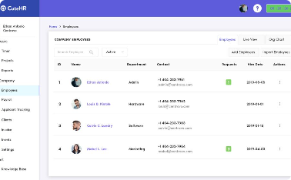

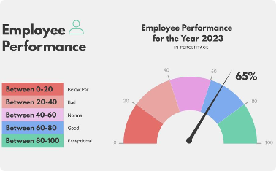
Demo and Usage Examples
A hands-on demo of the system's user interface, showcasing its key features and functionality. Includes a step-by-step guide on how to add and manage employee data, track attendance and leave, and perform performance evaluations.
Adding Employee Data
Tracking Attendance
Performing Performance Evaluations
Easily add new employee data to the system, including personal details, job responsibilities, and salary information.
Record employee attendance through a modern and convenient web-based interface, accessible from any device with an internet connection.
Use data analytics tools to evaluate employee performance, identify trends, and make informed decisions for business growth.

Slide 6

Conclusion
A summary of the key points covered in the presentation, including the benefits of implementing the employee management system using Python and opportunities for further development and enhancements.
1
Summary
2
Benefits
Our Python-based employee management system offers a range of features to streamline employee data management, attendance tracking, leave management, and performance evaluation.
By implementing the system using Python, businesses can take advantage of its powerful data processing capabilities and user-friendly interface.
3
Opportunities for Further Development
Further development opportunities include adding payroll processing, employee self-service options, and integrating with other third-party HR systems.

