Slide 1
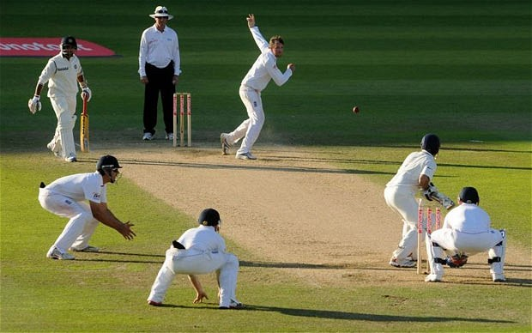
Data from Cricket Matches
Avinash Mishra
Raveekiat Singhaphandu
Matti Lorenzen

Slide 2
About the Data
Ball-by-ball information for three different format of the game.
One Day International
T20
Test Cricket( Multi day game)
Number of Matches for each format:
1,233 One-day internationals
804 T20 internationals
345 Test matches
Featuring 52 countries, 13 IPL(Indian Premier League) teams

Slide 3
About the Data conti…
No of Attributes : 46
Info
Innings
Missing Match data – 50 matches
IPL 100%
ODI 90%
T20 97%
Test 98%
Source: http://cricsheet.org/

Slide 4
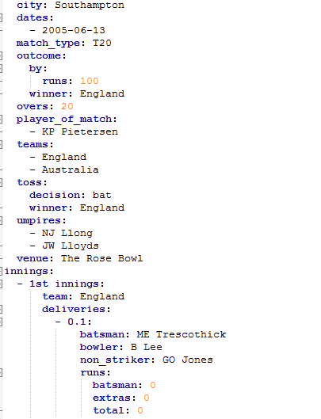

Slide 5
Teams
International Teams | IPL Teams
New Zealand India West Indies South Africa England Australia Pakistan Sri Lanka Afghanistan Bangladesh | Delhi Daredevils Gujarat Lions Kings XI Punjab Kolkata Knight Riders Mumbai Indians Rising Pune Supergiants Royal Challengers Bangalore Sunrisers Hyderabad

Slide 6
Attributes for Batsman
Team
Current IPL team
Previous IPL Team
Non-striker Batsman
Run scored
No of ball faced
Location( Home, away)
Against whom(Other Team)
No of 4 and 6
Over in which he got out
Against which Bowler.
Win
Player of the Match

Slide 7
When does a particular batsman score good/bad?
• During which over slot?
• Against which type of bowler? Right hand bowler or left hand bowler and
against Spinner, faster or medium pacer bowler.
• Against which country?
• Where? Away or home country.
• When? In first inning or second inning.
• What are the chances of a batsman getting out against a particular
bowler?

Slide 8
Attributes for Bowlers
International Team
Current IPL team
Previous IPL Team
No of over he bowled
Runs scored in his over
Location( Home, away)
Against whom(Other Team)
No of 4 and 6 he gave
Over in which he got wicket
Type of Batsman.
Win
Player of the Match

Slide 9
When does a bowler bowl more effectively?
• In terms of wickets and in terms of economy( no of runs per
over).
• During which over slot?
• Against which type of batsman? Right hand batsman or left
hand batsman.
• Against which country?
• Where? Away or home country.
• When? In first inning or second inning.

Slide 10
IPL
How performance of a batsman/bowler changed when he switched the IPL team.
Who is going to perform well in this IPL, based on last year IPL and international performance.
Predict IPL team winner

Slide 11
Questions ?

