Slide 1
Data Mining Lab Course Cricket Dataset
Week 4 Presentation:
Avinash Mishra
Matti Lorenzen
Raveekiat Singhaphandu

Slide 2
Main Achievements
Performance of a Batsman against a particular bowler.
Parsing of Players profile from cricinfo website.
Setting up the Performance parameter for players.
Players performance with a particular nonstriker batsman.
Detailed and easy description.
Updated last week Wiki to be more descriptive.
Feedback for the Mashable Online Popularity Data Set

Slide 3
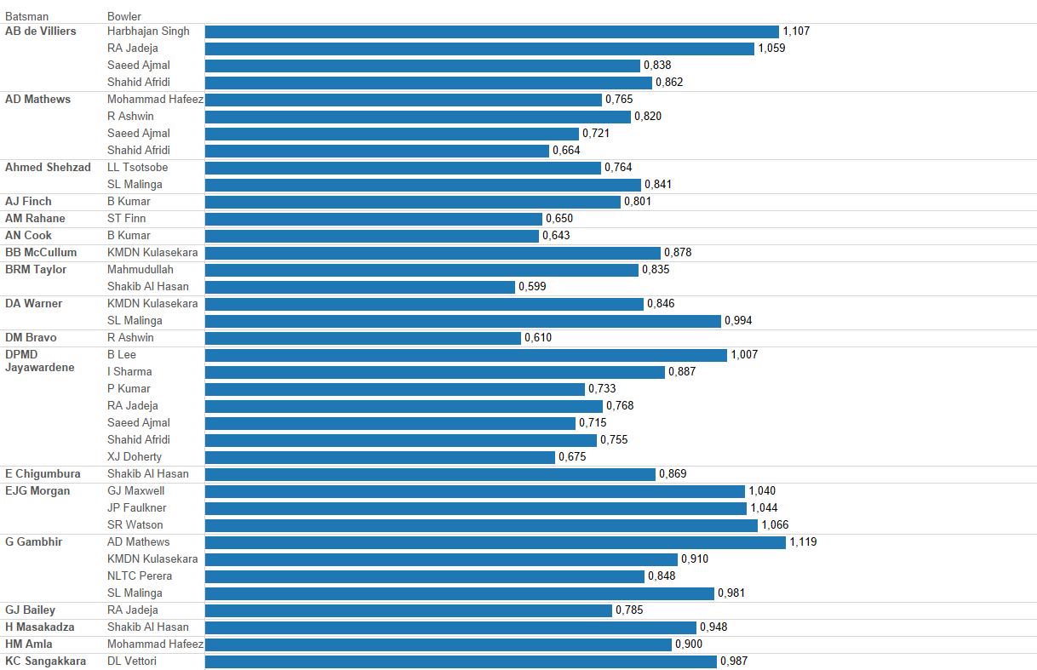
Strike Rate of a Batsman against a particular bowler

Slide 4
Players profile
We parsed the profile of each player from espncricinfo.com.
Some attributes:
Playing_role, Batting_style, Bowling_style, Batting/Bowling Average
SR: Strike rate
BUT WHY??
More detailed analysis of player performance.
Players performance comparison during 10 year time frame.
Problem :
Different name of a player in different dataset.
IN PlayerInfoAll table
Name: Mahela Jayawardene
Full Name: Denagamage Proboth Mahela de Silva Jayawardene
In Innings table
Batsman: DPMD Jayawardene

Slide 5
How do we solve it?(1)
First method:
We found that ESPNcricinfo have the search bar which we can simply build URL request
For DPMD Jayawardene
http://search.espncricinfo.com/ci/content/site/search.html?search=+DPMD%20+Jayawardene;type=player
Retrieve all the link result to player profile
Problems
Player name are more common than we think
There are five Amjad Ali from Pakistan
No possible way to easily distinguished them without actually look through the data
The HTML page for each player does not contain any information about the abbreviation

Slide 6
How do we solve it?(2)
Second method:
Again, we found that ESPNcricinfo have the list currently active team member and also using abbreviation name ☺ for each player
Now we list all the player abbreviation name and their link
Download those link and save in HTML format
Parsed interested data in to CSV
Finally we can link this recently acquired data with the innings table

Slide 7
Performance Parameters
' | ODI | T20
Batting Average | 37 | 28.02
Batting Strike rate | 77.84 | 119.27
Bowling Average | 27.4 | 30
Bowling Strike rate | 31.5 | 23.5
Bowling Economy rate | 5 | 6.5

Slide 8
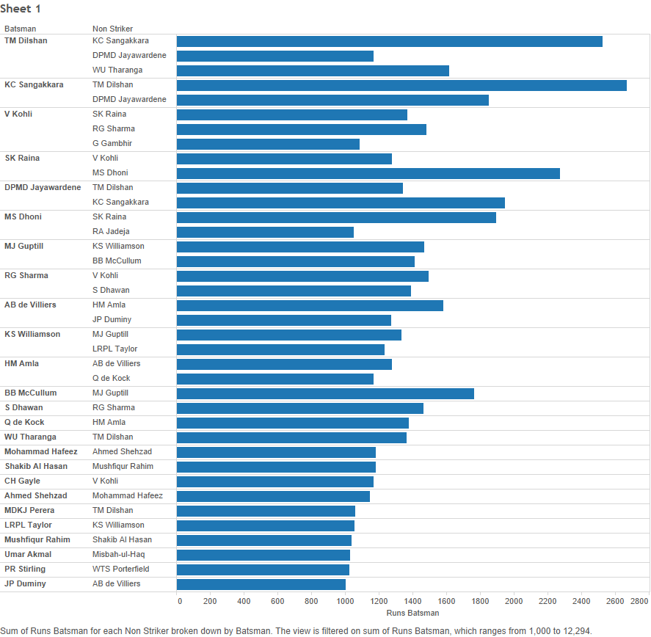
Batsman and nonstriker batsman

Slide 9
Next Task…..
Player performance against a type of bowler/batsman.
Batsman performance with type of batsman at non striker end.
Players performance in this time duration as compare to whole career.
Player performance grouping

Slide 10
Feedback for Team 4 : Mashable Online Popularity Data Set
No longer using original dataset due to errors discussed last week
Extraction of statistical features, categorized number of shares → 3 groups
Analysis of frequent words, channels usually published in
In the presentation: „Most Valuable Authors are Publishing Their Most Articles In The Same Channels” In the wiki: “Against our intuition, each author is publishing in all channels and does not have a single channel of expertise.”
Very well structured, a clear plan, the wiki is looking very nice.
Out of interest – did you notify the author of the paper regarding the faults in the dataset?

