Slide 1
VIRTUAL RESOURCES IN Directx 12

Slide 2
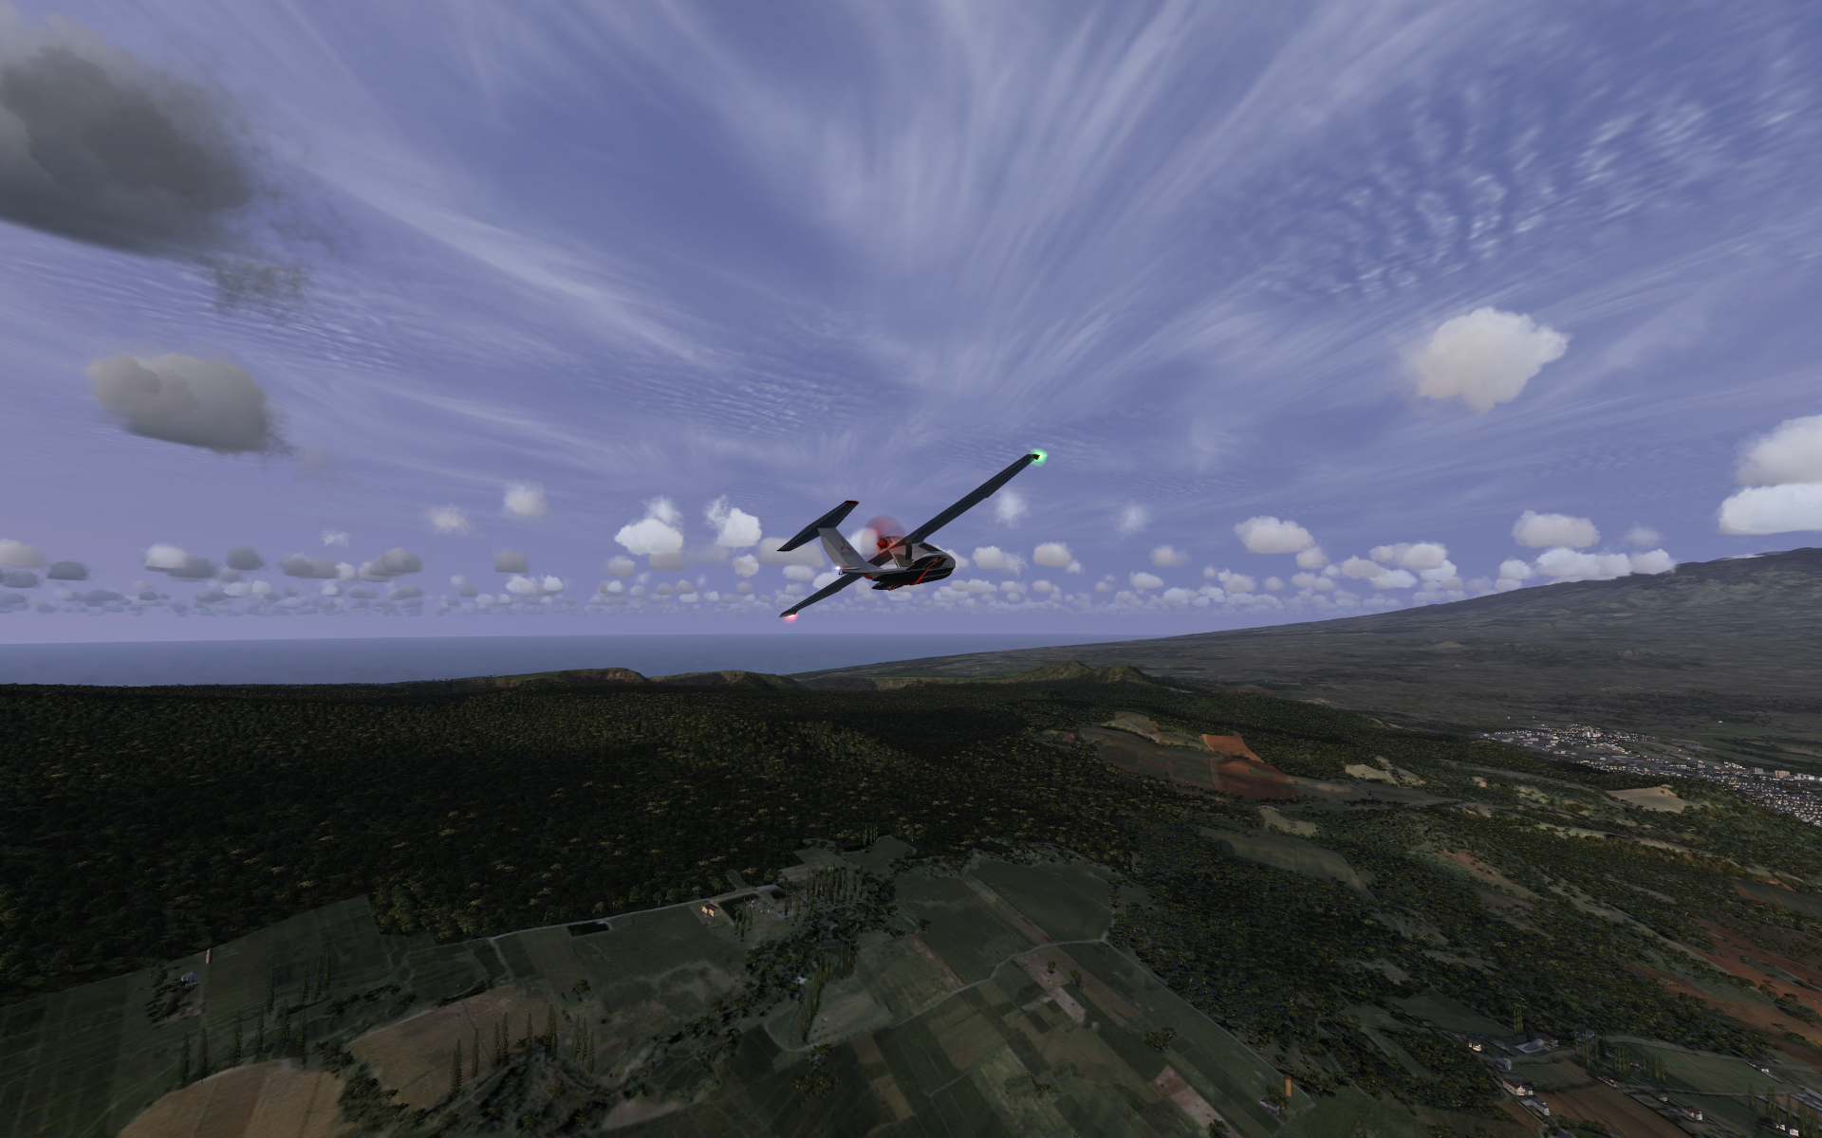
Gamers want expansive worlds
Vehicle (100MB)
Town (1GB)
House (10MB)
Terrain (10GB)
But they come at a cost…

Slide 3
Texture streaming
Stream textures as needed by the immediate region.
Depending on player position + view, load new resources and unload old ones.
Stream granularity is whole resources (still tens of MB).
5GBps (PCIE effective bandwidth)/60Hz ≈ 85MB/frame.
May need artificial transition regions to ease loading.
Often only need a small region of a texture, so bandwidth and memory capacity are wasted.

Slide 4
Hardware tiling
Stream texture regions (tiles) as necessary.
Program hardware page tables to perform indirection.
Same approach as software tiling, but hardware-accelerated!
Since 2012 supported by hardware (GCN, Kepler)

Slide 5
Hardware tiling
Hardware
filtering units
Page table
Physical memory (Heap)
Virtual texture
(UV space)
A | X
B | 1
C | X
D | 6
E | 4
F | 2
G | X
H | X
I | 5
0
1
2
3
4
5
6
7
A | B | C
D | E | F
G | H | I
Bilinear filtering ☺
Trilinear filtering ☺
Anisotropic filtering ☺

Slide 6
TILE SHAPES
Tiles are 64 KiB, so pixels that fit in are different sizes
 | 1x MSAA | 4x MSAA
4bpp | 512 x 256 | 256 x 128
8bpp | 256 x 256 | 128 x 128
16bpp | 256 x 128 | 128 x 64
32bpp | 128 x 128 | 64 x 64
64bpp | 128 x 64 | 64 x 32
128bpp | 64 x 64 | 32 x 32

Slide 7
ABOut the demo
Two 16k tiled texture cubes.
Diffuse (BC1 UNORM): 6 x 16384² x 0.5bpp x 1.333 = 1GB
Normal (BC5 SNORM): 6 x 16384² x 1.0bpp x 1.333 = 2GB
Shared tile pool: 256 x 64KB tiles = 16 MB (<1% of assets)

Slide 8
ABOut the demo
Two 16k tiled texture cubes.
Diffuse (BC1 UNORM): 6 x 16384² x 0.5bpp x 1.333 = 1GB
Normal (BC5 SNORM): 6 x 16384² x 1.0bpp x 1.333 = 2GB
Shared tile pool: 256 x 64KB tiles = 16 MB (<1% of assets)
Pool size = width x height x ∑(layer format sizes) x 4 x 1.333
Example: 1920 x 1080 x (4bpp + 8bpp) x 4 x 1.333 ≈ 16MB

Slide 9
EXAMPLE ON DirectX 12
Why this example?
Provides good level of interaction between CPU and GPU
Several building blocks
Uploading Resources
Geometry
Textures
Tiled Resources mapping
Asynchronous loading
Mipmap computation

Slide 10
SCHEMATIC of the example
Mars is described as points on a sphere icosahedron
Geometry
X,Y,Z – normalized in [-1;1] (scaled 1:10) from original
655 361 vertices
3 932 159 triangles
Every position is used as a normal
Every position is used as uvw coordinate mapped on a 6 cube faces

Slide 11
SCHEMATIC of the example
Mars is described as points on a sphere icosahedron
Each subresource (face/MIP) is stored as a grid of row-major tiles
Subresources are ordered according to standard Direct3D ordering.
Subresources with sizes less than the format's standard tile shape are padded to a full tile. Called packed mip chain.
Example: 1x1, 2x2, 4x4, 8x8,16x16, 32x32 – all packed in 64kb

Slide 12
SCHEMATIC of the example
Load the geometry
Upload the geometry to the gpu
Open textures for async operations
Do a sampling pass
Check what parts of the textures are visible
Issue async operations for new seen texture data
Upload to the GPU the loaded ones from previous passes
Discard not visible ones anymore
Sample loaded data pass on the screen with lighting

Slide 13
BUILDING BLOCKS / ASYNC
Programming model with continuations
When you call a function and get back the result you assume it is computed already
When you call a continuation function it passes you back, computed result plus the rest of the computation that you can later on try to fetch.

Slide 14
Concurrency RUNTIME
Library that helps with robust scalable parallel applications
Abstracts details of
Thread creation
Work Submission
task<uint32_t> f () { return very slow int32_t; }
task<uint32_t> g() { return f().then([](int32_t a) { return a +1; });

Slide 15
CppWinRT
Library that helps you use windows api functions
Windows API moved from traditional C API to object oriented APIs back in 2012
In C++ api was used with C++/CX language extension
Foo^ foo = ref new Foo();
CppWinrt is a c++ library that is not an extension (cpp17)

Slide 16
COROUTINES
Generalization of functions
Function can be suspended and resumed at any point of invocation
Helps with non preemptive multitasking (what is preemptive?)
In reality helps to reduce code noise so far.
New implementations (example)
Concurrency runtime and CppWinrt provide support

Slide 17
SCHEMATIC of the example
We use concrt::task and concrt::task_group
During the initialization of the app
Spawn several tasks to
Load geometry vertices, indices (block on the filesystem)
Create pipeline states ( block on compiling + filesystem)
We use coroutines in file loading functions

Slide 18
SCHEMATIC oF THE EXAMPLE
Sampling Renderer
Sample the sphere and get which mip levels we need
normals
diffuse
Residency Manager
Get the data from sampling
Look in the caches, seen, mapped, to be removed, update the tiled resources
Algorithm ensures that if mip is loaded, all before it are also there. (simplifies shaders). So it stores maximum residency.
Main Renderer
Assemble two passes (sampling and show on screen)

Slide 19
SCHEMATIC oF THE EXAMPLE
Buffers that we need
Most important question
Lifetime of the buffers, second question
CPU/GPU access, third question
Double or triple buffers ?
If we use cpu/gpu sync then 2 or 3
If we use only gpu then probably only 1
Parallel tasks come with buffers
1 Buffer -> Generate work on the cpu, wait for the gpu to execute it
Used in tools very often by the way.

Slide 20
SCHEMATIC oF THE EXAMPLE
Descriptor heaps.
CPU – 3 of them global (RTV, DSV, SRV)
GPU – 1 of them global (SRV)
Shaders can see only GPU so we need to copy from the CPU to the GPU Descriptor
Root signature shows several tables and reading up to 4 textures
Cold holds indices into these descriptors

Slide 21
SCHEMATIC oF THE EXAMPLE
Root signature has
36 DWORDS embedded directly into it (very fast gpu access)
One Table with 4 textures (t0,t1,t2,t3)

Slide 22
SCHEMATIC OF THE EXAMPLE
Sampling Renderer
Render Target ( RGBA8)
Stores u,v,w (which parts of the cube we see)
Mip Level. Which of the low resolution
Depth Stencil to eliminate invisible pixels
2 Buffers in the read back heap (one per frame)
So the gpu can render in one of them
The cpu parses the other one
Descriptors for buffers (on the cpu heaps, shaders will not read them, just write them)

Slide 23
SCHEMATIC OF THE EXAMPLE
Residency Manager
2 Tiled Resources (Reserved Resources)
Cubmaps 6 faces x 16384x16384 pixels with 15 mip levels
1 Heap to back up the physical memory 16 Mibs
2 Residency textures
R8 – for every tile (64x32, 32x32)
Which mip levels are loaded
4 Upload copies of the residency textures
2 per texture for double buffering
Information about the tiling of the resources
State management

Slide 24
MAIN Renderer
2 Swap Chain Buffers
1 Depth Buffer
4 Heaps
Descriptors for the resources

Slide 25
COLLECTING SAMPLES
GPU
Render the sphere
Need only matrices, stored in the root constants
Pixel shader encodes mip level + uvw s
Mip level is normalized to the max mip levels in the textures (15)
Copy to the Readback resource
Textures in the gpu are swizzled format.
To be sampled efficiently
This performs unswizzle

Slide 26
COLLECTING SAMPLES
CPU
Reads the texture and decodes the samples.
From UVW and Mip computes
Which tile was hit.
Submits these tiles to the residency manager as a list
The work here depends on the resolution in the sampling renderer
Sampling renderer is 16x less pixels than the back buffer resolution
But can be around 10 000 samples which are mostly the same
May sample random samples.
May prepare exact list on the gpu with a compute shader and read it

Slide 27
RESIDENCY MANAGER
Initial state
Residency state for every tiled resource (2 in our case)
6 Faces 32x64 with 1 byte (the mip level) initially 0xFF (smallest)
Upload this to the GPU (building block)
Involves Swizzles. Special API from DirectX.
CPU mindset assumes linear resources (cube * width * height)
Must copy cube by cube, line by line to the gpu so it knows how to swizzle. What to put where

Slide 28
RESIDENCY MANAGER
Initial State
Heap, maps virtual resources to tile 0. To have something mapped.
Initiate initial loading of the files with the async operations.
Samples are (tracked, seen, loading, mapped ) - states
On samples submission
Convert samples to tiles and mips for every particular resource
See if the sample is tracked (record which frame sees it)
If the sample is new add it to the seen list

Slide 29
REsIDENCY MANAGER
Process Samples (typical work here 32x64x6 + 50%)
Sort seen samples to see which to load
more recent with higher mips first
Sort load samples to see which to map
Prefer loaded to loading and more recent
Sort mapped tiles to see which to evict from the memory
Prefer older seen to evict them first
For work, always one should asks himself.
What is my expected working set. Is it unbounded, how does it scale?

Slide 30
REsIDENCY MANAGER
Process Samples work on maximum tiles per frame 100
Get the seen tiles and issue load commands for them push them to loading state and remove them from the list.
Restrict maximum load ops per frame
Get tile from the loading list, reserve a slot in the heap for it. One tile (64kb)
If the tile is too old skip it. The loading took too much time
If the heap is full evict the older seen tile from the mapped tiles
Map the tile

Slide 31
REsIDENCY MANAGER
Tile mapping
All tiles that need to be mapped are coalesced.
This is done in order to issue one call to UpdateTileMappings
Necessary information for mappings.
List of tiles ( width and height and cube and mip )
Offset into the Heap in tile
This is for every tiled resource (two in our case)
Update tile mapping involves a kernel call so the CPU will stall here.
We want only 1 stall per frame.

Slide 32
REsIDENCY MANAGER
Tile residency upload
For all mapped tiles we need to know which is the maximum loaded level.
Residency textures hold it.
So when a tile is mapped we update the textures
The gpu uses this information for sampling

Slide 33
MAIN RENDERER
Renders the terrain again
Samples residency + tiled resources
Performs lighting

Slide 34
BUILDNG BLOCKS
Wait for an idle gpu
Submit value on the main fence and wait on the cpu for the gpu to pass it
Using of descriptor heaps.
Copy of descriptors. We do it only once during loading
Setting root signature to work with it
Debug Device + GPU Validation
Very useful, cuts development time a lot

