Slide 1
NEURAL-NETWORK ACCELERATOR VERIFICATION
NN-Accel-Triage
Agentic AI for Failure Triage and Root-Cause Hinting
in Neural-Network Accelerator Verification
342.6× faster triage
100% triage accuracy
123 tests passing
Research project presentation · 2026 · RTL + CocoTB/Verilator + Claude

Slide 2
1 · INTRODUCTION
Verification produces failures faster than humans can triage
▪ Neural-network accelerators (systolic MAC arrays + quantization units) are pervasive; functional correctness across tensor shapes, quantization, and memory behavior is safety-critical.
▪ Verification runs large nightly regressions. When tests fail, engineers triage by hand — reading logs, waveforms, scoreboard diffs, and commit history to find the root cause.
▪ Manual triage is slow (~3 hours per regression here), inconsistent, and does not scale as the design and test suite grow.
▪ We present NN-Accel-Triage: a layered testbench plus an agentic AI that clusters failures, explains likely root causes, and recommends next debug steps.
NN-Accel-Triage
Introduction

Slide 3
2 · PROBLEM STATEMENT
Automate what an engineer does after a failing regression
▪ Input: a regression database of RTL simulation mismatches — logs, scoreboard diffs, traces, config, and commit metadata.
▪ Required output: automatically (a) group failures by root cause, (b) explain each in natural language, and (c) recommend debug steps — reproducibly and faster than manual.
Why it is hard
▪ Failure signals are heterogeneous — mismatch rate, error magnitude, first-divergence cycle, config.
▪ The number of root causes is unknown a-priori.
▪ Explanations must be domain-grounded, not generic.
▪ Needs a fair, repeatable benchmark vs the manual baseline.
NN-Accel-Triage
Problem Statement

Slide 4
3 · OBJECTIVES
Five core objectives
i
Verify functional correctness across tensor shapes, quantization modes, and memory behaviors.
ii
Cluster regression failures automatically by symptom / root cause.
iii
Generate natural-language debug summaries and likely root-cause hints.
iv
Benchmark triage time against manual methods.
v
Package a reproducible failure-analysis benchmark others can run.
NN-Accel-Triage
Objectives

Slide 5
4 · METHODOLOGY
A seven-stage pipeline: from RTL fault to root-cause report
STAGE 1
Design & Fault Injection
Parameterized RTL; 13 fault variants across 8 categories (frozen ground truth).
STAGE 2
Simulation & Logging
CocoTB + Verilator vs NumPy golden model; append 1 JSON record per test.
STAGE 3
Feature Extraction
13 features / record (+ optional VCD divergence signals).
STAGE 4
Clustering
DBSCAN over feature vectors + rule-based symptom labels.
STAGE 5
Agentic Triage
Claude + RAG (TF-IDF) + multi-turn debug loop → cause, confidence, steps.
STAGE 6
Benchmark & Eval
Per-label P/R/F1 & accuracy vs ground truth; time & speedup; no-LLM baseline.
STAGE 7
Packaging
Docker one-command pipeline, HTML dashboard, released dataset.
DATA BUS
regression_db.jsonl
Append-only shared log wired through every stage (1→2→3→4→5→6→7).
NN-Accel-Triage
Methodology

Slide 6
5 · SYSTEM IN ACTION
Watch one failing test flow through the pipeline
Animated GIF — plays automatically in Slide Show mode. A fault flows: RTL → simulate → mismatch record → cluster → Claude triage → root-cause report.
NN-Accel-Triage
System in Action

Slide 7
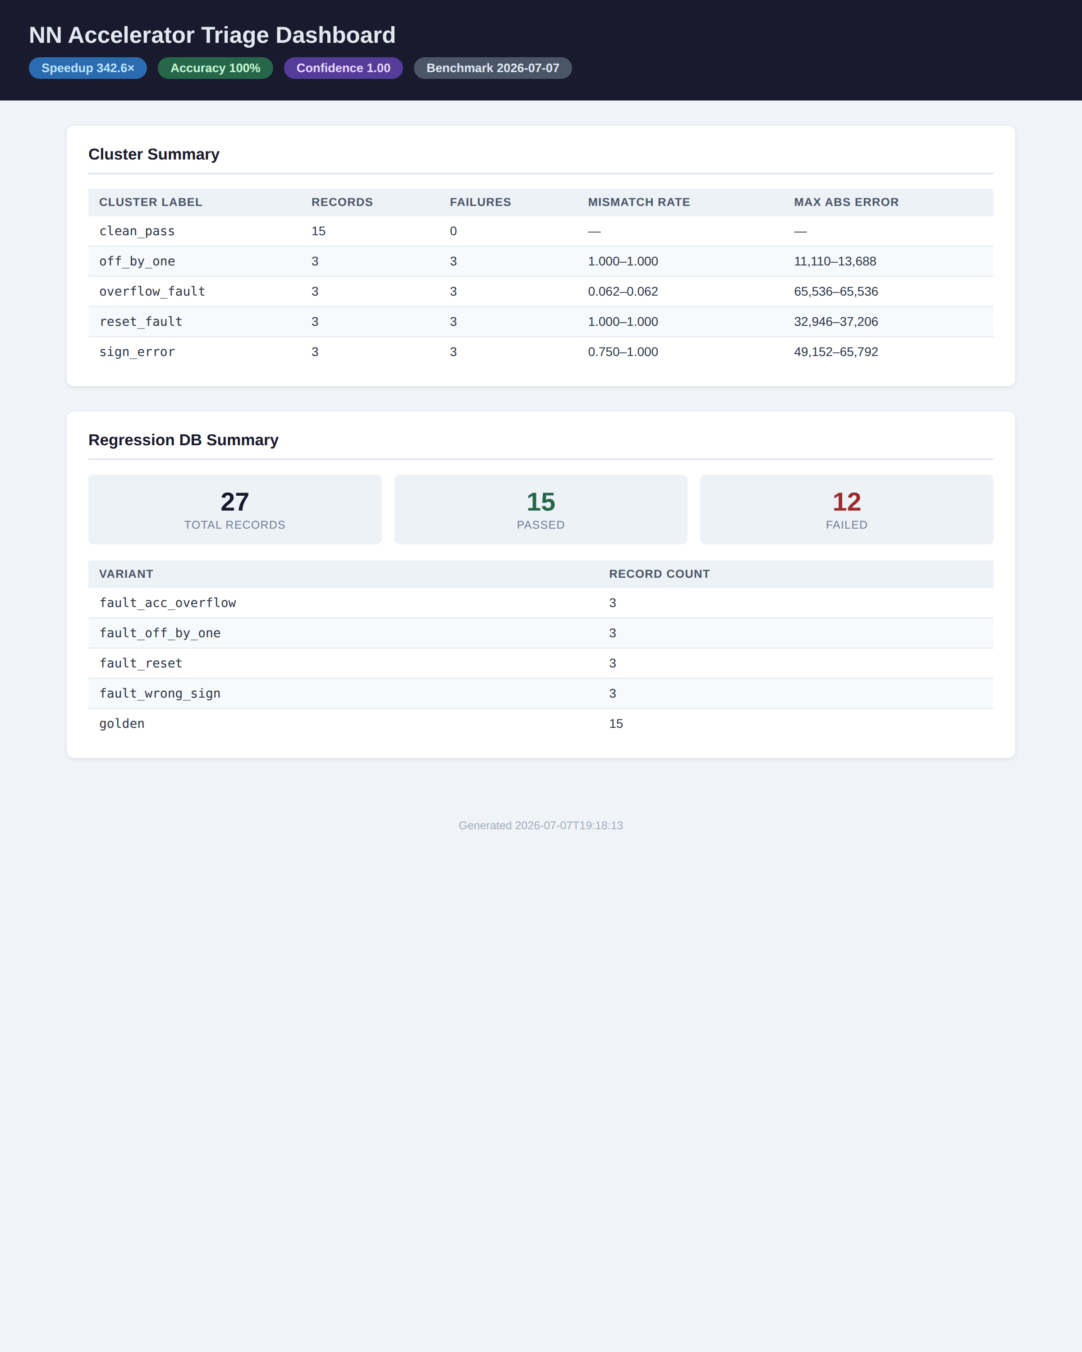
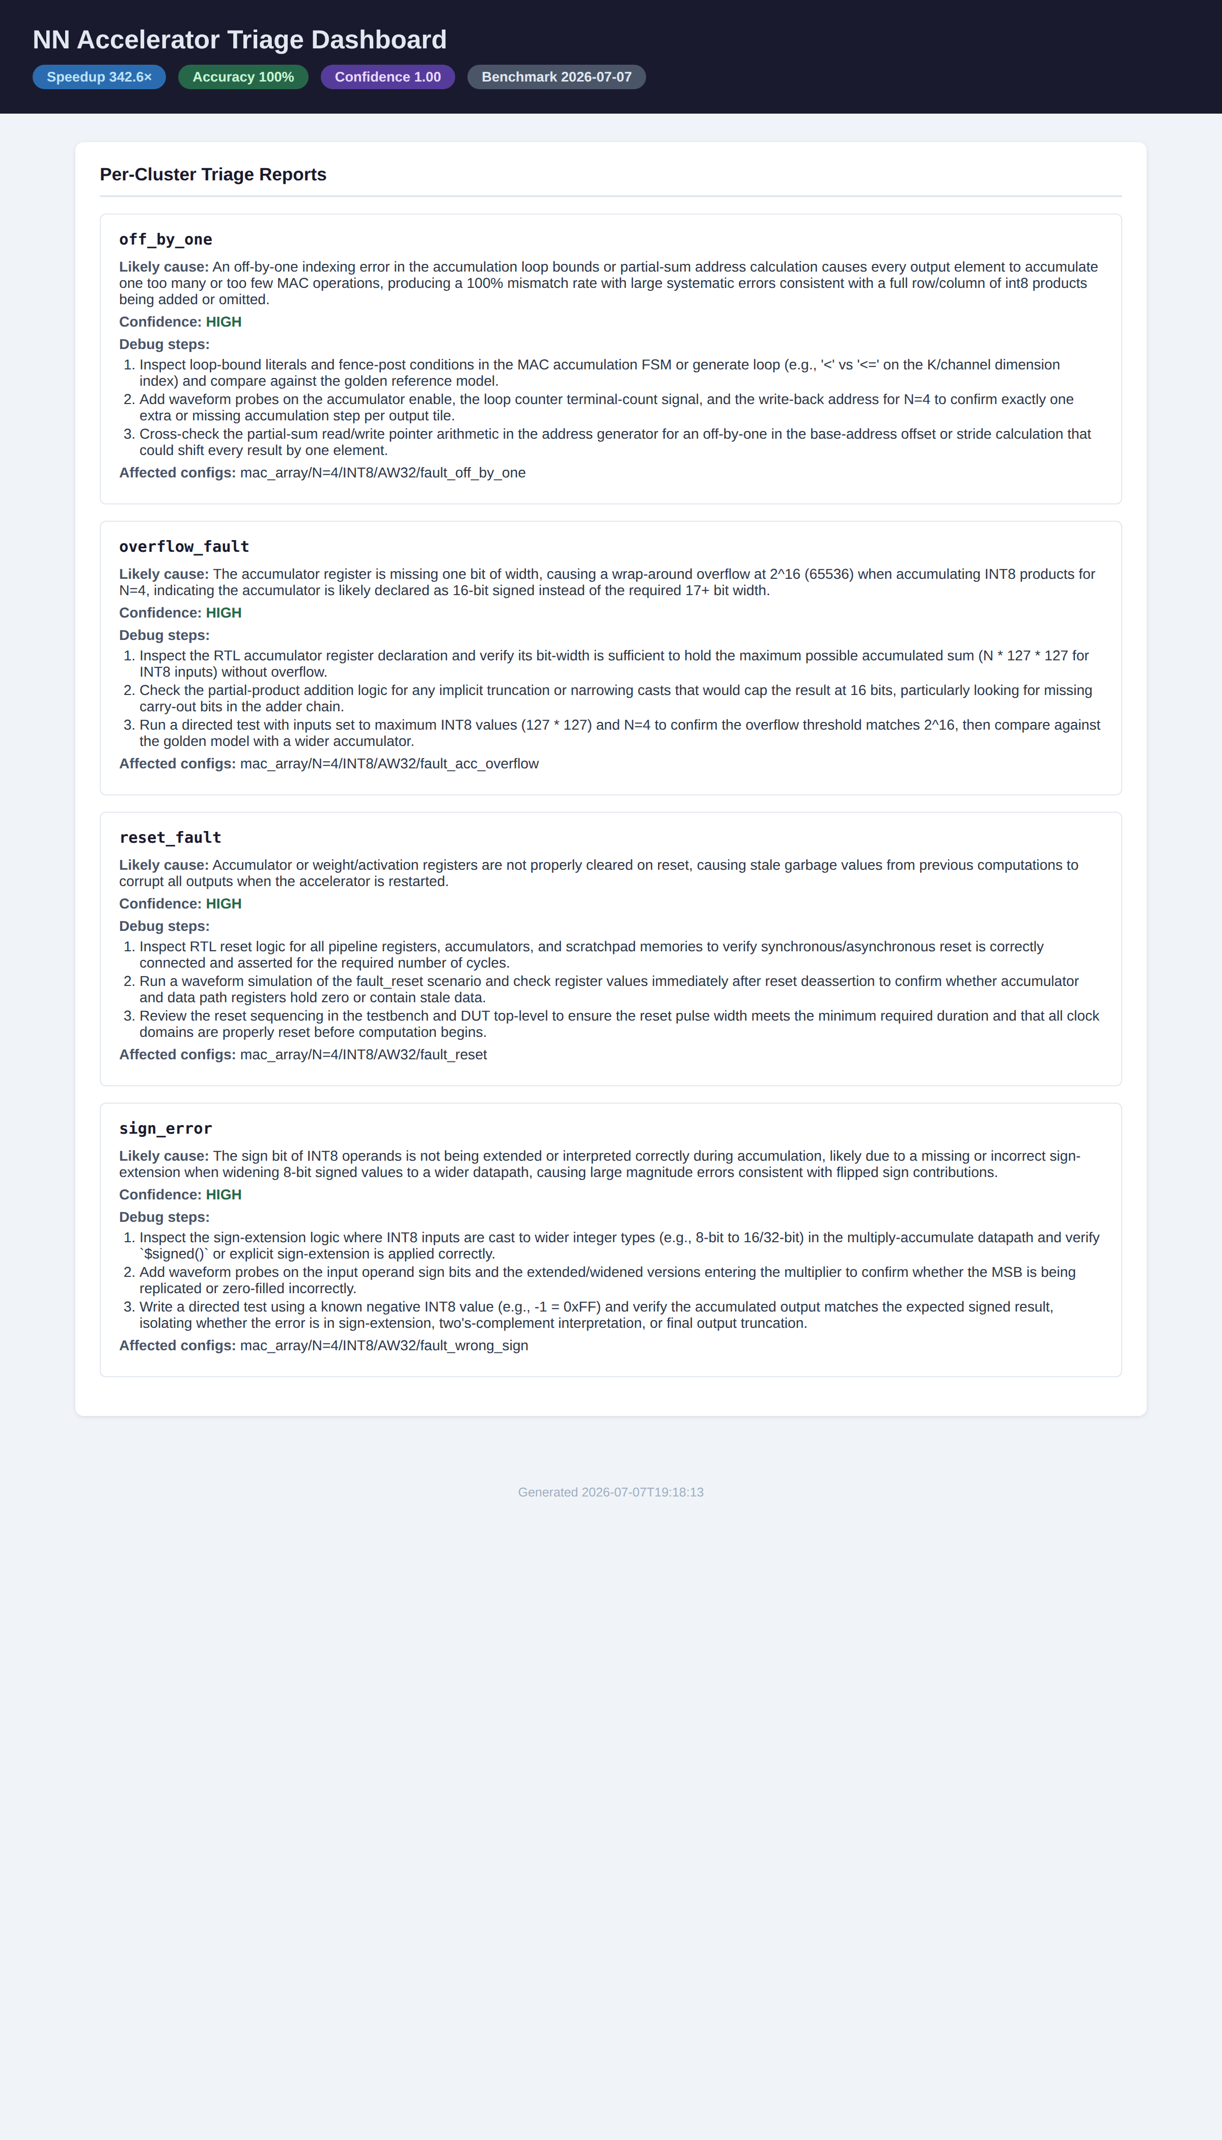
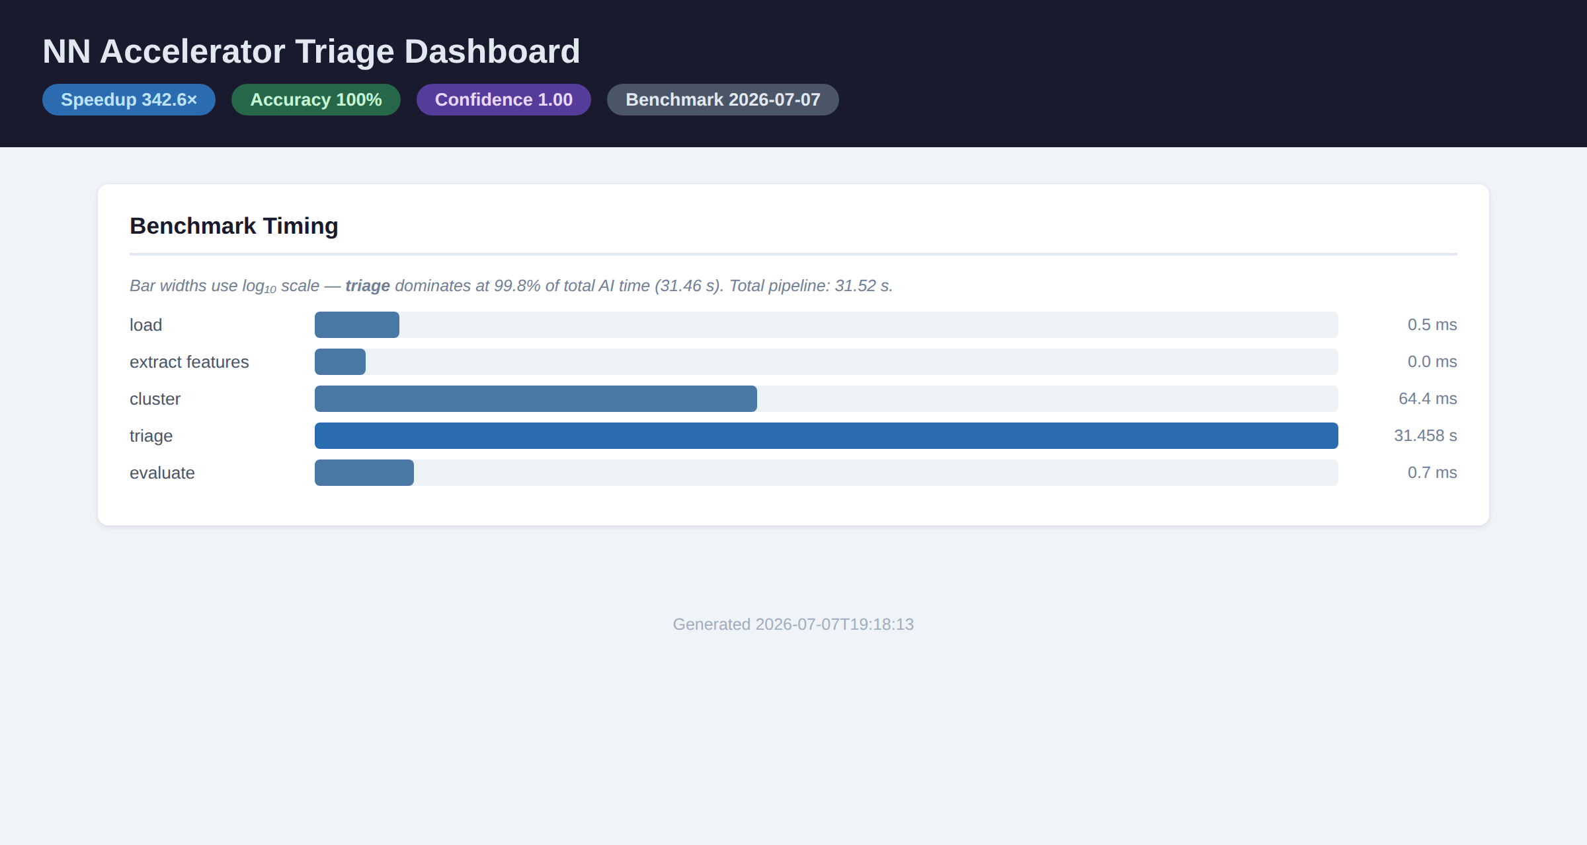
6 · VISUALS — TRIAGE DASHBOARD
One dashboard: verification, explanation, and packaging
Verification
Explanation + Debugging
Packaging / Benchmark
Cluster summary + 27 records (15 pass / 12 fail).
Per-cluster likely cause + debug steps.
Stage timing + headline metrics.
NN-Accel-Triage
Visuals

Slide 8
7 · OUTPUTS — FAULT DATASET
13 fault variants mapped to 8 ground-truth categories
Variant | Injected bug | Ground-truth label
fault_acc_overflow | Accumulator 32→16 bit; sums overflow silently | accumulator_overflow
fault_acc_w24 / w20 | Accumulator narrowed to 24 / 20 bit | accumulator_overflow
fault_wrong_sign | Weight cast signed→unsigned; no sign-extend | sign_extension_error
fault_b_unsigned | B_reg loses signed qualifier | sign_extension_error
fault_off_by_one | Outer loop ends at N-2; last column dropped | loop_boundary_error
fault_loop_over | Spatial loop runs N+1×; OOB extra product | loop_boundary_error
fault_subtract | Accumulator subtracts instead of adds | arithmetic_error
fault_reset / quant_reset | Reset polarity inverted; stale outputs | reset_polarity_error
fault_quant_shift_fixed | Per-channel shift replaced by fixed >>1 | shift_error
fault_quant_no_clamp | INT8 saturation clamp removed; wraps | saturation_error
fault_quant_wrong_sign_zp | zero_pt added unsigned instead of signed | zero_point_error
NN-Accel-Triage
Outputs · Dataset

Slide 9
7 · OUTPUTS — EVALUATION METRICS
Per-label triage evaluation vs ground truth (27 records)
Root-cause label | Prec. | Recall | F1 | Supp.
no_fault | 1.00 | 1.00 | 1.00 | 15
accumulator_overflow | 1.00 | 1.00 | 1.00 | 3
loop_boundary_error | 1.00 | 1.00 | 1.00 | 3
reset_polarity_error | 1.00 | 1.00 | 1.00 | 3
sign_extension_error | 1.00 | 1.00 | 1.00 | 3
100%
1.000
Overall accuracy
Mean confidence
27
1.00
Records evaluated
Macro-F1
Note: two accumulator-width faults (w24 / w20) are mathematically latent for N=4 INT8 (max partial sum 64,516 < 2²⁰) and correctly appear as passing — not misclassifications.
NN-Accel-Triage
Outputs · Evaluation

Slide 10
8 · RESULTS & CONCLUSION
Agentic triage: 100% accurate and 342× faster than manual
100%
342.6×
31.5 s
123
Triage accuracy (LLM)
Speedup vs manual
vs ~180 min manual
Automated tests pass
Method | Accuracy | Mean conf. | Triage time | Note
Manual (human) | baseline | — | ~180 min | Reference baseline
Rule-based (no LLM) | 72.7% | 0.000 | ~0.07 s | Ablation — clustering only
LLM-augmented (ours) | 100% | 1.000 | 31.5 s | Full agentic pipeline
Conclusion: the agentic component lifts accuracy 72.7% → 100% and confidence 0 → 1.0, while a fully reproducible Docker pipeline and released dataset let others re-run the benchmark. Limitations: small 13-variant fault library and a single accelerator design — future work scales both and adds waveform-grounded retrieval.
NN-Accel-Triage
Results & Conclusion

Slide 11
9 · REFERENCES
References
[1] W. Snyder et al. Verilator — open-source SystemVerilog simulator. veripool.org.
[2] cocotb — Coroutine-based Cosimulation Testbench. cocotb.org.
[3] M. Ester, H.-P. Kriegel, J. Sander, X. Xu. “A Density-Based Algorithm for Discovering Clusters (DBSCAN).” KDD, 1996.
[4] F. Pedregosa et al. “scikit-learn: Machine Learning in Python.” JMLR 12, 2011.
[5] P. Lewis et al. “Retrieval-Augmented Generation for Knowledge-Intensive NLP Tasks.” NeurIPS, 2020.
[6] G. Salton, C. Buckley. “Term-Weighting Approaches in Automatic Text Retrieval.” IP&M, 1988.
[7] Anthropic. “Claude Models & Messages API.” Technical documentation, 2024–2026.
[8] N. Jouppi et al. “In-Datacenter Performance Analysis of a Tensor Processing Unit.” ISCA, 2017.
[9] Accellera. Universal Verification Methodology (UVM) 1.2 Standard, 2014.
[10] B. Jacob et al. “Quantization and Training of NNs for Efficient Integer-Arithmetic Inference.” CVPR, 2018.
Related-work references compiled for context — verify / replace specifics before final submission.
NN-Accel-Triage
References

