Slide 1
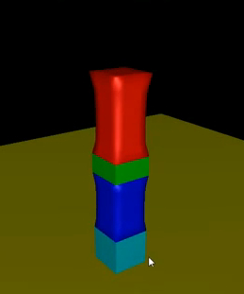
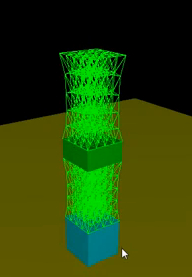
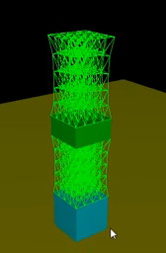
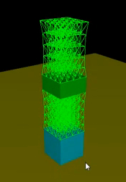
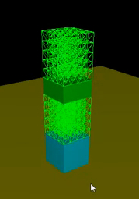

Slide 2
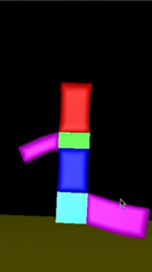
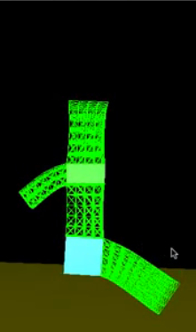
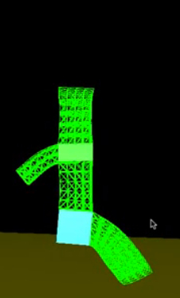
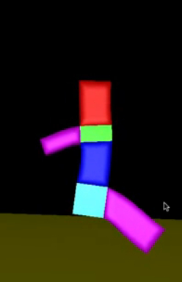
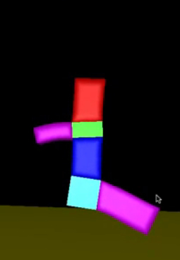

Slide 3
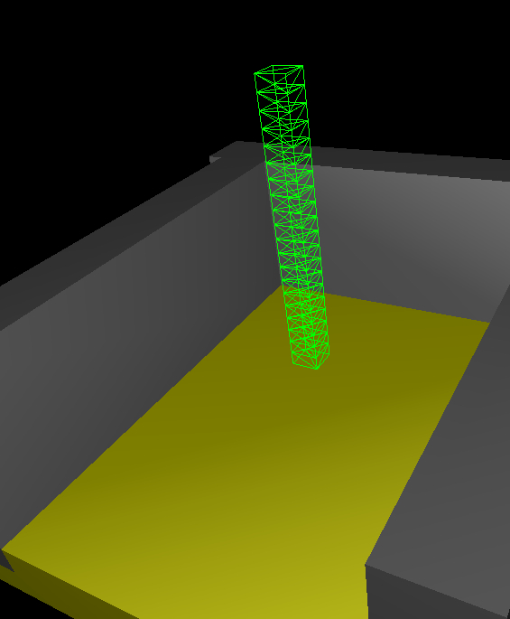
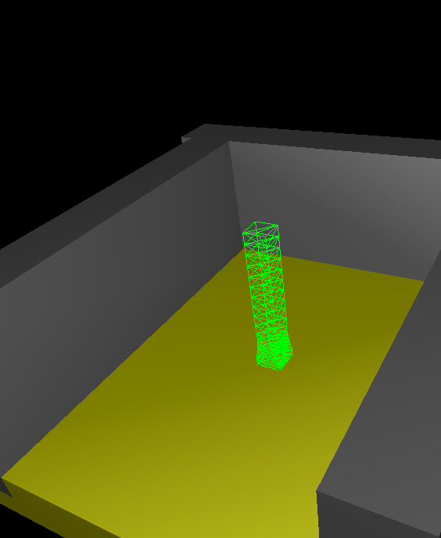
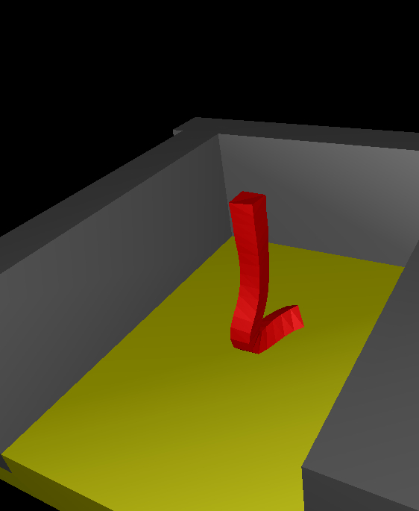
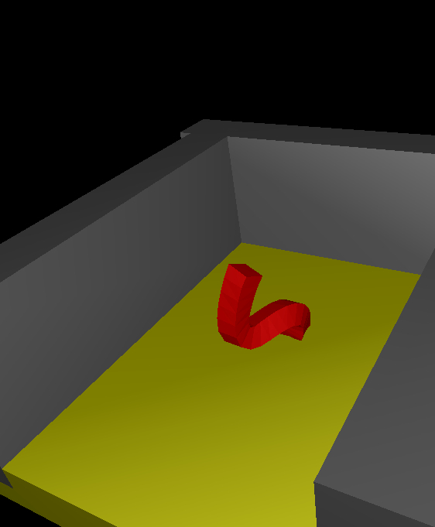
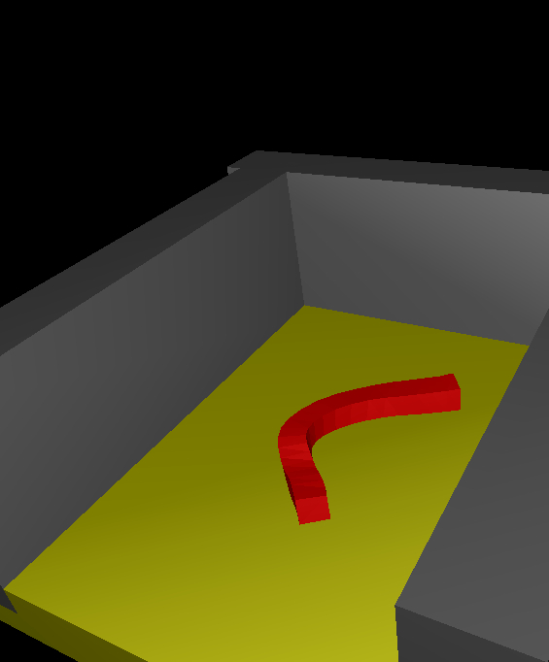
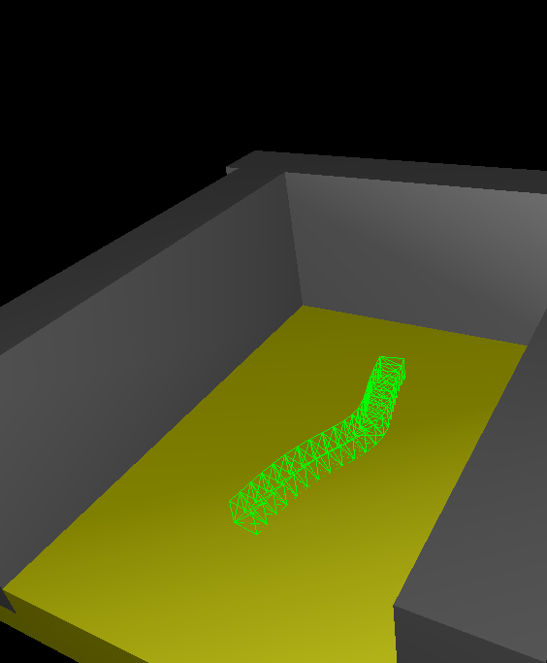
2
5
4
1
3
6
5
2

Slide 4
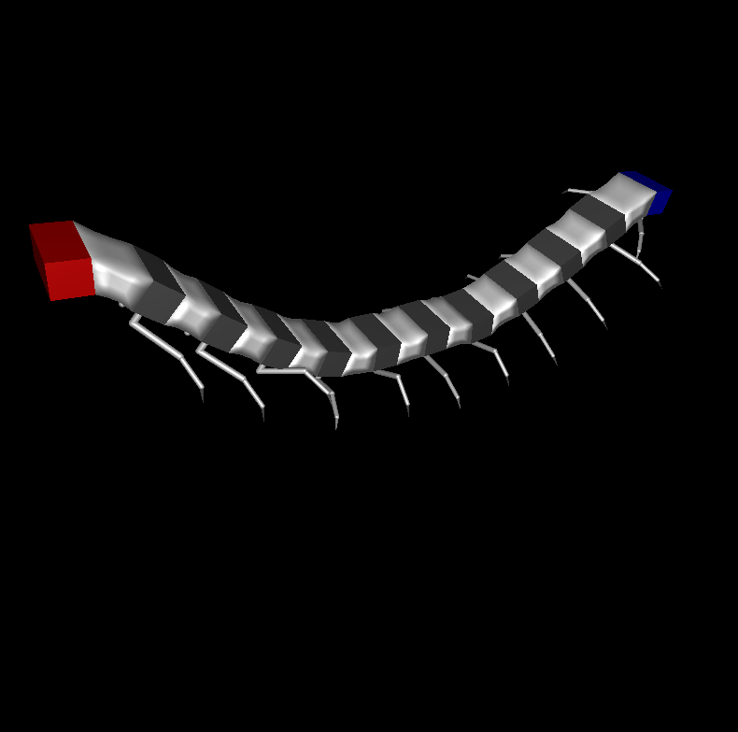
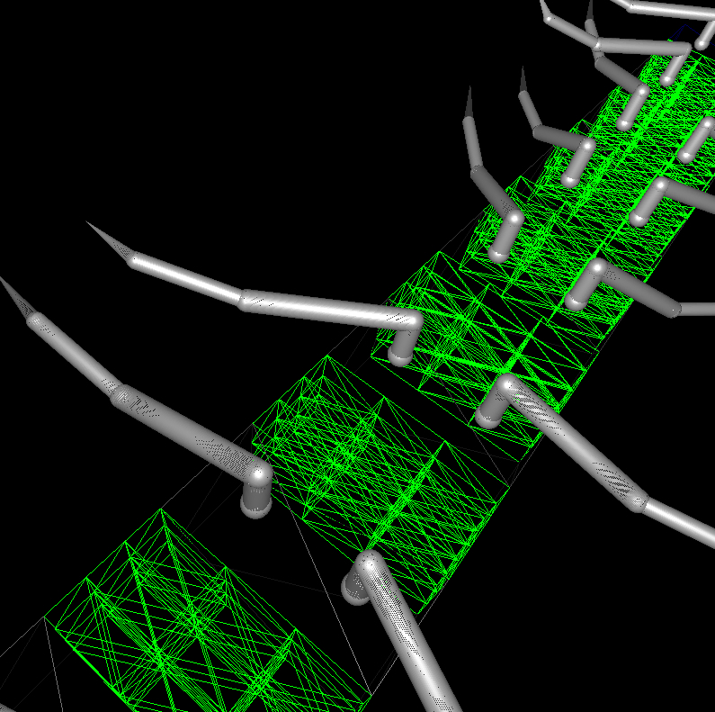
B
Bottom view of
A Rigid Section
Tetrahedral mesh
Of the soft section
Deformable Sections
A rigid leg attached to the bottom of a rigid section
Rigid Sections

Slide 5
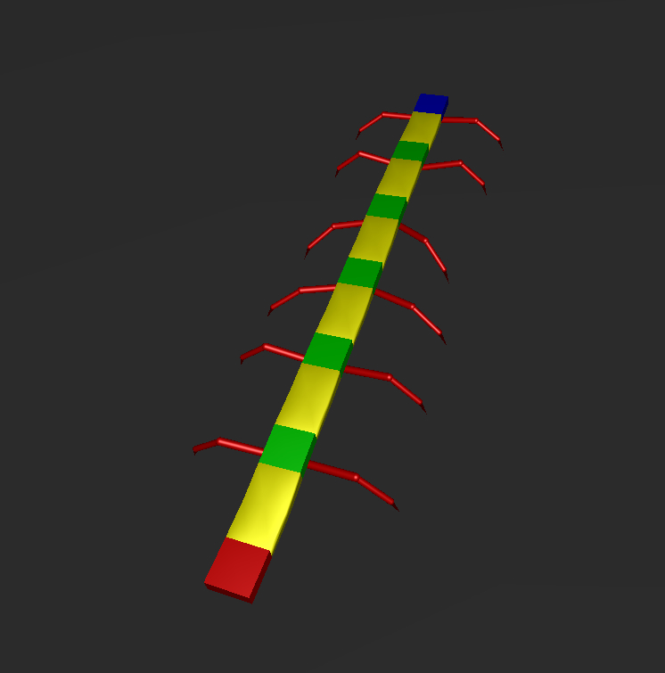
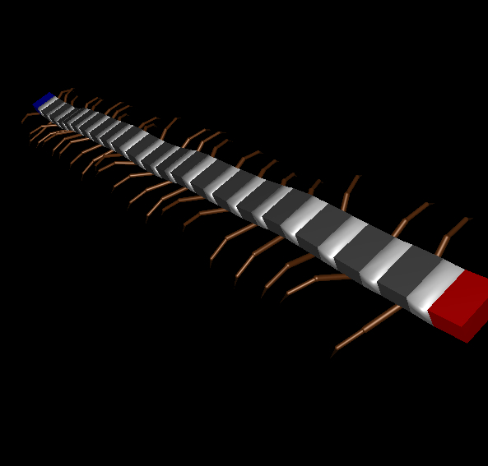
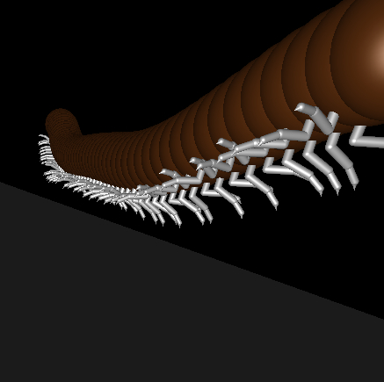
A
B
C

Slide 6
x(t) = Φ(X)
X = x(0)
Φ(X, t): X -> x(t)
Rest state, with minimum energy and no force
Deformed state, force arises from the increased energy.

Slide 7
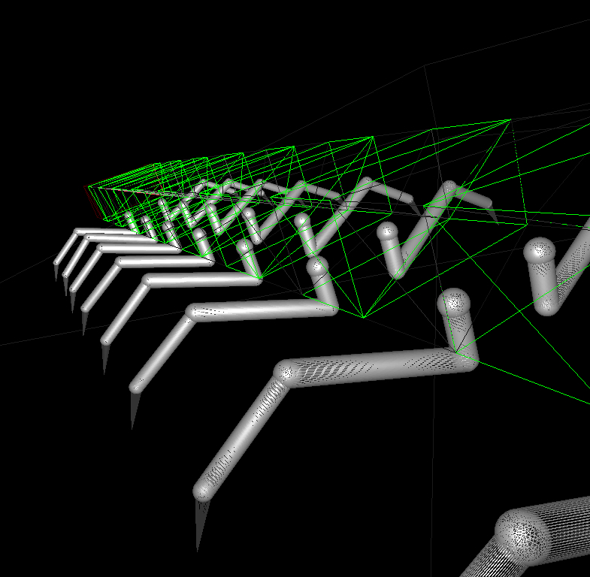
A
Y
X
θ
Z
α
β
Leg plane
γ
B
Top View
P
O
Side View
M
O
P

Slide 8
Target Net of a Rigid Section
Orientation of
rigid section
Controller
Net
Position of
rigid section
Sense
of elastic force
from the previous
Soft section
Inverse
Kinematics
Physics try to minimize the deformation
Desired output
Supervised Learning

