Slide 1

AI-Powered Payout Assistant & Lead Tracker Reimagining Post-Sale Engagement for GroMo Partners Using AI
TEAM DECIDERS
Team Members:
Parthiban G – CSE(IOT)
Ponmadhan D – CSE(IOT)
Shakhib Akthar S – CSE(IOT)
Prem S – CSE(IOT)
Shahid Afridi T – CSE(IOT)

Slide 2
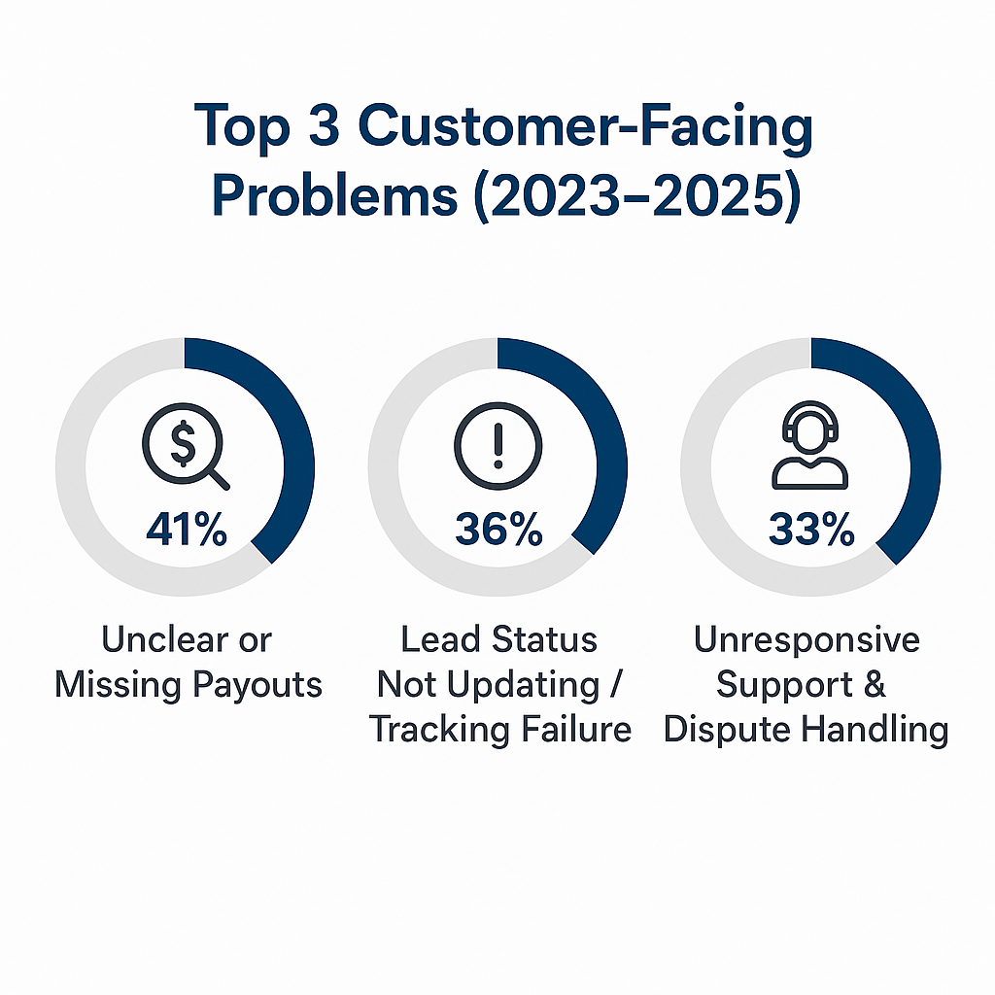
Why Is This Problem Important?
What’s the core issue?
Many GroMo Partners (GPs) face denied payouts or lead rejections — without clarity or feedback.
Why It Matters:
GPs lose earnings and trust
No system shows why payouts fail
Repeated manual errors reduce success chances
1000s of agents drop out due to lack of guidance
Source:- google playstore customer reviews

Slide 3

The Problem We Are Solving
Challenges Faced by GPs:
No clarity on lead/payout status
No alert before payout deadline expires
No feedback loop from GroMo or bank
Limited support, no proactive guidance or escalation path”
Reduced Earnings
Frustration
Dropout
Impact:

Slide 4
How Our System Helps
Lead Scores: Predict If a lead will convert
Payout Risk Alerts: Warn GPs of likely payout failures
Action Nudges: “Submit KYC within 24 hours”
Real-time Status: Expected payout date, delay reasons
Key Features:
Lead Intelligence Engine → Predict lead success
Payout Tracker & Predictor → Track and prevent payout failures
Alerts & Nudges → Timely actions to secure payout

Slide 5
Behind the Scenes: The lead and payout tracking Process
Lead Submission: Data is collected and passed through backend models
Lead Intelligence Engine: 1)AI model analysis lead data. 2)Predicts convertion score.
Payout Prediction Module: Checks lead status + timeline against payout eligibility rules.
Smart Alerts & Recommendations: 1) If payout is at risk: Alert Gp: “Aadhar not verified-upload now to avoid failure”.
Feedback Loop: Model retrains using new data to improve predictions and alerts.
GP Interface (Dashboard + Chatbot): Can ask chatbot : “Why didn’t I receive the payout?”.

Slide 6

End-to-End Workflow
Step 1
Lead submitted by GP
Step 2
Lead scored + payout predicted
Step 3
Risk alerts sent to GP
Step 4
GP acts → lead converts → payout success

Slide 7
What’s Next?
AI Chatbot Assistant.
Integration with Financial Institution APIs.
Mobile App Dashboard Integration.
Self-Learning Feedback System.

Slide 8

Why Our Solution Matters
For GroMo Partners (GPs):
Provides real-time clarity on lead and payout status
Sends early alerts to prevent payout loss
Helps boost trust and motivation through transparency
For GroMo Business:
Reduces ticket volume and manual dispute handling.
Increases GP retention and engagement
Improves payout efficiency and brand credibility.
For AI System Performance:
Continuously learns from lead outcomes (feedback loop)
Scalable across product types, geographies, and agents.
Easy to integrate with current backend APIs.

Slide 9

Conclusion & Call to Action
GPs work hard — they deserve clarity.
Our Smart Core AI helps them track leads, secure payouts, and grow with confidence.
Let’s help GroMo Partners earn more and trust more.
Let’s build smarter trust and stronger outcomes — powered by AI.
Thank you! Questions? Let's build this together.

