Slide 1






SRI KRISHNA COLLEGE OF TECHNOLOGY
An Autonomous Institution | Accredited by NAAC with 'A' Grade
Affiliated to Anna University | Approved by AICTE
KOVAIPUDUR, COIMBATORE 641042
SAP HACKFEST’25
TEAM BOTZILLA
Department of Computer Science and Engineering (Internet of Things)
Name | Register Number
Vishal M (TL) | 727822TUIO060
Anusha S B | 727822TUIO004
Sree Aishwarya G | 727822TUIO049
Shenbaga Kasthuri R | 727823TUIO046
Prem S | 727823TUIO039

Slide 2
IDEA / APPROACH DETAILS
Theme 2 : Preventing Digital Fraud
Business Field : Banking Sector
🛑PROBLEM STATEMENT :
1. Lack of Transparent Decision-Making:
Current AI systems operate as black boxes, leading to mistrust.
2. Unethical Bias in Fraud Detection:
Many fraud prevention systems disproportionately target marginalized groups.
💡 SOLUTION:
AI DHARMA – Ethical & Fair Fraud Prevention Inspired by Indian Wisdom
Enhances transparency in decision – making.
Protects sensitive data from cyber threats.
Balances fraud prevention with user convenience.

Slide 3
IDEA / APPROACH DETAILS
PROJECT ALIGNMENT WITH IKS AND SDG
INDIAN KNOWLEDGE SYSTEM (IKS) | SUSTAINABLE DEVELOPMENT GOALS(SDG)
Dharma – Ethical Responsibility | SDG 8 – Secure Transactions
Nyaya - Justice and Fairness | SDG 9 – AI & Innovations
Raksha - Security and Protection | SDG 16 – Ethical AI Systems

Slide 4
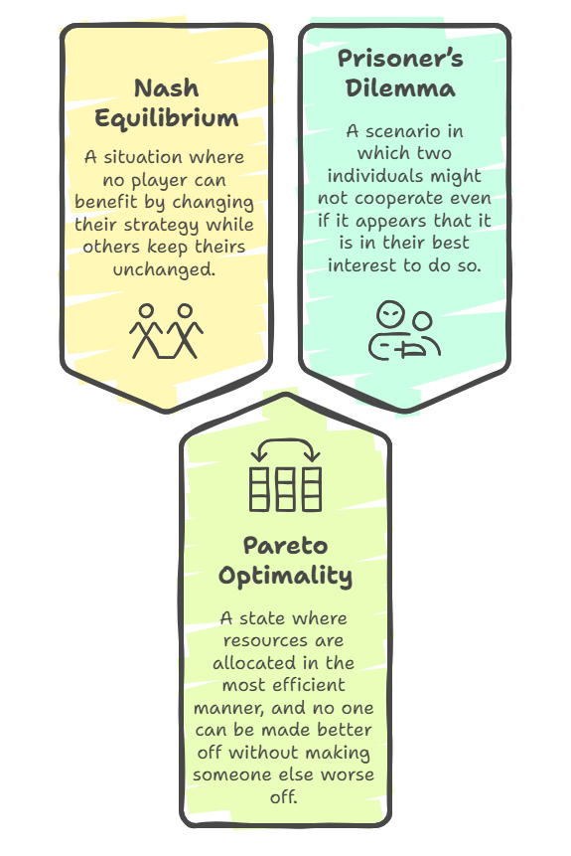
CONCEPTS AND IMPLEMENTATION
Implementation of AI & Game Theory
AI BASED FRAUD DETECTION:
Uses machine learning to detect suspicious patterns in transactions.
Behavioral analysis helps identify deviations from normal user activity.
GAME THEORY APPLICATION:
Nash Equilibrium: Adaptive detection makes fraud too risky.
Pareto Optimality: Targets high-risk cases, minimizing delays.
Prisoner’s Dilemma: Fraud data sharing reduces risks.

Slide 5
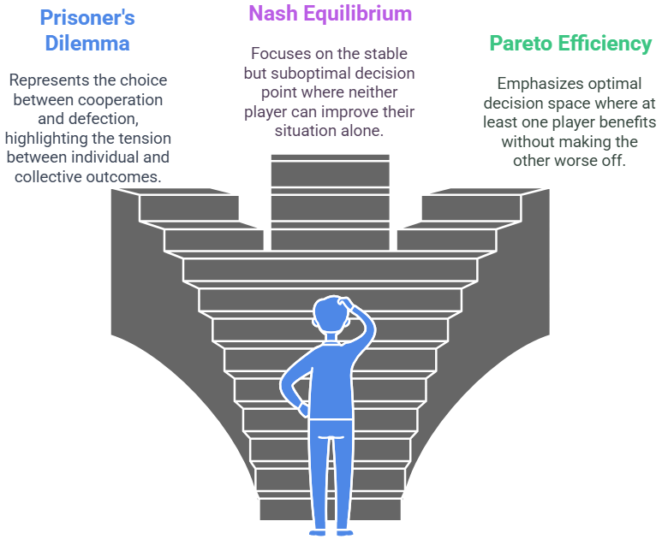
CONCEPTS AND IMPLEMENTATION
Implementation of Game Theory

Slide 6
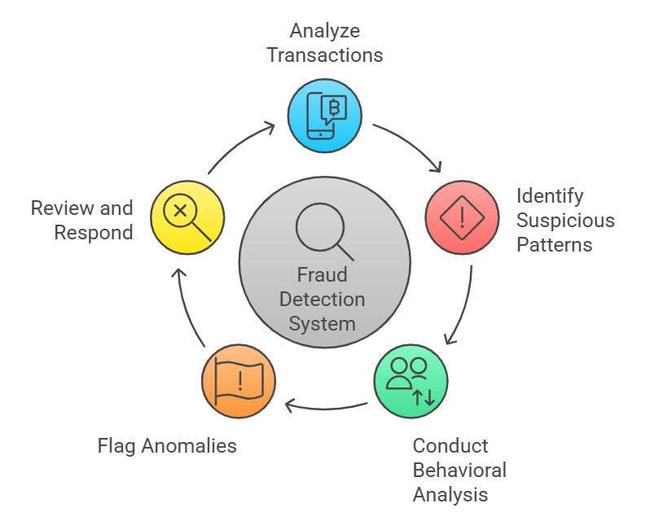
CONCEPTS AND IMPLEMENTATION
Implementation of AI

Slide 7
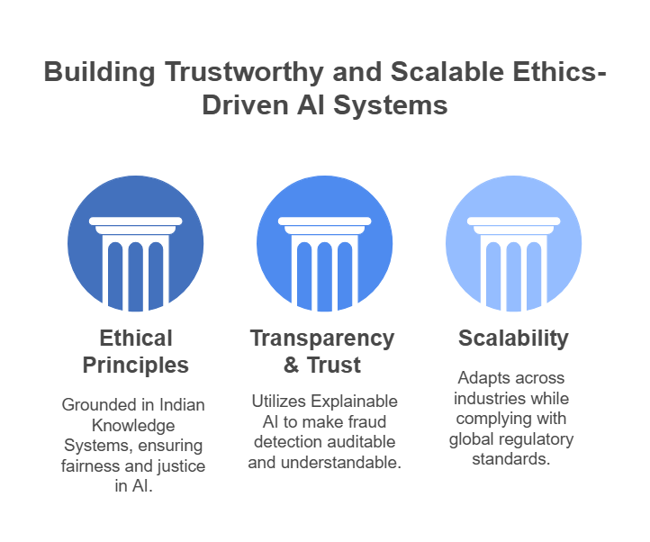
CONCEPTS AND IMPLEMENTATION
Uniqueness of the Project

Slide 8
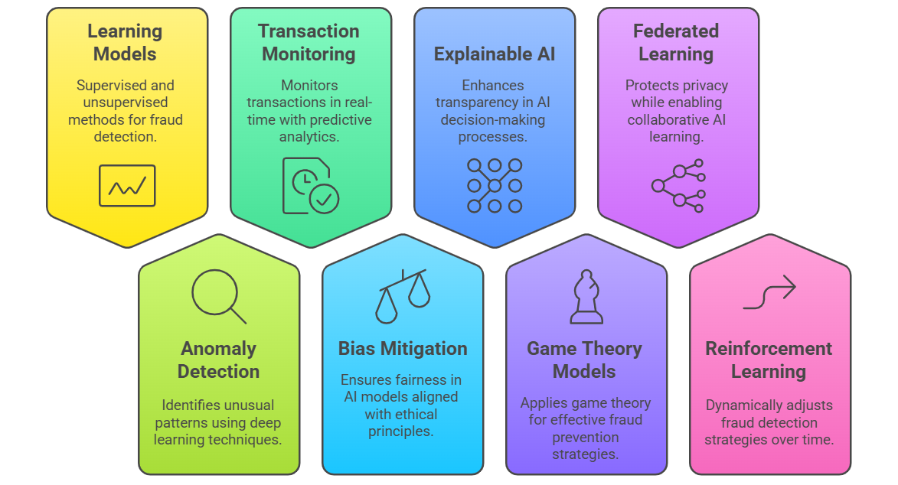
INTEGRATION WITH AI&ML

Slide 9
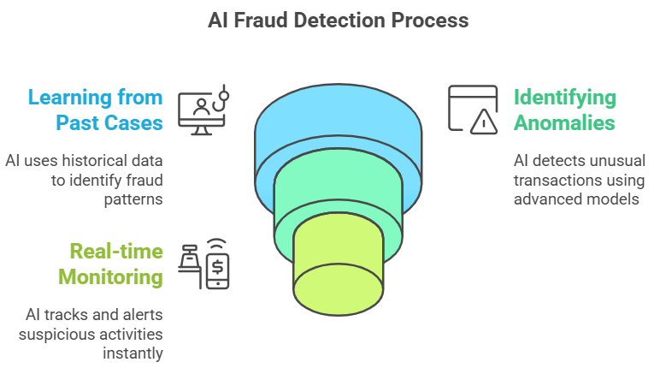
INTEGRATION WITH AI&ML

Slide 10
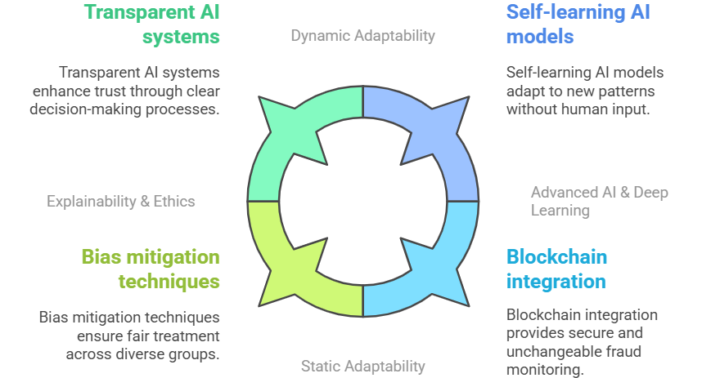
FUTURE ASPECTS

Slide 11
CONCLUSION
Ethical & Transparent Fraud Detection – Integrates AI, Game Theory, and IKS principles for fairness.
Trust & Compliance – Uses Explainable AI (XAI) and privacy-focused techniques to ensure accountability.
Scalable & Adaptive – Works across industries with real-time fraud detection and regulatory compliance.
Future-Ready Approach – Advances in self-learning AI, federated learning, and blockchain will enhance security and efficiency.

Slide 12
THANK YOU
- Team Botzilla

