Slide 1

Responsible Investing
Girish, Kinjal, Pallavi, Rachna, Sagar

Slide 2

THE WAY TO GET STARTED IS TO QUIT TALKING AND BEGIN DOING.
Walt Disney

Slide 3

Agenda
Responsible Investing
Problem Statement
Data Description
Jupyter Notebook
Tableau Dashboard

Slide 4

Responsible Investing
Definition

Slide 5

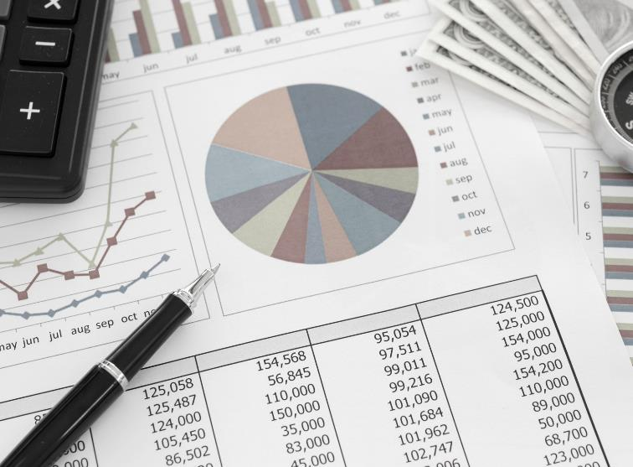
Responsible Investing
Responsible Investing is an approach to investment that explicitly acknowledges the relevance to the investor of environmental, social and governance factors, and of the long-term health and stability of the market.
ESG stands for Environmental, Social, and Governance. Investors are increasingly applying these non-financial factors as part of their analysis process to identify material risks and growth opportunities.

Slide 6
Problem Statement
Responsible Investing

Slide 7
Problem Statement
In recent years, data science has served as an indispensable tool when taking into consideration investment decisions. With a growing awareness of corporate social and environmental accountability, potential investors can harness the power of data to enact responsible investing.
RMDS Lab is hosting its data science competition, Brace for Impact: Creating a Dashboard for Responsible Investing Using Machine Learning. This special competition's contestants will be challenged with collecting data sets and creating a dashboard that can help potential investors to review the social and environmental impacts of companies in which they might invest.

Slide 8
Data Description
Dataset

Slide 9
Data Description
Main Dataset (funds.csv) contains around 6,003 datapoints related to Funds curated by Morningstar with 29 available features.
It contains following variable types:
Categorical: 10
Numeric: 15
Boolean: 4

Slide 10
Dataset Statistics
Statistics | Description
Number of Variables | 29
Number of Observations | 6003
Missing Cells (%) | 3.0%
Duplicate Rows (%) | 0.0%
Total size in memory | 1.3 MB
Average record size in memory | 232 Byte

Slide 11
Jupyter Notebook
EDA and Model Building

Slide 12
Jupyter Notebook
Notebook | Description
Responsible_Investing1_Girish | EDA and Model Building/Prediction
Responsible_Investing2_Kinjal | EDA and Model Building/Prediction
Responsible_Investing3_Pallavi | EDA and Model Building/Prediction
Responsible_Investing4_Sagar | EDA and Model Building/Prediction

Slide 13
Tableau Dashboard
Visualization

Slide 14
Tableau Dashboard
Based on Return
Based on Investment
1, 3, 5, 10 yr. returns based on Sustainability Rating.
Highest Market cap with Highest Return and Sustainability Score.
Fixed Income with best Yield and YTD Return.
Zero investment in Alcohol, Small Arms and Tobacco based on ESG Score.
Zero investment in Animal testing, Fossil Fuels, Thermal Coal based on ESG Score.

Slide 15
Tableau Dashboard
Institutional investment managers use equity style box categories as a central consideration for their portfolio management objectives
For stocks and stock funds, the vertical axis is divided into three company-size categories based on market capitalization: large, medium, and small
We have done our analysis based on these categories
Investors use equity style boxes to identify specific stocks or stock funds for targeted investment portfolio allocations

Slide 16
Tableau Dashboard
Comparison between Large, Medium and Small Core
Based on Investment
Top Funds based on zero investment in Alcohol, Small Arms, Animal testing, Fossil Fuels, Thermal Coal and Tobacco based on ESG Score. Only funds with Morningstar Sustainability Rating = 5 have been taken into considerations
Large Core Funds
Mid Core Funds
Small CoreFunds
Based on Returns, Sustainability Score, Market cap
Based on % 3 Years Annualized Ratings and Morningstar Sustainability Rating

Slide 17
Insights
Number of Large Core Funds with Morning Star Sustainability Rating 5 are higher compared to others and they are giving higher returns also
There are no Small Core Funds that do not invest in Thermal Core and Fossil Fuel
The ratio of funds which are claiming to be ESG Sustainable is very less
Top funds with Morningstar Sustainability Rating 5 are having ESG score approximately between 16 to 22
Top 3 Large Core Funds which investors can choose for Sustainable Investment are:
Morgan Stanley
Pax Large Cap fund
BlackRock Advantage ESG US Eq
Top 3 Mid Core Funds which investors can choose for Sustainable Investment are:
Cavana Hill Mid Cap
Parnassus Mid cap
Neuberger Berman US Equity
Top Small Core Funds which investors can choose for Sustainable Investment is:
Calvert Green

Slide 18



Summary
TBD

Slide 19


THANK YOU
Reduce
Reuse
Recycle

