Slide 1
nervousnet
An Overview
Author: Prasad P. Pulikal
Author: ppulikal@ethz.ch

Slide 2

nervousnet
The Ecosystem
Community
Development
Products | Applications
Tools
Maintenance
Visualization
New Features
Status Checking
Data Analytics
Forums
Surveys
IoT Sensors
Mobile Applications
Tutorials
Blogs

Slide 3
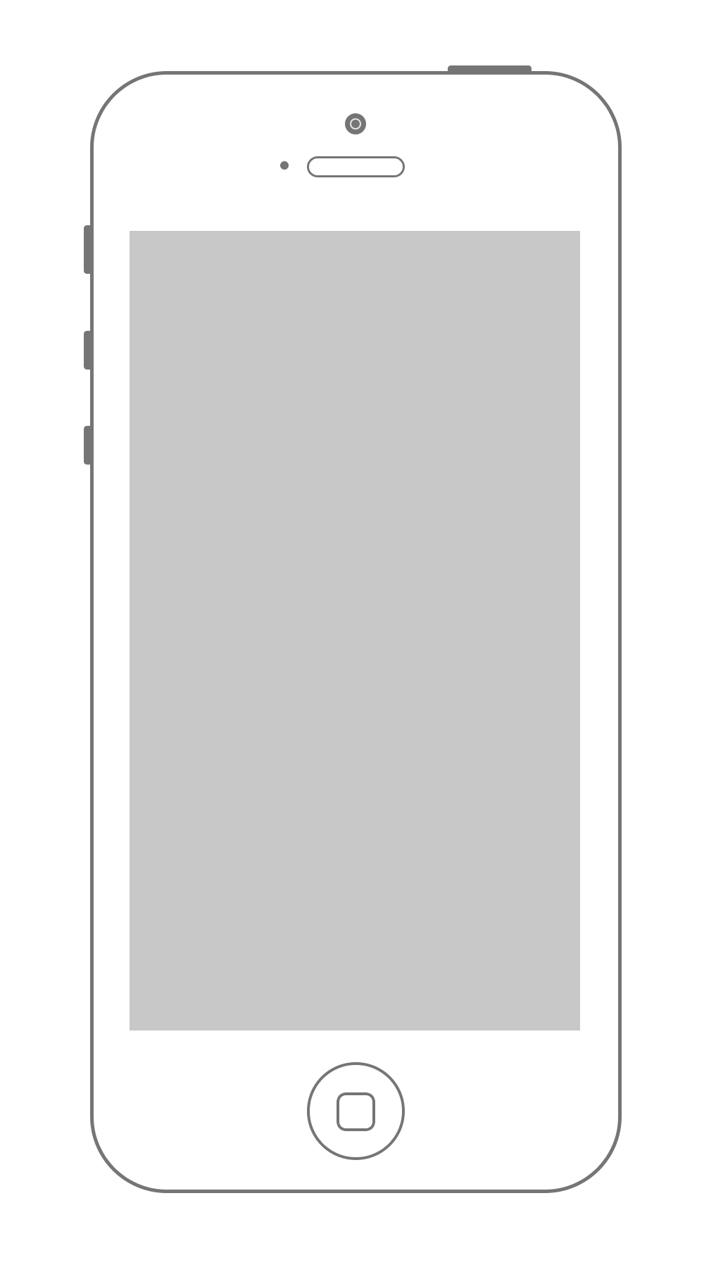

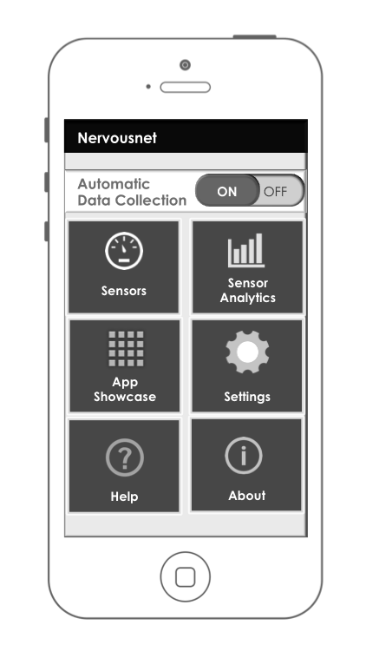


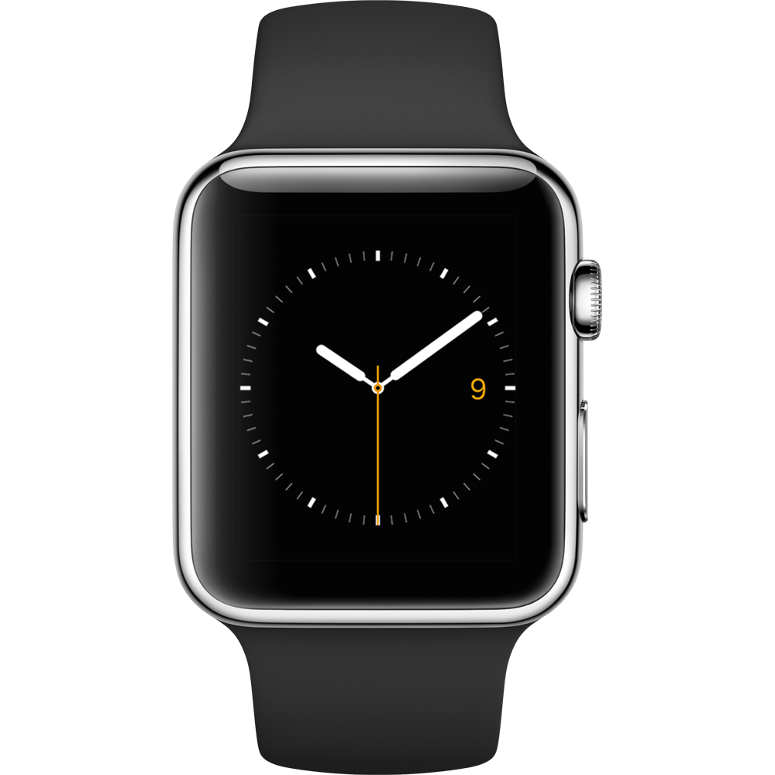


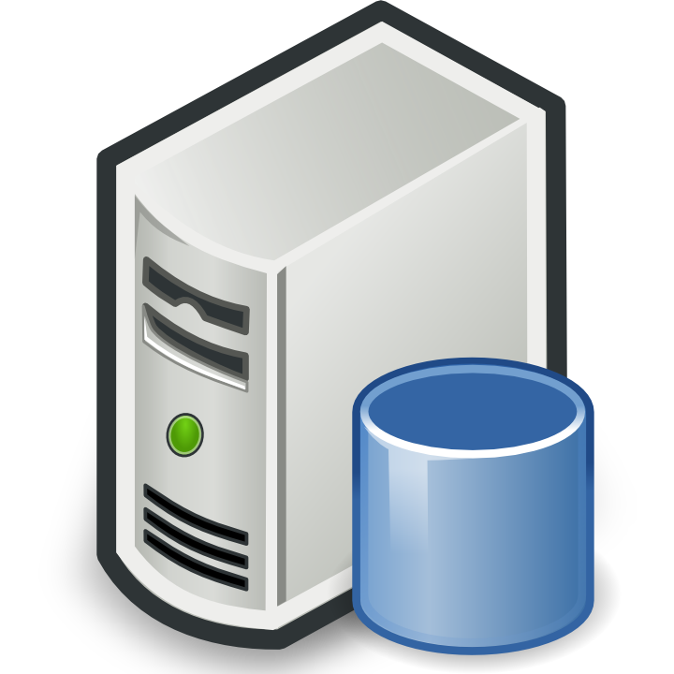



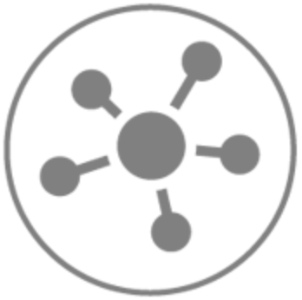
nervousnet
The Platform
Axons
API's
Nervousnet
HUB
Analyze
IOT
devices
Visualize
Nervousnet CORE
( Distributed Servers )
Partner
Platforms
Utilize

Slide 4
nervousnet
The Platform
Mobile App- Native Mobile Application built for Android and iOS platforms.
Allows users to view and share various Sensor related Data
Required to be installed for running external apps (Axons) built using nervousnet PlatformAPI’s.
Acts like a connectivity hub for external products like smartwatches, beacons and external sensors that want to share sensor data with the nervousnet platform.
Android version uses background Services to enable third party apps and extensions to connect and share data with the Nervousnet platform.
iOS version uses WebViews and allows for external Axons to run inside a WebView container.
Axons (Native)- Native Android apps, Smart devices, beacons that can connect to the nervousnet HUB mobile app.
Uses the nervousnet Platform API's to receive and share sensor data.
Works only in Android devices
Uses the Android background services feature.
Possibility of using Bluetooth, Wi-Fi Direct to do connect to the nervousnet mobile app.
Axons - HTML, JavaScript and CSS applications that run inside WebView containers inside the nervousnet apps.
Currently supported on the iOS platform.
Android Platform support in the next phase.
nervousnet CORE – Distributed and Decentralized set of Servers
Used to store and collect Data shared by Clients (Mobile & Web), IOT Hardware sensors and devices, partner platforms and more.
Individual Servers are called nervousnet Nodes.
Mobile Clients will have the option of selecting a server from a list.

Slide 5
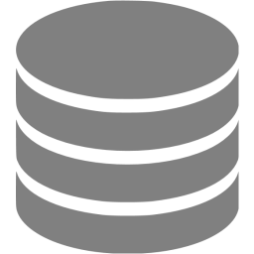
nervousnet HUB
Mobile Application Architecture
Third party applications / Axons
Native Axons
Background Services (Android)
WebView
External Applications
API’s
WebView Server
Authentication Engine
nervousnet HUB API Interface
Read API’s
Write API’s
Query API’s
V. Sensor Registration API’s
Local Analytics Engine (LAE)
SSL
Storage Engine
VM
nervousnet mobile App
Database
nervousnet CORE
( Distributed Servers )
Sensors
Mobile Phone Environment

