Slide 1

An AI pipeline to understand an NLS video collection
King’s
Digital Lab
Geoffroy Noël, Sept 2026

Slide 2
King’s
Digital Lab
Objectives & approach
Find out how well current AI tools can describe the structure and content of an archival video collection.
Detect intended units to simplify, improve and refine downstream tasks.
Visual and spoken.
Generalist & specialised
deep learning (open-weight) models. Mainly Video Language Models (VLM).
2. Segment
Extract and reformat speech
1. Transcribe

Slide 3
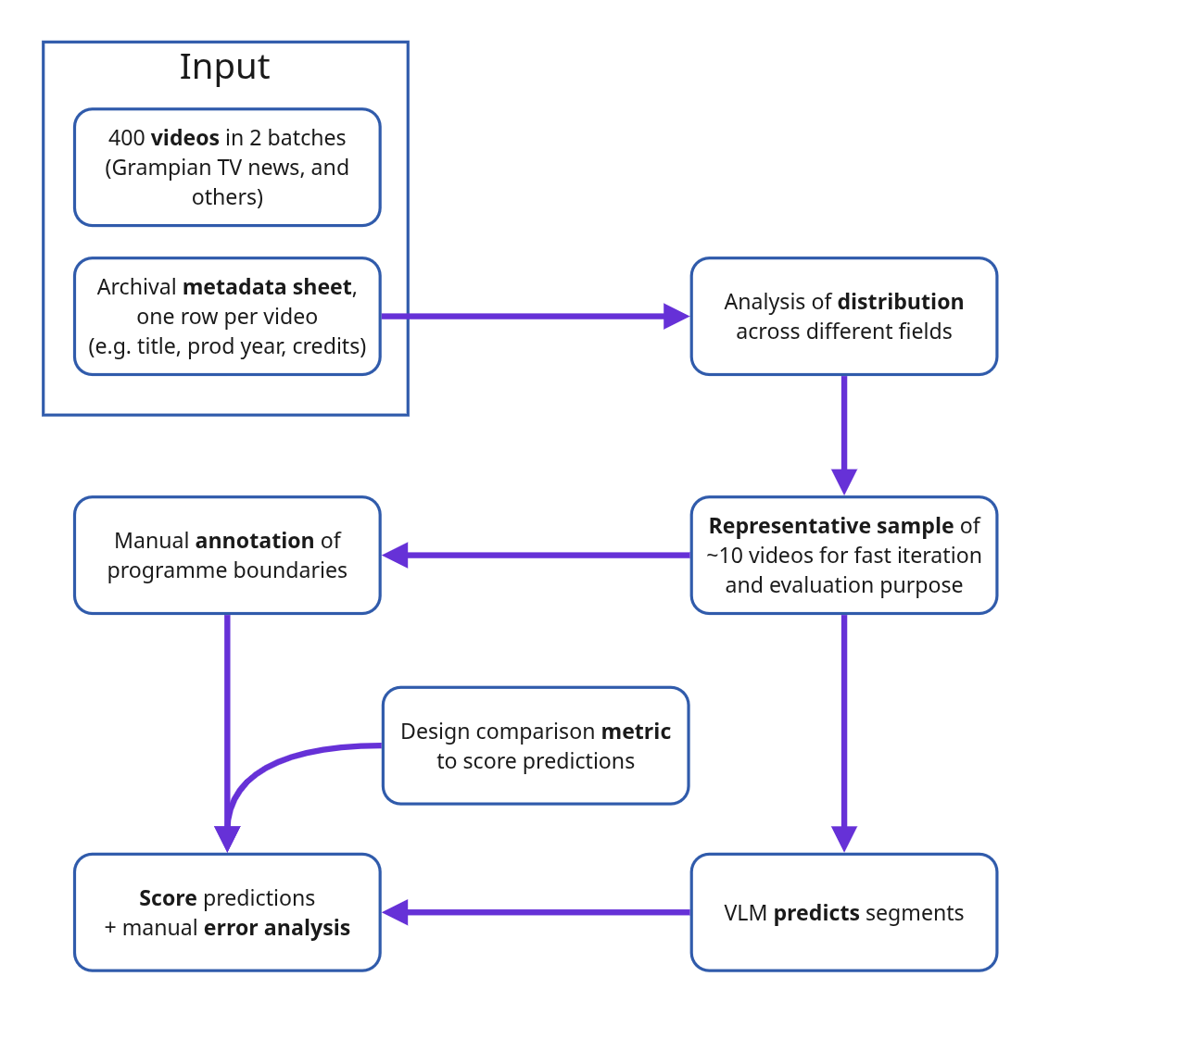
[batches, metadata sheets, samples, annotations]
King’s
Digital Lab
Input material & evaluation sample
Sample
Duration 3 to 110 mins,
Type: TV NEWS rushes, horror fiction, promotion, instructional, …
Production year: 1930s to 1990s
Sound/silent/mixed
Colour/bw/mixed
Number of programmes: 1 to 25 per tape

Slide 4
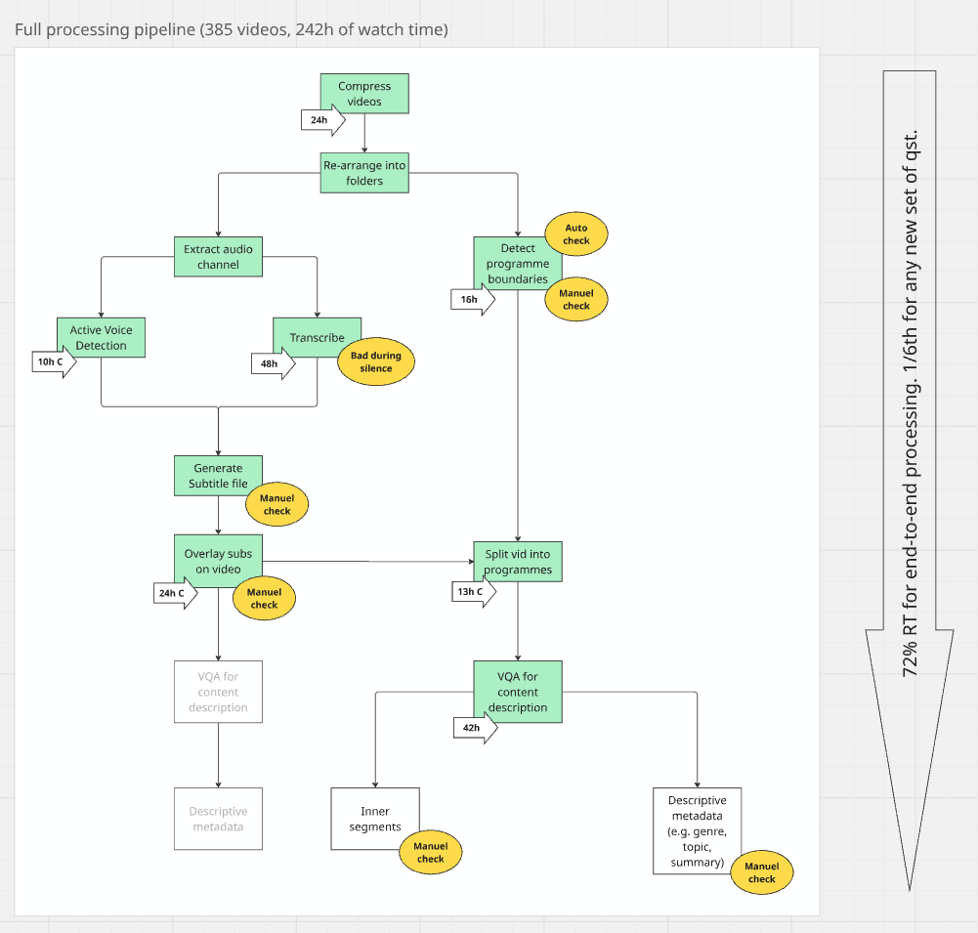
King’s
Digital Lab
Processing
pipeline
2. Segment
1. Transcribe
3. Describe

Slide 5
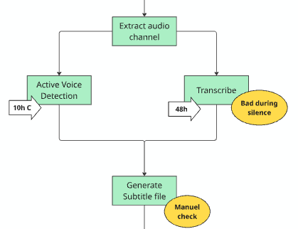
King’s
Digital Lab
1. Transcription
Method
Extract audio track from full video
Transcribe speech from audio track
into sentences and time codes using Nvidia canary model.
Spot all periods of speech vs non-speech in the track using an Voice Activity Detector model (Silero VAD)
Split long sentences into smaller clauses, remove sentences during non-speech periods
Write output into a SRT file (SubRip Subtitle)

Slide 6
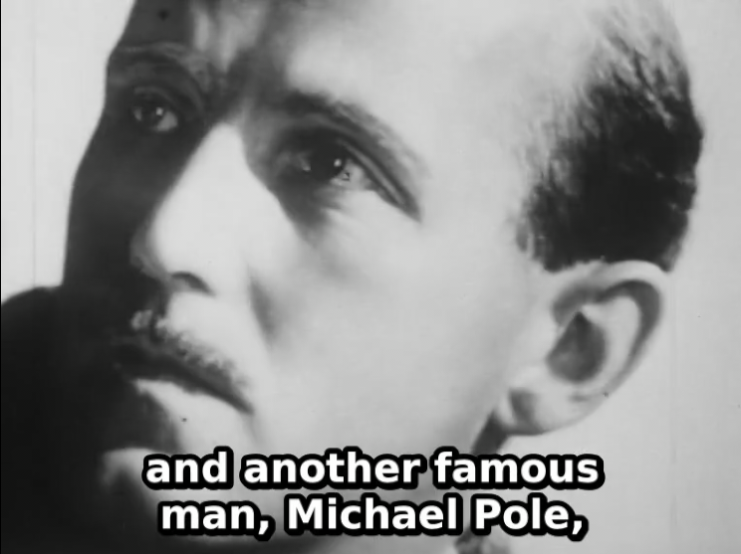
King’s
Digital Lab
Transcription – known issues
Internal monologue: left over on the edges of non-speech regions suppressed by our method. Could be improved but possibly at a cost of processing speed.
Mishearing: factors like sound quality, overlapping speech or regional accents cause transcription errors. Including expletives...
No perfect setting for VAD confidence threshold.
Names: e.g. Michael Powell
Yet sometimes properly corrected at a later stage by another model (In this case: the synopsis and summary fields)

Slide 7
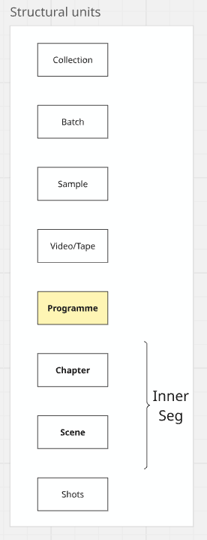
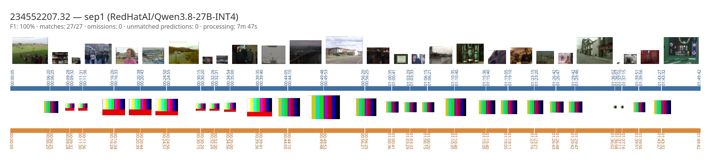
King’s
Digital Lab
2. Outer segmentation (progs)
Programme: for the purpose of analytical processing by VLMs, our definition of programme is a sequence of shots on either side of a clear visual boundary called a separator, such as color bars, blank screen, static. However some judgement should be used to disregard visual separators within a programme (e.g. chapter titles, credits, scene transitions like fades).
Method:
Divide a tape into chunks of 15 minutes with 2 minute overlap
Send each chunk at 2fps to a VLM (Qwen3.8-27B) with a prompt designed to locate and characterise outer separators
Merge all responses in a structured format (json)

Slide 8
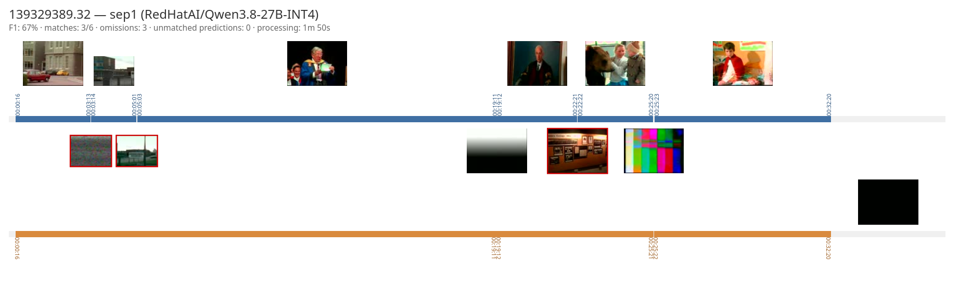
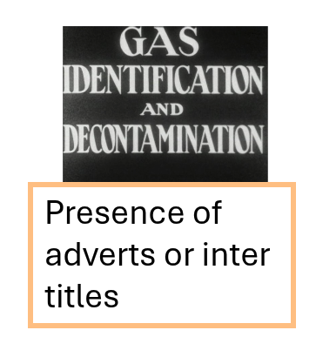
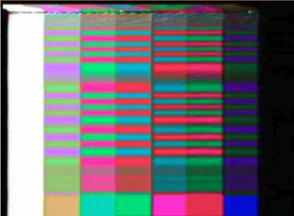
King’s
Digital Lab
Segmentation – known issues
High variability of programme lengths
Variety of separators: static, color bars, etc.​
Visual artifacts
Straight cut; or color bar flashing for a fraction of a second

Slide 9
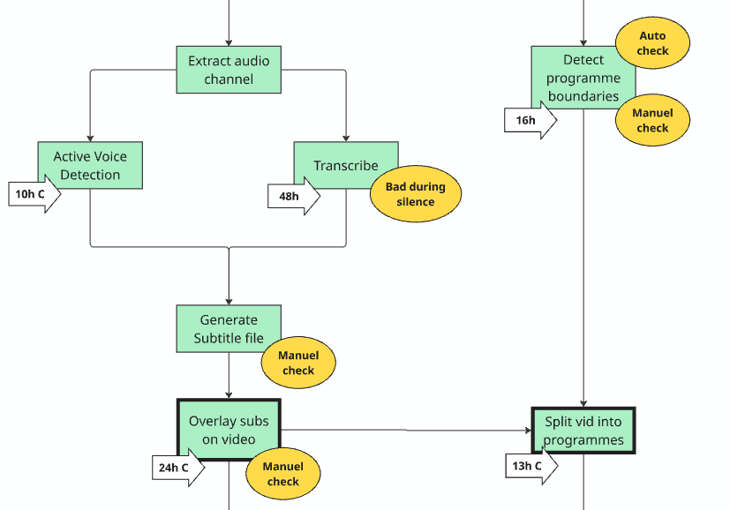
King’s
Digital Lab
Burn and split
This produces one clip per detected programme, with subtitles burnt onto it

Slide 10
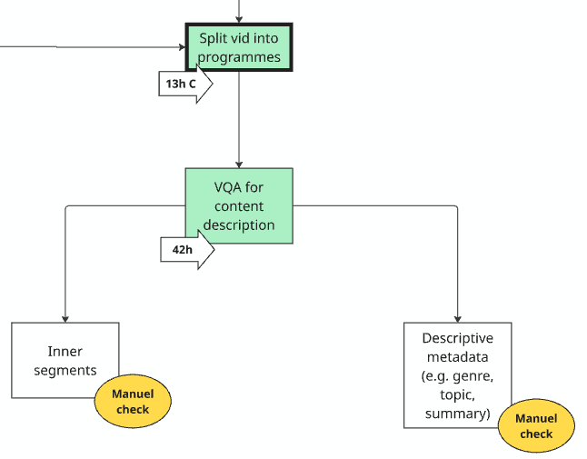
King’s
Digital Lab
3. Generate descriptions
Method
For each programme (w/ subs at 1fps), send a single prompt with multiple questions to a VLM. One question per metadata field. Some responses are structured (e.g. credits broken down by role and names). The model only sees the visuals and receives no supplementary information about the input video.
One question called ‘segments’ asks the model to locate and describe major inner segments. The definition is left open so the model can flexibly use visual cues (like chapter titles) when present or more semantic cues such as change of scene/location.

Slide 11
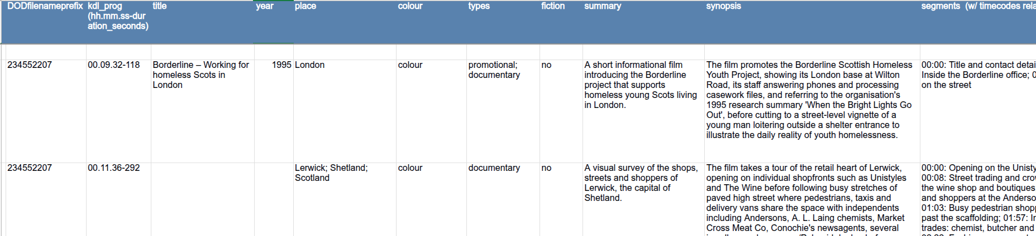
King’s
Digital Lab
Results
All answers are converted into a new metadata sheet with one row per detected programme and one column per answer about a field.
Reference to NLS video file names
Reference to KDL programme files

Slide 12
King’s
Digital Lab
Impressions
More reliable Year: but rarely predicted Fiction Colour Duration Titles: when predicted | Could be improved Outer segments: error analysis; miscategorised as inner segments Inner segments: more clearly distinguish “chapters” from scene or shots (different questions) Titles: many missing b/c they are on the separator, not our programme
Promising Place names: when VLM can read them Can identifies the mid-level units often missing from catalogue (chapters, scene) | Challenging People and place names Large controlled vocabulary (e.g. 900+ categories)

Slide 13
King’s
Digital Lab

Slide 14
King’s
Digital Lab
Segmentation prompt
List every full-screen separator between distinct programmes.
A visual separator usually looks like SMPTE color bars, blank screen, production card, countdown leaders, static or white noise. It is always totally distinct in style from surrounding programmes, usually non-photographic and never intended for public audience.
Compare with programmes on either side of the separator to confirm this. Return an empty list if the input doesn't contain any definite separator. Other screens within a programme like ending credits or chapter titles should not be reported as programme separators but may help finding/confirming nearby separators.

Slide 15
King’s
Digital Lab
Description prompt (v2)
The attached video is a single programme from a national archive. Returns a json dictionary with the following keys:
* year (the year the programme was made, only if specified and certain),
* place (shortlist of regions or specific identifiable place names where this is filmed),
* title (the title of the programme, if specified),
* segments (list of main chapters or major segments, for each a `title` and a `starting` timecode),
* summary (one very concise sentence summarising the content of the programme),
* synopsis (one longer sentence summary of the content of the programme),
* colour (either: black-and-white or colour or sepia or colour-and-black-and-white),
* fiction (yes if definitively fiction, no otherwise),
* types (one or more values from tv news, amateur, educational, sponsored, advertising, animation, documentary, promotional, fiction, drama, tv sports, instructional, religion, comedy, horror, home movie, scientific),
* keywords (10 key topical or thematic tags for this programme; avoid overly specific tags like place names, people or objects),
* credits (if specified).

Slide 16
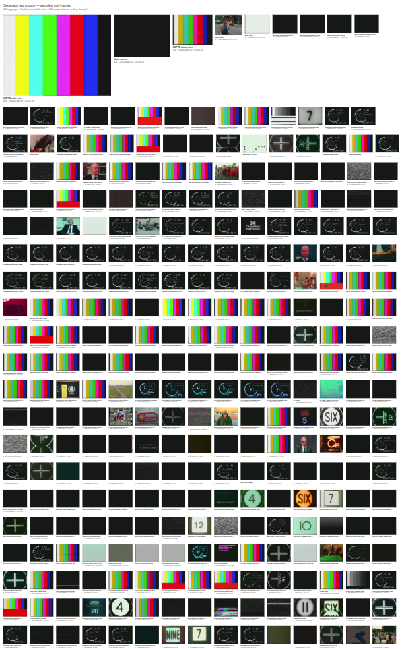
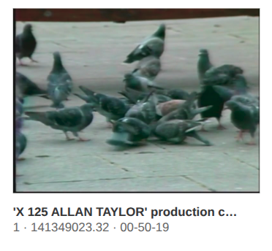
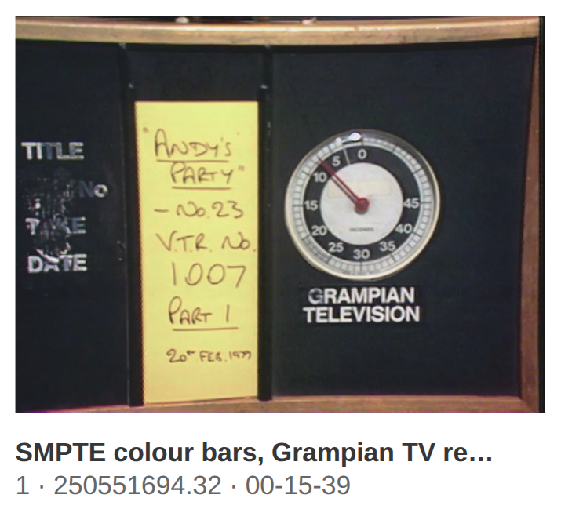
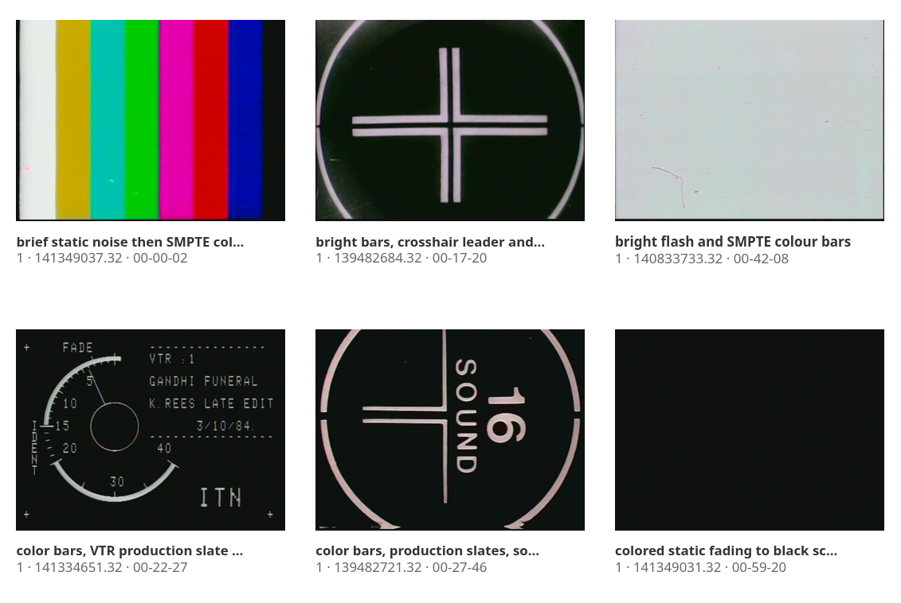
King’s
Digital Lab
Outer separators
Most frequent tags for outer separators
825 SMPTE color bars
321 black screen
158 SMPTE colour bars
34 color bars
13 white flash
12 SMPTE color bars followed by black screen
10 static noise then black screen
9 static then black screen
8 SMPTE color bars then black screen
7 black screen then SMPTE color bars
6 black screen followed by SMPTE color bars
6 Grampian production slate / title card
6 TV static / white noise
6 SMPTE color bars (bright variant)

Slide 17
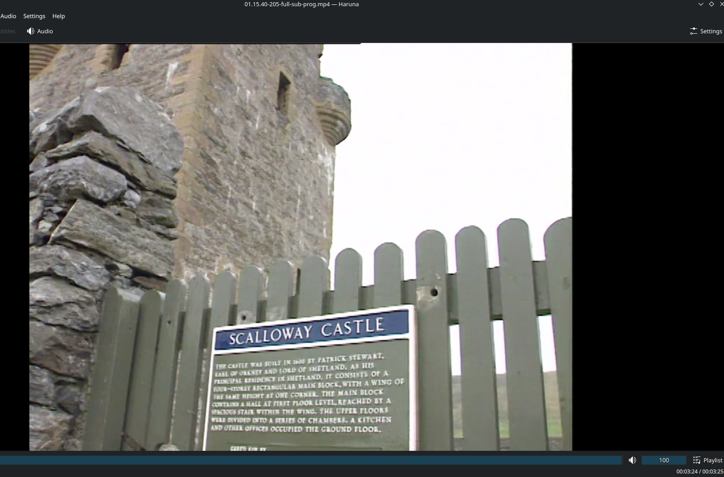
King’s
Digital Lab
VLM reading signs
The programme offers a slow, atmospheric walk-through of Scalloway Castle, the early-seventeenth-century stronghold erected by Patrick Stewart, Earl of Orkney, beginning at the heavy studded oak portal and moving past a grilled window and shadowed passages into the bare stone halls, before ending on the towering, roofless curtain of the main block rising above a turf mound.
(234552207, 01.15.40-205)

Slide 18
King’s
Digital Lab
T

Slide 19
King’s
Digital Lab
T

Slide 20
King’s
Digital Lab
T

