Slide 1


VP 2.0
Kings College Virtual Library
Application Mockups
(V 4.2)

Slide 2
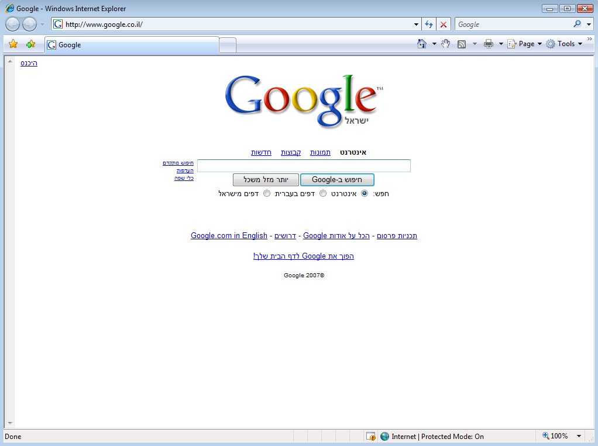





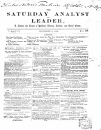
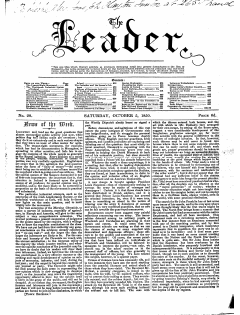
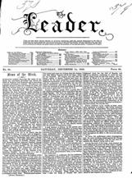
In
Articles
Advanced Search
View options: Detailed View Simple View
16 documents found in folder: Volume 2
The Leader
Volume 1
Volume 2
Northern Star (1837-52)
Tomahawk
Publishers Circular
Monthly Repository
English Woman’s Journal
The leader
Source:
Series:
Volume:
Number:
Published: Jan 4, 1852
Editions: 4
260 pages
Bibliographical location:
The Saturday Analyst Leader
Source:
Series:
Volume:
Number:
Published: Jan 4, 1852
Editions: 4
260 pages
Bibliographical location:
The leader
Source:
Series:
Volume:
Number:
Published: Jan 4, 1852
Editions: 4
260 pages
Bibliographical location:
The leader
Source:
Series:
Volume:
Number:
Published: Jan 4, 1852
Editions: 4
260 pages
Bibliographical location:
The leader
Source:
Series:
Volume:
Number:
Published: Jan 4, 1852
Editions: 4
260 pages
The Leader
by George Tenet (Author)
Published: Jan, 2004
Added: May, 12, 2007
Versions: None
ISBN: 1579546110
340 pages
Home About Olive Copyright © 2000 – 2007. Olive Software Inc. All rights Reserved

Slide 3
In: Articles Pictures Ads
In
Articles
Advanced Search
View options: Detailed View Simple View
16 documents found in folder: Volume 2
The Leader (1850 -1860)
Volume 1
Volume 2
Northern Star (1837-52)
Tomahawk (1867 - 1870)
Publishers Circular (1820 -1890)
Monthly Repository (1830 - 1890)
English Woman’s Journal
(1810- 1830)
The Leader (1850-1880), Tuesday August 21, 1872
The Northern Star (1820-1980), Sunday January 25, 1822
The English Woman’s Journal (1820-1890), Thursday March 01, 1881
The Publisher’s Circular (1850-1880), Wednesday May 13, 1854
The Leader (1850-1880), Tuesday August 21, 1872
The Northern Star (1820-1980), Sunday January 25, 1822
The English Woman’s Journal (1820-1890), Thursday March 01, 1881
The Publisher’s Circular (1850-1880), Wednesday May 13, 1854
The Leader (1850-1880), Tuesday August 21, 1872
The Northern Star (1820-1980), Sunday January 25, 1822
The English Woman’s Journal (1820-1890), Thursday March 01, 1881
The Saturday Analyst and Leader (1850-1880), Saturday, November 3, 1860
The Leader (1850-1880), Tuesday August 21, 1872
The Northern Star (1820-1980), Sunday January 25, 1822
The English Woman’s Journal (1820-1890), Thursday March 01, 1881
The Publisher’s Circular (1850-1880), Wednesday May 13, 1854
Home About Olive Copyright © 2000 – 2007. Olive Software Inc. All rights Reserved

Slide 4


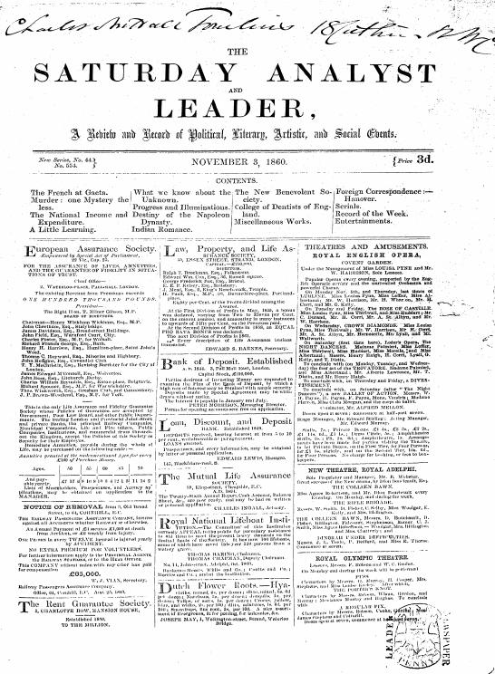

Navigate
Actions
Component mode Page zoom mode Zoom Tools
About this issue
Departments
Page thumbnails
Editions (4)
Search this number
Double Page View
The Saturday Analyst and Leader, November 3, 1860
The Leader relies extensively on other publications, especially for its local news, reports of fires and murders, and miscellaneous notes. I have recorded most references in the opening numbers of a volume, and then where editors respond directly to a title or they cite a title that seems indicative of the sweep of sources cited. The Daily News and Morning Chronicle (voice of the Foreign Office) are the most frequently cited, but they regularly cite works from South America, Europe and North America.
http://www.ncse.kcl.ac.uk/index.html
Title: The Saturday Analyst and Leader
Published November 03 1860 Added: Feb 2007
123 pages
Source: Series: Volume: 2 Number: Bibliographical Location:
Editions: 5 Format: Broadsheet

Slide 5
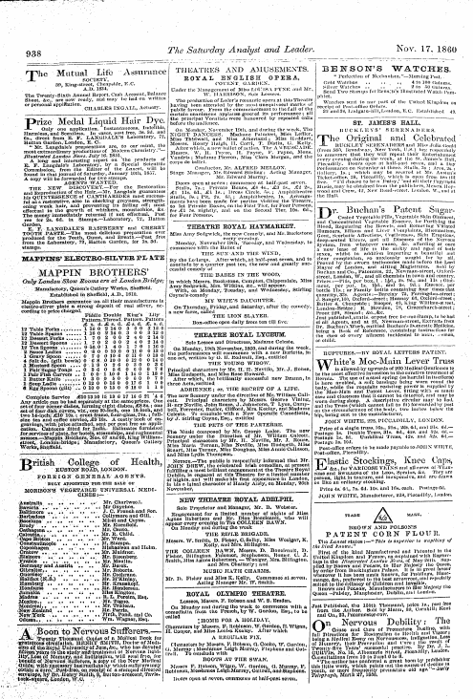
Navigate
Actions
Component mode Page zoom mode Zoom Tools
About this issue
Departments
Page thumbnails
Editions (4)
Search this number
Double Page View
The Saturday Analyst and Leader, November 3, 1860
The Leader relies extensively on other publications, especially for its local news, reports of fires and murders, and miscellaneous notes. I have recorded most references in the opening numbers of a volume, and then where editors respond directly to a title or they cite a title that seems indicative of the sweep of sources cited. The Daily News and Morning Chronicle (voice of the Foreign Office) are the most frequently cited, but they regularly cite works from South America, Europe and North America.
http://www.ncse.kcl.ac.uk/index.html
Title: The Leader
Published November 03 1860 Added: Feb 2007
123 pages
Source: Series: Volume: 2 Number: Bibliographical Location:
Editions: 5 Format: Broadsheet

Slide 6


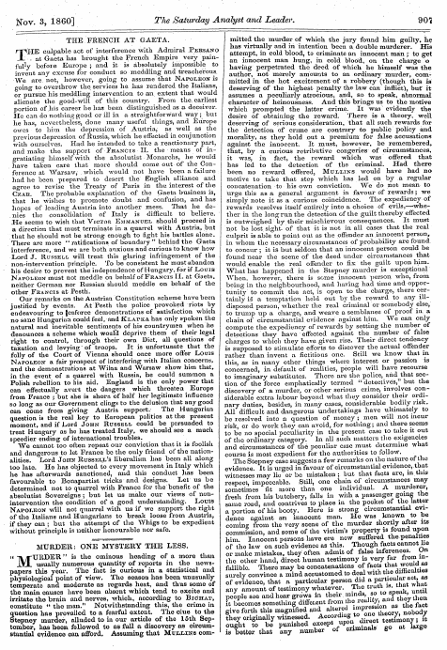
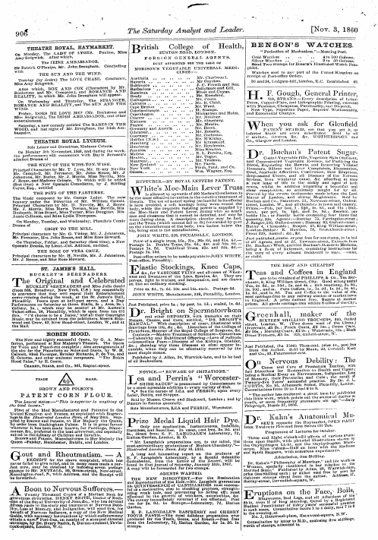
Navigate
Actions
Component mode Page zoom mode Zoom Tools
Actions Close
Send link by Email…
Add to my Favorites…
Copy link to clipboard
Add link to Yahoo My Web
Print…
Rotate
The Leader (1850 - 1890) > Volume 1 > July 4 1856 > edition2
Home | About Olive | Copyright © 2000 – 2007. Olive Software Inc. | All rights Reserved

Slide 7

Navigate
Actions
Component mode Page zoom mode Zoom Tools
Tools Close
Preferences:
Flip effect
Document Actions:
Read offline
Download as PDF
Click to zoom in
Double click to open item
Leader (1852 – 1890) > Volume 1 > July 4 1856 > edition2
Home | About Olive | Copyright © 2000 – 2007. Olive Software Inc. | All rights Reserved

Slide 8
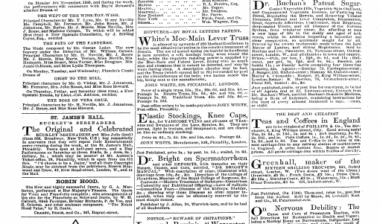
Navigate
Actions
Component mode Page zoom mode Zoom Tools
Click to zoom out

Slide 9
Navigate
Actions
Component mode Page zoom mode Zoom Tools

Slide 10
Navigate
Actions
Component mode Page zoom mode Zoom Tools
Click to open article

Slide 11

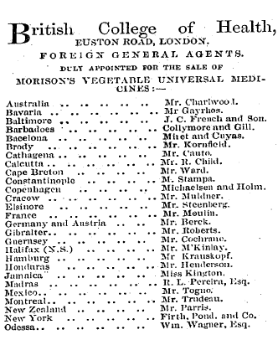
Navigate
Actions
Component mode Page zoom mode Zoom Tools
Actions
Zoom Close
Actions
Continue

Slide 12
Navigate
Actions
Zoom Close
Actions
Component mode Page zoom mode Zoom Tools
Open navigation bar
Send to…
Print…
Save…
Add to Favorites…
Add to Yahoo
my Web…
Meta Data
The Saturday Analyst & Leader
November 3, 1800
378 Words
Page 476
Continue

Slide 13
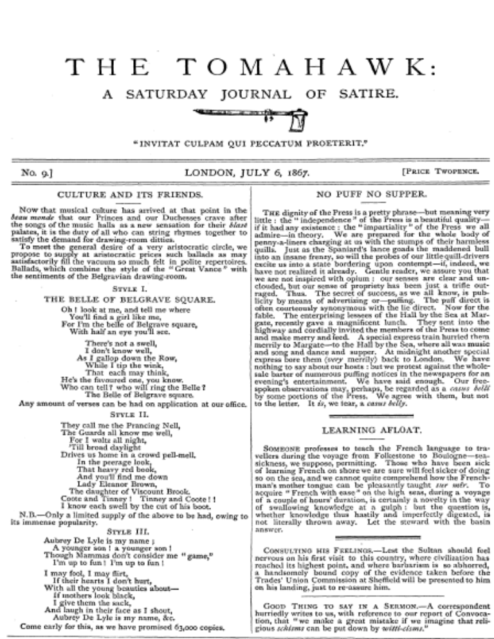
Navigate
Actions
Component mode Page zoom mode Zoom Tools
About this issue
Departments
Page thumbnails
Editions (4)
Search this number
Double Page View
The Tomahawk, July 6, 1867
The Tomahawk’s political impact should not be underestimated: in a Parliamentary debate about the “Peace Preservation (Ireland) Bill” 1870, Tomahawk is mentioned as an example of the sort of seditious material that should not be exported to Ireland: “A paper with such cartoons published in London, going over to Ireland and circulating there, would be far more mischievous than if originally printed in Dublin.” The Times, Saturday 26 March 1870, p.6 col c and a Beckett’s defence the following Monday 28 March 1870, p.5 col d.
Title: The Tomahawk
Published November 03 1860 Added: Feb 2007
123 pages
Source: Series: Volume: 2 Number: Bibliographical Location:
Editions: 5 Format: Broadsheet
The Tomahawk, July 6, 1867
Home Search About Copyright © 2000 – 2007. Olive Software Inc. All rights Reserved

Slide 14



Navigate
Actions
Component mode Page zoom mode Zoom Tools
About this issue
Departments
Page thumbnails
Editions (4)
Search this number
Page 1
Double Page View
Page 1
Page 4
Page 4
Page 5
Page 6
Page 9
The Tomahawk, July 6, 1867
Home Search About Copyright © 2000 – 2007. Olive Software Inc. All rights Reserved

Slide 15



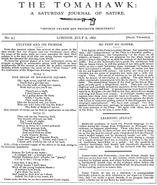
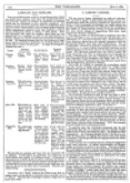
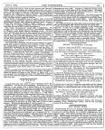
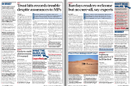
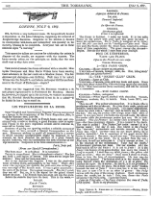
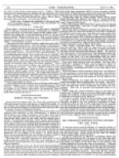

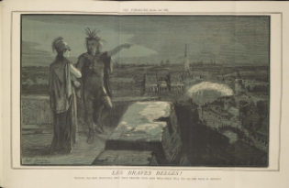

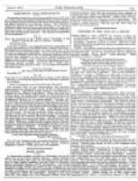
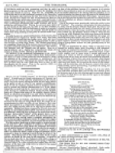
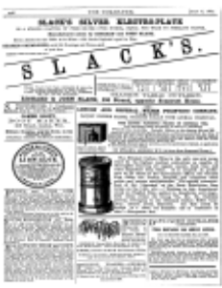
Navigate
Actions
Component mode Page zoom mode Zoom Tools
About this issue
Departments
Page thumbnails
Editions (4)
Search this number
Close navigation bar
unpag
934
935
936
937
unpag
unpag
940
941
942
943
The Tomahawk, July 6, 1867
Home Search About Copyright © 2000 – 2007. Olive Software Inc. All rights Reserved

Slide 16
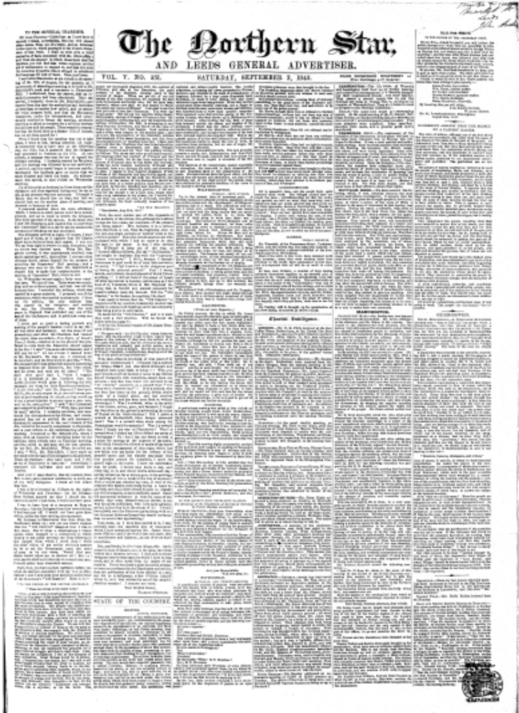
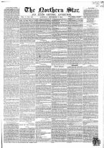
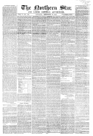
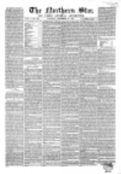
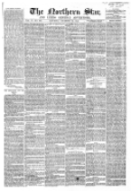
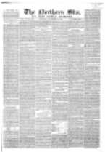
Navigate
Actions
Component mode Page zoom mode Zoom Tools
About this issue
Departments
Page thumbnails
Editions (4)
Search this number
Double Page View
1
Town & Country
2
3
4
The Northern Star, September 1843
Home Search About Copyright © 2000 – 2007. Olive Software Inc. All rights Reserved

Slide 17
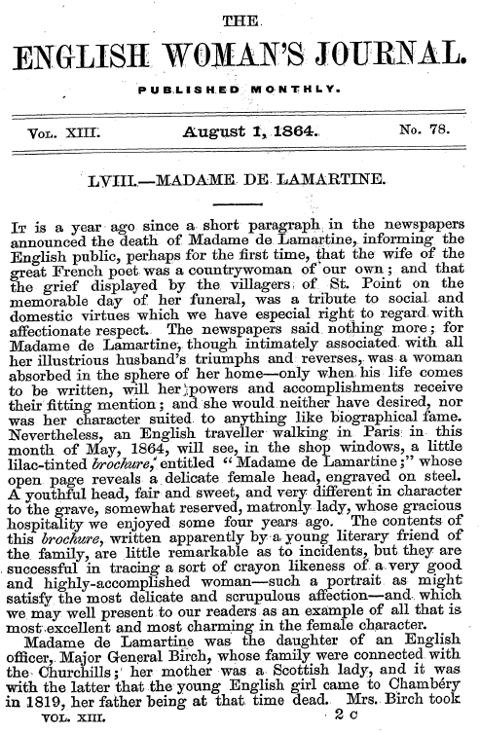

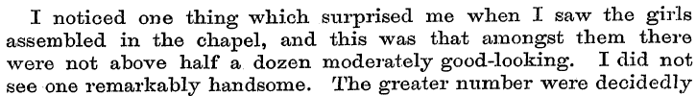



Navigate
Actions
Component mode Page zoom mode Zoom Tools
About this issue
Departments
Page thumbnails
Editions (4)
Search this number
General
100% | 4 hits | Page 6 | main edition | Words: 216
80% | 4 hits | Page 4 | 2nd edition | Words: 353
80% | 4 hits | Page 4 | 3rd edition | Words: 2578
80% | 4 hits | Page 4 | 2nd edition | Words: 704
The Northern Star, September 1843
Home Search About Copyright © 2000 – 2007. Olive Software Inc. All rights Reserved

Slide 18
In
Articles
Advanced Search
View options: Detailed View Simple View
16 documents found in folder: Volume 2
The Leader
Volume 1
Volume 2
Northern Star (1837-52)
Tomahawk
Publishers Circular
Monthly Repository
English Woman’s Journal
The leader
Source:
Series:
Volume:
Number:
Published: Jan 4, 1852
Editions: 4
260 pages
Bibliographical location:
The Saturday Analyst Leader
Source:
Series:
Volume:
Number:
Published: Jan 4, 1852
Editions: 4
260 pages
Bibliographical location:
The leader
Source:
Series:
Volume:
Number:
Published: Jan 4, 1852
Editions: 4
260 pages
Bibliographical location:
The leader
Source:
Series:
Volume:
Number:
Published: Jan 4, 1852
Editions: 4
260 pages
Bibliographical location:
The leader
Source:
Series:
Volume:
Number:
Published: Jan 4, 1852
Editions: 4
260 pages
The Leader
by George Tenet (Author)
Published: Jan, 2004
Added: May, 12, 2007
Versions: None
ISBN: 1579546110
340 pages
Home About Olive Copyright © 2000 – 2007. Olive Software Inc. All rights Reserved

Slide 19
Shakespeare
In
Articles
Quick Search
Advanced Search
Select publication/s:
Meta data search:
The Leader (1850 – 1860)
Northern Star (1800 - 1900)
Tomahawk (1867 - 1870)
Publisher’s Circular (1880 - 1890)
Monthly Repository (1800 - 1900)
English Woman’s Journal (1858 - 1864)
Title:
Subject:
Source:
Search in all publications
Description:
Date Range:
From:
To:
Department Title:
Edition:
Main All
Printer Name:
Result list style:
Printer Location:
Publisher Name:
View results as :
Snippets Articles Pages
Publiasher Location:
Sorted by:
Format:
Editor Name:
Home About Olive Copyright © 2000 – 2007. Olive Software Inc. All rights Reserved

Slide 20




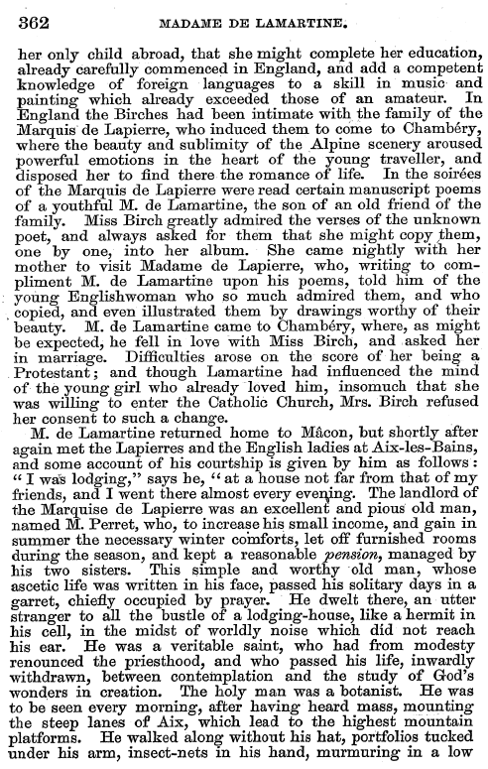
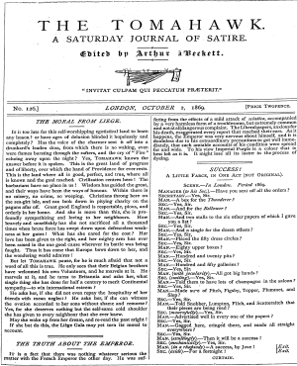

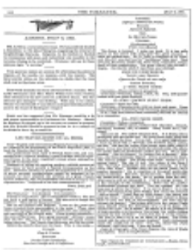


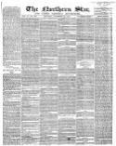
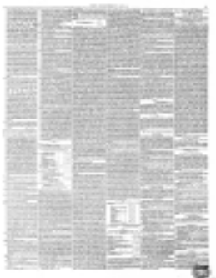
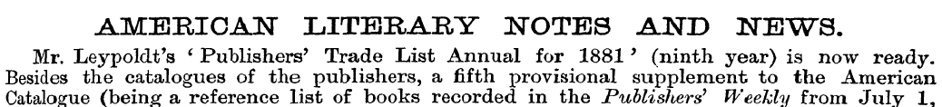
Tesco
Shakespeare
In
Articles
Advanced Search
3 items found
View results as :
Snippets Articles Pages
English Women’s Journal| Volume | August 01, 1864 | 560 words | 100 %
Show Text | Hide Text
View Cover
View Page 50
The Tomahawk| Volume | October 02. 1869 | 560 words | 100 %
View Cover
View Page 32
The Northern August| Volume | December 24, 1842 | 560 words | 100 %
AMERICAN LITERARY NOTES AND NEWS
Mr. Leypoldt’s ‘Publishers’ Trade List Annual for 1881’ (ninth year) is now ready…
View Cover
View Page 50
Show Text | Hide Text
Home About Olive Copyright © 2000 – 2007. Olive Software Inc. All rights Reserved

Slide 21
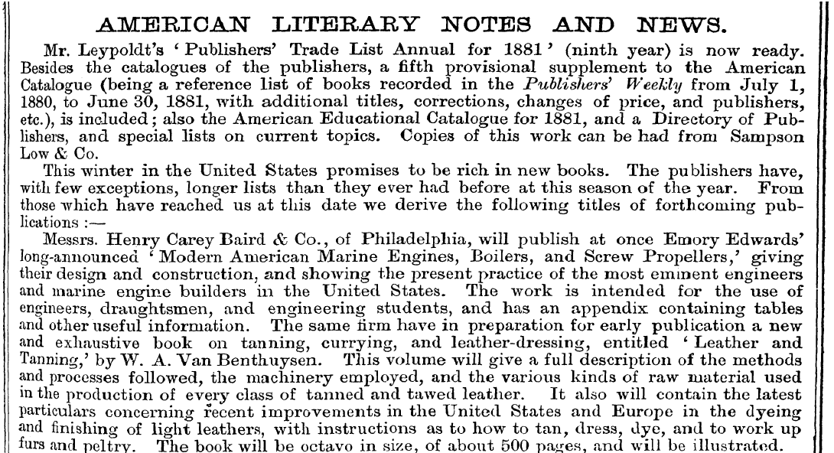
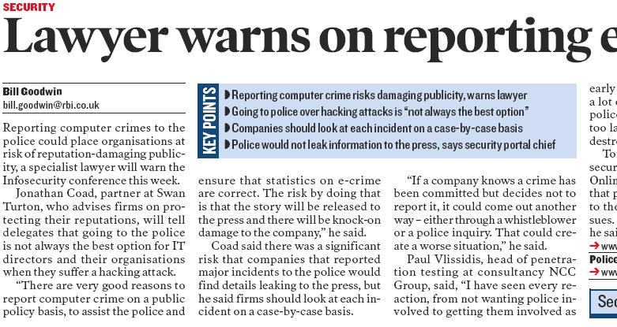
Tesco
Shakespeare
In
Articles
Advanced Search
Actions
3 items found
View results as :
Snippets Articles Pages
Text size Close
English Women’s Journal| Volume | August 01, 1864 | 560 words | 100 %
Send to…
Show Text | Hide Text
Print…
View Cover
View Page 50
Save…
The Tomahawk| Volume | October 02. 1869 | 560 words | 100 %
Add to Favorites…
Add to Yahoo
my Web…
Meta data
View Cover
View Page 32
Publisher Circular
The Northern August| Volume | December 24, 1842 | 560 words | 100 %
Tuesday, November 01, 1881
From page 6
AMERICAN LITERARY NOTES AND NEWS
Mr. Leypoldt’s ‘Publishers’ Trade List Annual for 1881’ (ninth year) is now ready…
View Cover
View Page 50
Show Text | Hide Text
Home About Olive Copyright © 2000 – 2007. Olive Software Inc. All rights Reserved

Slide 22
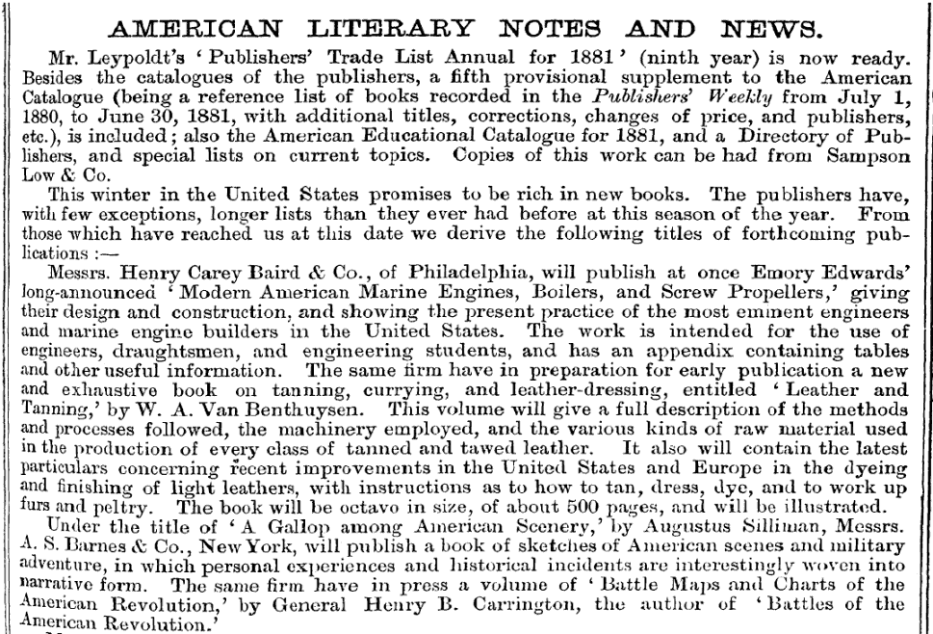

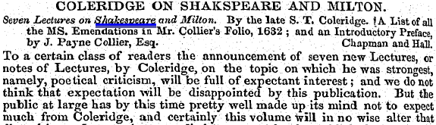
In
Advanced Search
View results as :
Snippets Articles Pages
Tuesday, November 01, 1881
Page 78,
Saturday November 15, 1856
Page 78,
Home About Olive Copyright © 2000 – 2007. Olive Software Inc. All rights Reserved

Slide 23
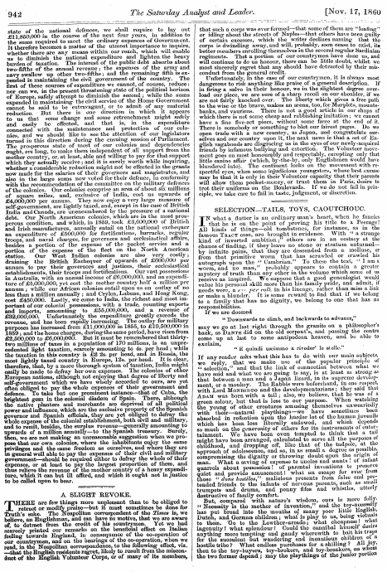
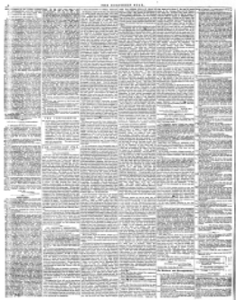
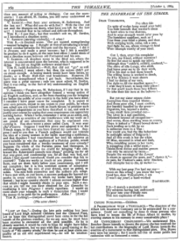
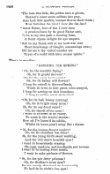
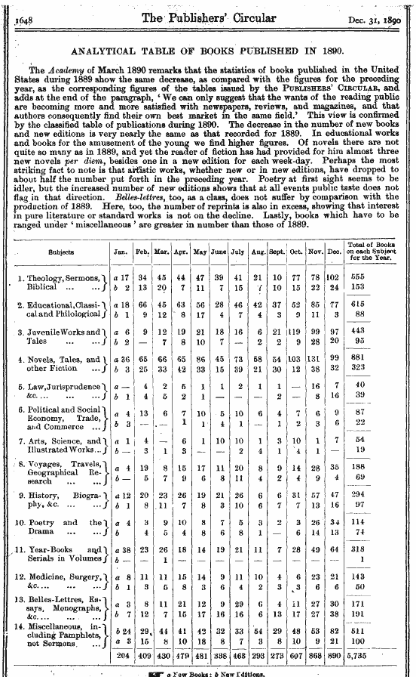
In
Advanced Search
View results as :
Snippets Articles Pages
English Women’s Journal
January 05, 1812
The Tomahawk
March 21, 1834
The Northern Star
December 1846
The Publisher’s Circular
July 04. 1896
Page 435
Page 996
Page 332
Page 675
Home About Olive Copyright © 2000 – 2007. Olive Software Inc. All rights Reserved

Slide 24
books
In
Ads
Quick Search
Advanced Search
Select publication/s:
Meta data search:
The Leader (1850 – 1860)
Northern Star (1800 - 1900)
Tomahawk (1867 - 1870)
Publisher’s Circular (1880 - 1890)
Monthly Repository (1800 - 1900)
English Woman’s Journal (1858 - 1864)
Title:
Subject:
Source:
Search in all publications
Description:
Date Range:
From:
To:
Department Title:
Edition:
Main All
Printer Name:
Printer Location:
Result list style:
Publisher Name:
View results as :
Snippets Articles Pages
Publisher Location:
Sorted by:
Format:
Editor Name:
Home About Olive Copyright © 2000 – 2007. Olive Software Inc. All rights Reserved

Slide 25
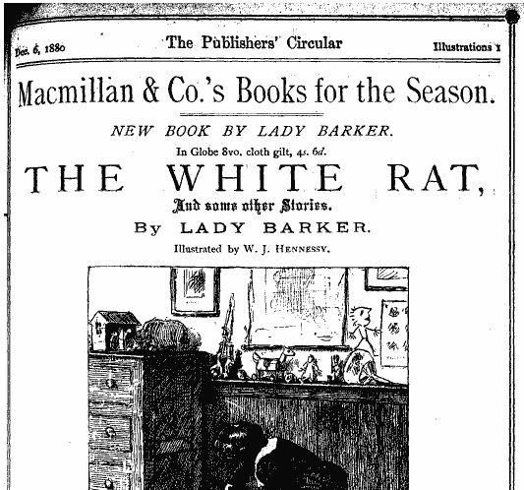

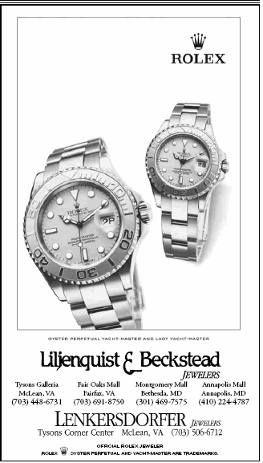

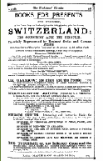
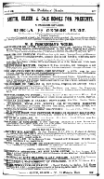
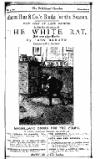
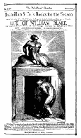





Actions
Zoom Close
In
Ads
Quick Search
View results as :
Snippets Articles Pages
Show full page
Send to…
Print…
Save…
Add to Favorites…
January 2006
January 1881
March 1882
January 2006
Page 20,
Page 20,
Page 78,
Page 20,
Add to Yahoo
my Web…
January 1889
July 1884
November 1885
December 1883
Page 78,
Page 20,
Page 78,
Page 20,
Home About Olive Copyright © 2000 – 2007. Olive Software Inc. All rights Reserved

Slide 26



In
Ads
Quick Search
View results as :
Snippets Articles Pages
November 07, 1881
Page 20,
December 02 1882
Page 78,
Home About Olive Copyright © 2000 – 2007. Olive Software Inc. All rights Reserved

