Slide 1

VP 2.0
Kings College Virtual Library
Application Mockups

Slide 2
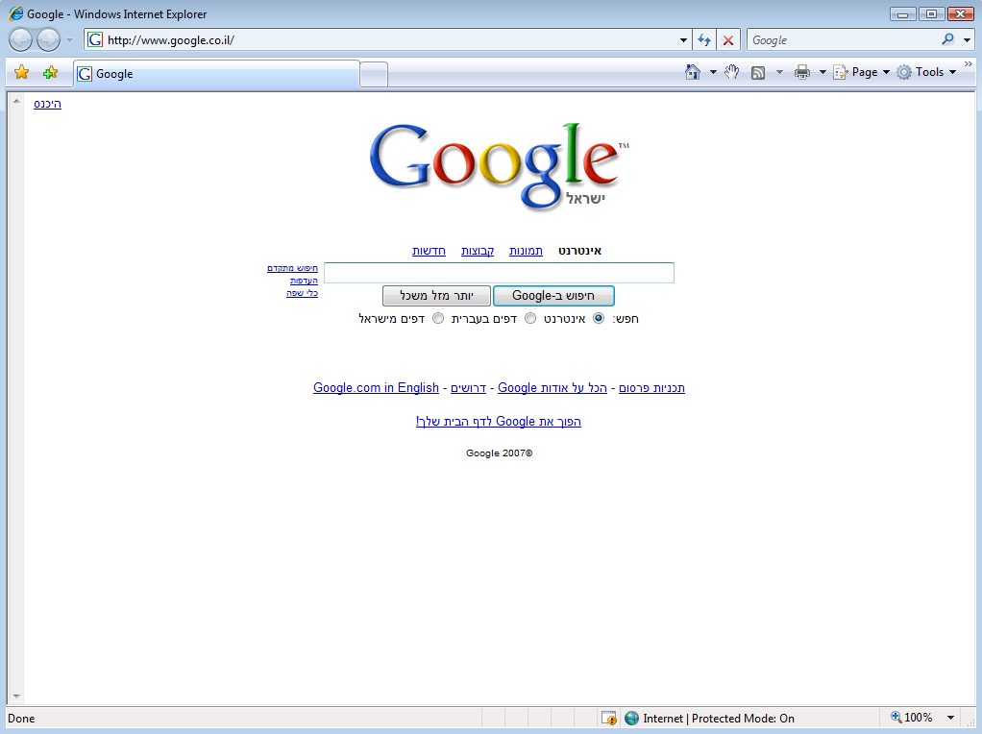






In: All Tables Pictures Ads
In all folders Advanced search MyPublisher
View options: Grid List
10 documents found in folder: Volume 2
The Leader
Volume 1
Volume 2
Northern Star
Tomahawk
Publishers Circular
Monthly Repository
English Woman’s Journal
Einstein: His Life and Universe
by :Walter Isaacson (Author)
Published: Jan, 2006
Added: May, 12, 2007
Versions: None
ISBN: 1579546110
260 pages
Leaving Well
by George Tenet (Author)
Published: Jan, 2005
Added: May, 12, 2007
Versions: None
ISBN: 1579546110
450 pages
At the Center of the Storm: My Years at the CIA
by George Tenet (Author)
Published: Jan, 2004
Added: May, 12, 2007
Versions: None
ISBN: 1579546110
340 pages
Home About Olive Copyright © 2000 – 2007. Olive Software Inc. All rights Reserved

Slide 3








In: All Tables Pictures Ads
In all folders Advanced search MyPublisher
View options: Grid List
10 documents found in folder: Volume 2
The Leader
Volume 1
Volume 2
Northern Star
Tomahawk
Publishers Circular
Monthly Repository
English Woman’s Journal
March, 2007
182 pages
April, 2007
182 pages
May, 2007
182 pages
June, 2007
182 pages
July, 2007
182 pages
August, 2007
182 pages
September, 2007
182 pages
October, 2007
182 pages
November, 2007
182 pages
December, 2007
182 pages
Home About Olive Copyright © 2000 – 2007. Olive Software Inc. All rights Reserved

Slide 4


In: All Tables Pictures Ads
Leather
In all folders Advanced search MyPublisher
Component zoom Page zoom Zoom Actions Full screen
Navigate
Tools
Component zoom Page zoom Zoom Actions Full screen
Front page
Table of components
Page thumbnails
Versions history
Search
Computer Weekly, May 2007
Thoroughly revised and updated, a new edition of the classic health reference furnishes accessible healing remedies for a wide range of illnesses and maladies--ranging from addictions and age spots to weight control--providing doctor-tested, easy-to-follow guidelines and thousands of useful, get-better tips from leading health experts. 25,000 first printing.
By Prevention Health Books, Prevention Magazine
Published 2007 Added: Feb 2007
123 pages
ISBN 1579546110
Editions: 5

Slide 5
Navigate
Tools
Component zoom Page zoom Zoom Actions Full screen
Front page
Table of components
Page thumbnails
Versions history
Search
Computer Weekly, May 2007
Thoroughly revised and updated, a new edition of the classic health reference furnishes accessible healing remedies for a wide range of illnesses and maladies--ranging from addictions and age spots to weight control--providing doctor-tested, easy-to-follow guidelines and thousands of useful, get-better tips from leading health experts. 25,000 first printing.
By Prevention Health Books, Prevention Magazine
Published 2007 Added: Feb 2007
123 pages
ISBN 1579546110
Editions: 5

Slide 6

Navigate
Tools
Component zoom Page zoom Zoom Actions Full screen
Click to zoom in
Home About Olive Copyright © 2000 – 2007. Olive Software Inc. All rights Reserved

Slide 7

Navigate
Tools
Component zoom Page zoom Zoom Actions Full screen
Click to zoom out

Slide 8
Navigate
Tools
Component zoom Page zoom Zoom Actions Full screen

Slide 9
Navigate
Tools
Component zoom Page zoom Zoom Actions Full screen
Click to open article

Slide 10

Navigate
Tools
Component zoom Page zoom Zoom Actions Full screen
Actions
Zoom Close
Continue

Slide 11
Navigate
Tools
Component zoom Page zoom Zoom Actions Full screen
Click to open article
Actions
Zoom Close
Send to…
Print…
Save…
Add to Favorites…
Add to Yahoo
my Web…
Properties…
Continue

Slide 12

Navigate
Tools
Component zoom Page zoom Zoom Actions Full screen
Back
Actions
Text size Close
Send to…
Print…
Save…
Add to Favorites…
Add to Yahoo
my Web…
Properties…
Continue

Slide 13
Navigate
Tools
Component zoom Page zoom Zoom Actions Full screen
Front page
Table of components
Page thumbnails
Versions history
Search
Computer Weekly, May 2007
Thoroughly revised and updated, a new edition of the classic health reference furnishes accessible healing remedies for a wide range of illnesses and maladies--ranging from addictions and age spots to weight control--providing doctor-tested, easy-to-follow guidelines and thousands of useful, get-better tips from leading health experts. 25,000 first printing.
By Prevention Health Books, Prevention Magazine
Published 2007 Added: Feb 2007
123 pages
ISBN 1579546110
Editions: 5
Computer Weekly, May 2007
Home Search About Copyright © 2000 – 2007. Olive Software Inc. All rights Reserved

Slide 14




Navigate
Tools
Component zoom Page zoom Zoom Actions Full screen
Front page
Table of components
Page thumbnails
Versions history
Search
Page 1
Page 2
Page 4
Computer Weekly, May 2007
Home Search About Copyright © 2000 – 2007. Olive Software Inc. All rights Reserved

Slide 15

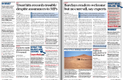


Navigate
Tools
Component zoom Page zoom Zoom Actions Full screen
Front page
Table of components
Page thumbnails
Versions history
Search
1
2
3
4
5
6
7
8
9
10
11
Computer Weekly, May 2007
Home Search About Copyright © 2000 – 2007. Olive Software Inc. All rights Reserved

Slide 16
Navigate
Tools
Component zoom Page zoom Zoom Actions Full screen
Front page
Table of components
Page thumbnails
Versions history
Search
Main
1
2
3
4
Computer Weekly, May 2007
Home Search About Copyright © 2000 – 2007. Olive Software Inc. All rights Reserved

Slide 17

Navigate
Tools
Component zoom Page zoom Zoom Actions Full screen
Front page
Table of components
Page thumbnails
Versions history
Tesco
Search
In Main edition All
100% | 4 hits | Page 6 | main edition
80% | 4 hits | Page 4 | 2nd edition
80% | 4 hits | Page 4 | 3rd edition
80% | 4 hits | Page 4 | 2nd edition
Computer Weekly, May 2007
Home Search About Copyright © 2000 – 2007. Olive Software Inc. All rights Reserved

Slide 18
In: All Tables Pictures Ads
In all folders Advanced search MyPublisher
Search
View options: Grid List
10 documents found in folder: Volume 2
The Leader
Volume 1
Volume 2
Northern Star
Tomahawk
Publishers Circular
Monthly Repository
English Woman’s Journal
March, 2007
182 pages
April, 2007
182 pages
May, 2007
182 pages
June, 2007
182 pages
July, 2007
182 pages
August, 2007
182 pages
September, 2007
182 pages
October, 2007
182 pages
November, 2007
182 pages
December, 2007
182 pages
Home About Olive Copyright © 2000 – 2007. Olive Software Inc. All rights Reserved

Slide 19
In: All Tables Pictures Ads
In all folders Advanced search MyPublisher
Advanced Search
The Leader
Volume 1
Volume 2
Northern Star
Tomahawk
Publishers Circular
Monthly Repository
English Woman’s Journal
Search text :
tesco
Publication:
The Leader
Northern Star
Tomahawk
Publisher’s Circular
Monthly Repository
English Woman’s Journal
Date Range:
From:
To:
Search for : All Articles Tables Pictures Ads
Edition:
All
Sort by:
View results as :
Snippets Pages
Home About Olive Copyright © 2000 – 2007. Olive Software Inc. All rights Reserved

Slide 20



In: All Tables Pictures Ads
Tesco
In all folders Advanced search MyPublisher
3 items found
Results View: Professional Detailed Quick
Paper name| Volume | date | 560 words | 100 %
Select
…Tesco is standardizing its business processes and IT systems to support plans for global expansion…
View Cover
View Page 50
Paper name| Volume | date | 560 words | 100 %
…Tesco has given MPs on the Public Accounts Committee an assurance that problems following a troubled…
Select
Paper name| Volume | date | 560 words | 100 %
View Cover
View Page 32
Select
…Tesco online banking customers has been welcomed for raising security awareness among consumers, but it may…
View Cover
View Page 50
Home About Olive Copyright © 2000 – 2007. Olive Software Inc. All rights Reserved

Slide 21
In: All Tables Pictures Ads
Tesco
In all folders Advanced search MyPublisher
3 items found
Actions
Results View: Professional Detailed Quick
Text size Close
Paper name| Volume | date | 560 words | 100 %
Select
Send to…
…Tesco is standardizing its business processes and IT systems to support plans for global expansion…
Print…
View Cover
View Page 50
Save…
Paper name| Volume | date | 560 words | 100 %
Add to Favorites…
Add to Yahoo
my Web…
Select
…Tesco has given MPs on the Public Accounts Committee an assurance that problems following a troubled…
Properties
View Cover
View Page 32
Paper name| Volume | date | 560 words | 100 %
Select
…Tesco online banking customers has been welcomed for raising security awareness among consumers, but it may…
View Cover
View Page 50
Home About Olive Copyright © 2000 – 2007. Olive Software Inc. All rights Reserved

Slide 22
Back
In: All Tables Pictures Ads
Tesco
Actions
In all folders Advanced search MyPublisher
Text size Close
3 items found
Results View: Professional Detailed Quick
Paper name| Volume | date
Send to…
Select
Print…
100 % | 4 hits| 560 words
Save…
View Cover
View Page 50
Add to Favorites…
Paper name| Volume | date
Add to Yahoo
my Web…
Metadata:
By Prevention Health Books, Prevention Magazine
Published May 2007 CW
Computer Weekly, Read business
672 words
ISBN 1579546110
Select
100 % | 4 hits| 560 words
Properties
View Cover
View Page 32
Paper name| Volume | date
Select
100 % | 4 hits| 560 words
View Cover
View Page 50
Home About Olive Copyright © 2000 – 2007. Olive Software Inc. All rights Reserved

Slide 23
In: All Tables Pictures Ads
Ad/pictures Search
In all folders Advanced search MyPublisher
View options: Grid List
10 documents found in folder: Volume 2
The Leader
Volume 1
Volume 2
Northern Star
Tomahawk
Publishers Circular
Monthly Repository
English Woman’s Journal
March, 2007
182 pages
April, 2007
182 pages
May, 2007
182 pages
June, 2007
182 pages
July, 2007
182 pages
August, 2007
182 pages
September, 2007
182 pages
October, 2007
182 pages
November, 2007
182 pages
December, 2007
182 pages
Home About Olive Copyright © 2000 – 2007. Olive Software Inc. All rights Reserved

Slide 24
In: All Tables Pictures Ads
In all folders Advanced search MyPublisher
Advanced Search
The Leader
Volume 1
Volume 2
Northern Star
Tomahawk
Publishers Circular
Monthly Repository
English Woman’s Journal
Search text :
Allergy
Publication:
The Leader
Northern Star
Tomahawk
Publisher’s Circular
Monthly Repository
English Woman’s Journal
Date:
From:
To:
Search for : All Articles Tables Pictures Ads
Edition:
All
Sort by:
View results as :
Snippets Pages
Home About Olive Copyright © 2000 – 2007. Olive Software Inc. All rights Reserved

Slide 25







In: All Tables Pictures Ads
Allergy
In all folders Advanced search MyPublisher
Actions
Results View: Thumbnails Pages
Zoom Close
Show full page
Send to…
Print…
Save…
January 2006
January 2006
January 2006
January 2006
Add to Favorites…
Page 20,
Page 20,
Page 78,
Page 20,
Add to Yahoo
my Web…
Properties…
January 2006
January 2006
January 2006
January 2006
Page 78,
Page 20,
Page 78,
Page 20,
Home About Olive Copyright © 2000 – 2007. Olive Software Inc. All rights Reserved

Slide 26
In: All Tables Pictures Ads
Allergy
In all folders Advanced search MyPublisher
Results View: Thumbnails Pages
Newspaper 1
January 2006
Newspaper 1
January 2006
Newspaper 1
January 2006
Newspaper 1
January 2006
Newspaper 1
January 2006
Newspaper 1
January 2006
Page 20,
Page 20,
Page 20,
Page 20,
Page 20,
Page 20,
Newspaper 1
January 2006
Newspaper 1
January 2006
Newspaper 1
January 2006
Newspaper 1
January 2006
Newspaper 1
January 2006
Newspaper 1
January 2006
Page 20,
Page 12,
Page 30,
Page 14,
Page 34,
Page 79,
Home About Olive Copyright © 2000 – 2007. Olive Software Inc. All rights Reserved

