Slide 1
Architectural Overview:
Editorial Database
RDBMS
structured content
(web data entry, RDBMS datatypes)‏
Interpretive Layer
(authority lists: people,
events, places)‏
Metadata
(about the material:
archival, authorial,
technical)‏
Preservation/XML derivatives (e.g. EAD, TEI, METS,MODS, RDF/OWL
Diplomatic Features
mixed content (XML data entry, RDBMS blob)‏
Text
Interface with publication framework (e.g. cocoon; odbc, http, ??)‏

Slide 2
Type
Parent
Number
Architectural Overview:
Components of an XML Record
Record
collates
Text
is one of
Transcription
(required)‏
Translation
(optional)‏
References
(optional)‏

Slide 3

Architectural Overview:
XML Schema, Root Element

Slide 4
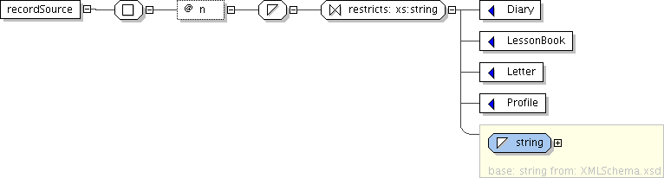
Architectural Overview:
XMLSchema,RecordSource Element

Slide 5
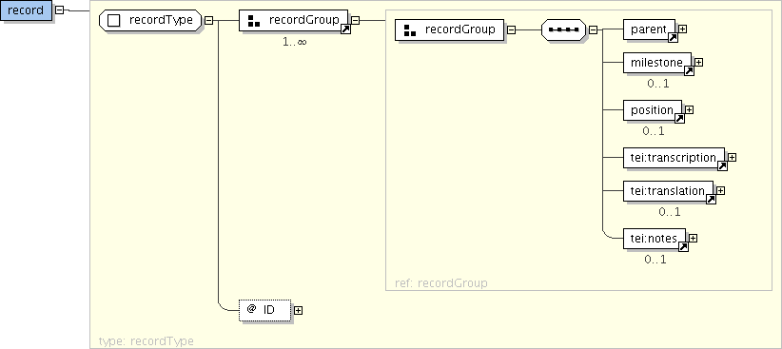
Architectural Overview:
XML Schema: Record Element

Slide 6
Architectural Overview:
Record Workflow
Edit Record
(XML)‏
Store in
Subversion
Process XML
Records
Relational
record exists?
Edit Metadata
(DB)‏
Create DB
Record
NO
YES
Update DB
Record

