Slide 1








Schenker Documents Online: A Critical Virtual Edition
RMA Horizons, Friday 15 July 2011.
Ian Bent, William Drabkin,
David Bretherton, Paul Caton.

Slide 2
Overview
Introductory Remarks
Content Creation
Content Presentation

Slide 3
I. Introductory remarks
Professor William Drabkin
Music, University of Southampton
Principal Investigator

Slide 4
II. Content Creation
Dr David Bretherton
Music, University of Southampton
Postdoctoral Research Fellow
Notes:
Not going to speak about Schenker per se, but about the practical and technical concerns of the Schenker Documents Online framework.

Slide 5
Content Creation
Workflow
Metadata
Encoding

Slide 6
Workflow

Slide 7
Workflow Diagram
Ian Bent
David Bretherton
Geoffrey Chew
Marko Deisinger
William Drabkin
Heribert Esser
Martin Eybl
Sigrun Heinzelmann
Christoph Hust
Timothy L. Jackson
Iby Jolande-Varga
Kevin Karnes
John Koslovsky
Robert Kosovsky
Nicholas Marston
Transcribers
Lots
William Pastille
John Rothgeb
Lee Rothfarb
Michaela Searfoorce
Hedi Siegel
Robert Wason
Arnold Whittall
Translators
Editors
Handful
Encoders
Handful
Website

Slide 8

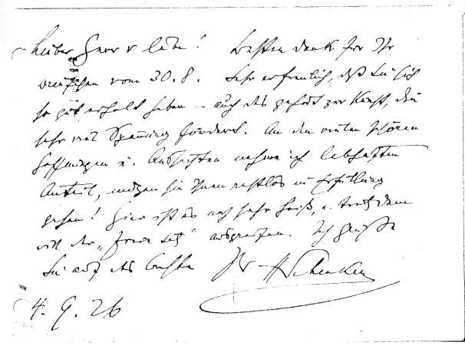

Ensuring Fidelity
Comprehensive editorial guidelines covering things from to
Transcribers
Know
German & Schenker
Have
Equals
Quality Functionality Future proof
Translators
Editors
Encoders
Notes:
Add scan of document and medallion image.

Slide 9
Metadata

Slide 10
SDO Metadata
For SDO, we manage metadata (information about rather than intrinsic to the documents) using our Metadata Interface.
We store metadata pertaining to:
catalogue IDs
format
provenance
licence
copyright

Slide 11
SDO Metadata
Q: Why not keep metadata within the actual data file?
A1: Managing it separately allows us to quickly access and edit the it without having to open up the 1000s of separate xml files that contain the encoded documents.
A2: It allows us the flexibility to manage metadata at either the document, container, collection, or repository (library/ archive) level (metadata is inherited).

Slide 12
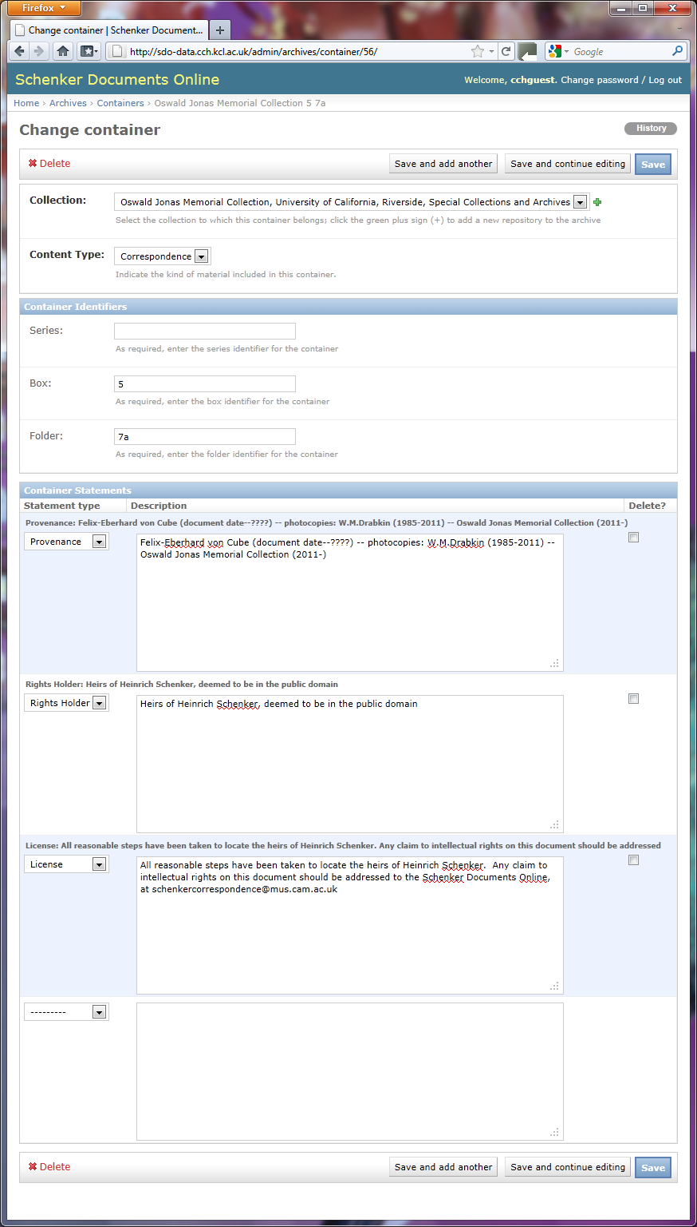
Container Level Control

Slide 14
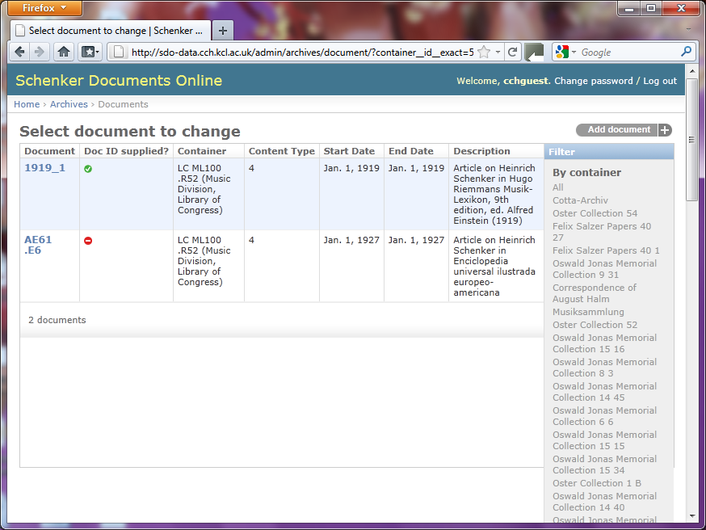
Document Level Control

Slide 15
Encoding

Slide 16
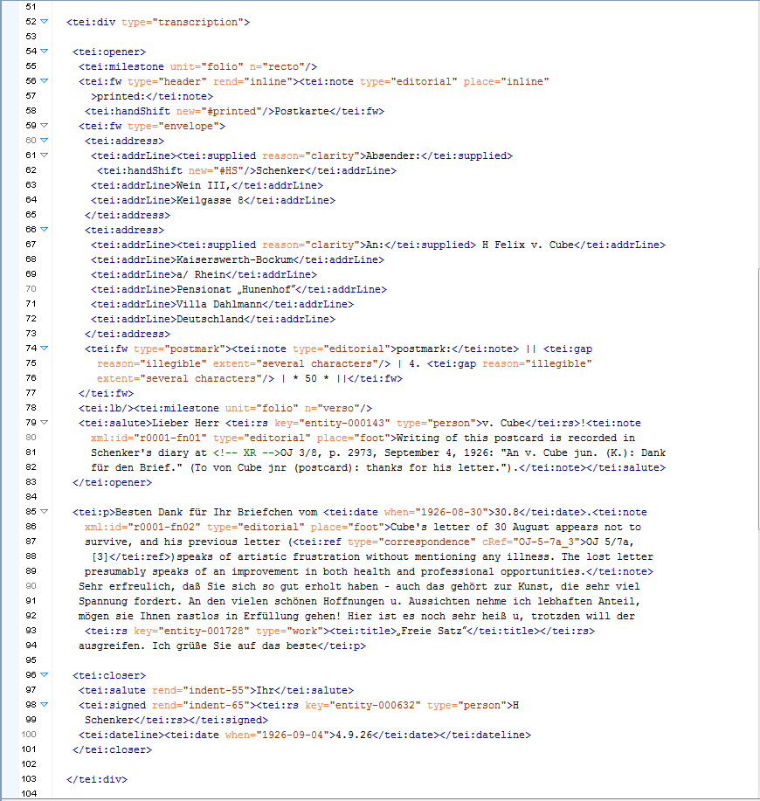
Notes:
Red: describing the physical aspects of the document.
Yellow: describing content type

Slide 17
Notes:
Yellow: describing content type

Slide 18
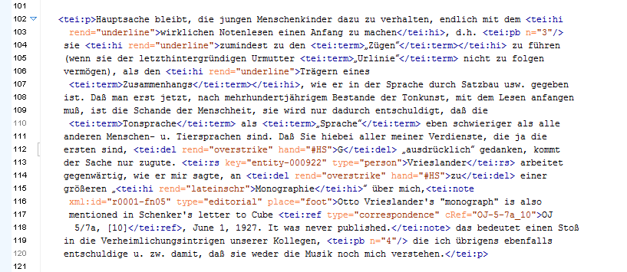
Notes:
Purple: typographic features

Slide 19
Notes:
Green: editorial comments

Slide 20
Notes:
Green: editorial
Blue: attaching semantic information

Slide 21
Notes:
Blue: attaching semantic information
Pink:

Slide 23
III. Content presentation
Dr Paul Caton
Digital Humanities, King’s College London
Research Associate

Slide 24
XML files of primary docs
XML profile files
Web application
Metadata framework
Solr index
EATS entity records

Slide 25
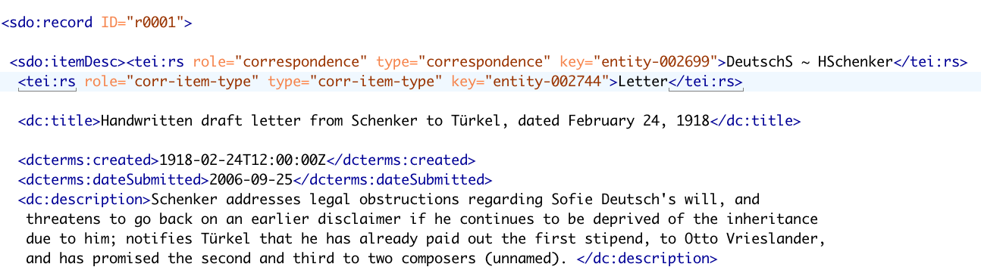
Encoding associates information in files with entity records:
values of “key” attribute are the names of entity records

Slide 26
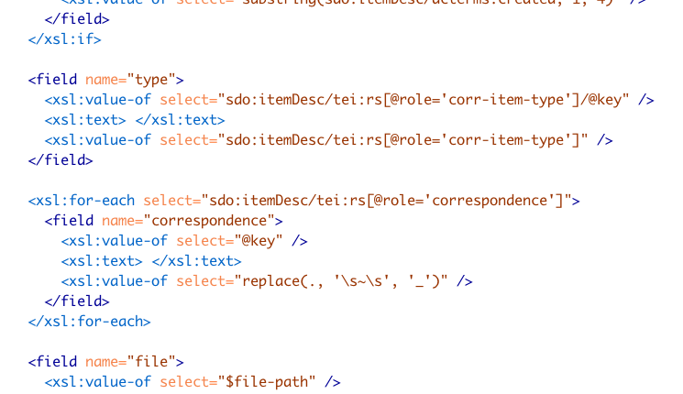
Defining fields for Solr index:
key values included in Solr index, linking documents with relevant entity records

Slide 27
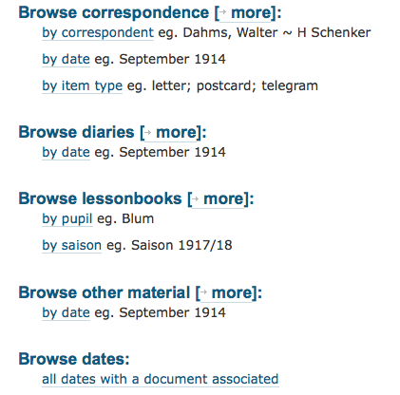
Current SDO browsing options:
pathways enabled by Solr index

Slide 28
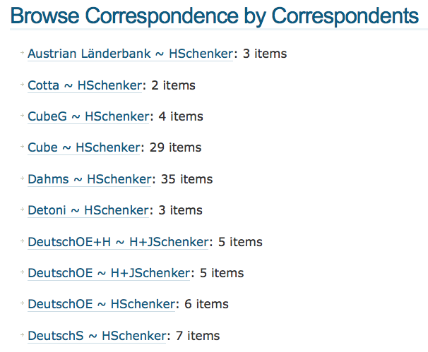
everything drawn from the Solr index

Slide 29
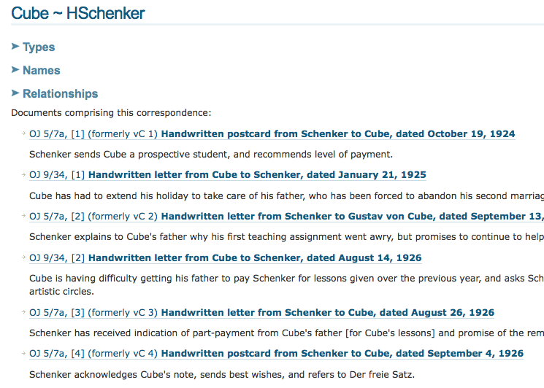
This summary list drawn from the Solr index and the record for the Cube ~ HSchenker correspondence entity

Slide 30
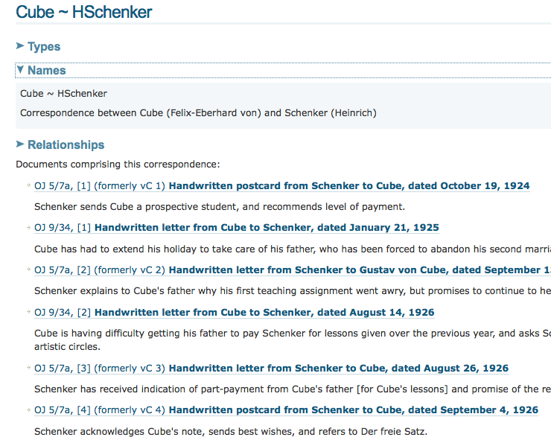
Types, Names, and Relationships come from the entity record

Slide 31
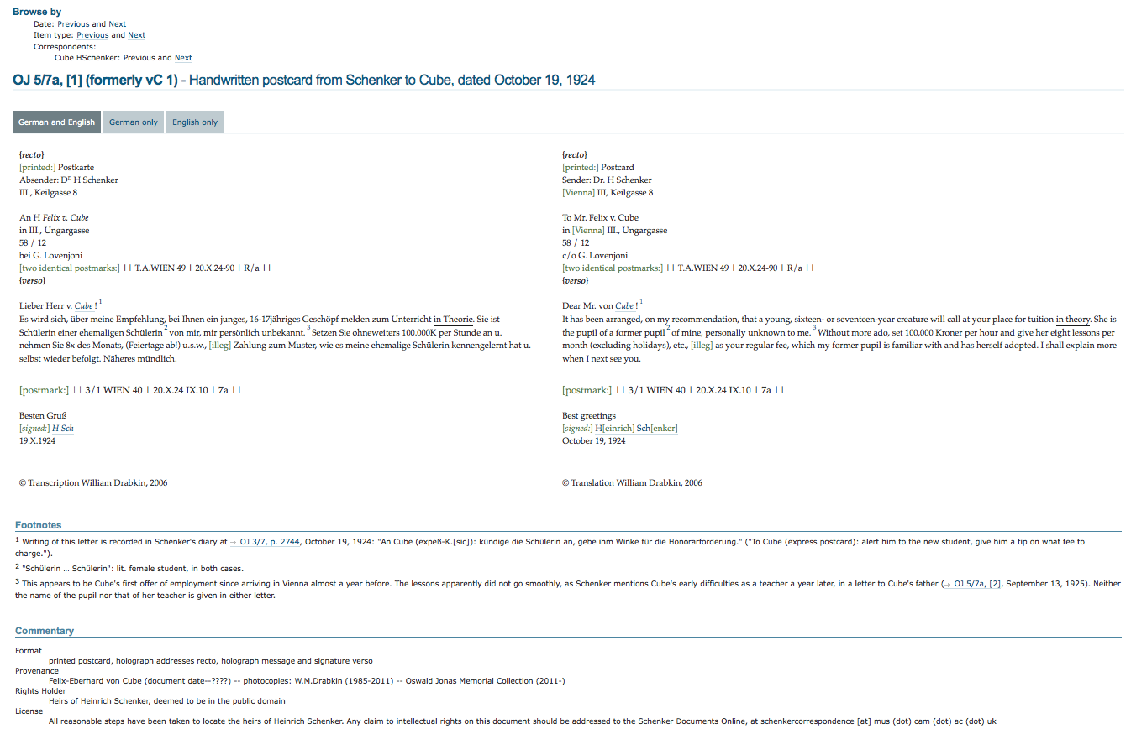
Default item display
Browse options
Text of the document
Editorial footnotes
Metadata

Slide 32
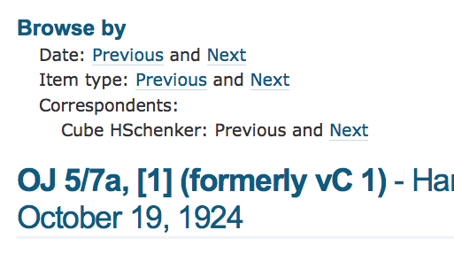
Browse options
all “Previous” and “Next” links enabled by the Solr index

Slide 33
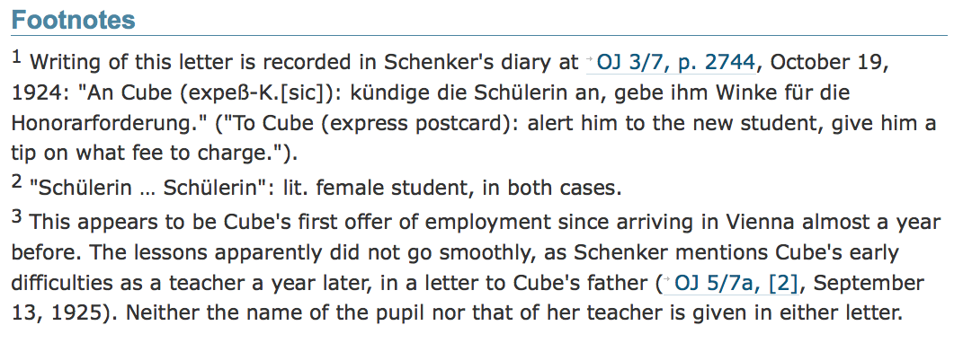
Editorial footnotes
cross-reference links

Slide 34
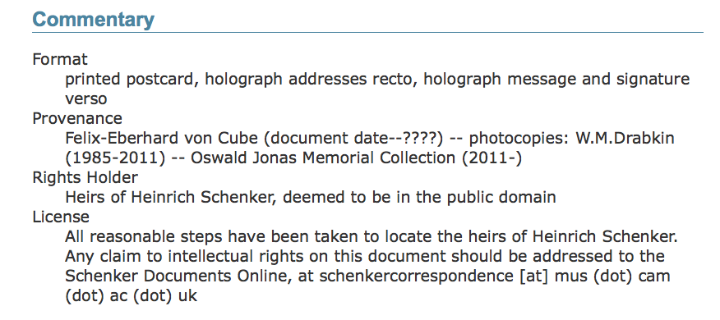
Metadata
All this information drawn from the Metadata Framework

Slide 35
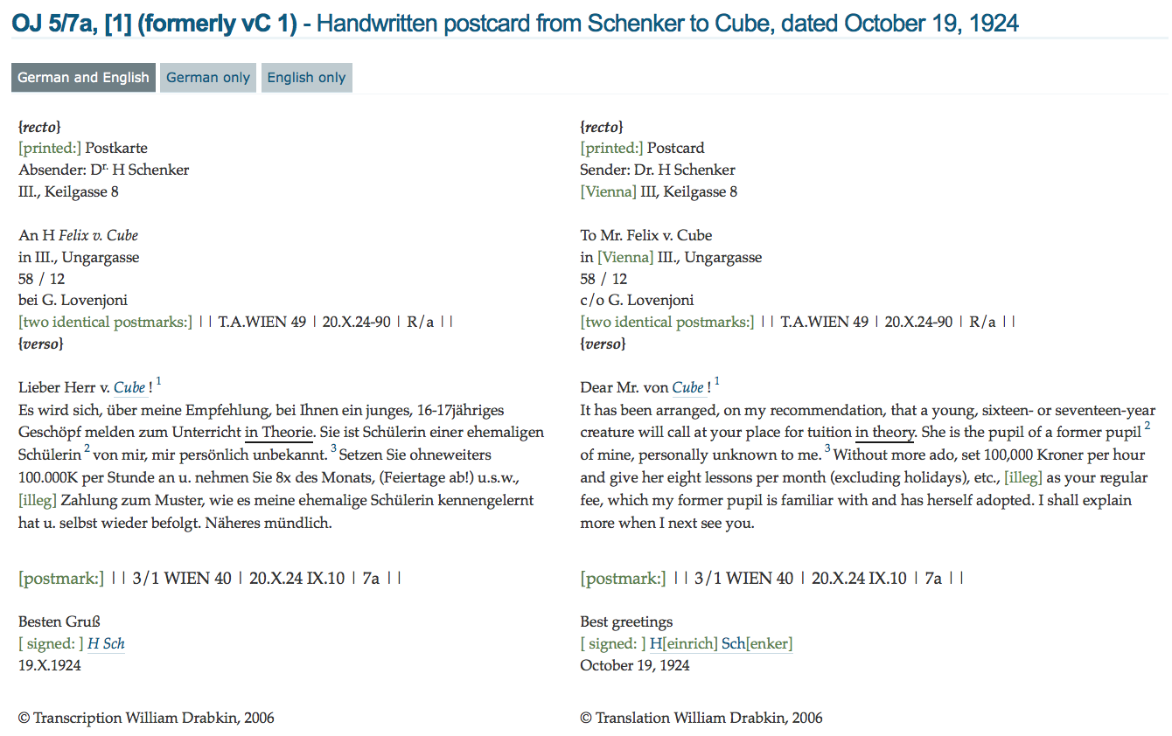
Text of the document
footnote links
entity record links

Slide 36
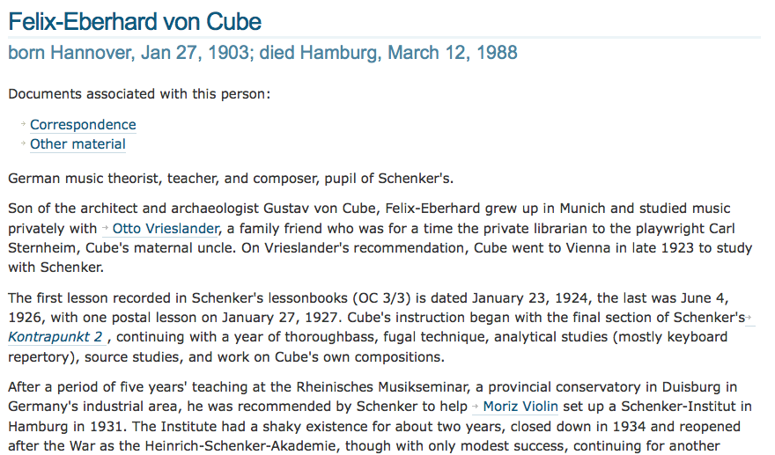
Profile / entity display:
entity record links

Slide 37
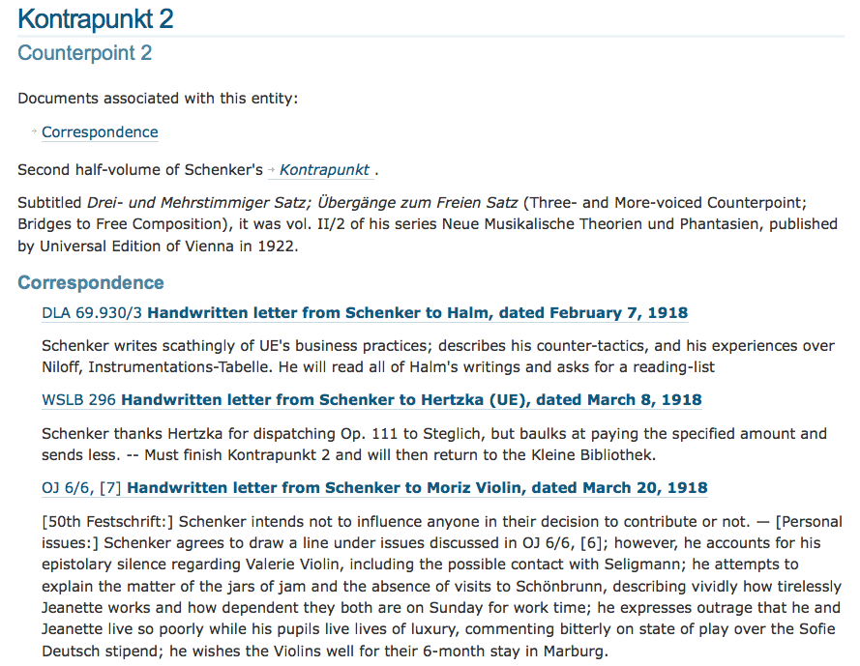
Secondary material can lead back to primary:

Slide 38
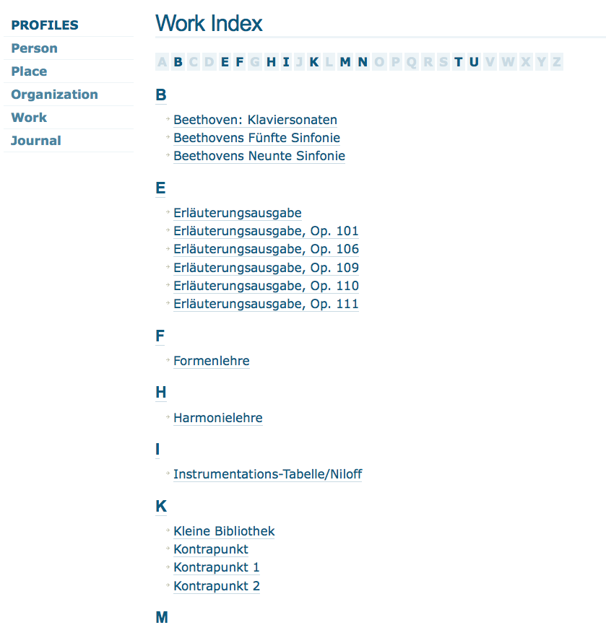
“Profiles” offer direct access to important contextual material

Slide 39
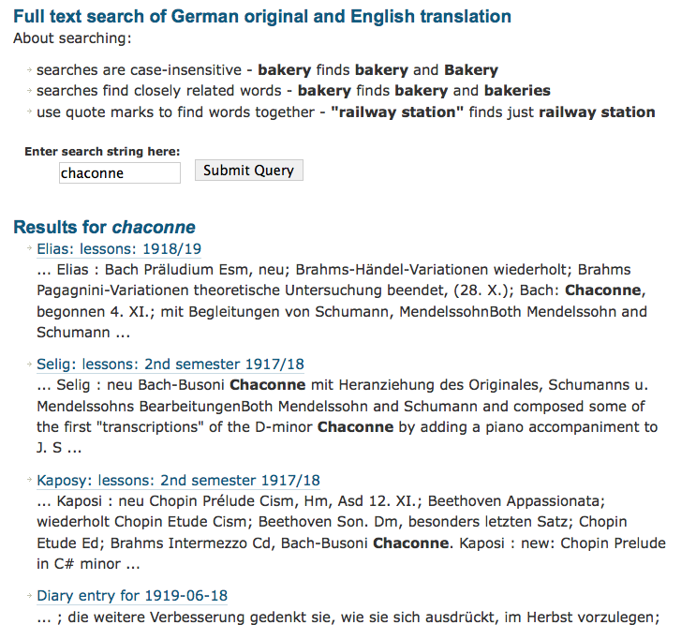
Searching is another access pathway

Slide 40
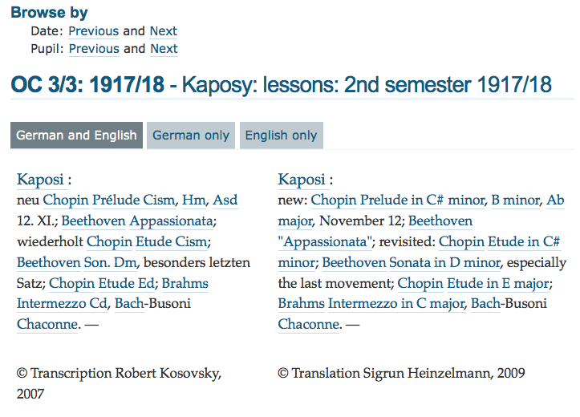
entity record link for “Chaconne”

Slide 41
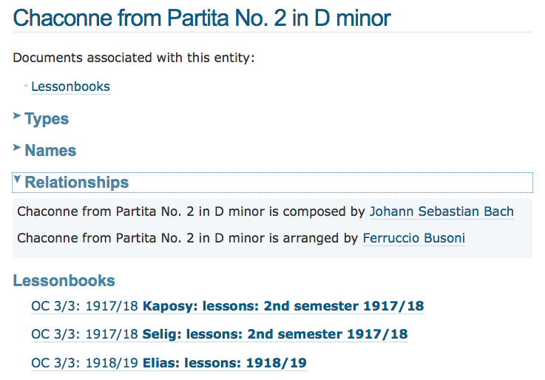
Pseudo-profile for “Chaconne”, created from EATS entity record:
relationships this entity has with other entities

Slide 42
Entity
record
Entity
record
Entity
record
Document content
Entity
record
Entity
record
Entity
record

Slide 43
Entity
record
Entity
record
Entity
record
Project A set of documents
Project B set of documents

Slide 44

www.schenkerdocumentsonline.org

