Slide 1

XML Training
Part 2: TEI Overview
CCH XML team, 2007

Slide 2
Summary
Introduction to the TEI
Components of the TEI
TEI Workflow

Slide 3
TEI Facts and Figures
Stands for the Text Encoding Initiative
Mark-up scheme for texts, began as SGML, now expressed in XML
Consortium managed
Community maintained
Contains over 400 elements!

Slide 4
The Buzz about the TEI
Rigorous
  Comprehensive schema and guidelines for use
Flexible
  400 hundred elements, combinable in many ways
Extensible
  Can include 'pieces' of other markup languages, invented markup, or customisation to existing elements
Standards-based, Community-oriented
  P5 released in November 2007, consortium developed; large community of active adopters: scholars, technologists and researchers
Notes:
The EpiDoc Collaborative for Epigraphic Documents in TEI XML

Slide 5
Uses of the TEI
Text creation and data capture
Interchange of data
Growing the digital text library
Preservation
Notes:
FROM HS

Slide 6
The TEI Consortium
Web site
  www.tei-c.org
  Reference and training materials
Email list for general queries

Slide 7
Components of the TEI
Modules
Model Classes
Document Analysis
Workflow
Notes:
The EpiDoc Collaborative for Epigraphic Documents in TEI XML

Slide 8
The TEI at the CCH
General
  CCH guidelines for web publication
Project-specific
  models developed individually for scholarly materials
Notes:
FROM HS

Slide 9
TEI Modules
“a convenient way of grouping together .... associated element declarations”
(1 The TEI Infrastructure, 1.1 TEI Modules)
core – elements available in all documents
tei – infrastructural
header – common metadata
drama – performance texts
verse - verse
dictionaries – print dictionaries
manuscript description – specialized metadata

Slide 10
TEI Model Classes
“the class system thus provides a way of reducing the whole TEI galaxy of elements into a tidy hierarchy”
(1 The TEI Infrastructure, 1.3.2 Model Classes)
divisions
  high level, possibly self-nesting, major divisions of texts.
chunks
elements such as paragraphs and other paragraph-level elements, which can appear directly within texts or within such divisions, but not within other chunks.
phrase-level elements
elements such as highlighted phrases, book titles, or editorial corrections which can occur only within chunks (paragraphs or paragraph-level elements), but not between them (and thus cannot appear directly within a division)

Slide 11
TEI Divisions
TEI
teiHeader
text

Slide 12
TEI Divisions
TEI
teiHeader
fileDesc
encodingDesc
profileDesc
revisionDesc

Slide 13
<teiHeader>
<fileDesc>
<titleStmt>
<title>XML training test</title>
<author>Author's name</author>
</titleStmt>
<publicationStmt>
<distributor>Centre for Computing in the Humanities</distributor>
<address> <addrLine>Strand, London WC2R 2LS</addrLine> </address>
</publicationStmt>
<sourceDesc>
<p>No source: created in electronic format</p>
</sourceDesc>
</fileDesc>
<revisionDesc>
<change>
<date>2007-05-10</date>
<respStmt> <name>PS</name> </respStmt>
</change>
</revisionDesc>
</teiHeader>

Slide 14
TEI Divisions
TEI
teiHeader
text
front
body
back

Slide 15
<front>
<div type="dedication">
<p>To our three selves</p>
</div>
<div type="preface">
<head>Author's Note</head>
<p>All the characters in this book are purely imaginary, and if the
author has used names that may suggest a reference to living persons
she has done so inadvertently.
...</p>
</div>
</front>

Slide 16
Divisions to Chunks
TEI
teiHeader
text
body
div
head
p

Slide 17
<body>
<div type="part">
<head>Fallacies of Authority</head>
<p>The subject of which is Authority in various shapes, and the object, to repress
all exercise of the reasoning faculty.</p>
<div n="1" type="chapter">
<head>The Nature of Authority</head>
<p>With reference to any proposed measures having for their object the
greatest happiness of the greatest number....</p>
<div n="1.1" type="section">
<head>Analysis of Authority</head>
<p>What on any given occasion is the legitimate weight or influence to be
attached to authority ... </p>
</div>
<!-- end of section 1.1 -->
<div n="1.2" type="section">
<head>Appeal to Authority, in What Cases Fallacious.</head>
<p>Reference to authority is open to the charge of fallacy when... </p>
</div>
<!-- end of section 1.2 -->
<!-- other sections here -->
</div>
<!-- end of chapter 1 -->
<!-- other chapters here -->
</div>
<!-- end of part A -->
<!-- other parts here -->
</body>

Slide 18
TEI Chunks
Paragraphs <p>
Lists <list>
Tables <table>
Addresses
Blockquotes

Slide 19
Paragraphs
<p>Some text</p>

Slide 20
Lists
<list type=“ordered”>
<item>Apples</item>
<item>Oranges</item>
<item>Lemons</item>
</list>

Slide 21
Lists
<list type=“bulleted”>
<item>Apples</item>
<item>Oranges</item>
<item>Lemons</item>
</list>

Slide 22
Tables
<table>
<row>
<cell>Name</cell>
<cell>Lucia</cell>
</row>
</table>
Name
Lucia

Slide 23
Tables
<table>
<row>
<cell role=“label”>Name</cell>
<cell role=“label”>Country</cell>
</row>
<row>
<cell role=“data”>Lucia</cell>
<cell role=“data”>Spain</cell>
</row>
</table>
Name
Country
Lucia
Spain

Slide 24
Phrase-level elements
Links
Images
Footnotes
Formatting
Meaningful Alternatives

Slide 25
Links
<xref type=“external”
url=“http://www.google.com”>
Google
</xref>
<xref type=“email”
url=“cch@kcl.ac.uk”>
Email CCH
</xref>

Slide 26
Images
<p>
<figure url=“a004”>
</figure>
</p>
NO CONTENT

Slide 27
Images
<p>
<figure url=“a004”>
</figure>
</p>
NO CONTENT
Lookup table

Slide 28
Footnotes
…in his book about the Aztecs,<note>Leon-Portilla, (1978)</note> he spoke about …

Slide 29
Formatting
… he said he was
<hi rend=“bold”>very</hi> annoyed …
… he said he was
<hi rend=“italic”>very</hi> annoyed …

Slide 30
Meaningful Alternatives
the theory of the humours is above all a <emph>physiological</emph> account
<foreign>mens sana in corpore sano</foreign>, a sound mind requires a healthy body.
Barry Ife. <title>Was the Novel a Spanish Invention?. </title> Canning House, 2002

Slide 31
.
the theory of the humours is
above all a physiological account
mens sana in corpore sano,
a sound mind requires a healthy body.
Barry Ife. Was the Novel a Spanish
Invention?. Canning House, 2002.

Slide 32
XML Workflow

HTML



FO
PDF
TEI

TXT
XSLT

Slide 33
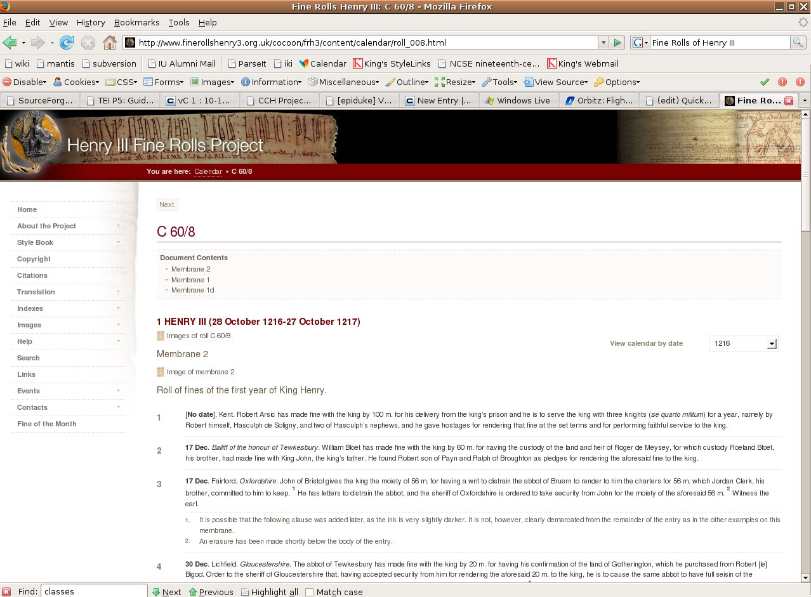
Heading
Bullet
Notes:
The Early Americas Digital Archive (EADA) is a collection of electronic texts and links to texts originally written in or about the Americas from 1492 to approximately 1820

Slide 34
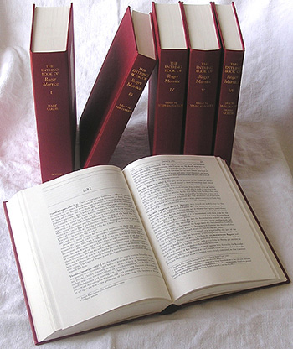
Calendar of Fine Rolls
of the Reign of Henry III [1216-1248]
616 pages ISBN: 1843833379
Hardback: 20/Sep/2007
Boydell & Brewer: http://www.boydell.co.uk/43833379.HTM
Notes:
Digital Archive of Letters in Flanders

Slide 35
Customised for the Schenker Documents Online project training,
given 27 November, 2007
CCH, Kay House

