Slide 1

XML Training
Part 1: XML Overview
CCH XML team, 2007

Slide 2
Summary
Markup
XML
  Defined
  Mechanics
  Workflow
Conclusion

Slide 3
Markup languages
Markup before computers
Computerised markup
  different languages (HTML, TACT …)
  different objectives
  variety of syntax

Slide 4
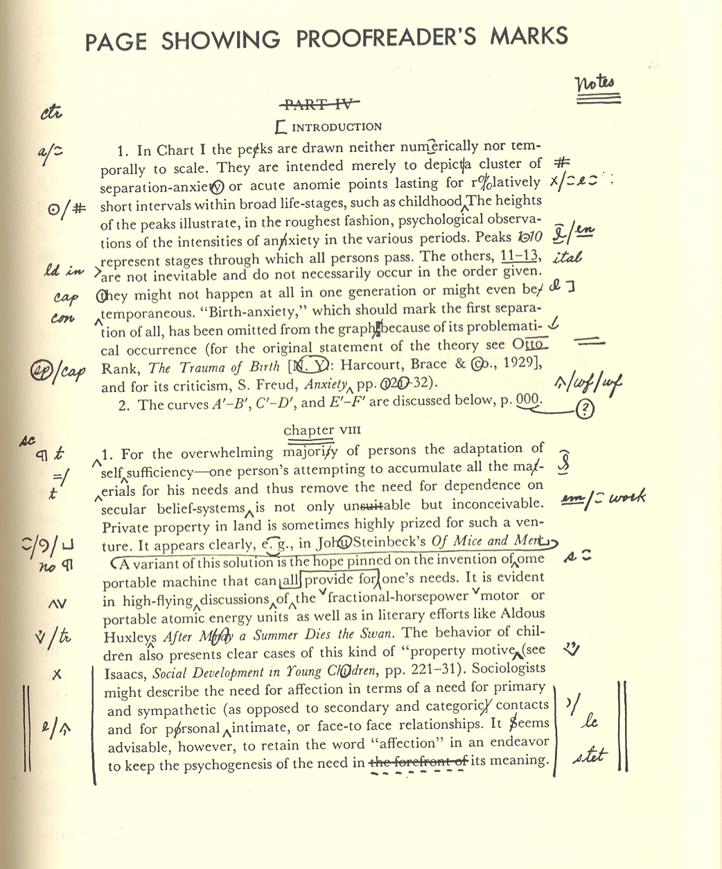
BETTER EXAMPLE OF PRE-COMPUTERS MARKUP??

Slide 5
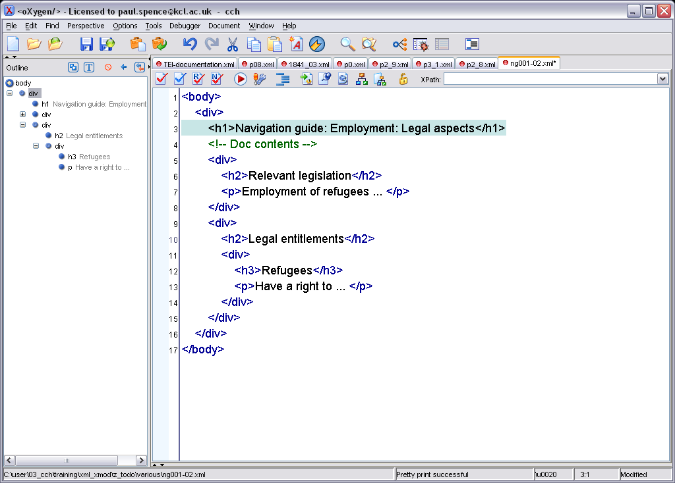
Heading
Bullet

Slide 6
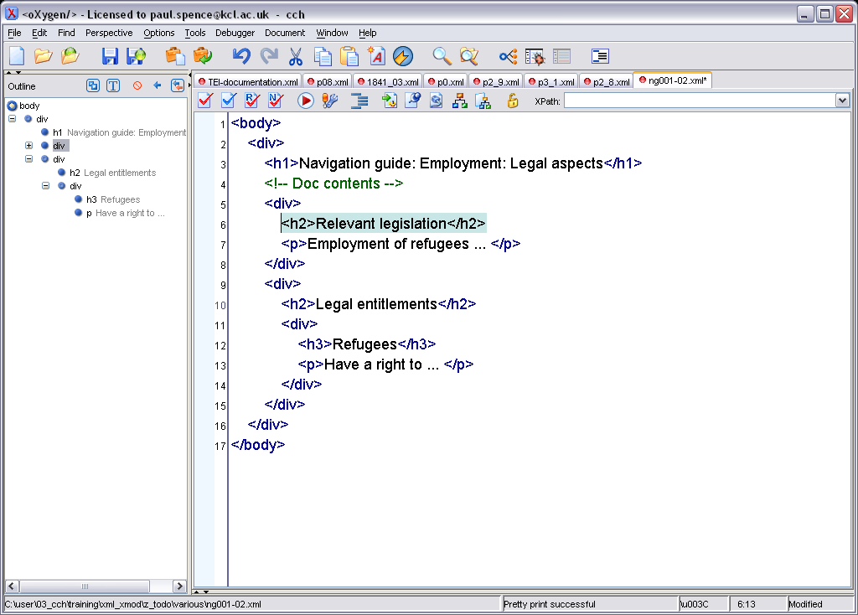
Heading
Bullet

Slide 7
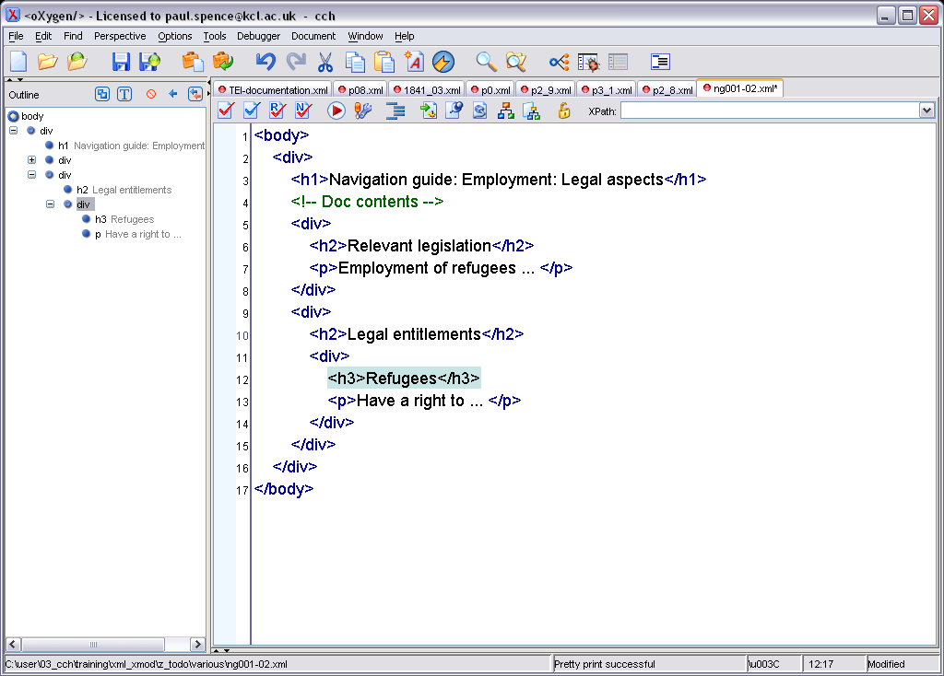
Heading
Bullet

Slide 8
SGML (Standard Generalised Markup Language) – ISO 8879:1986

Slide 9
Elements
Primary data structure within languages based on SGML
Contain anything that can be viewed as a structural component of a text
“Structure” can be: a paragraph, a section but also a word or a single character or even the space between two words

Slide 10
Elements are delimited by tags and enclose content
<element>content</element>
start-tag
end-tag

Slide 11
In SGML-based languages relations among elements are:
  Hierarchical
  Ordinal
Relations among elements can be described as family relations (parents, ancestor, children, siblings…)

Slide 12
Nesting of elements:
<parent>
<child>Some text</child>
</parent>

Slide 13
Overlapping Not Permitted
<parent>
<child>Some text</parent>
</child>

Slide 14
Case is Meaningful
<Parent>
<child>Some text</CHILD>
</parent>

Slide 15
.
the theory of the humours is
above all a physiological account
mens sana in corpore sano,
a sound mind requires a healthy body.
Barry Ife. Was the Novel a Spanish
Invention?. Canning House, 2002.

Slide 16
What is XML?
An international standard for the exchange of data
A ‘meta-language’- a language for describing other languages
Describes what something means in a given context

Slide 17
Separation of content and formatting
Marked-up source content is independent of the way it is rendered
Formatting applied later in separate process (itself often XML-based)

Slide 18
XML Workflow

HTML



FO
PDF
TEI

TXT
XSLT

Slide 19
Mechanics of XML
Elements
Attributes
Entities
Grammar
Encoding

Slide 20
The content of an element can be:
1. text
<para>Some text</para>

Slide 21
2. Elements
  <table>
  <row>
  <cell></cell>
  <cell></cell>
  </row>
  </table>
hierarchical
ordinal

Slide 22
3. Elements and text
<bibl>
<author>C. Collodi</author>
<title>Le avventure di Pinocchio</title>
p. 23-34
</bibl>

Slide 23
Mechanics of XML
Elements
Attributes
Entities
Schema
Encoding

Slide 24
Attributes
categorize
modify
label or count
Make explicit what is implicit

Slide 25
Attributes
<person type=“author” name=“Mendoza, Eduardo”>
E. Mendoza
</person>
<person type=“author” name=“Mendoza, Eduardo”>
the author of ‘La ciudad de los prodigios’
</person>

Slide 26
Mechanics of XML
Elements
Attributes
Entities
Schema
Encoding

Slide 27
Entities
&cch;
Centre for Computing in the Humanities
&eacute;
Roueché

Slide 28
Schema
 ⬅   
XML files ‘DTD’
‘RelaxNG’
‘W3C Schema’

Slide 29
Schema
Vocabulary and grammar of a specific XML language
Defines which elements, attributes and entities are allowed in a specific XML document
Defines how to use elements and attributes (required, optional, repeatable, types…)

Slide 30
Mechanics of XML
Elements
Attributes
Entities
Schema
Encoding

Slide 31
Encoding
Unicode:
  provides a unique Number for every character, no matter what the platform, not matter what the program, no matter what the language
Specifies how the computer refers to the characters in a document
Managed by XML tools, but can have an effect on the way characters render

Slide 32
Encoding
<?xml version="1.0" encoding="utf-8"?>
persönlich - or- pers?nlich

Slide 33
.
the theory of the humours is
above all a physiological account
mens sana in corpore sano,
a sound mind requires a healthy body.
Barry Ife. Was the Novel a Spanish
Invention?. Canning House, 2002.

Slide 34
MovableType
the theory of the humours is above all a <em>physiological</em> account
<i>mens sana in corpore sano</i>, a sound mind requires a healthy body.
Barry Ife. _Was the Novel a Spanish Invention?. _ Canning House, 2002

Slide 35
Hypertext Markup Language (HTML)
the theory of the humours is above all a <em>physiological</em> account
<i>mens sana in corpore sano</i>, a sound mind requires a healthy body.
Barry Ife. <i>Was the Novel a Spanish Invention?. </i> Canning House, 2002

Slide 36
The Text Encoding Initiative (TEI)
the theory of the humours is above all a <emph>physiological</emph> account
<foreign>mens sana in corpore sano</foreign>, a sound mind requires a healthy body.
Barry Ife. <title>Was the Novel a Spanish Invention?. </title> Canning House, 2002

Slide 37
Customised for the Schenker Documents Online project training,
given 27 November, 2007
CCH, Kay House

