Slide 1








Schenker Documents Online: A Critical Virtual Edition
RMA Horizons, Friday 15 July 2011.
Speakers: William Drabkin,
David Bretherton, Paul Caton.

Slide 2
Overview
Introductory Remarks
Content Creation
Content Presentation

Slide 3
I. Introductory remarks
Professor William Drabkin
Music, University of Southampton
Principal Investigator

Slide 4
II. Content Creation
Dr David Bretherton
Music, University of Southampton
Postdoctoral Research Fellow
Notes:
Not going to speak about Schenker per se, but about the practical and technical concerns of the Schenker Documents Online framework.

Slide 5
Content Creation
Workflow
Metadata
Encoding
Entities & Semantics

Slide 6
Workflow

Slide 7
Workflow Diagram
Ian Bent
David Bretherton
Geoffrey Chew
Marko Deisinger
William Drabkin
Heribert Esser
Martin Eybl
Sigrun Heinzelmann
Christoph Hust
Timothy L. Jackson
Iby Jolande-Varga
Kevin Karnes
John Koslovsky
Robert Kosovsky
Nicholas Marston
Transcribers
Lots
William Pastille
John Rothgeb
Lee Rothfarb
Michaela Searfoorce
Hedi Siegel
Robert Wason
Arnold Whittall
Translators
Editors
Handful
Encoders
Handful
Website

Slide 8

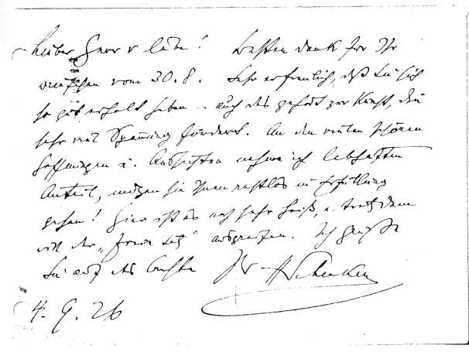
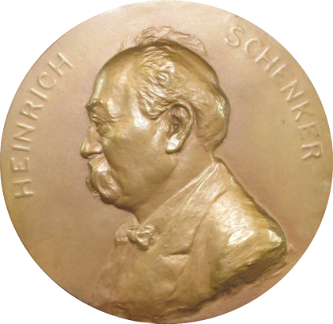
Ensuring Fidelity
Comprehensive editorial guidelines covering things from to
Know Have Equals German & Schenker
Transcribers
Translators
Editors
Encoders
Notes:
Add scan of document and medallion image.

Slide 9
So What?
It’s not inexpensive … … so we only want to do it once.
The dataset we are creating is of extremely high quality
Enables excellent functionality on the website
AND scope to add more functionality in the future
Excellent resource and exemplar.

Slide 10
Metadata

Slide 11
SDO Metadata
Metadata is a special type of data.
For SDO, we manage metadata (information about rather than intrinsic to the documents) using our web-based Metadata Interface.
Q: What metadata do we store?
A: Catalogue, Format, provenance, licence, and copyright information.
Q: Why not keep metadata within the same file as the actual data?
A1: Managing it separately allows us to quickly access and edit the it without having to open up the 1000s of separate xml files that contain the encoded documents.
A2: It allows us the flexibility to manage metadata at either the document, container, collection, or repository (library/ archive) level (metadata is inherited).

Slide 12
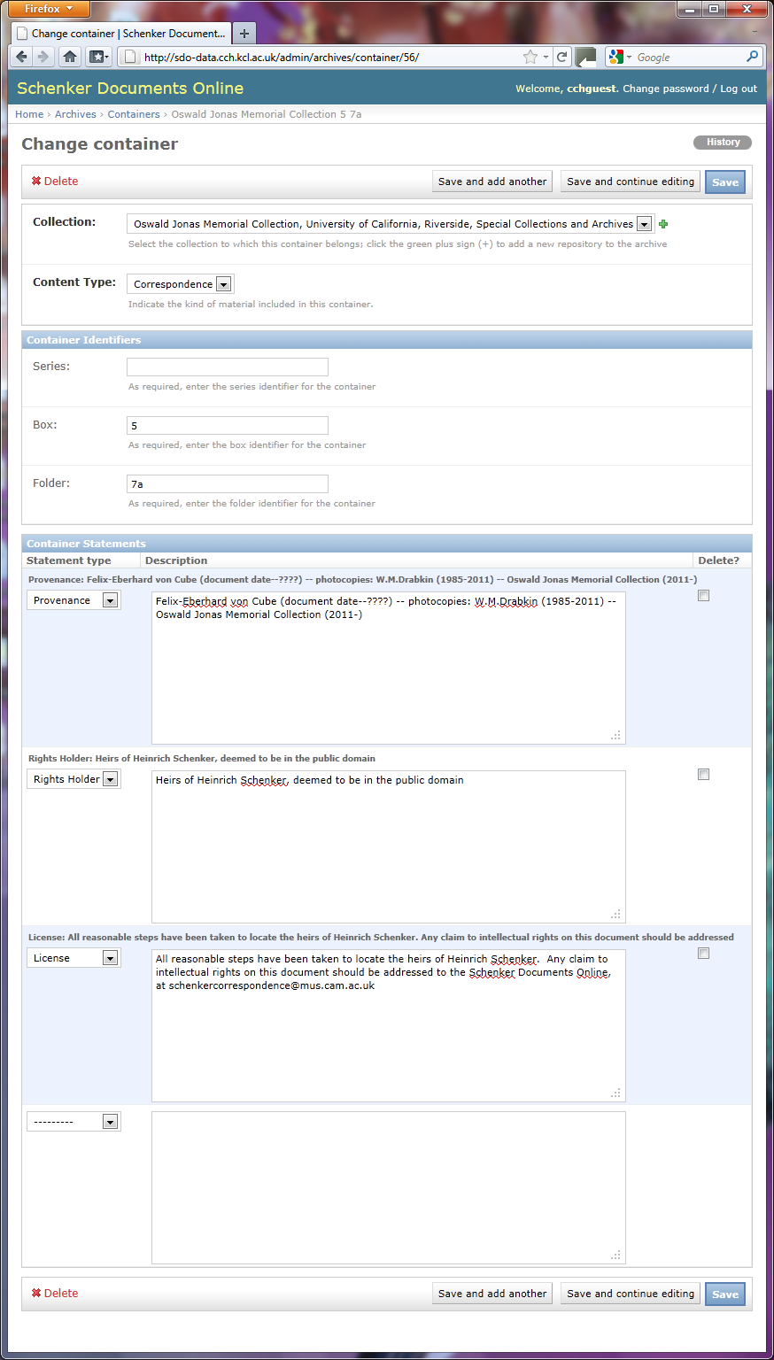
Container Level Control

Slide 13
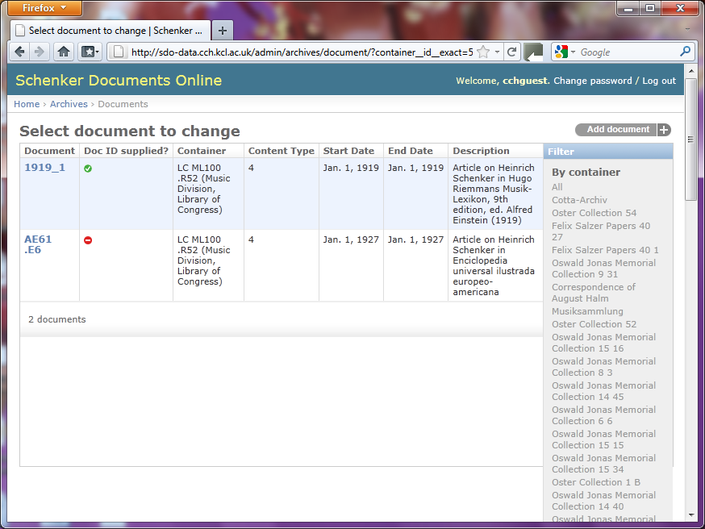
Document Level Control

Slide 14
Encoding

Slide 15
Schema & File Structure
We use a composite xml schema, drawing on namespaces including:
dc
marc
sdo
tei
Collections, Records, and transc./transl.

Slide 16
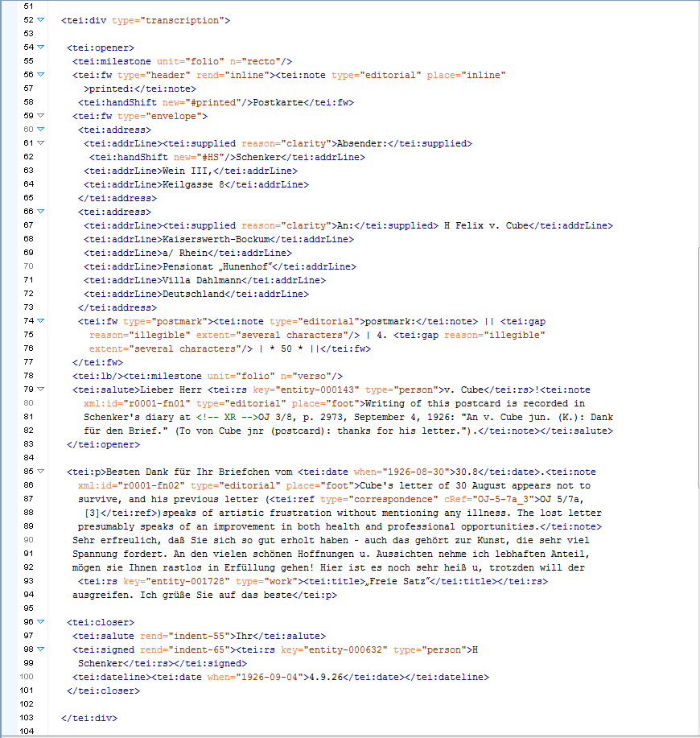
Notes:
Red: describing the physical aspects of the document.
Yellow: describing content type

Slide 17
Notes:
Yellow: describing content type

Slide 18
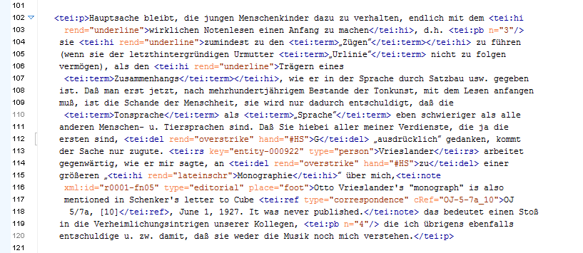
Notes:
Purple: typographic features

Slide 19
Notes:
Green: editorial comments

Slide 20
Notes:
Green: editorial
Blue: attaching semantic information

Slide 21
Notes:
Blue: attaching semantic information
Pink:

Slide 27
Document Structure
Basic structure of the document
And also elements that many will recognise from HTML:
paragraph breaks
text style
tables

Slide 28
Editorial Additions
Corrections, clarifications
editorial comments
footnotes

Slide 29
III. Content presentation
Dr Paul Caton
Digital Humanities, King’s College London
Research Associate

Slide 30
XML files of primary docs
XML profile files
Web application
Metadata framework
Solr index
EATS entity records

Slide 31
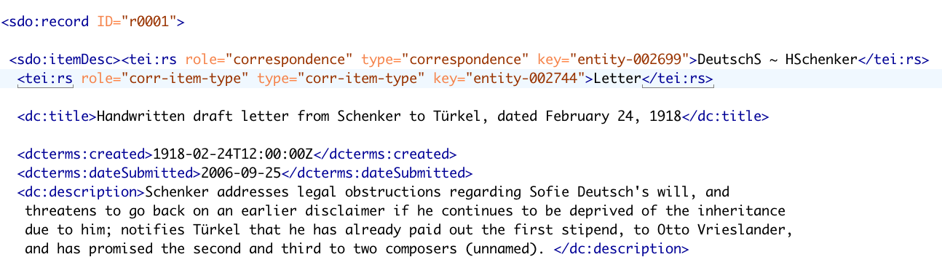
Encoding associates information in files with entity records:
values of “key” attribute are the names of entity records

Slide 32
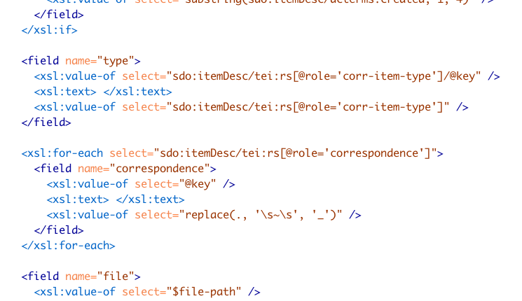
Defining fields for Solr index:
key values included in Solr index, linking documents with relevant entity records

Slide 33
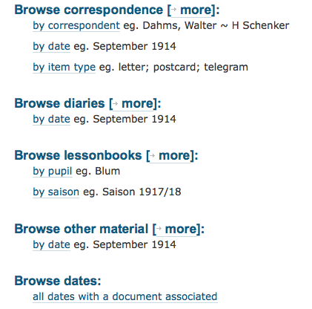
Current SDO browsing options:
pathways enabled by Solr index

Slide 34
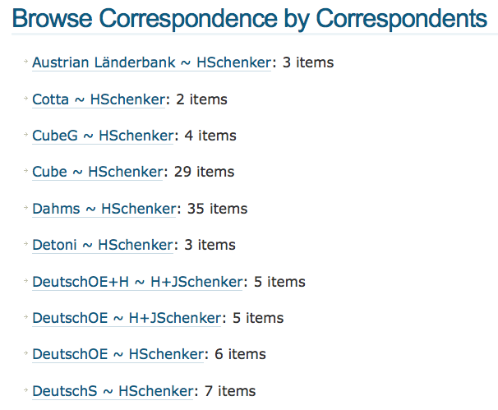
everything drawn from the Solr index

Slide 35
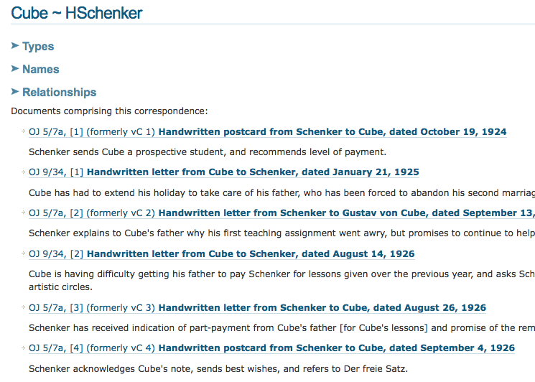
This summary list drawn from the Solr index and the record for the Cube ~ HSchenker correspondence entity

Slide 36
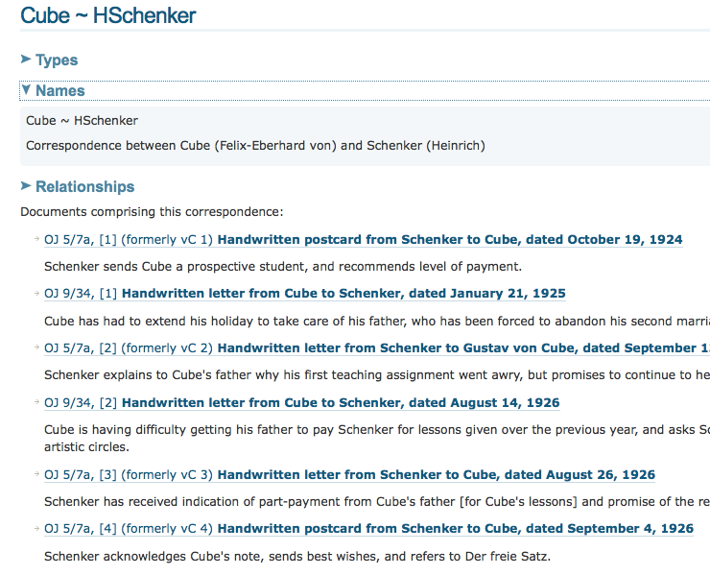
Types, Names, and Relationships come from the entity record

Slide 37
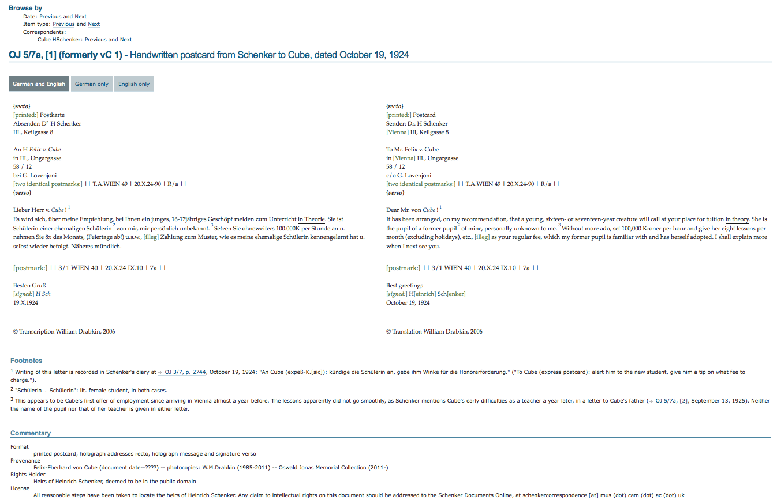
Default item display
Browse options
Text of the document
Editorial footnotes
Metadata

Slide 38
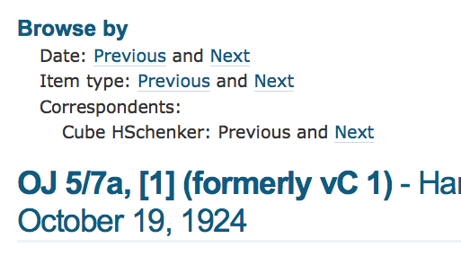
Browse options
all “Previous” and “Next” links enabled by the Solr index

Slide 39
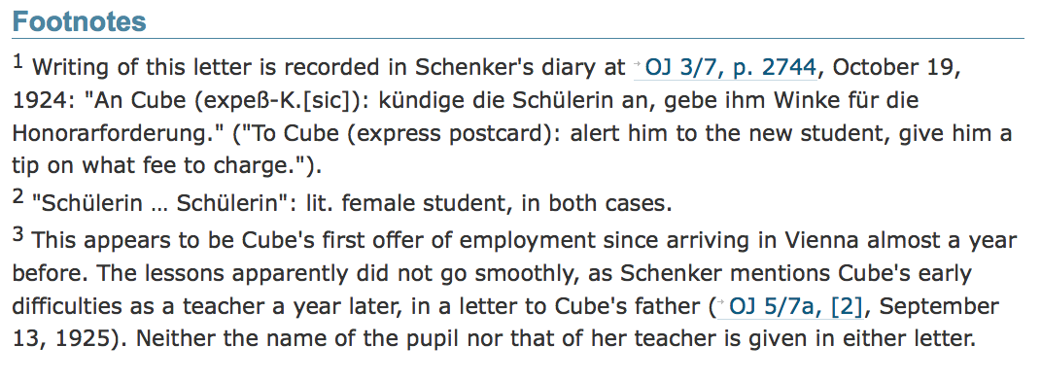
Editorial footnotes
cross-reference links

Slide 40
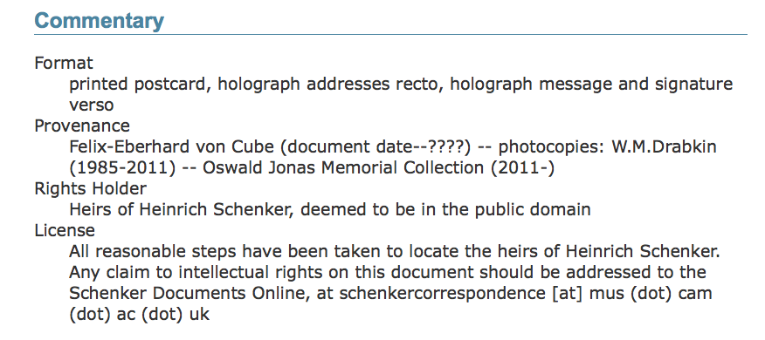
Metadata
All this information drawn from the Metadata Framework

Slide 41
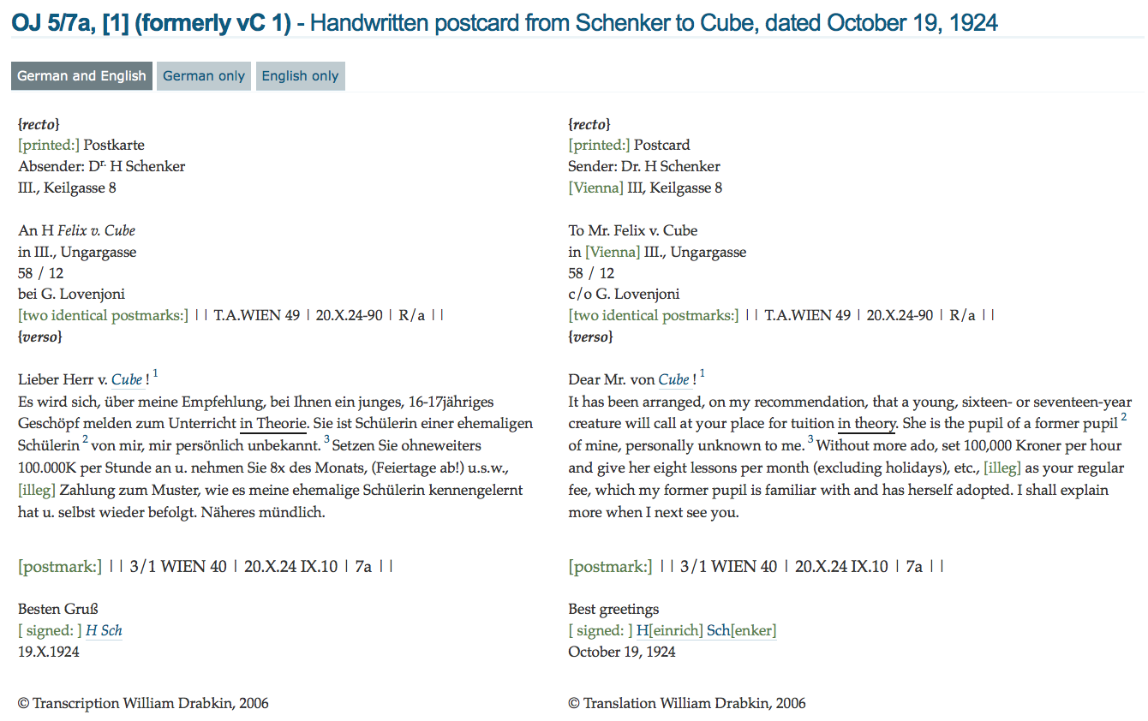
Text of the document
footnote links
entity record links

Slide 42
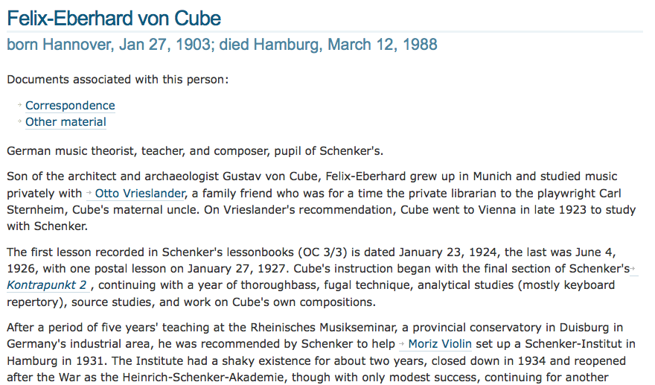
Profile / entity display:
entity record links

Slide 43
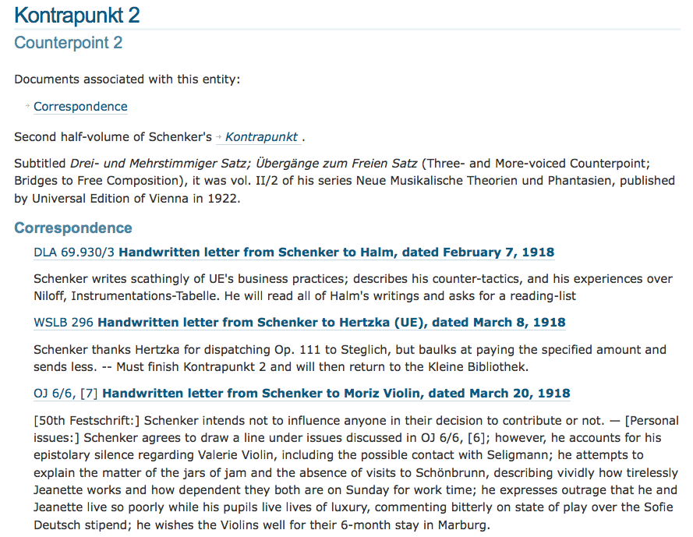
Secondary material can lead back to primary:

Slide 44
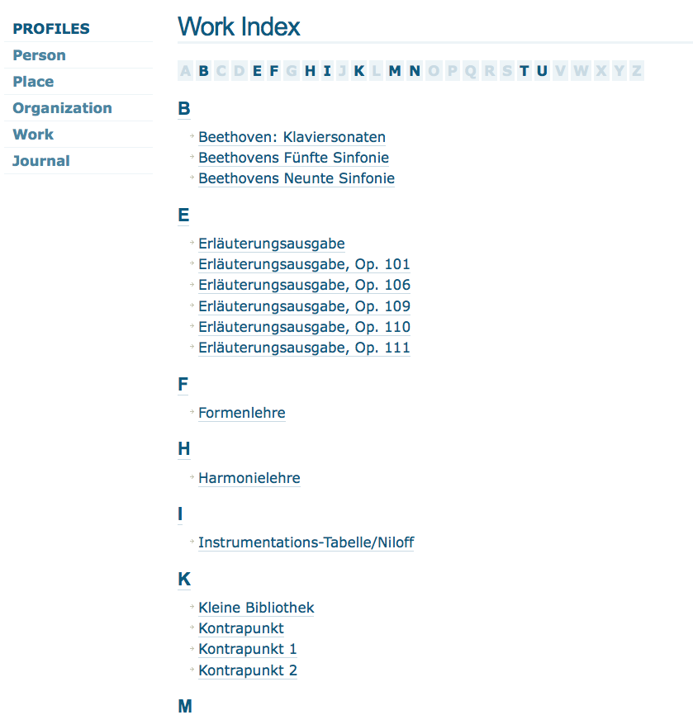
“Profiles” offer direct access to important contextual material

Slide 45
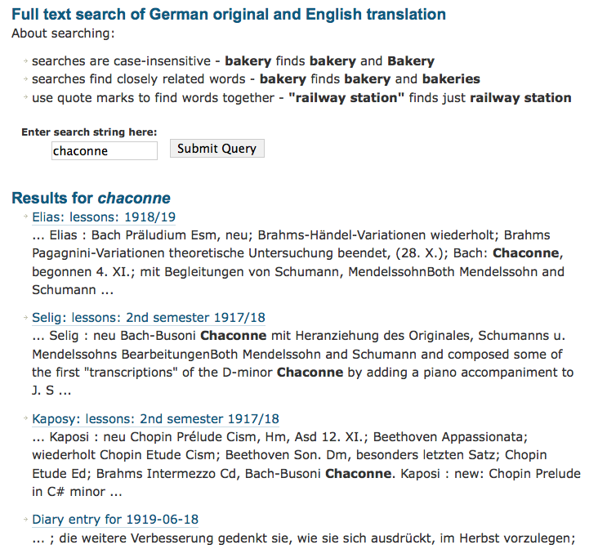
Searching is another access pathway

Slide 46
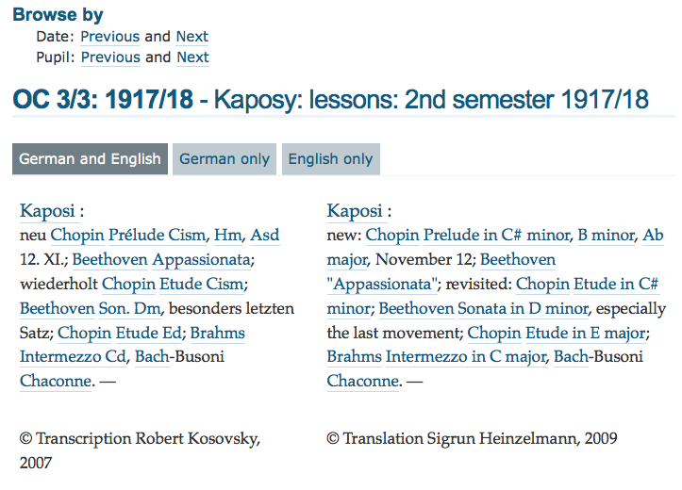
entity record link for “Chaconne”

Slide 47
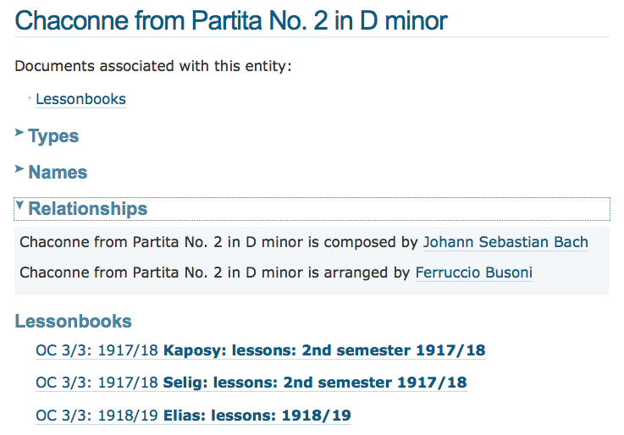
Pseudo-profile for “Chaconne”, created from EATS entity record:
relationships this entity has with other entities

Slide 48
Entity
record
Entity
record
Entity
record
Document content
Entity
record
Entity
record
Entity
record

Slide 49
Entity
record
Entity
record
Entity
record
Project A set of documents
Project B set of documents

Slide 50

www.schenkerdocumentsonline.org

