Slide 1
SDO slides for RMA2011
PC

Slide 2
XML files of primary docs
XML profile files
Web application
Metadata framework
Solr index
EATS entity records

Slide 3
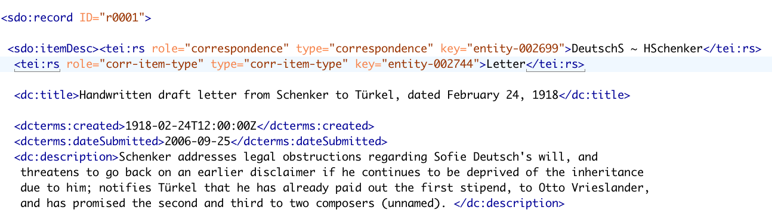
Encoding associates information in files with entity records:
values of “key” attribute are the names of entity records

Slide 4
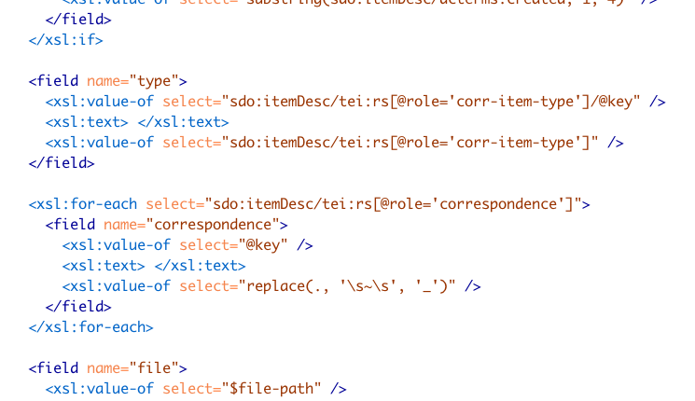
Defining fields for Solr index:
key values included in Solr index, linking documents with relevant entity records

Slide 5
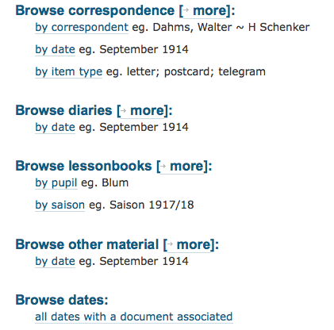
Current SDO browsing options:
pathways enabled by Solr index

Slide 6
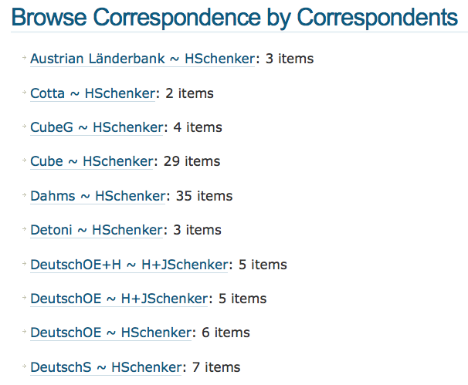
everything drawn from the Solr index

Slide 7
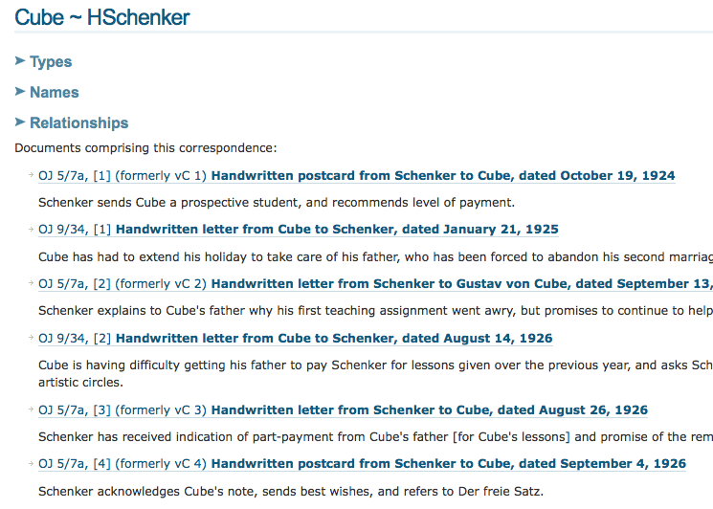
This summary list drawn from the Solr index and the record for the Cube ~ HSchenker correspondence entity

Slide 8
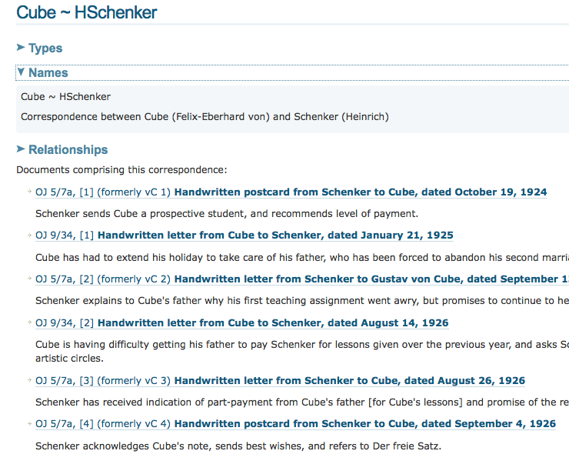
Types, Names, and Relationships come from the entity record

Slide 9
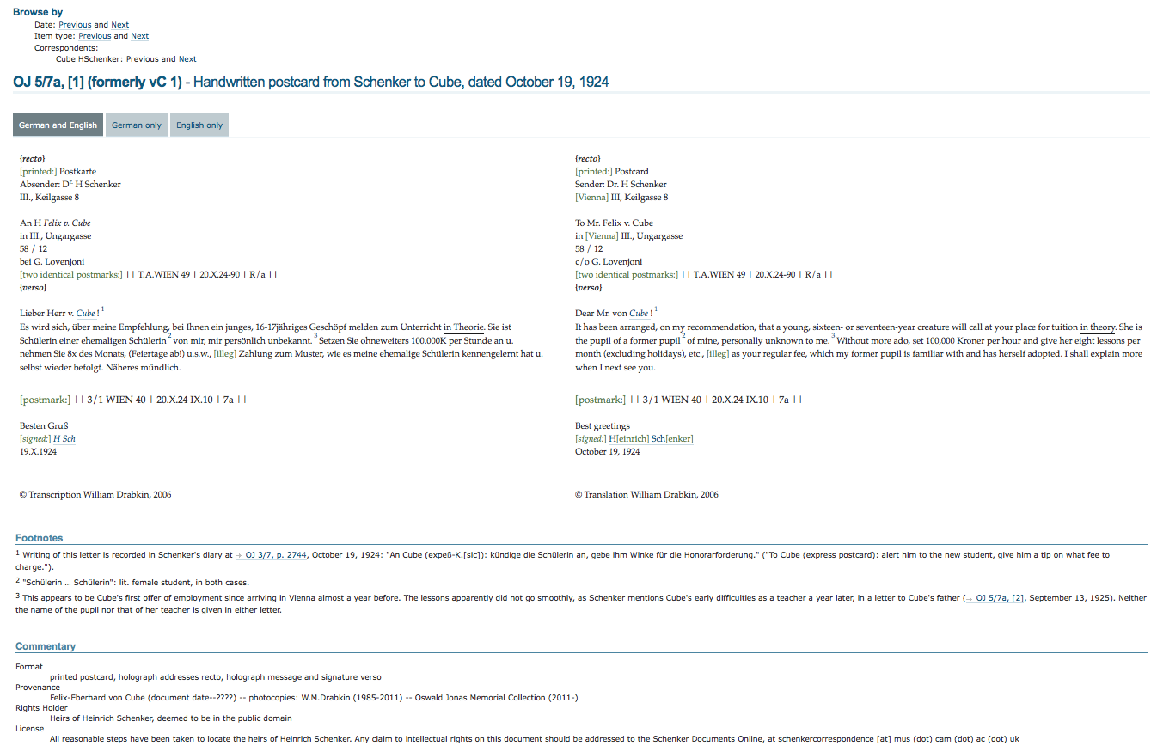
Default item display
Browse options
Text of the document
Editorial footnotes
Metadata

Slide 10
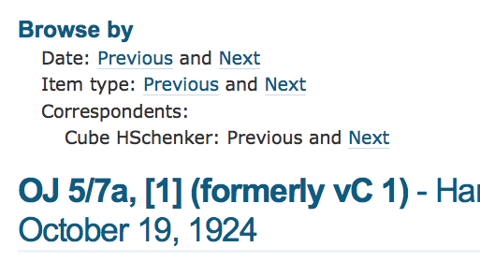
Browse options
all “Previous” and “Next” links enabled by the Solr index

Slide 11
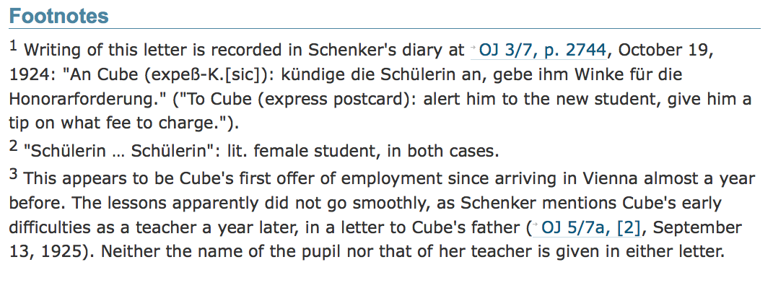
Editorial footnotes
cross-reference links

Slide 12
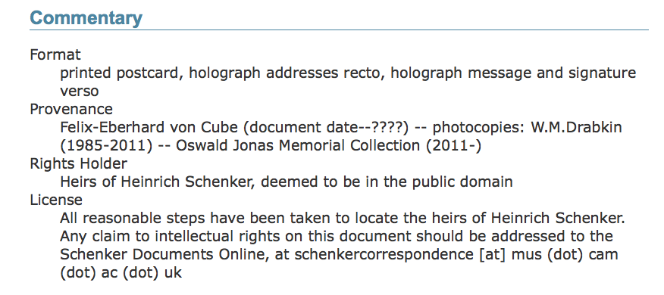
Metadata
All this information drawn from the Metadata Framework

Slide 13
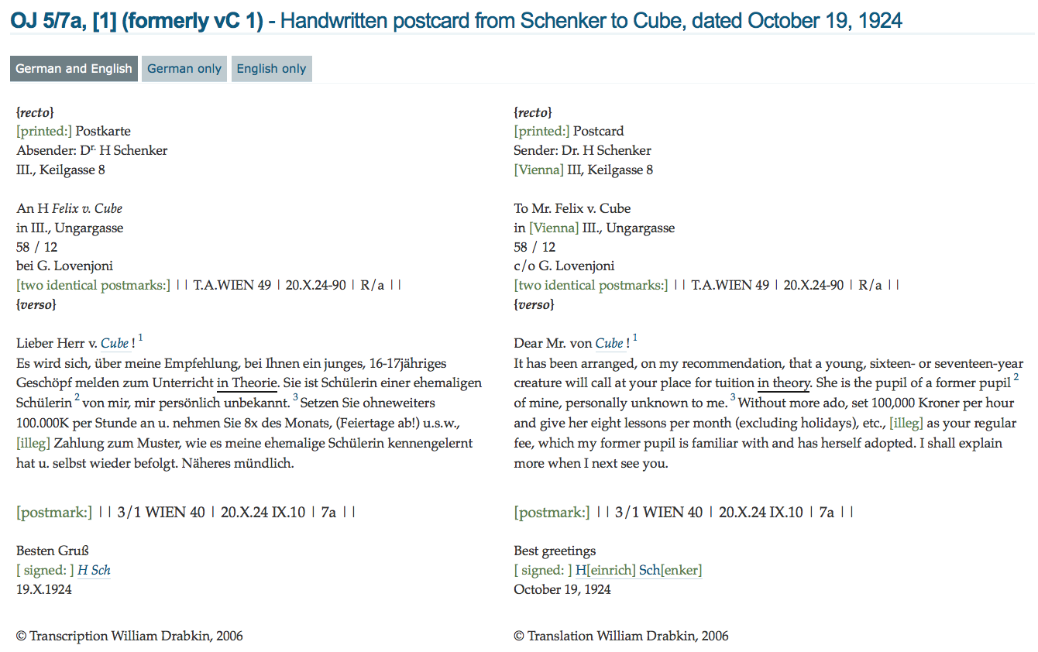
Text of the document
footnote links
entity record links

Slide 14
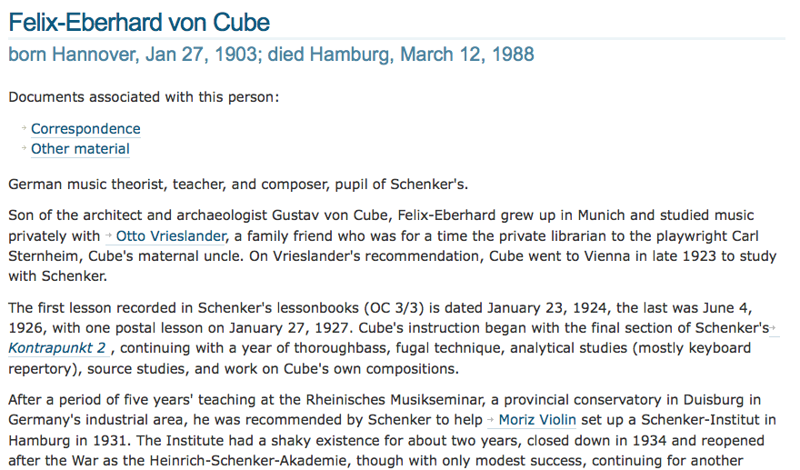
Profile / entity display:
entity record links

Slide 15
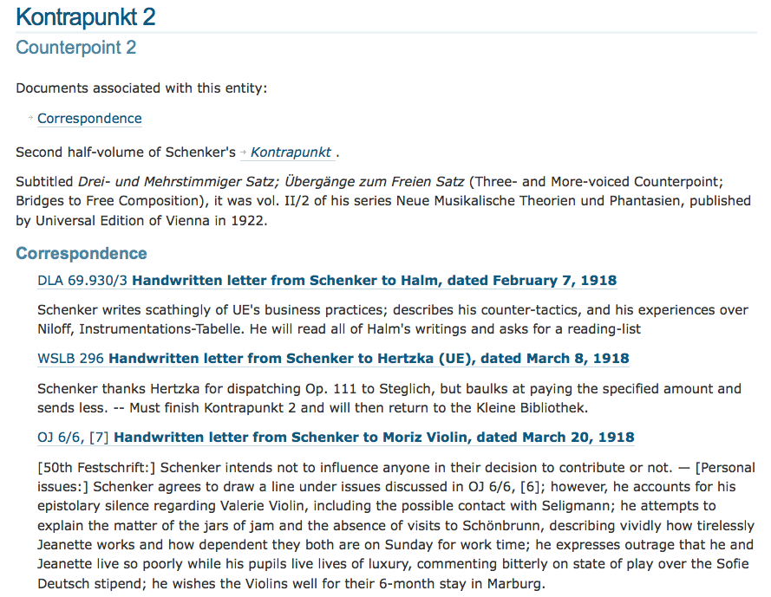
Secondary material can lead back to primary:

Slide 16
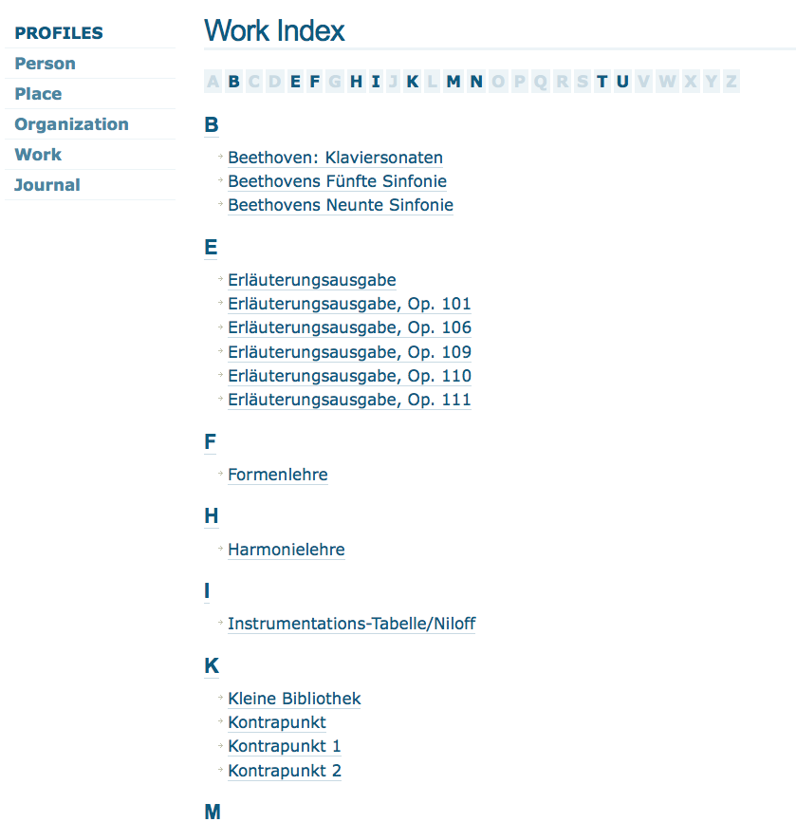
“Profiles” offer direct access to important contextual material

Slide 17
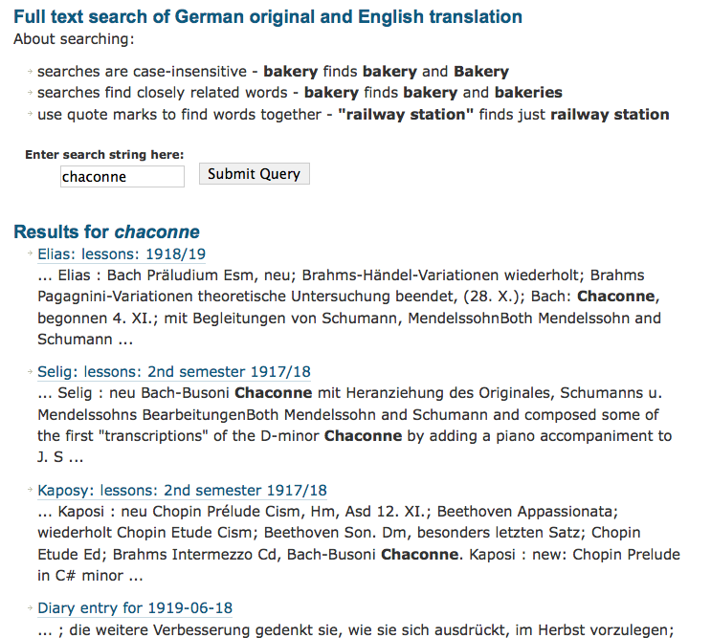
Searching is another access pathway

Slide 18
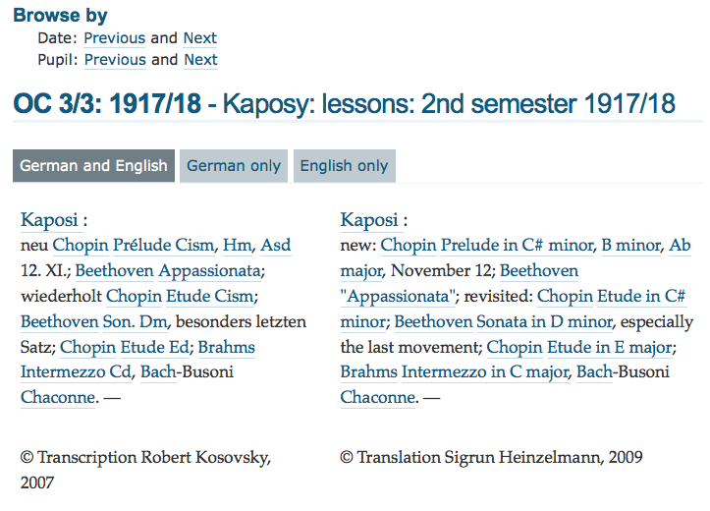
entity record link for “Chaconne”

Slide 19
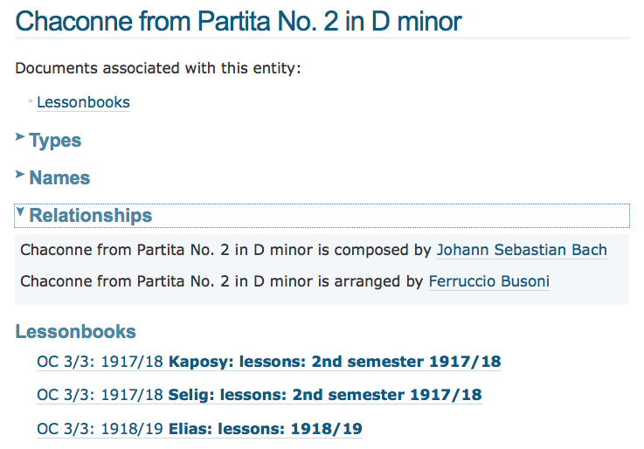
Pseudo-profile for “Chaconne”, created from EATS entity record:
relationships this entity has with other entities

Slide 20
Entity
record
Entity
record
Entity
record
Document content
Entity
record
Entity
record
Entity
record

Slide 21
Entity
record
Entity
record
Entity
record
Project A set of documents
Project B set of documents

Slide 22







www.schenkerdocumentsonline.org

