Slide 1
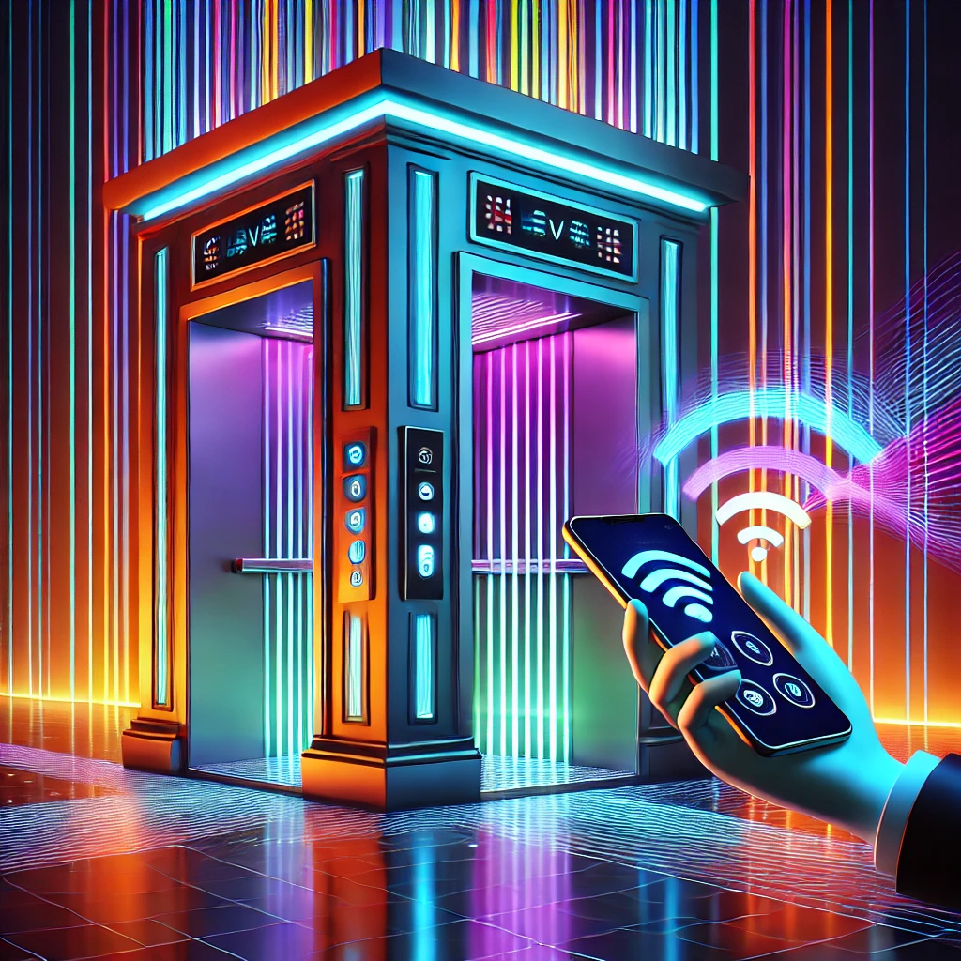

SMART ELEVATOR SYSTEM
Presented by:
1. Kingstone Showa
2. Kelvin Manyeki

Slide 2
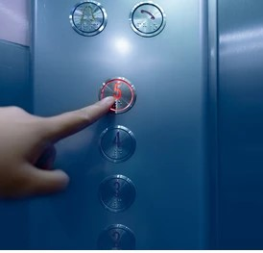
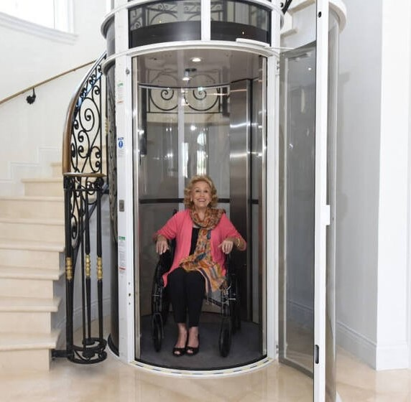
Limitations of Traditional Elevator
Hygiene
Reliance on embedded buttons, which may cause hygiene concerns.
2. User Interface
Limited accessibility and interaction for disabled people.
3. Data Driven Functionalities
Lack of data collection means to improve the human safety and overall functionalities of buildings

Slide 3
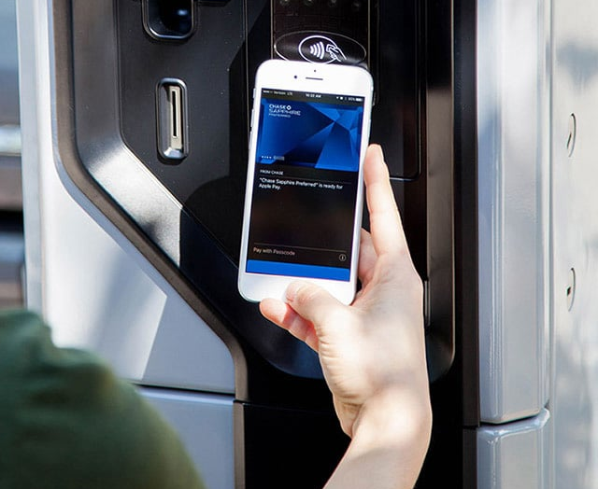


The Need for Smart Elevators
The main goal is to innovate traditional elevator systems by enabling remote interaction and enhancing safety, convenience, and reliability. Our project aims to achieve the following:
1. Contactless
Remote interaction with the elevator system to improve hygiene by removing buttons in elevators.
2. Automation
Smooth, automated operation for user convenience and energy saving.
3. Safety
Enhanced safety features to prevent accidents. For example the door cannot close when the user is still on the way.
4. Data Collection
To collect user interactions data for informed decision making such as when to maintain the system.

Slide 4
System Architecture
Node Red Dashboard
Wi-Fi
MQTT
Mosquitto
LED Lights
ARDUINO
WIFI
Photoresistor
Stepper Motor
Power supply
Servo Motor

Slide 5
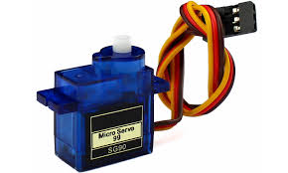

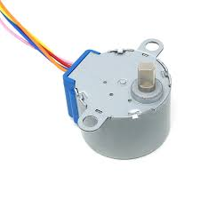

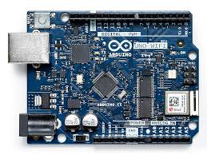

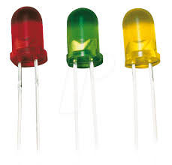

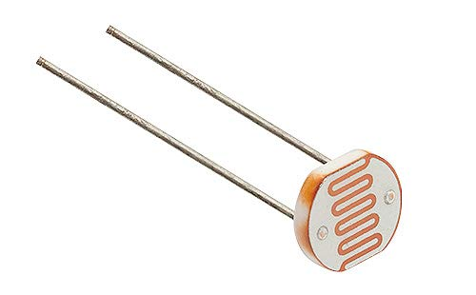
MQTT Protocol
Subscriber
Topic: elevator/request
Publisher
Topic: elevator/request
Topic: elevator/status
Topic: elevator/status
Publisher
Subscriber
Mosquitto Broker

Slide 6
Key Features and Innovations
1. Remote Control
Users can interact with the elevator via a dashboard rather than physical buttons.
2. Safety Mechanism
Photoresistor sensor ensures the door doesn’t close when an object is detected on the door.
3. Intuitive Visualization
Node-Red dashboard provides a user-friendly interface for monitoring and control the elevator.
4. Energy Efficiency
Optimized use of motors and LEDs to avoid energy loss when the system is not in use

Slide 7
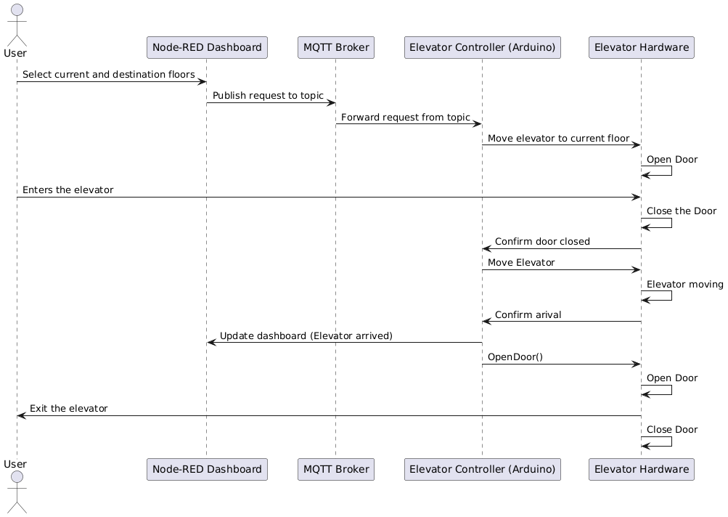
Sequence Diagram (Request Elevator)

Slide 8
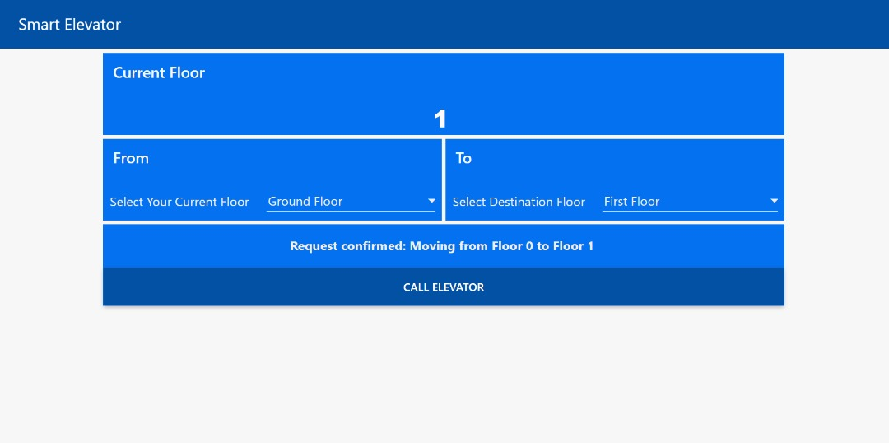
User Interface
Current Floor: Shows the floor that the elevator is currently in.
From: The user selects the floor they are currently in ( The floor they are currently in.
To: The User selects the floor they want to visit.
Feedback: The app gives feedback to the user on their requests and displays the motion of the elevator

Slide 9
Future Suggestions
1. RFID Access Control
Restrict access to specific floors using RFID technology, ensuring only authorized personnel can enter sensitive areas.
2. Predictive Maintenance with AI
Utilize artificial intelligence to monitor elevator performance and predict maintenance needs, reducing downtime.
3. Mobile App Integration
Develop a mobile application for remote elevator control and status monitoring, improving user convenience.
4. Voice and Gesture Commands
Incorporate voice recognition and gesture-based controls for hands-free elevator operation, enhancing accessibility.
5. Data-Driven Service Optimization
Analyze user data to automatically adjust elevator services based on building occupancy and usage patterns.

Slide 10
Demo
Thank You

