Slide 1


High throughput, Real-time Edge Stream Processing with Topology Aware Resource Matching
Based on the paper by: Peng Kang, Samee U. Khan, Xiaobo Zhou, Palden Lama
Presented by: Kingstone Showa (CloudStar)
Date: 30 May 2025

Slide 2
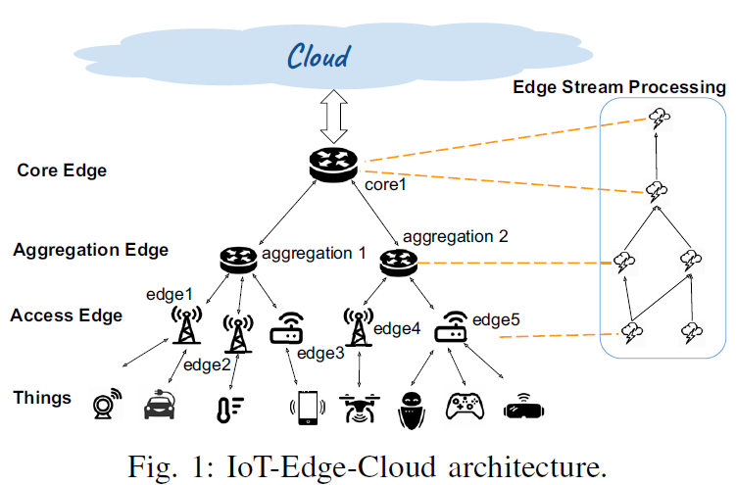
Edge Stream Processing
Stream processing is a distributed computing
paradigm for processing and analysis of high-volume, heterogeneous, and continuous data streams to extract insights and actionable results in real time.
For this to be called Edge Stream Processing, stream processing engines (SPEs) are distributed on IoT Gateways and edge routers which are closer to the users and devices.
Since these nodes has limited resources, are existing SPEs suitable for use at the edge?

Slide 3
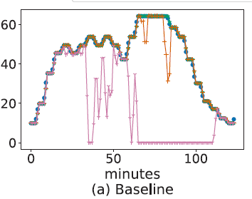
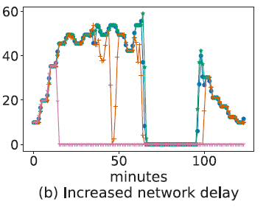
Limitations of Existing SPEs
The resource schedulers in existing SPEs, are designed for resource-rich cloud data centers
Not well suited for the resource-constrained edge environment.
Edge nodes are geographically distributed, face variable network delays with heterogeneous computing capacity.
Pre-Evaluation
To demonstrate these limitations a case study was conducted on a testbed of virtual machines emulating the edge environment.
Linux traffic control tool was used to control the network delay between the edge nodes.
The testbed hosted four concurrently running applications from the RIoTBench, each facing a dynamic workload.
The resource scheduling techniques of Amnis, Coda, RStorm , and default Storm was evaluated by measuring the effective throughput of an Extraction, Transform, and Load application.
(a) Baseline case (access-aggregation-core edge | 15ms – 50ms)
(b) Doubled network delay
Notes:
Fig. 1. The edge network has a tiered structure, encompassing
nodes with diverse capacities across the access, aggregation,
and core layers.

Slide 4
Solution: Beaver
Beaver is a resource scheduling framework for real-time edge stream processing
Integrates application topology partitioning and game-theoretic two-sided matching
The goal is to Minimize CPU, memory, and network bottlenecks
Implemented using Apache Storm + Kubernetes
Key components
Resource Profiler
Resource Profiler obtains the baseline resource usage profile of application topologies (DAGs) on a dedicated edge node.
2. Logical Mapping Generator
Employs a scheduling algorithm to generate a list of matching pairs that associate each operator group with a corresponding edge node.
3. Physical Placement Module
Deploys each operator group as Docker container on the designated edge node using the Kubernetes Pod scheduler.

Slide 5
Resource Profiling
The Resource Profiler runs each application on a dedicated edge node and measures the average utilization of CPU, memory, and network for each stream operator
Why it's critical
Prevents overloading nodes with too many or too heavy operators
Enables smarter placement decisions based on actual needs
How it's done
VMs with various vCPU and memory configurations were used to emulate heterogeneous edge nodes.
Prometheus was used to collect runtime metrics
Profiles operators under different input loads to estimate usage

Slide 6
Two-sided matching
To efficiently assign application DAGs to edge nodes based on mutual ranking preferences to avoid resource bottlenecks.
Applications (DAGs) rank edge nodes based on
How well a node matches their CPU, memory, and bandwidth needs
Network delay from upstream operators
Nodes with fewer performance risks are ranked higher
Edge nodes rank applications based on
How much residual resource capacity will be left after placement
DAGs that leave more CPU, memory, and bandwidth unused are preferred
Matching process
DAGs propose to their top-ranked nodes
Nodes accept if they are unassigned or prefer the new proposal
If a DAG cannot be placed due to resource limits, it is partitioned and retried
Outcome
Matches reflect mutual best fit between applications and nodes

Slide 7

Topology Partitioning
Split large application DAGs into smaller parts to enable efficient deployment across multiple edge nodes.
When is it triggered?
When a DAG cannot be placed on a single node due to resource limits
When a node prefers another DAG (based on matching scores)
How it works:
DAG is modeled as a weighted graph (nodes = operators, edges = data flow)
Each edge's weight reflects the data rate between two operators
The goal is to reduce inter-node communication
Spectral Partitioning Technique:
Builds the graph Laplacian matrix
Computes the Fiedler vector (2nd smallest eigenvector)
Partitions the graph g:
Positive values → one subset (g’)
Negative values → another (g’’)
Result:
Operators with heavy data exchange stay together
DAGs are split intelligently, reducing network overhead
Enables scalable, resource-aware operator placement

Slide 8
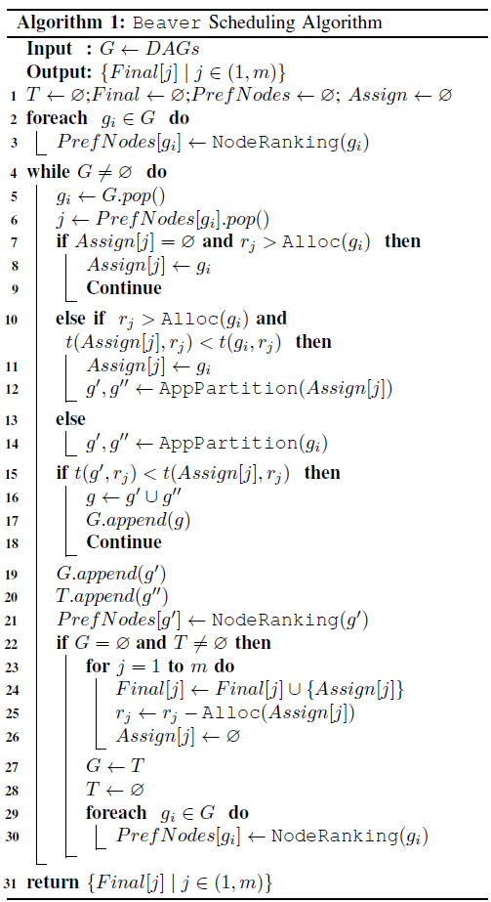
Beaver Scheduling Algorithm
Start
DAGs Queue
Starts with a list of application DAGs to be placed
For each DAG
Ranks nodes based on best fit for resources and delay
Iterative matching
DAG proposes to its top-ranked node
If the node is available, it accepts
If not, it compares current vs. new DAG’s residual resource usage and accepts the better one
If a DAG can’t be placed:
Uses spectral partitioning to split DAG into smaller parts
New parts are re-queued for placement
Continues until all DAGs or partitions are successfully placed
Assing?
Assign?
Occupied Node
Free Node & Enough Res

Slide 9
Physical Placement Module
Ensures operators are deployed exactly where needed for high performance
Pluggable scheduler assigns stream operators to the right pods
Runs the placement plan determined by the Scheduling Algorithm
Uses Kubernetes for container orchestration
Configures pods with:
Apache Storm container
nodeName field for target edge node
Supervisor daemon for task management

Slide 10
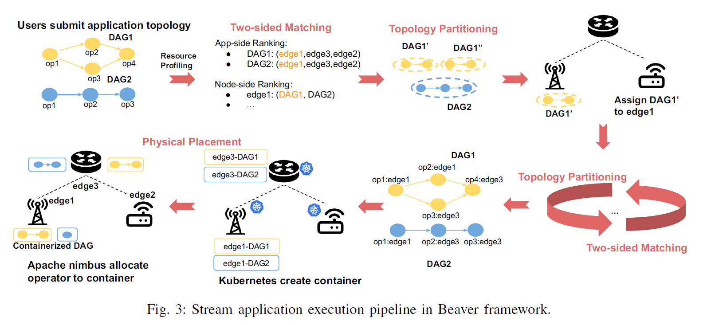
Beaver framework

Slide 11
Evaluation Summary
Testbed
8 VMs (access, aggregation, core edge nodes)
Emulated heterogeneous edge environment using Linux TC (network delay, bandwidth)
Applications & Datasets
Four real-time IoT applications from RIoTBench
Sense Your City and NYC Taxi datasets
Comparisons
Beaver vs. RStorm, Amnis, Coda, and default Storm
Key Findings
Beaver consistently outperforms other methods:
Achieves ≥1.6× higher throughput
Maintains lower 95th percentile latency under varying network delays
Efficient resource utilization (CPU, memory, network)
Robust to increased network delays and reduced bandwidth
Partitioning and two-sided matching adapt to workload dynamics
Ensures scalable, efficient, and stable deployment under real-world edge conditions

Slide 12
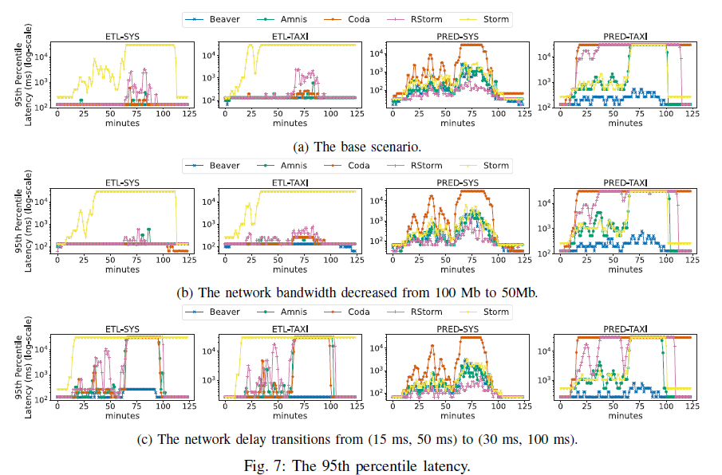
Results

Slide 13
Grazie

