Slide 1

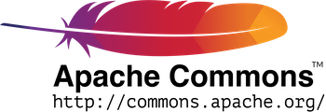
Software Dependability
Project: Apache Commons Codec
Presented by: Kingstone Showa

Slide 2
Introduction
Apache Commons Codec provides robust implementations of essential encoding and decoding algorithms, such as Base64, URL encoding/decoding, checksum calculations, and digest algorithms.
These functionalities are integral to numerous software systems, ensuring efficient data transformation and secure communication.
As a result, ensuring the dependability of Apache Commons Codec is vital to maintaining trust and confidence in its various applications.

Slide 3
Software Quality Analysis
I forked the official Apache Commons Codec repository to my GitHub account
I created a new project on SonarCloud and linked to the forked repository
I configured the project properties and a CI/CD pipeline was established
First
Next
Next
SonarCloud analyzed the library’s codebase and provided detailed insights into its quality metrics
Finally

Slide 4
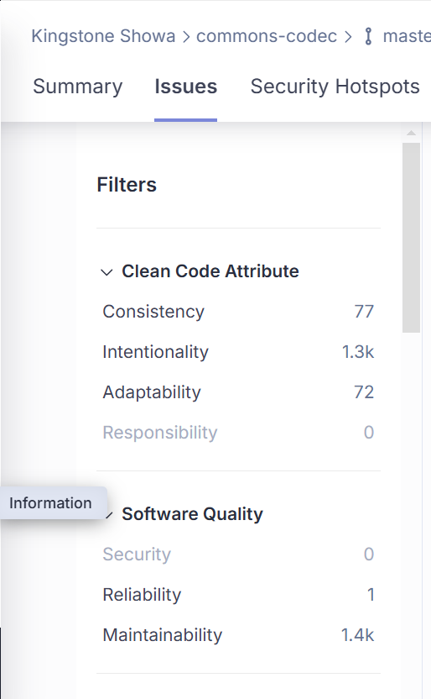
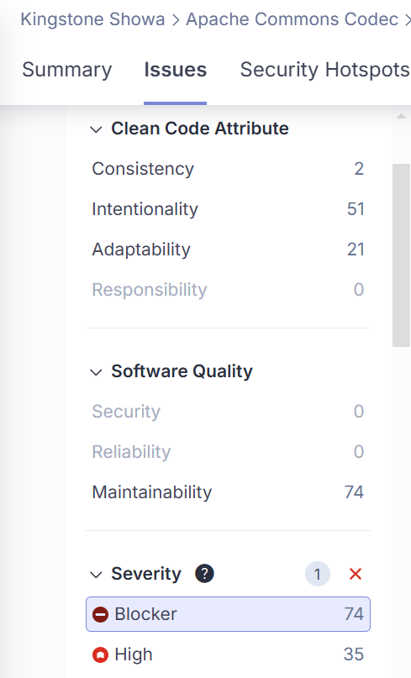
Issues Categories and Resolved
In resolving these issues, I prioritized issues based on their severity to address the most critical problems first
These issues were related to deprecated code snippets and the improper use of switch cases without break commands, which could lead to unintended behavior
However, some were identified as false positives after thorough evaluation and these issues were dismissed.

Slide 5
Dockerizing Mavern Project
For the second phase of the project, I created a Text Encoding/Decoding Maven application that uses the updated Apache Commons Codec library.
This mini-project provides a simple web-based interface for encoding and decoding text using the library.
The application implements Base32 functionality using the Base32 class from the Apache Commons Codec library
Dockerization Process
A Dockerfile was created to define the container's build process and runtime configuration.
In order to successfully run the containerized application I had to copy the dependencies into the lib folder of my Docker project.
This was made possible by including the following command in my Dockerfile

Slide 6
Code Coverage Analysis
I used JaCoCo to evaluate how much of the codebase is executed during testing.
The initial code coverage was 97.9%, a remarkable result for such a large and complex library. However, gaps were identified, particularly in the org.apache.commons.codec.cli package, where the Digest class had minimal test coverage at 8.6%.
I manually added additional test cases

Slide 7
Mutation Testing with PIT

Slide 8
Improving Test Coverage

Slide 9
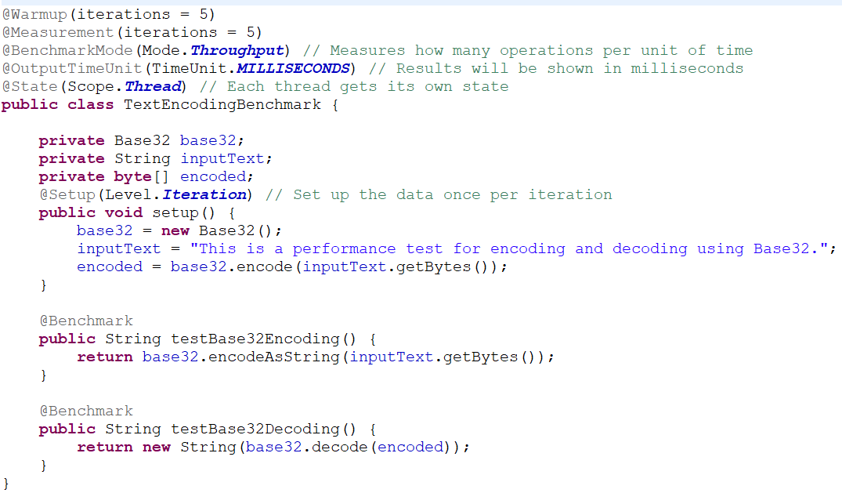
Benchmark Analysis with JMH
The performance of Base32 encoding and decoding was benchmarked using the Java Microbenchmark Harness (JMH).
I integrated JMH dependencies into the project using Maven
I created a TextEncodingBenchmark class with methods for Base32 encoding and decoding benchmarks.
The benchmarks were configured to measure throughput (operations per millisecond) over 5 warmup iterations and 5 measurement iterations, each lasting 10 seconds.
Base32 Encoding
Average Throughput: 722.354 ops/ms
Variability: ±55.014 ops/ms
Standard Deviation: 14.287 ops/ms
Base32 Decoding
Average Throughput: 752.372 ops/ms
Variability: ±47.813 ops/ms
Standard Deviation: 12.417 ops/ms
Notes:
The results indicate that Base32 decoding achieves a higher average throughput compared to encoding, suggesting lower computational overhead for decoding operations.
Encoding, however, exhibited slightly greater variability, possibly due to the additional complexity in handling input data transformations during the encoding process.
Both encoding and decoding demonstrated strong performance, with throughput metrics remaining consistently high.
The standard deviation values confirm that the results are statistically significant and reliable under the test conditions.

Slide 10
Find Security Bugs
To analyze security related issues, I installed and run FindBugs on Eclipse. The tool found only one security related issue in org.apache.commons.codec.digest.PureJavaCrc32Test.
I replaced the Random class with SecureRandom, because SecureRandom provides strong random values suitable for security-sensitive operations, avoiding predictability risks.

Slide 11
OWASP Dependency-Check Analysis
I configured OWASP Dependency-Check and scanned the project for the possible vulnerabilities. The report was generated as follows.
From the report, no vulnerabilities were identified in the project's dependencies. All libraries are up-to-date and free from reported security issues.

Slide 12


Thank You!

