Slide 1


Image Transformation and Advanced Edge Detection Techniques
Prasanta Das
Software Developer
Centre for Development of Advanced Computing

Slide 2
Contents
Topics Covered:
Image Transformations
Advanced Edge Detection Techniques
Hands-On Activity:
Apply Transformations on Images
Compare Different Edge Detection Techniques

Slide 3
Image Transformations
Image transformations are operations that modify an image’s geometry, pixel values, or visual representation.
Purpose: Enhance image quality, extract features, or manipulate images for machine learning or creative use.
Applications:
Augmentation for deep learning (e.g., rotating, cropping).
Medical imaging enhancements.
Real-time computer vision tasks (e.g., perspective correction in self-driving cars).

Slide 4
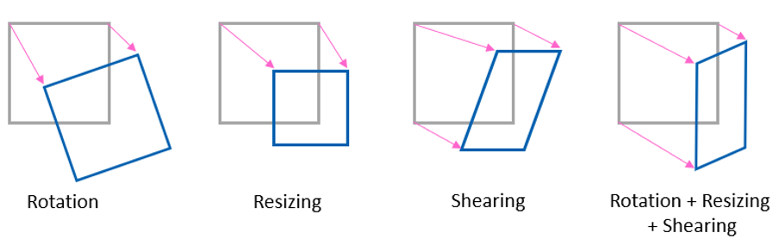
Types of Image Transformations
Geometric Transformations
Translation: Moving an image horizontally or vertically.
Rotation: Rotating the image by a specific angle.
Insight: Precision matters in aerial imagery; a small rotation error can misclassify objects.
Scaling: Enlarging or shrinking the image.
Use Case: Scaling satellite images while preserving spatial resolution.
Shearing: Skewing the image to alter its shape.

Slide 5
Types of Image Transformations
Pixel-level Transformations
Grayscale Conversion: Reducing an image to a single channel.
Histogram Equalization: Enhancing contrast by redistributing intensity values.
Unique Insight: Adaptive histogram equalization is widely used in medical imaging to highlight subtle variations.
Thresholding: Converting images to binary based on intensity values.

Slide 6

Types of Image Transformations
Affine Transformations
An affine transformation is a geometric transformation that preserves parallelism and lines, but not necessarily angles and distances.
Applications: Document scanning for aligning text.
Combine translation, rotation, scaling, and shearing.
Perspective Transformations
Altering the viewing angle.
Example: Correcting camera distortion in architectural photography.

Slide 7
Tools and Libraries for Image Transformations
OpenCV: Extensive library with functions like warpAffine, warpPerspective, and more.
Pillow (PIL): Easy-to-use Python library for simple transformations.
Scikit-image: Research-grade transformations and filters.
Deep Learning Augmentation Libraries:
Augmentations: Advanced augmentation techniques for ML tasks.
TensorFlow/Keras Preprocessing Layers: For real-time augmentation during training.

Slide 8
Advanced Image Transformations
Morphological Transformations
Operations like dilation, erosion, opening, and closing.
Use Case: Extracting connected components in crack detection.
Color Transformations
HSV and LAB conversions.
Insight: LAB color space is perceptually uniform and used in color-based segmentation.

Slide 9
Image Transformations in AI
Data Augmentation: Random rotation, flipping, and cropping enhance the diversity of training data.
Use Case: Apple harvesting robot—augment images to simulate various orientations of fruits.
Feature Extraction: Sobel and Canny edge detection help in detecting boundaries.
Fourier and wavelet transforms for frequency-domain features.

Slide 10
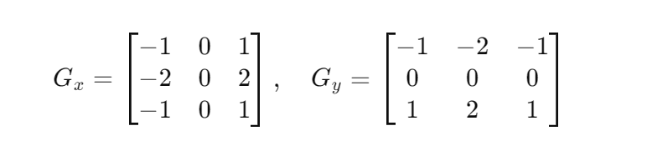
Edge Detection
Sobel Edge Detection
Sobel is a simple and quick method to calculate the gradient of an image's intensity in both horizontal and vertical directions.
It uses two 3x3 convolution kernels (one for the x-direction and one for the y-direction).
The convolution results in gradients along these axes, highlighting edges.

Slide 11
Edge Detection
Canny Edge Detection
Canny is a multi-stage, more sophisticated edge detection algorithm, designed to reduce noise and detect strong edges efficiently.
Features:
Less sensitive to noise.
Detects edges more accurately and clearly.
Takes more computational time compared to Sobel.

Slide 12
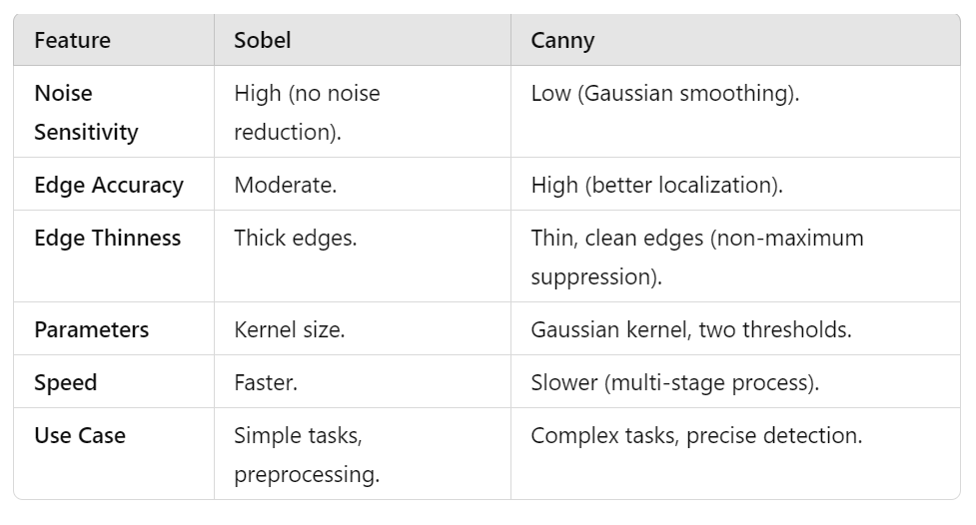
Sobel vs Canny

Slide 13
Thank You
Any Question?

