Slide 1
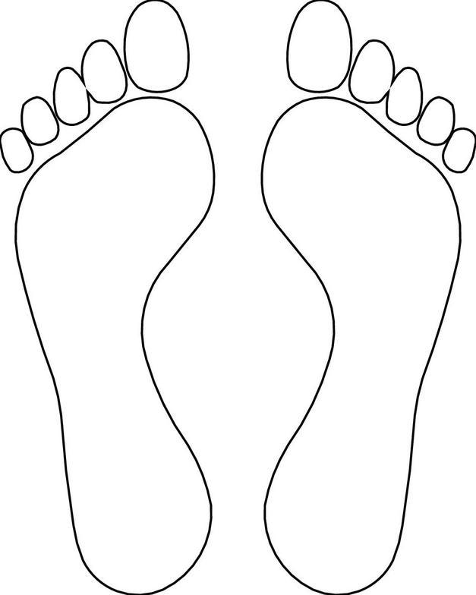






VALE
REFLEXOLOGY

Slide 2


Slide 3




V A L E
REFLEXOLOGY
07885 479048
Daviskingsland@outlook.com
www.valereflexology.co.uk

Slide 5

V A L E
Kim Davis BSc (Hons)
LEVEL 5 DIPLOMA REFLEXOLOGY PRACTIONER
07885 479048
REFLEXOLOGY
Daviskingsland@outlook.com
VALID FOR A FIRST DUOPODY REFLEXOLOGY CONSULTATION
(90 mins - £65)
This voucher has no alternative cash value – Valid until 30th June 2024

