Slide 1
Custom S500
Flight Controller
TEAM MEMBERS
Progress review — VEGA SDK, firmware preparation
and ground-station development
01 Joseph
02 Kuriakose
03 Gokul
TEAM NAME
AAROH
04 Abin
INSTITUTION
ST. JOSEPH’S COLLEGE OF ENGINEERING
AND TECHNOLOGY, PALAI
05 Dennis
06 Adith
MENTOR
DR. ELVIN KURUVILA
DATE
30/10/26

Slide 2
VEGA | FLIGHT CONTROLLER HARDWARE
Carrier Board Design in KiCad
Design update — board, link and bus interfaces
BOARD SCOPE
KICAD DESIGN FLOW
LAYOUT RULES
•
HAT for the ARIES v3 board.
•
Schematic capture in KiCad.
Placement is driven by noise, not by convenience.
•
Power, RC, motors, telemetry, I²C.
•
Footprint assignment and layout.
•
No hand-wiring on the aircraft.
•
Design-rule check before fabrication.
MAGNETOMETER ≥ 50 MM
Clear of power and ESC conductors.
Design stage — KiCad schematics and layout planned • nothing fabricated or tested

Slide 3
VEGA | FLIGHT CONTROLLER HARDWARE
RC Link & I²C Sensor Bus
Operator link on ARIES v3 and the aircraft sensor bus
RC LINK
RC SAFETY
I²C SENSOR BUS
•
Ground controller on ARIES v3.
•
Arm gate: tilt, throttle, switch, link.
IMU, magnetometer and barometer share one bus at 400 kHz.
•
Prescribed receiver on UART1.
•
500 ms loss → level, descend, log.
•
SBUS · 50 Hz command frames.
•
Bench targets: 40 ms · 600 ms.
HEADING ONLY
Attitude comes from the IMU, not the compass.
Interfaces specified — nothing built, bench-tested or flown

Slide 4
VEGA | FLIGHT CONTROLLER FIRMWARE
SDK Acquisition & Development Setup
Progress since the previous review
SDK & TOOLCHAIN
DOCKER WORKSPACE
CURRENT STATUS
•
Obtained the original VEGA SDK.
•
Used Docker as the development environment.
Development environment
preparation is in progress.
•
Added the SDK to the project workspace.
•
Worked with the project files inside the container.
•
Added the VEGA RISC-V toolchain to the workspace.
•
Reviewed the SDK setup and build workflow.
NO HARDWARE VALIDATION
Target board testing has not started.
SDK and toolchain are available in the workspace • target hardware test pending

Slide 5
VEGA | FLIGHT CONTROLLER FIRMWARE
Initial Firmware Module Preparation
Identifying the core software blocks for the flight controller
01 | AHRS
02 | PID CONTROLLER
Attitude and Heading Reference System
Flight Control Feedback
Purpose: estimate the vehicle's orientation.
Purpose: calculate corrections to reach desired values.
GYROSCOPE
ACCELEROMETER
MAGNETOMETER
→
→
SETPOINT
PID CONTROL
CORRECTION
↓ SENSOR DATA
P + I + D TERMS
AHRS FILTER → ROLL / PITCH / YAW
Initial C source prepared with AI assistance. Integration with sensor and actuator drivers is not complete.
Initial C source prepared with AI assistance; review and validation remain.
AHRS and PID are planned firmware modules • source code requires review and testing

Slide 6
VEGA | FLIGHT CONTROLLER FIRMWARE
Current Status & Next Steps
Work completed so far and the immediate development sequence
PROGRESS SINCE PREVIOUS MEETING
IMPLEMENTATION PLAN
•
Obtained the original VEGA SDK.
1
Verify Docker environment and SDK setup
•
Added SDK and RISC-V toolchain to the workspace.
2
Review and understand the AHRS and PID source
•
Used Docker for the development workflow.
3
Build and cross-compile using the VEGA toolchain
•
Prepared initial AHRS and PID C files with AI assistance.
4
Resolve build issues and prepare BSP integration
5
Test on VEGA hardware when the board is available
No board-level testing has been performed.
Current stage: environment setup and initial firmware preparation

Slide 7
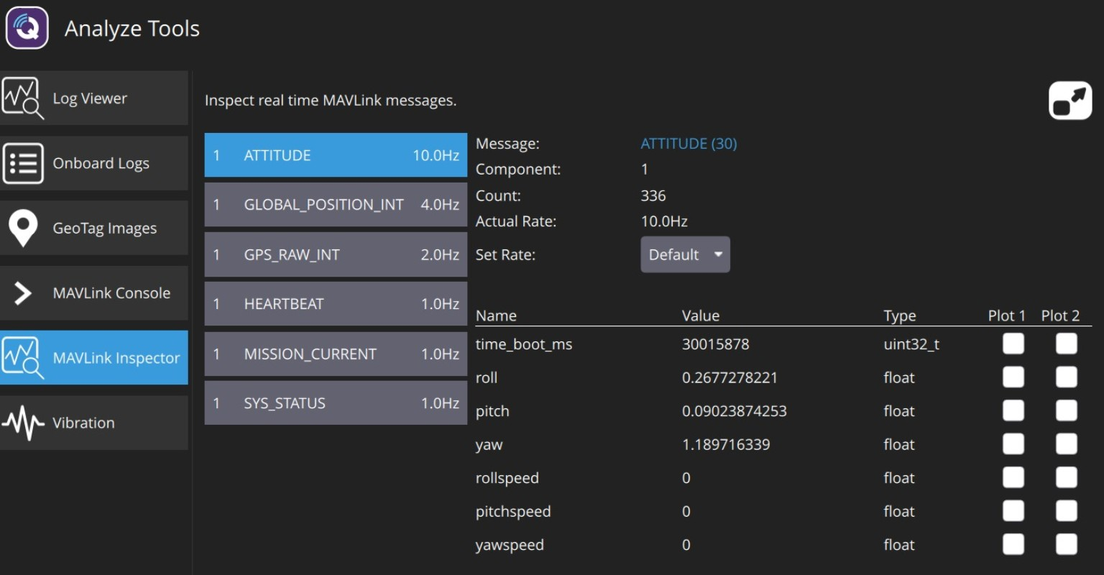
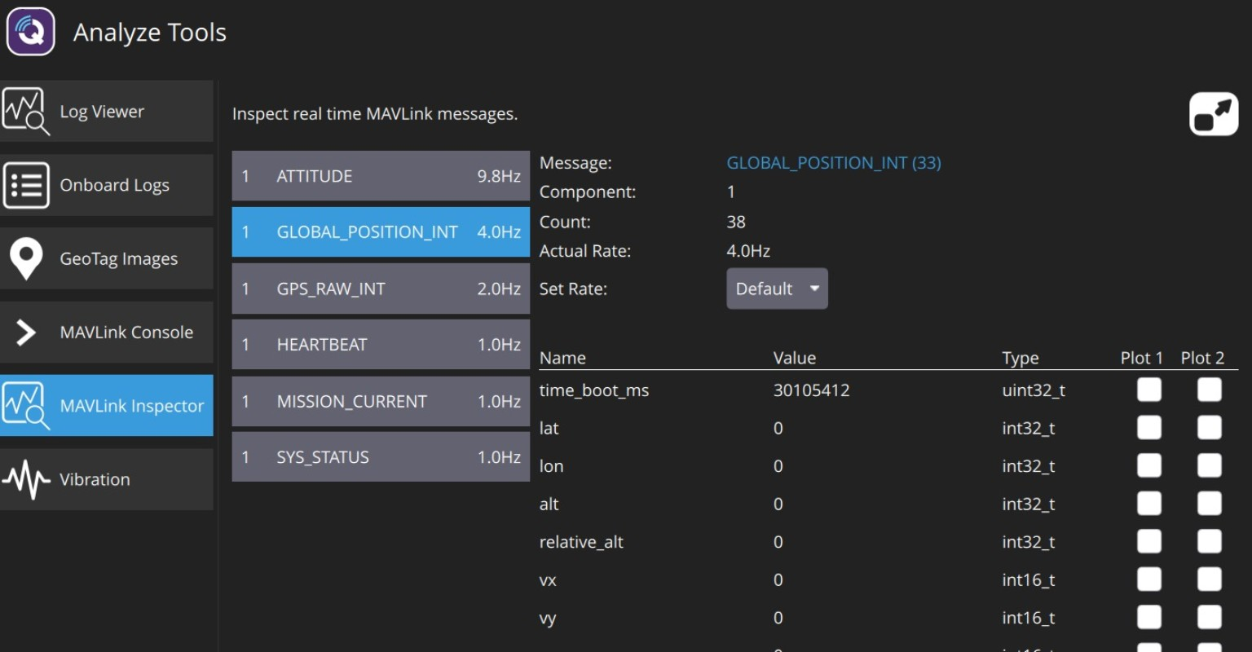
VEGA | MAVLINK GROUND STATION
Ground Station Progress & Next Steps
simulation completed at station level
CURRENT PROGRESS
MAVLINK INSPECTOR
IMPLEMENTATION PLAN
• QGroundControl MAVLink Inspector tested
• ATTITUDE: 10 Hz
• GLOBAL_POSITION_INT: 4 Hz
• GPS_RAW_INT: 2 Hz
• HEARTBEAT: 1 Hz
• Position fields currently zero; validate source data
1
Run Zephyr native_sim on Ubuntu
2
Send MAVLink HEARTBEAT via PTY/UDP
3
Verify messages in QGroundControl
4
Add simulated ATTITUDE + SYS_STATUS
ATTITUDE message fields received
5
Port to VEGA UART when board arrives
STATUS
Station-side telemetry visible.
No VEGA hardware test yet.
6
Integrate IMU, RC, battery, actuators & failsafe
heartbeat received • rates verified • logs saved

Slide 8
THANK YOU

