Slide 1


RESTRICTED
SEMINAR PRESENTATION ON
MANAGEMENT OF OESTEOARTHRITIS
BY
SMMA AMOKE KC
M6369
THE DEPARTMENT OF PHARMACY TECHNICIAN NIGERIAN NAVY COLLEGE OF HEALTH SCIENCES OFFA
KWARA STATE
JUN 25
RESTRICTED

Slide 2
RESTRICTED
INTRODUCTION
RESTRICTED

Slide 3
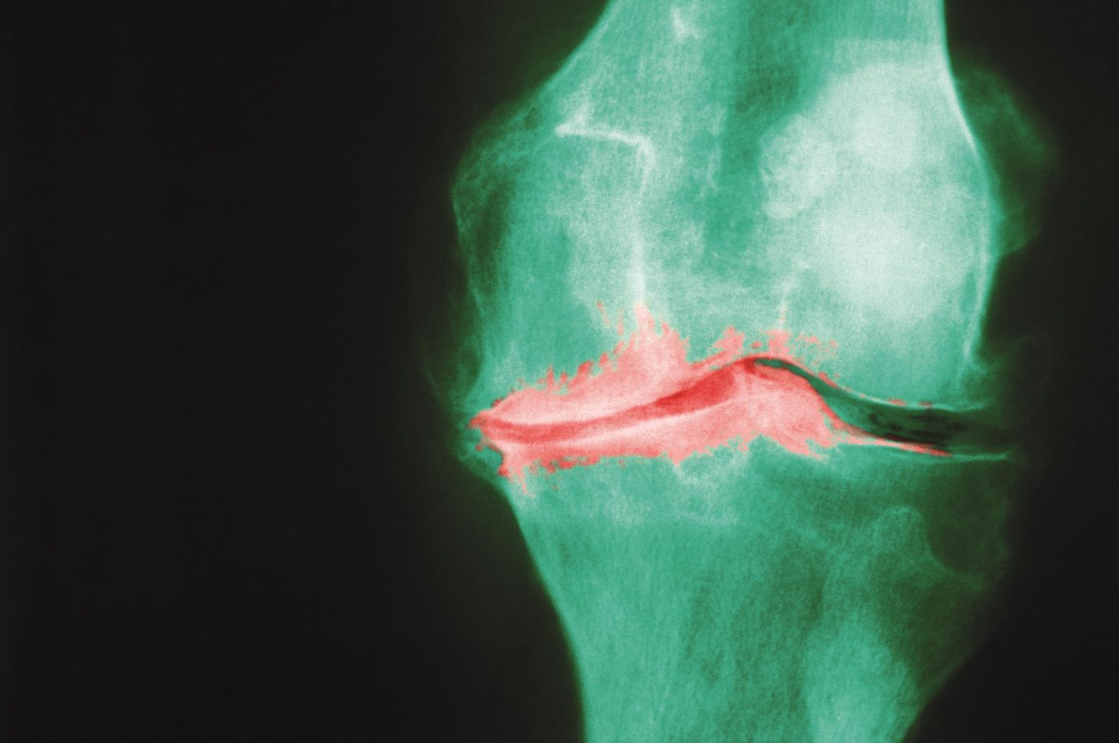
RESTRICTED
RESTRICTED

Slide 4
RESTRICTED
AIM
THE AIM OF THIS SEMINAR PRESENTATION IS TO ACQUAINT THE AUDIENCE ON MANAGEMENT OF OSTEOARTHRITIS WITH A VIEW TO MAKING RECOMMENDATIONS.
RESTRICTED

Slide 5
RESTRICTED
SCOPE
1. DEFINITION OF TERMS
2. EPIDEMIOLOGY
3. PATHOPHYSIOLOGY
4. CAUSES
5. RISK FACTORS
6. SYMPTOMS
7. DIAGNOSIS
8. MANAGEMENT
RESTRICTED

Slide 6
RESTRICTED
DEFINITION OF TERMS
1. OSTEOARTHRITIS (OA)
2. CARTILAGE
3. SYNOVIAL FLUID
4. OSTEOPHYTES (BONE SPURS)
5. CREPITUS
6. SUBCHONDRAL BONE
7. DEGENERATION
RESTRICTED

Slide 7
RESTRICTED
EPIDEMIOLOGY
1. AS OF 2019, THE GLOBAL CASES OF THE KNEE AND HIP OA WERE APPROXIMATELY 364.6 MILLION AND 33 MILLION, RESPECTIVELY, WITH AN ESTIMATED ANNUAL INCREASE RATE OF 0.3% FOR BOTH TYPES
2. THE OVERALL PREVALENCE OF OSTEOARTHRITIS IN NIGERIA WAS LOWER THAN THE GLOBAL AVERAGE
3. THE ESTIMATED INCREASE IN CASES OF OA IN NIGERIA FROM 1999 TO 2019 WAS BETWEEN 100 AND 150%
RESTRICTED

Slide 8
RESTRICTED
PATHOPHYSIOLOGY
1. IN HEALTHY JOINTS, TWO BONES ARTICULATE WITH ONE ANOTHER SEPARATED BY SHOCK-ABSORBING CARTILAGE
2. WHEN JOINTS ARE SUBJECTED TO LARGE LOADS OR IMPACT, THE CARTILAGE AND BONE MAY BE DAMAGED.
3. NUMEROUS REPAIR MECHANISMS ATTEMPT TO RESTORE NORMAL FUNCTION WITHIN THE DAMAGED JOINT TO ENSURE THE JOINT CONTINUES TO DISSIPATE LOAD CORRECTLY.
RESTRICTED

Slide 9
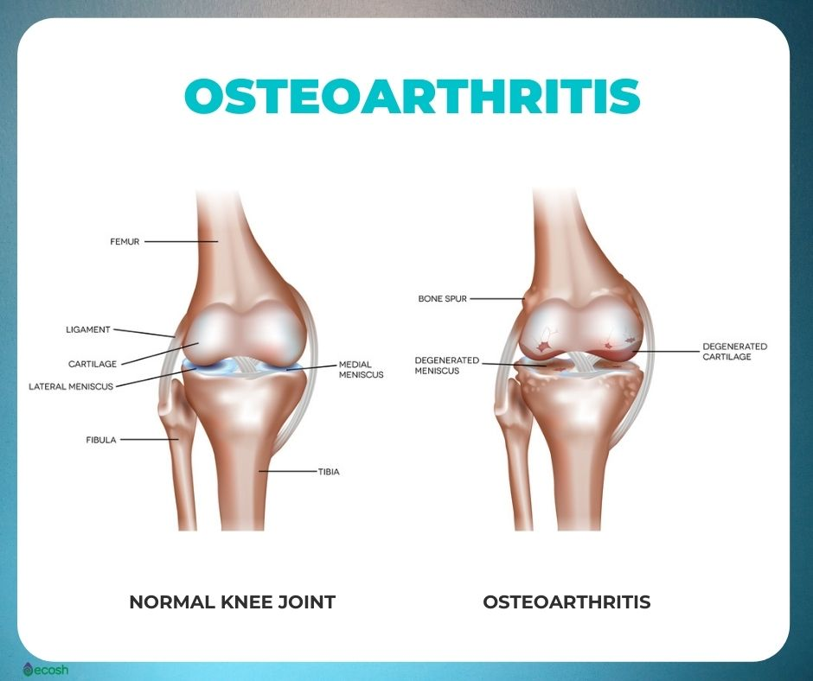
RESTRICTED
PATHOPHYSIOLOGY (CONTD)
4. THIS RESULTS IN A CYCLE OF BIOMECHANICAL AND BIOCHEMICAL DEGENERATION, WHERE THE SHOCK-ABSORBING CARTILAGE IS PROGRESSIVELY DESTROYED
5. THIS EXPOSES THE BONE TO GREATER LOAD AND LEADING TO BONE DAMAGE (BONE MARROW LESIONS)
RESTRICTED

Slide 10
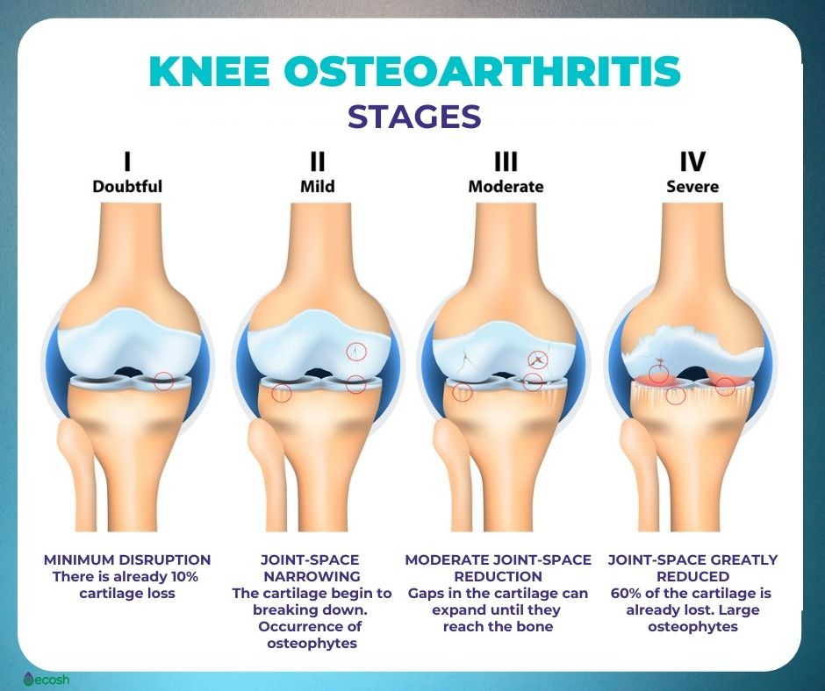
RESTRICTED
PATHOPHYSIOLOGY (CONTD)
RESTRICTED

Slide 11
RESTRICTED
CAUSES
1. OSTEOARTHRITIS CAN AFFECT WEIGHT-BEARING AND NON-WEIGHT-BEARING JOINTS, AND MAY INVOLVE SINGLE OR MULTIPLE JOINTS
2. THE EXACT ETIOLOGY OF OSTEOARTHRITIS IS UNKNOWN HOWEVER THERE ARE RISK FACTORS
RESTRICTED

Slide 12
RESTRICTED
RISK FACTORS
1. AGE
2. TRAUMA
3. OCCUPATION
4. EXERCISE
5. GENDER
6. GENETICS
7. OVERWEIGHT AND OBESITY
8. DIET
9. BONE DENSITY
RESTRICTED

Slide 13
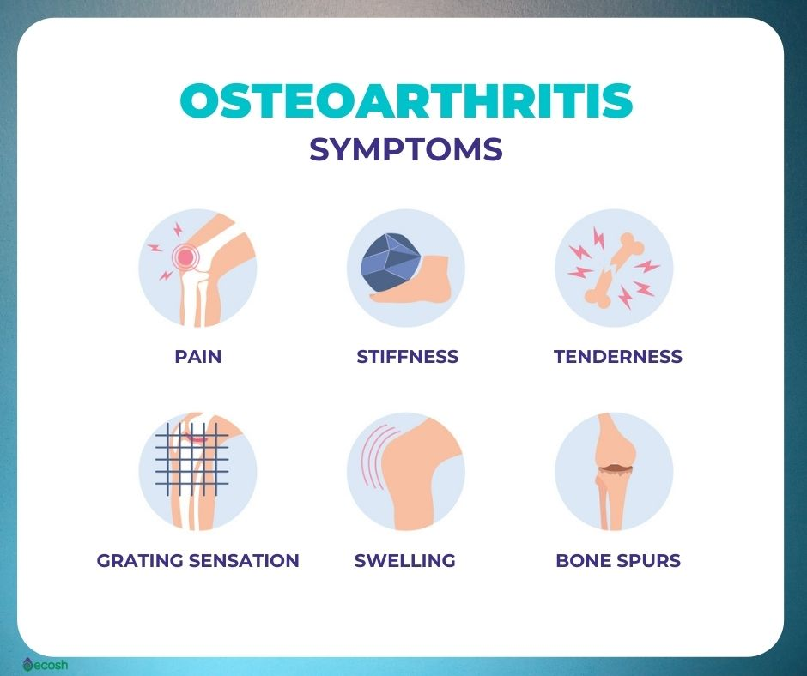
RESTRICTED
SIGNS AND SYMPTOMS
1. PAIN
2. STIFFNESS
3. TENDERNESS
4. LOSS OF FLEXIBILITY
5. GRATING SENSATION
6. BONE SPURS
7. SWELLING
AN IMAGE SHOWING THE SIGNS AND SYMPTOMS OF OA
RESTRICTED

Slide 14
RESTRICTED
DIAGNOSIS
THE DIAGNOSIS OF OSTEOARTHRITIS IS BASED ON SEVERAL FACTORS SUCH AS:
1. AGE
2. HISTORY
3. SYMPTOMS
4. LABORATORY TESTS TO RULE OUT OTHER DISEASES
5. IMAGING TESTS
RESTRICTED

Slide 15
RESTRICTED
MANAGEMENT
1. OSTEOARTHRITIS IS MANAGED SYMPTOMATICALLY
2. THERE IS NO PHARMACOLOGICAL AGENT CAPABLE OF RETARDING THE PROGRESSION OF OSTEOARTHRITIS
3. TREATMENT IS FOCUSED ON RELIEF OF PAIN, MAINTENANCE OF QUALITY OF LIFE, AND PRESERVATION OF FUNCTIONAL INDEPENDENCE
4. MANAGEMENT OF OA IS DIVIDED INTO NON PHARMACOLOGICAL, PHARMACOLOGICAL AND SURGICAL PROCEDURES
RESTRICTED

Slide 16
RESTRICTED
NON-PHARMACOLOGICAL MANAGEMENT
1. WEIGHT MANAGEMENT
2. EXERCISE
3. MASSAGE
4. HEAT AND COLD THERAPY
5. PATIENT EDUCATION
RESTRICTED

Slide 17
RESTRICTED
PHARMACOLOGICAL MANAGEMENT
1. ACETAMINOPHEN
2. NON-STEROIDAL ANTI-INFLAMMATORY AGENTS (NSAIDS)
3. TOPICAL AGENTS
4. OPIOID ANALGESICS
5. STEROID INJECTIONS
RESTRICTED

Slide 18
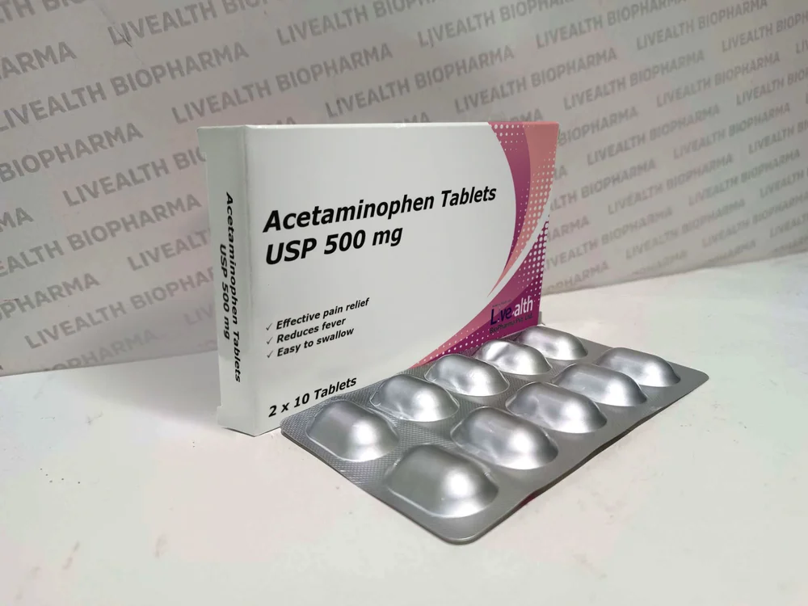
RESTRICTED
PHARMACOLOGICAL MANAGEMENT (CONTD)
ACETAMINOPHEN (PARACETAMOL)
RESTRICTED

Slide 19
RESTRICTED
PHARMACOLOGICAL MANAGEMENT (CONTD)
ACETAMINOPHEN (PARACETAMOL)
1. THIS IS THE FIRST LINE OF DRUG THERAPY IN OSTEOARTHRITIS
2. MOA: ACETAMINOPHEN'S EXACT MECHANISM OF ACTION HAS NOT BEEN FULLY ESTABLISHED
3. SIDE EFFECTS: HEPATOTOXICITY
4. DOSAGE: 3g-4g DAILY IN DIVIDED DOSES
RESTRICTED

Slide 20
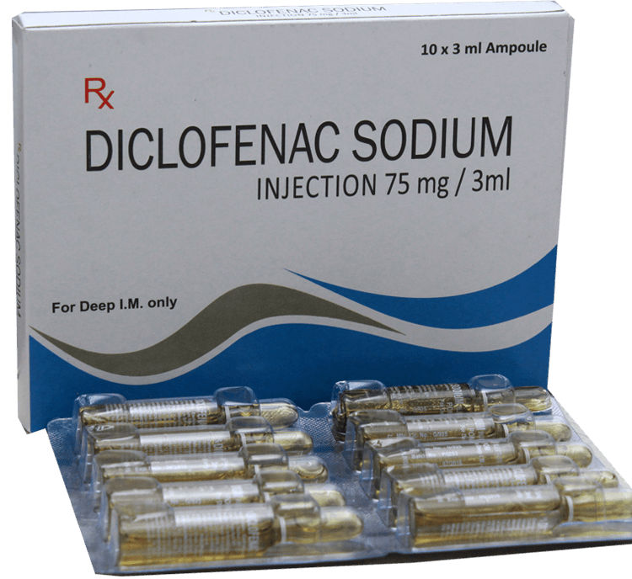
RESTRICTED
PHARMACOLOGICAL MANAGEMENT (CONTD)
NON-STEROIDAL ANTI-INFLAMMATORY AGENTS (NSAIDS)
AN IMAGE SHOWING A PACK OF DICLOFENAL INJECTIONS
RESTRICTED

Slide 21
RESTRICTED
PHARMACOLOGICAL MANAGEMENT (CONTD)
NON-STEROIDAL ANTI-INFLAMMATORY AGENTS (NSAIDS)
1. EXAMPLES: IBUPROFEN, NAPROXEN, DICLOFENAC, CELECOXIB
2. MOA: THEY INHIBIT COX-1 AND COX-2 ENZYMES WHICH ARE INVOLVED IN PROSTAGLANDIN SYNTHESIS
3. SIDE EFFECTS: PEPTIC ULCER, NEPHROTOXICITY
4. CAUTION: CO-PRESCRIPTION OF PROTON PUMP INHIBITORS (PPIS) IS ADVISED FOR HIGH-RISK PATIENTS
RESTRICTED

Slide 22
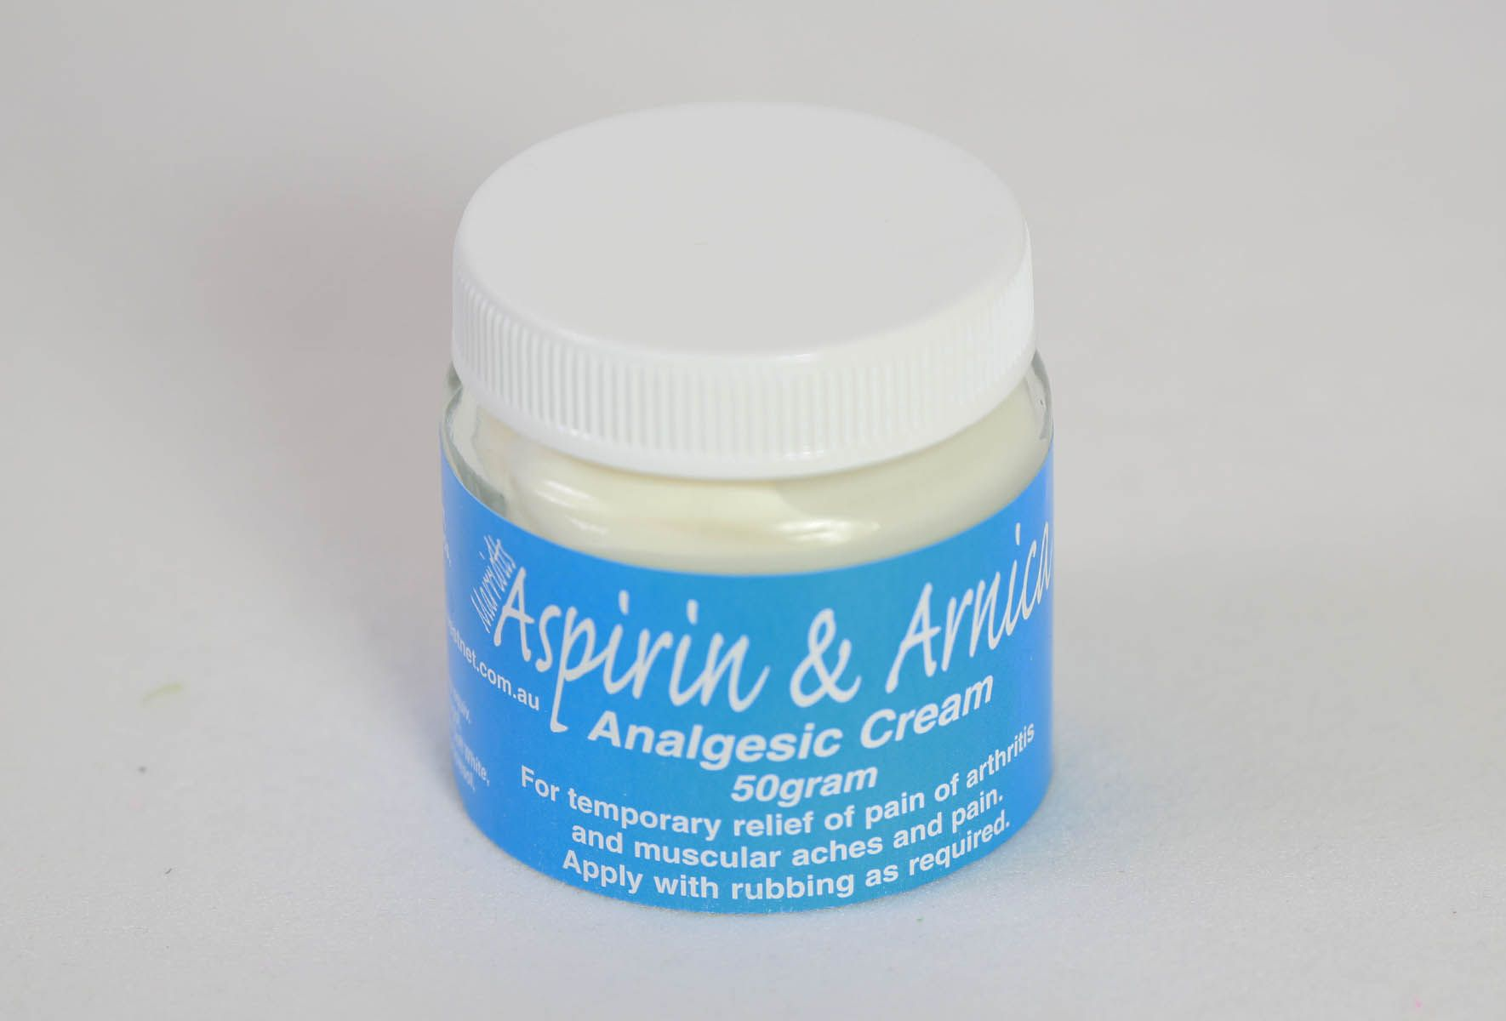
RESTRICTED
PHARMACOLOGICAL MANAGEMENT (CONTD)
TOPICAL AGENTS
AN IMAGE SHOWING AN ASPIRIN CREAM
RESTRICTED

Slide 23
RESTRICTED
PHARMACOLOGICAL MANAGEMENT (CONTD)
TOPICAL AGENTS
1. TOPICAL TREATMENTS ARE USEFUL FOR LOCALIZED OA PAIN
2. THEY ARE SAFER ALTERNATIVE FOR ELDERLY PATIENTS OR THOSE WITH SYSTEMIC RISK FACTORS
3. EXAMPLES: CAPSAICIN CREAM, DICLOFENAC GEL, ASPIRIN CREAMS
4. SIDE EFFECTS: SKIN IRRITATION, BURNING SENSATION
5. CAUTION: PREFERRED IN OLDER ADULTS OR THOSE WITH CONTRAINDICATIONS TO ORAL NSAIDS
RESTRICTED

Slide 24
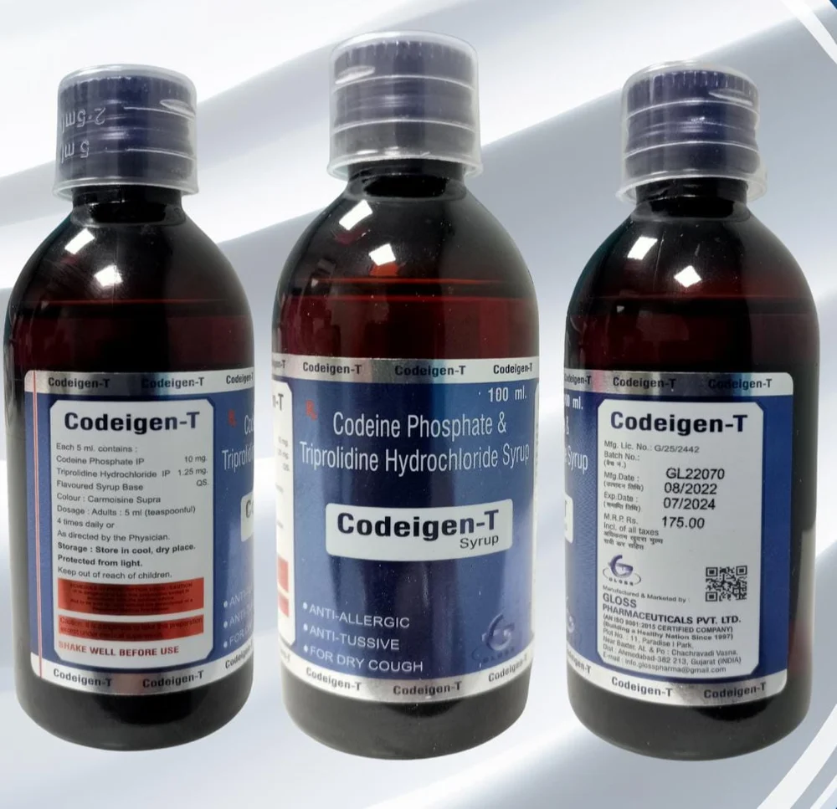
RESTRICTED
PHARMACOLOGICAL MANAGEMENT (CONTD)
OPIOID ANALGESICS
AN IMAGE SHOWING A BOTTLE OF CODEINE PHOSPHATE
RESTRICTED

Slide 25
RESTRICTED
PHARMACOLOGICAL MANAGEMENT (CONTD)
OPIOID ANALGESICS
1. EXAMPLES: TRAMADOL, CODEINE, MORPHINE
2. MOA: BIND TO OPIOID RECEPTORS IN THE CENTRAL NERVOUS SYSTEM TO BLOCK PAIN SIGNALS
3. SIDE EFFECTS: CONSTIPATION, DEPENDENCE, ADDICTION
4. CAUTION: THEY SHOULD BE USED ONLY WHEN ABSOLUTELY NECESSARY, AT THE LOWEST EFFECTIVE DOSE AND FOR THE SHORTEST POSSIBLE DURATION, UNDER CLOSE SUPERVISION
RESTRICTED

Slide 26
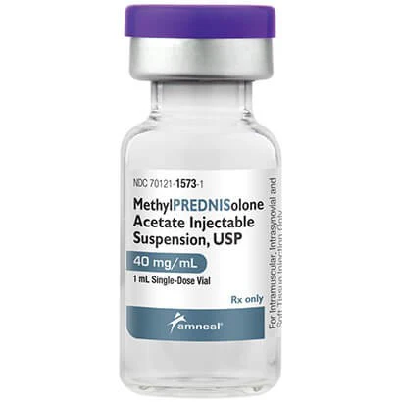
RESTRICTED
PHARMACOLOGICAL MANAGEMENT (CONTD)
STEROID INJECTIONS
AN IMAGE SHOWING A VIAL OF METHYLPREDNISOLONE INJECTION
RESTRICTED

Slide 27
RESTRICTED
PHARMACOLOGICAL MANAGEMENT (CONTD)
STEROID INJECTIONS
1. EXAMPLES: METHYLPREDNISOLONE, HYDROCORTISOL, TRIAMCINOLONE
2. MOA: THE BIND TO INTRA-CELLULAR STEROID RECEPTORS TO BRING ABOUT ANTI-INFLAMMATORY AND IMMUNOSUSUPPRESIVEPPRESIVE EFFECT
3. SIDE EFFECTS: PAIN AT THE SITE OF INJECTION,
4. CAUTION: SHOULD NOT BE USED FOR IMMUNO-COMPROMISED PATIENTS
RESTRICTED

Slide 28
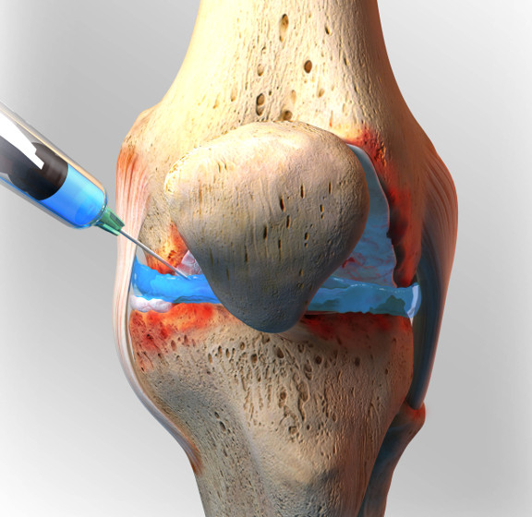
PHARMACOLOGICAL MANAGEMENT (CONTD)
RESTRICTED
STEROID INJECTIONS
AN IMAGE SHOWING THE SITE OF ADMINISTRATION OF STEROID INJECTIONS
RESTRICTED

Slide 29
RESTRICTED
SURGICAL PROCEDURES
1. JOINT REPLACEMENT SURGERY (ARTHROPLASTY)
2. JOINT FUSION SURGERY (ARTHRODESIS)
3. OSTEOTOMY
4. JOINT REVISION SURGERY
RESTRICTED

Slide 30
RESTRICTED
CONCLUSION
RESTRICTED

Slide 31
RESTRICTED
RECOMMENDATIONS
1. THE CNS SHOULD ENSURE THAT SCREENING FOR OSTEOARTHRITIS IS CARRIED OUT DURING RECRUITMENT
2. THE COMMANDANT SHOULD DIRECT THE MOIC TO CREATE ROUTINE AWARENESS ON ARTHRITIS ESPECIALLY OSTEOARTHRITIS
3. THE HOD PHARMACY DEPARTMENT SHOULD CONTINUE TO PROVIDE POTENT ANALGESICS FOR THE MANAGEMENT OF OSTEOARTHRITIS
4. THE CATERING OFFICER SHOULD CONTINUE TO PROVIDE BALANCE DIET IN ORDER TO REDUCE BINGE EATING AMONG STUDENTS
RESTRICTED

Slide 32
RESTRICTED
REFERENCES
1. Lawrence RC and Helmick CG. Estimates of the prevalence of arthritis and selected musculoskeletal disorders in the United States. Arthritis and rheumatism. 1998;41(5):778-799.
2. Hawker GA. Osteoarthritis is a serious disease. Clinical and experimental rheumatology. 2019;37(Suppl 120):3-6. 3.
3. Culliford D. Future projections of total hip and knee arthroplasty in the UK: results from the UK Clinical Practice Research Datalink. Osteoarthritis and cartilage.
4. Veronese N. Osteoarthritis and mortality: A prospective cohort study and systematic review with meta- analysis. Seminars in arthritis and rheumatism. 2016;46(2):160-167.
RESTRICTED

Slide 33
RESTRICTED
THANK YOU FOR YOUR RAPT ATTENTION
RESTRICTED

