Slide 1

Neighborhood Helper – Connecting Local Needs and Skills
A web-based platform for linking people who need small tasks done with local helpers.
It encourages community cooperation and provides affordable, reliable local help.

Slide 2

Problem Overview
Many communities struggle with:
• Difficulty finding trustworthy local help for small tasks.
• Lack of visibility for individuals offering affordable services.
• Manual, time-consuming coordination through social media or word-of-mouth.

Slide 3

Problem Aspects Solvable by a Program
The Neighborhood Helper program can:
• Automate the matching of requests and helpers.
• Store helper profiles, skills, and reviews.
• Simplify communication and job posting.
• Build trust through transparent history and feedback.

Slide 4

Transformation of the Original Process
Before: Manual searching, inconsistent communication, and no records.
After: Centralized, transparent, and efficient online interaction.
The program replaces traditional bulletin boards and word-of-mouth with an easy digital alternative.

Slide 5

Requirements of the Solution
The application must:
• Allow user registration and profile creation.
• Support posting, searching, and sorting.
• Enable communication and feedback.
• Be lightweight and function offline with localStorage.
• Offer an intuitive, user-friendly interface.

Slide 6

Impact on the Operating Model
Neighborhood Helper changes the model by:
• Enabling self-service job management.
• Reducing the need for middlemen.
• Automating matches, feedback, and alerts.
• Empowering users to connect directly and manage local resources.

Slide 7
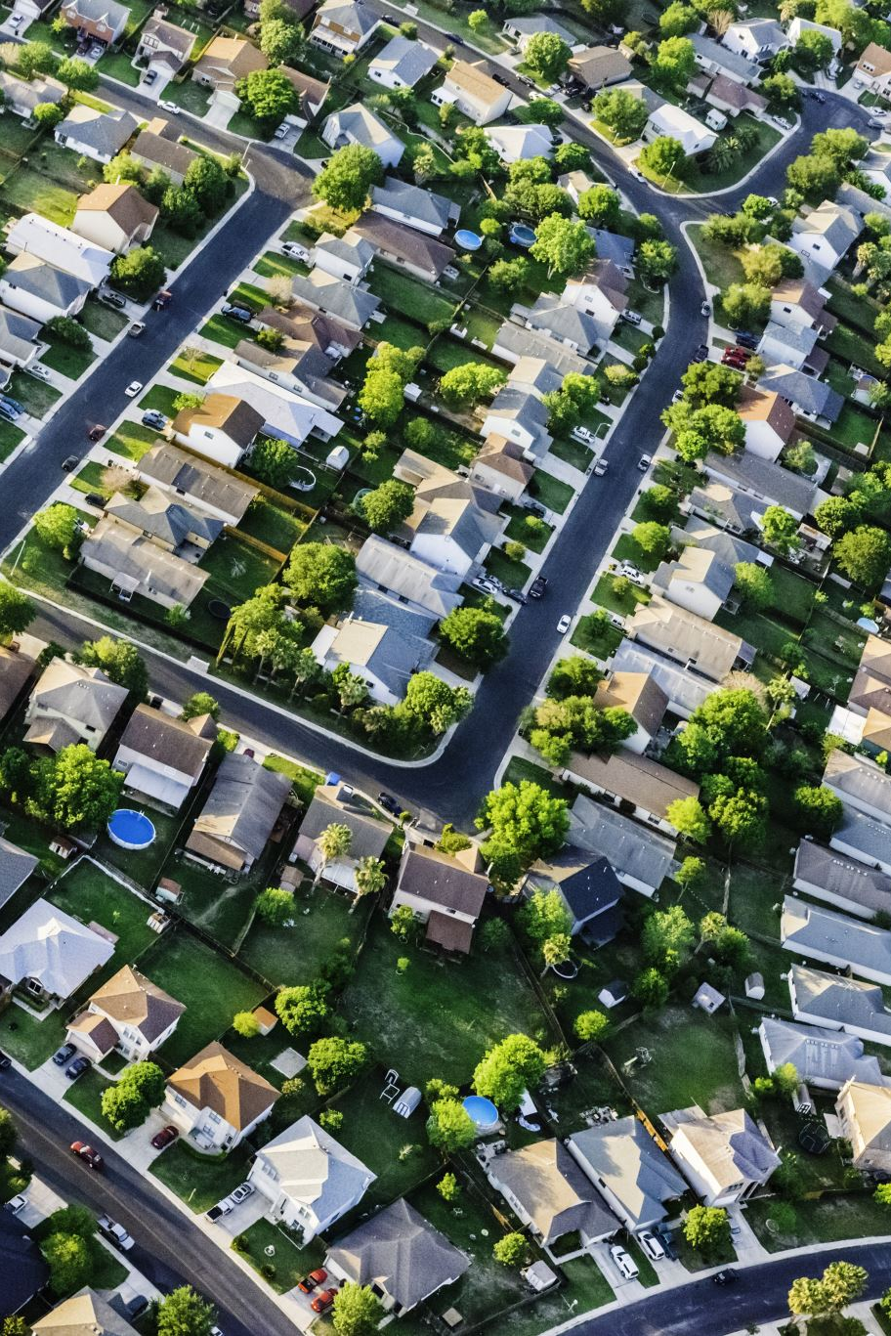
Usage Scenarios
The program will be used in:
• Residential neighborhoods and small towns.
• Community centers promoting cooperation.
• Student housing and retirement homes.
• Daily life situations on phones and PCs.

Slide 8

Technical Requirements
• Fully functional local HTML app (no server required).
• Uses browser localStorage for data persistence.
• Future option for cloud/server scalability.
• Runs on all modern browsers and devices.

Slide 9

Software Architecture
Architecture Overview:
• Frontend: HTML, CSS, JavaScript (single file structure).
• Data Layer: localStorage.
• Modular Components: dynamic JS-rendered pages.
• Scalable design ready for REST API expansion.

Slide 10

Ensuring Correct Functionality
To maintain quality:
• Validate inputs before saving data.
• Test all interactions and flows.
• Use community feedback for improvements.
• Include reset and backup functions for data safety.

Slide 11

Usability Considerations
Key usability goals:
• Clear navigation and visual hierarchy.
• Mobile-friendly responsive design.
• Accessibility for all ages.
• Input validation to prevent user errors.

Slide 12

How to Use the Program
1. Open index.html in any browser.
2. Use the navigation menu to access each feature.
3. Post requests or register as a helper.
4. Chat, rate, and favorite helpers.
5. View personal activity in Dashboard.
Outcome: A prototype that demonstrates how simple digital tools strengthen community collaboration.

