Slide 1
RevCycle BOT

Slide 2
Objective
Handle to reach out for internal resources just a chat away
SharePoint documents , Jira, GitHub
Futuristic thoughts
New Acute Case Management UI powered with chat

Slide 3



What’s my goal?

Slide 4
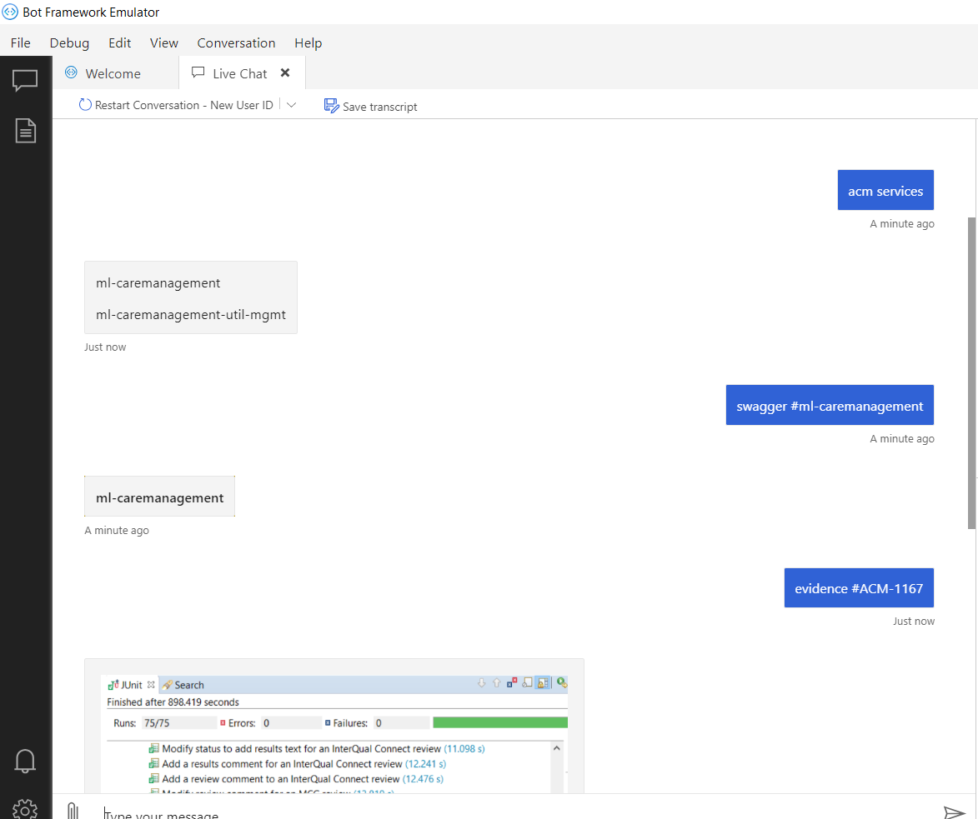
What’s going on !!!!
What’s Done?
Integrated Git Hub
Integrated JIRA as an anonymous user
Challenges?
Working on JIRA Rest API (Access key authentication)
Web scrapping (Associate login page)
Screenshot

Slide 5



Tech Stack

Slide 6
Thank you

