Slide 1
LAB 01
Platform bring-up and reproducible boot
Notes:
110 minutes. Kits are handed out at the start, one per student, and they keep them for the semester. Confirm every student has an NVMe drive, a power supply and a monitor cable before anyone opens a box — there is no reserve pool to make a shortfall up from. See doc 04 R-10.
[Sources]
— docs/03_syllabus_map.md §2–3 — lecture and lab pairing, per-lab detail

Slide 2
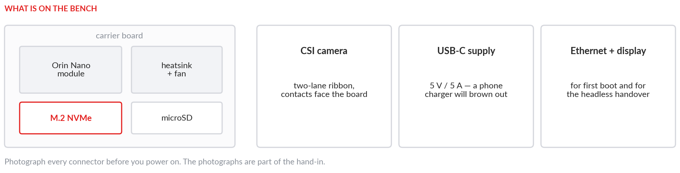
What is inside this machine?
Today's question: what is actually inside this machine, and how do I prove it?
Distrust any claim about this system that does not arrive with the command that verifies it.
ENEE459L · Lab 01 · Platform bring-up
Notes:
Open with the question rather than the procedure. Students who understand that the deliverable is evidence, not a booted board, produce far better reports.
[Sources]
— docs/03_syllabus_map.md §2–3 — lecture and lab pairing, per-lab detail
— CLAUDE_INSTRUCTION_ENEE459L.md §四, §十 — course scope; the rule that a number is measured, cited, or visibly marked illustrative

Slide 3
What you build, what you hand in
You build
A unit that boots from NVMe, not from the SD card
A health report a classmate can regenerate on their own board
Assembly photographs taken as you go, not reconstructed afterwards
You hand in
system_report.json
Boot log
lsblk and findmnt output
Assembly photographs
One paragraph on a result you did not expect
ENEE459L · Lab 01 · Platform bring-up
Notes:
The last item on the right is the one that separates this course from a tutorial. It is graded, and a paragraph saying nothing was surprising is not a pass.
[Sources]
— docs/03_syllabus_map.md §2–3 — lecture and lab pairing, per-lab detail
— docs/10_bringup_procedure.md — the bench procedure this slide compresses

Slide 4
The session in five moves
01
02
03
04
05
Assemble and inspect
Flash and first boot
Move root to NVMe
Run the health report
Compare with a neighbour
ENEE459L · Lab 01 · Platform bring-up
Notes:
Rough timing: 20 minutes assemble, 25 flash and boot, 25 migrate root, 20 report, 15 compare and submit. Step 3 is the one that runs long; watch the room and cut step 1 short if kits arrive part-assembled.
[Sources]
— docs/10_bringup_procedure.md — the bench procedure this slide compresses
— docs/03_syllabus_map.md §1 — course spine, 110-minute session structure, evidence discipline

Slide 5
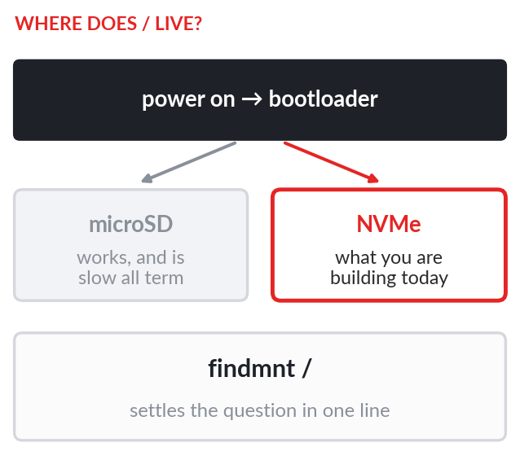
Prove it with a command
$ lsblk -o NAME,SIZE,TYPE,MOUNTPOINT
what block devices exist
$ findmnt /
which one root is actually mounted from
$ sudo lspci -vv | grep -E 'LnkCap|LnkSta'
what the link can do, and what it settled for
Every claim in your report must be traceable to a command in your log.
Notes:
Have them run all three before the migration and again after, and keep both. The two findmnt outputs together are the cleanest possible demonstration of what changed.
[Sources]
— docs/10_bringup_procedure.md — the bench procedure this slide compresses
— Read from the lab's own output — the code is in the repository and the run can be repeated

Slide 6
Three ways this goes wrong
Booted from SD
Ribbon reversed
Running without sudo
The unit comes up, everything appears to work, and every disk-bound step is slow for the rest of the semester. findmnt / is the check that catches it.
The CSI connector will latch either way round. Contacts face the board. A reversed ribbon enumerates as nothing at all, which reads like a dead camera.
Several checks need elevation. Without it they record as SKIP, and a SKIP is not evidence of anything — least of all of a pass.
ENEE459L · Lab 01 · Platform bring-up
Notes:
Show the SD-boot failure before they hit it. It is the failure mode this lab exists to teach, because it is silent — nothing errors, the machine is simply slower than the one next to it.
[Sources]
— docs/04_risk_register.md — the risk this slide is mitigating
— docs/03_syllabus_map.md §2–3 — lecture and lab pairing, per-lab detail

Slide 7
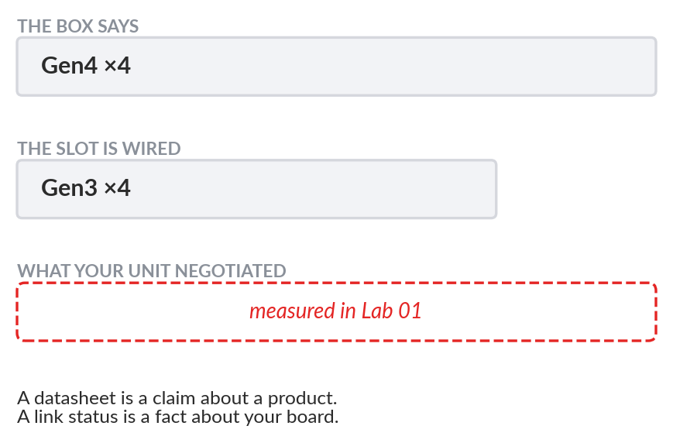
Spec sheet versus link speed
The M.2 slot on this carrier is wired for Gen3. Fit a Gen4 drive and it negotiates down — the sequential figure on the box never appears.
Read the negotiated width and speed out of LnkSta and compare it against LnkCap. The gap between them is the lesson.
Our units: ‹MEASURED: nvme_lnksta› negotiated, against a capability of ‹MEASURED: nvme_lnkcap›
ENEE459L · Lab 01 · Platform bring-up
Notes:
The two blanks are filled from the class's own preflight run before this lab is taught. Do not substitute a plausible number — the whole point of the slide collapses if the figure did not come off these boards.
[Sources]
— docs/01_hardware_platform_matrix.md §1, §3.2 — M.2 Key-M slots and lane widths
— common/media/photos/MANIFEST.md — receiving photographs and what they prove

Slide 8
Evidence and checkpoint
Measurements to record
Device inventory
NVMe negotiated link speed and width
Thermal idle baseline, per zone
All three go into the course benchmark schema, not into prose.
Checkpoint · last 15 min
Show your report to a neighbour
Find one field where your units disagree
Write one paragraph on why, and submit it
Identical hardware does not give identical numbers. Their report is a control, not your hand-in.
A system claim is worthless without a command that verifies it.
ENEE459L · Lab 01 · Platform bring-up
Notes:
The comparison is what makes unit-to-unit variation real, and it is the only control a student working alone has. Expect disagreement in idle temperature and, if any kit was mis-assembled, in link speed. Say out loud that the neighbour's report is not part of anybody's hand-in; otherwise somebody copies a field out of it.
[Sources]
— docs/03_syllabus_map.md §1 — course spine, 110-minute session structure, evidence discipline
— docs/06_measured_backfill_register.md — the open ‹MEASURED› tokens this slide carries

