Slide 1

E-Commerce Consumer Analytics Project
CERTIFICATE COURSE ON ARTIFICIAL INTELLIGENCE & DATA SCIENCE
OFFERED BY CMATER, DEPT. OF CSE, JU
A 4-Level Analytics of E-Commerce Consumer Behavior with Machine Learning and Tableau Dashboard
By Kingsuk Ghosh
Guide: Prof. Subhadip Basu & Sir Pradipta Sarkar

Slide 2
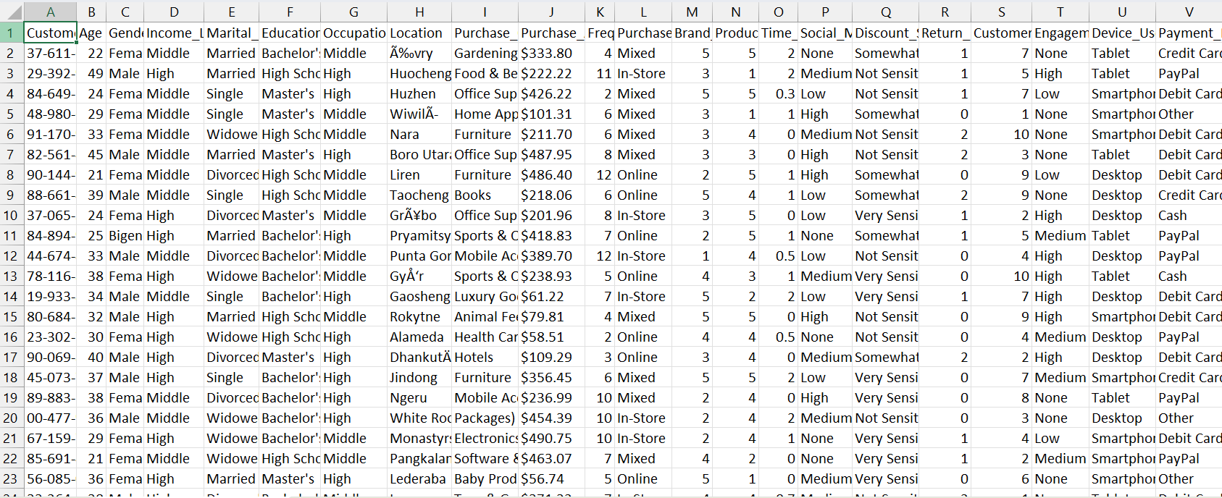
Introduction
E-commerce platforms generate large customer data.
This dataset includes features like purchase amount, satisfaction, rating, loyalty etc. [LINK: DATASET]
Fig. 1: Dataset

Slide 3
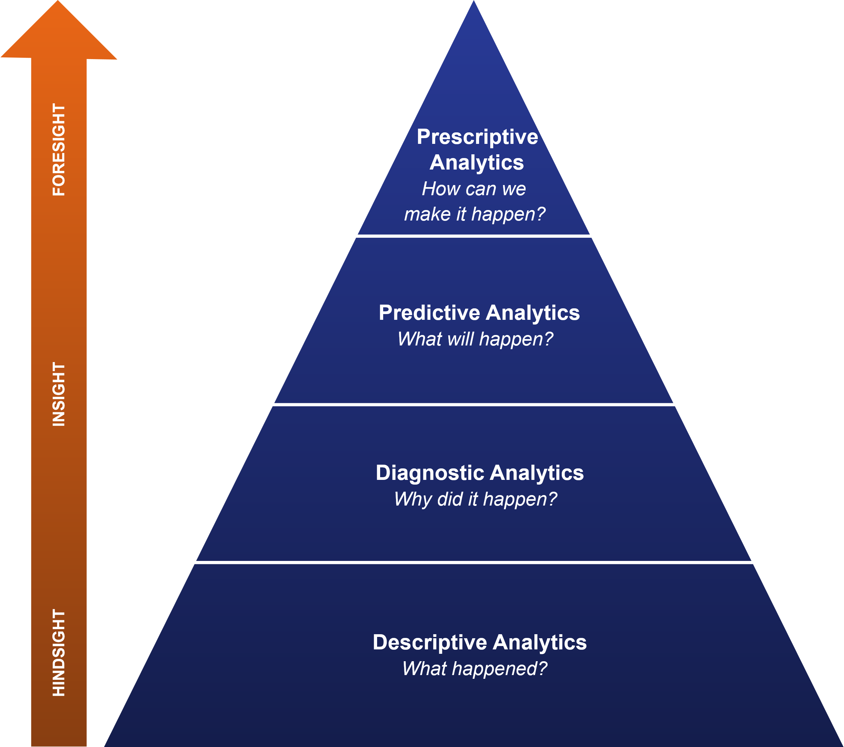
Introduction
This project uses a 4-level analytics approach (Descriptive, Diagnostic, Predictive, Prescriptive) using ML and Data Visualization by Tableau to better understand and improve customer behavior.
Fig. 2: The Four Levels of Data Analytics

Slide 4
Objectives
Segment customers using clustering.
Find key factors affecting satisfaction.
Predict purchase level (Low, Medium, High).
Suggest actions to improve satisfaction.
Create a Tableau dashboard for insights.

Slide 5
Methodology
Data Preprocessing
Descriptive: KMeans Clustering
Diagnostic: Decision Tree
Predictive: Classifier for Purchase Level
Prescriptive: Action Suggestions
Tableau Dashboard
LINK: PYTHON NOTEBOOK IN COLAB

Slide 6
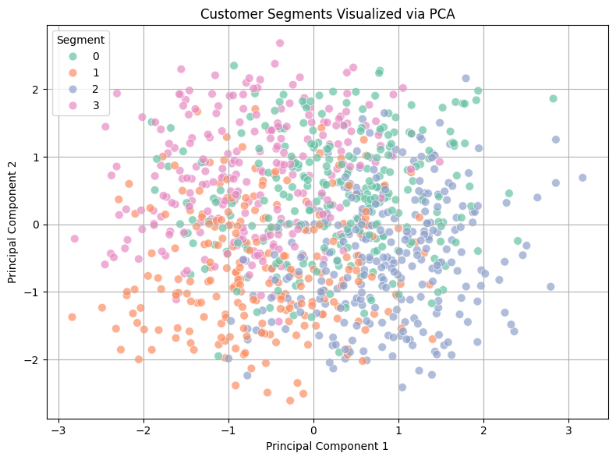
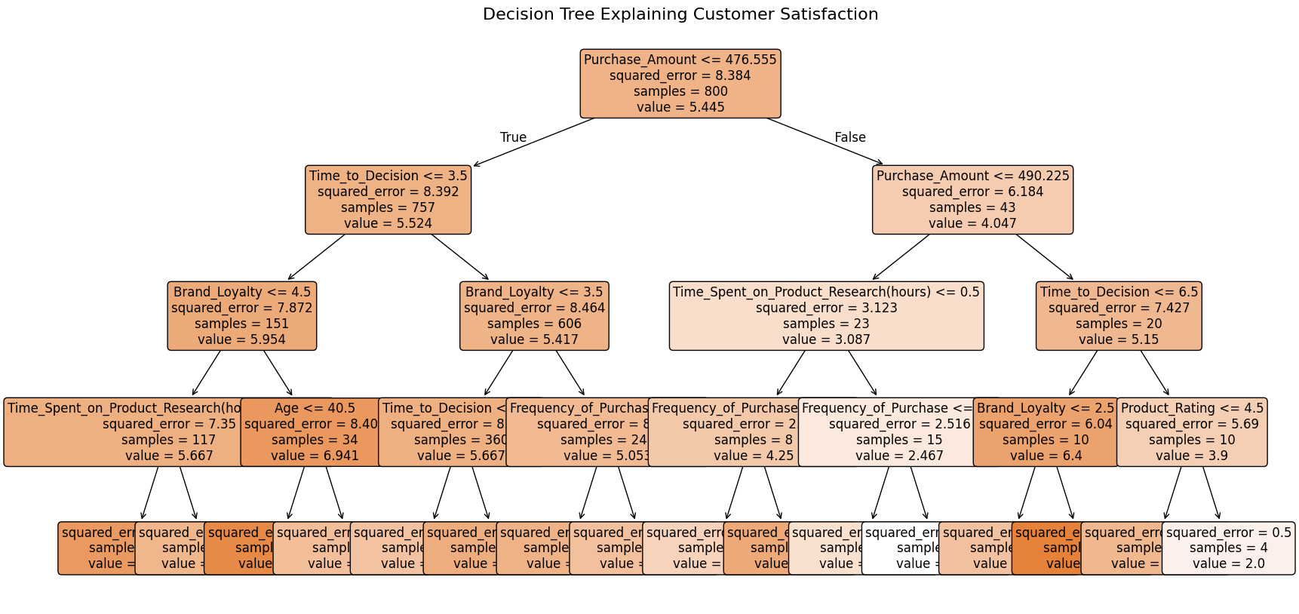
Key Results
4 customer segments identified.
Loyalty & Return Rate affect satisfaction.
Purchase level predicted with ~86% accuracy.
Model suggested actions to improve satisfaction.
Fig. 3: Customer Segmentation by KMeans Clustering
Fig. 4: Decision Tree for Customer Satisfaction

Slide 7
Tableau Dashboard
Interactive visualizations created in Tableau.
Shows customer segments, satisfaction, and trends.
Helps understand data at a glance.
LINK: TABLEAU DASHBOARD

Slide 8
Limitations & Conclusion
Less data in some categories.
Real-world factors like price/delivery missing.
Model assumes recommended changes will work in real life.
Project used ML and Tableau for 4-level analysis.
Helped understand and improve customer behavior.
Gave actionable insights for better business decisions.

