Slide 1
Sound Manipulations for Experimental Stimuli
Ed King
2/10/12
stanford.edu/~etking/praat

Slide 2
Goals
go over some of the stimuli-creation / modification tools available in Praat
manual manipulation
continua creation
give a high-level overview of the thought process behind stimuli creation

Slide 3
Creating stimuli
record a sound
extract some analysis (pitch, formants) from the sound
modify the analyzed object (PitchTier, FormantTier)
recombine the modified analysis object with the sound

Slide 4
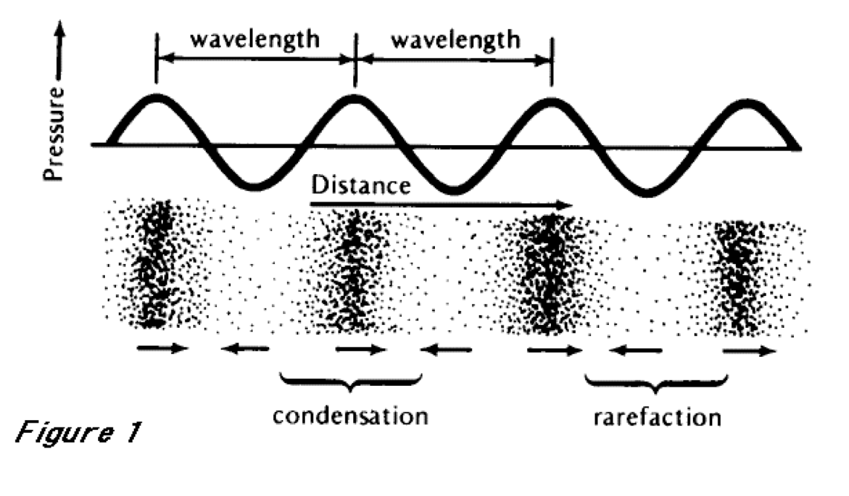
Some basics of sound

Slide 5
Some basics of Praat
opening a sound
saving a sound
extracting part of a sound
combining sounds

Slide 6
Intensity manipulation
changing whole word intensity
Sound: Modify -> Scale peak…
changing part of word intensity
Sound: To Intensity…
Intensity: Down to IntensityTier
IntensityTier+Sound: View & Edit
IntensityTier+Sound: Multiply

Slide 7
Pitch manipulation
Sound: To Manipulation…
(Manipulation: Play (overlap-add)
or Manipulation: Get resynthesis (overlap-add))
Manipulation: Extract pitch tier
whole word
PitchTier: Modify -> Formula…
PitchTier+Manipulation -> Replace pitch tier

Slide 8
Pitch manipulation 2
part of word
PitchTier+Sound: View & Edit
PitchTier+Manipulation: Replace pitch tier

Slide 9
Duration manipulation
whole word (stupid way)
Sound: Modify -> Modify times -> Scale times by…
whole word (better way)
Manipulation: Extract duration tier
DurationTier: Modify -> Formula…
DurationTier+Manipulation: Replace duration tier

Slide 10
Duration manipulation 2
part of word
DurationTier+Sound: View & edit
DurationTier+Manipulation: Replace duration tier

Slide 11
Demo: stress
stress in English is indicated by pitch, intensity, duration, and vowel centralization
we know how to change three of these
start with a word, “papa”
modify one version to have initial stress
modify one version to have ultimate stress

Slide 12
Continua
manual manipulation requires a lot of fiddling
sounds more natural to just use a speaker’s values
and sometimes we want a range of values
categorical perception studies
changing category boundaries

Slide 13
Continua: general strategy
record two sounds (endpoints)
extract some analysis along some dimension
gradually change the dimension of one endpoint, over some number of steps, to get closer to the other endpoint
usually do this with a script

Slide 14
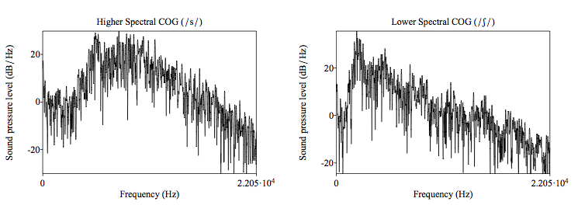
Fricative continuum
adapted from Styler 2011

Slide 15
Fricative continuum 2
we want to shift the spectral center of gravity
/s/-like to /sh/-like
we do this by directly modifying the sound wave
we aren’t good at analyzing / resynthesizing fricatives
the large spectral shapes of fricatives will sound okay at the midpoint
mono_continuum.py 1.wav 2.wav numsteps

Slide 16
Voicing continuum
s
z

Slide 17
Voicing continuum 2
we want to gradually add a low-frequency (voicing) peak to the spectrum
we also do this by directly manipulation the sound wave
voicing is a presence / absence property
so gradually adding periodicity to the sound file will work well

Slide 18
Formant continuum
a
i

Slide 19
Formant continuum 2
we want to gradually shift the vowel formants from the /a/ endpoint to the /i/ endpoint
DON’T do this by directly manipulating the sound file
formants are not presence/absence
they have spectral location, like fricatives
their distribution is not big enough, like fricatives, to sound reasonable in the middle

Slide 20
Formant continuum 3
instead, do formant resynthesis
Sound: Formants & LPC -> To LPC (burg) …
LPC+Sound: Filter (inverse)
LPC: To Formant
Formant: Down to Formant grid
FormantGrid+Sound: Filter
script for all this
create_continuum.praat

Slide 21
Other continua
nasality
nasality is presence/absence, and we are not good at analyzing/resynthesizing it
so do direct sound wave manipulation
Styler et al 2011 (ASA poster)
savethevowels.org/asa2011
pitch
we can analyze pitch pretty well, and it has important location
so do Sound: To Manipulation and modify the pitch as we did before

Slide 22
Continua, wrap-up
direct waveform manipulation
pros: simple, robust to measurement error
cons: can only add elements to a spectrum (can’t shift)
analysis & resynthesis
pros: can shift spectral elements (anything you can reliably measure)
cons: brittle under measurement error, requires knowing exactly what to measure

Slide 23
Other manipulations
band-pass (or high- or low-pass) filtering
Sound: Filter -> Filter (pass Hann band)
select the frequencies you want to allow
VOT manipulations
can cut/paste aspiration
but this does funny things to the (mostly masked) formant transitions
better to do it as a manual duration manipulation as on slide 10

Slide 24
Resources
all these materials
http://www.stanford.edu/~etking/praat
Akustyk for Praat
scripts and interfaces for analysis & synthesis
http://bartus.org/akustyk/
some script archives
http://www.linguistics.ucla.edu/faciliti/facilities/acoustic/praat.html
http://www.psychology.uiowa.edu/students/toscano/scriptarchives/

