Slide 1

CO-1 AT-3
• A Smart hom automation System is being designed to manag
lighting, temperture, and Security based on user
behavior and environmental conditions. The System must
respond to real-time inputs such as motion detection
temperisture changes, and time of day while also.
learning user Perference over time. In this content
explain th different types of intelligent agents
A) Intelligent Agents in Smart Home.
+ Simple Refler Agent...
Arts only on the current sitution Example: if
motion is detected, turn on the light
+ Model Based Agent..
Maintains information about the environment.
Example: remembers room temperature and Pryious
conditions.
Groal Based Agents/
Takes action to achiow a specific goal. Examp
maintains a comfortable temperatur
Utility-Based Agent.
chooses the best action based on wefulness.
Example: balances confort, energy saving, and
14
★
Security

Slide 2

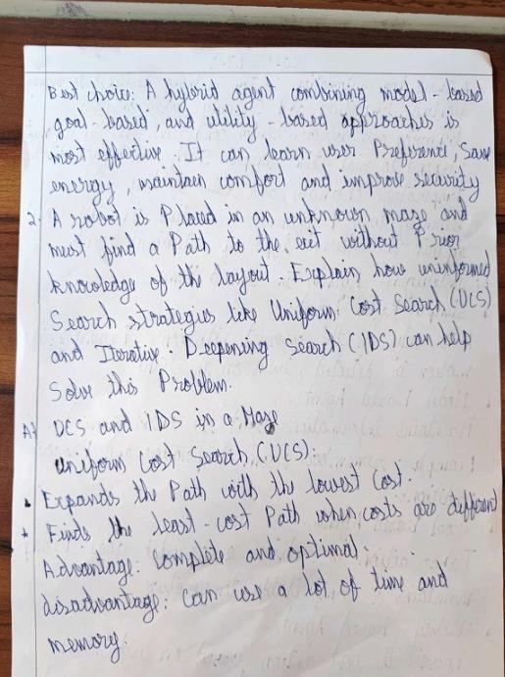

Slide 3

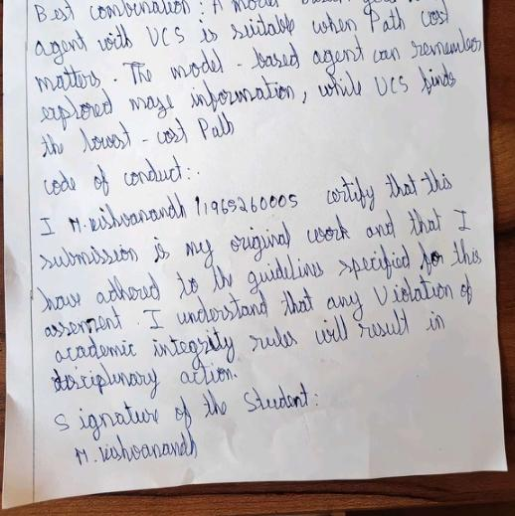
Iteractive Deeping Search (IDS),
Searches
depth, then depth 7, depth 2 and so on
Advantage: Uses less memory and is complete
disadvantage: Repeats Searches, So it can tak
Best coarbination: A model-based/good based
goa based
+
more teine

