Slide 1
YOUR EYEBROW TEXT
Your Presentation Title Goes Here
Research Focus: Your Field · Your Method
First Author
Your Institution · Your Event Name
Topic one
Topic two
Topic three
Notes:
Good morning/afternoon everyone. My name is [Name] and today I will be presenting our study on [topic]. This work was conducted at [Institution] in collaboration with [Collaborators]. I will walk you through our research question, methods, key findings, and what these results mean for practice and future research.

Slide 2
THE STUDY
Title & citation
Your Paper Title Goes Here: A Descriptive Subtitle If Needed
Author A., Author B., Author C., Author D.
Journal Name · Volume(Issue): Pages · Month Year
Study design
Setting
Key metric
What is the main question your study addresses?
Notes:
This slide shows the full citation for the paper we are discussing. The study was published in [Journal] and represents [X] years of work. The key contribution is [one-sentence summary of what the paper does that is novel].

Slide 3
BACKGROUND
Why this study matters
CONTEXT
RESEARCH QUESTION
Background point one
Background point two
Background point three
Gap in existing evidence
What is your main research question?
GAP & HYPOTHESIS
What gap in the literature does your study address?
What is your hypothesis?
Notes:
The motivation for this study comes from [brief context]. Despite growing attention to [topic], there remains a gap in [specific gap]. Our study addresses this by asking [research question]. This matters because [why the audience should care].

Slide 4
STUDY DESIGN
Cohort, measures, and analytical approach
1,234
3
OLS
participants in your sample
measurement time points
your analytical method
MEASURES
ANALYTICAL APPROACH
Outcome measure one: instrument name
Outcome measure two: instrument name
Outcome measure three: instrument name
Covariates: list here
Your primary analytical method
Model specification details
Sensitivity analyses conducted
Software used
Notes:
We used a [study design] with [N] participants measured at [X] time points. Our primary outcome was [outcome], assessed using [instrument]. We analysed the data using [method], adjusting for [covariates]. All analyses were conducted in [software].

Slide 5
RESULTS
Your first set of results
Description of what this table shows
Outcome | Group A | Group B
Outcome one | −0.15 ** | −0.08
Outcome two | −0.13 * | −0.11 *
Outcome three | −0.18 *** | −0.12 **
KEY TAKEAWAY
Main finding one
Main finding two
Main finding three
* p<.05 ** p<.01 *** p<.001 NS = not significant β = standardized coefficient
Notes:
Turning to our first set of results. This table shows [what the table presents]. The key pattern here is [describe the main trend]. Notice that [specific observation about a row or column]. This suggests that [interpretation].

Slide 6
RESULTS
Your second set of results
Description of what this table shows
Predictor | Group A | Group B
Predictor one | −0.21 * | −0.23 ***
Predictor two | NS | −0.16 ***
Predictor three | −0.15 *** | −0.10 *
KEY FINDING
Finding one
Finding two
Finding three
* p<.05 ** p<.01 *** p<.001 NS = not significant β = standardized coefficient
Notes:
This second table presents [what Table 2 shows]. The most striking finding is [highlight key result]. Compared to Table 1, we see [difference or consistency]. This is important because [why it matters].

Slide 7
KEY NUANCE
Comparing two dimensions
DIMENSION A
DIMENSION B
Finding for dimension A, time point 1
Finding for dimension A, time point 2
Pattern description
Interpretation
Finding for dimension B, time point 1
Finding for dimension B, time point 2
Pattern description
Interpretation
IMPLICATION
What this comparison means for theory or practice
Which dimension matters more and why
Notes:
A closer look at [Dimension A] versus [Dimension B] reveals an important nuance. On the left, [Dimension A] shows [pattern]. On the right, [Dimension B] shows [pattern]. The contrast between these two dimensions tells us [implication]. This distinction has practical consequences for [field or application].

Slide 8
DISCUSSION
Contextualising the findings
FINDING IN CONTEXT
INTERPRETATION
How your results compare to existing literature
Consistent or contradictory findings
Possible explanations
Why your findings might differ from prior work
Methodological differences that matter
Theoretical implications
STRENGTHS
LIMITATIONS
Strength one: sample size, design, etc.
Strength two: novelty, measures, etc.
Limitation one: design, generalisability, etc.
Limitation two: measures, attrition, etc.
Notes:
In the broader context, our findings [align with / diverge from] prior work by [Author, Year]. The top-left panel summarises this comparison. Our interpretation is that [explanation for pattern]. Key strengths of this study include [strengths]. We acknowledge limitations such as [limitations], which should be considered when interpreting these results.

Slide 9
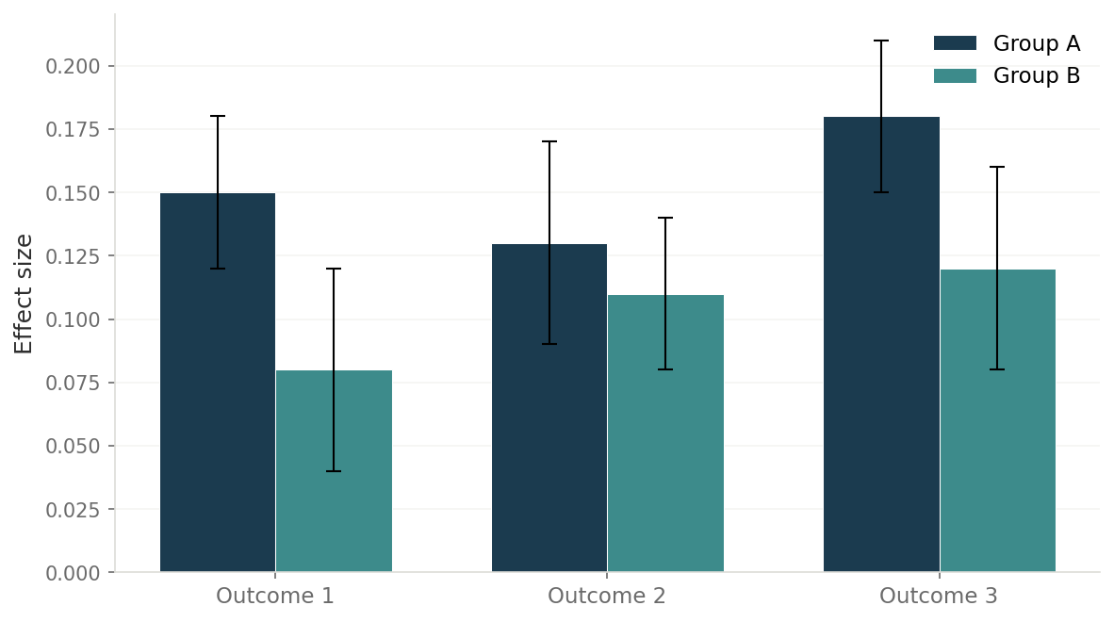
KEY FIGURE
Results visualisation
Figure 1. Replace this chart with your own using s.addImage(). Place the file in assets/.
Notes:
This figure visualises [what the figure shows]. The x-axis represents [variable] and the y-axis represents [variable]. The key pattern to notice is [describe the visual trend]. The error bars indicate [what they represent]. This visual confirms the statistical findings we discussed earlier.

Slide 10
IMPLICATIONS
Translating findings into practice
For practice
For policy
For research
Implication one for practitioners
Implication two for practitioners
Implication three for practitioners
Implication one for policy
Implication two for policy
Implication three for policy
Implication one for future research
Implication two for future research
Implication three for future research
Your key message that ties the implications together
Notes:
These findings carry implications across three domains. For practice, [practical implication]. For policy, [policy implication]. For future research, [research implication]. The overarching message is that [single takeaway that ties all three together].

Slide 11
THANK YOU
Questions?
Notes:
Thank you for your attention. I am happy to take questions. If you would like to know more, the full paper is available at [DOI or URL] and I can be reached at [email].

