Slide 1
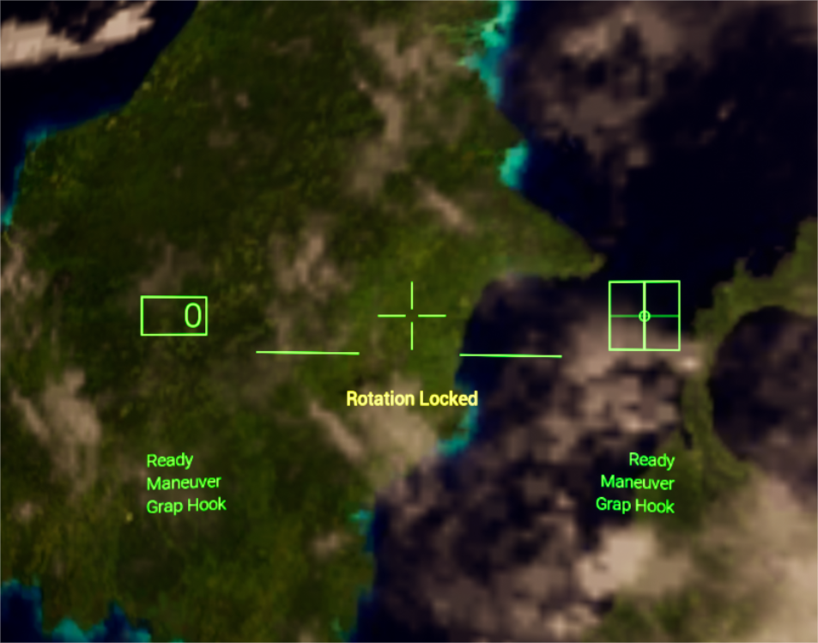
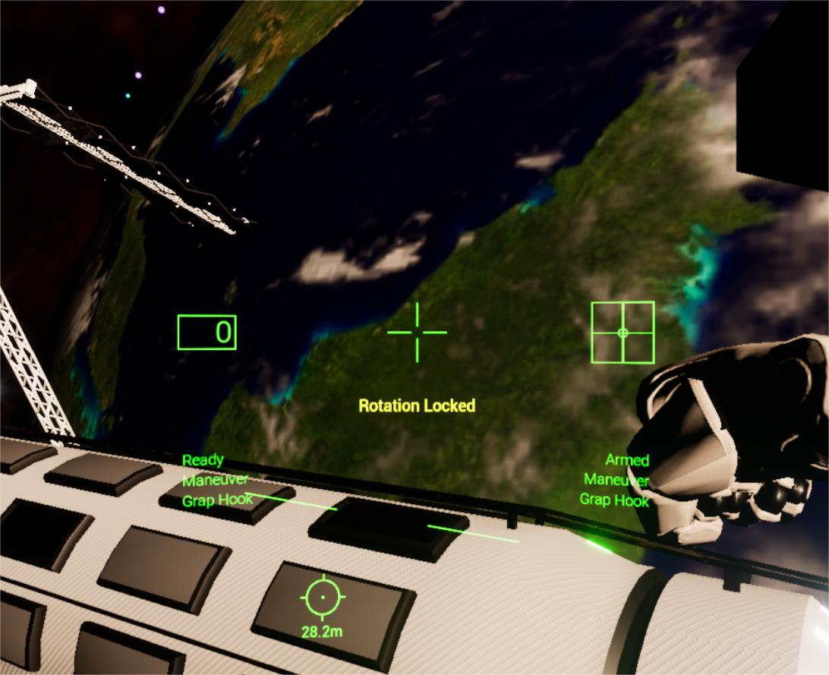
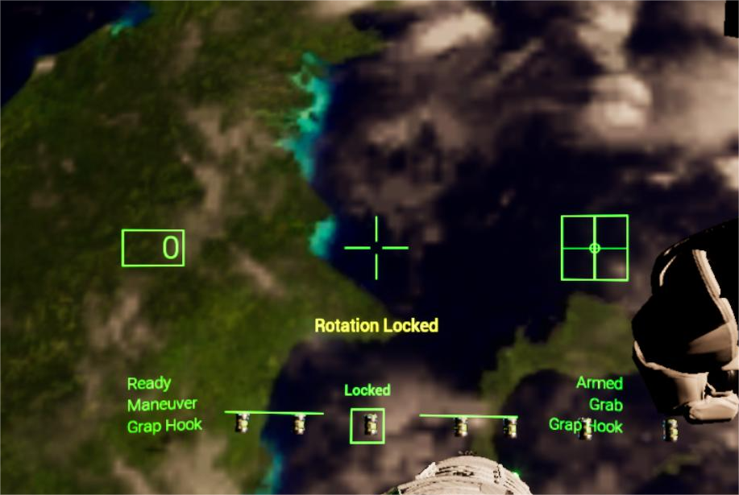
Deep Orbit
Technical features
Light sci-fi VR space exploration
Powered by Unreal Engine 4
Oculus standalone
Research goal
Design and create an original VR space inspired game
Based on user test and feedback, evaluate the human-computer interaction performance and gameplay
Wrist menu
Simple, intuitive game menu
Assimilates into the game theme
Grappling hook
Swift and precise maneuvering
Multi-purpose: maneuver or pick object
Integrated with HUD
Jetpack
Based on real-life astronaut jetpack
6 degree of freedom
Realistic orbital kinetics
Integrated with translation and rotation
HUD
Inspired by real-life flight HUD
Elaborate stereo visual effect
Compact with vital imformation
GitHub Repository: https://github.com/kingwaykingway/Master-Project

