Slide 2

WHAT’S DYNAMIC COMPONENTS
“A technique for adding a component to the DOM at run time. Requires that you exclude the component from compilation and then connect it to Angular’s change-detection and event-handling framework when you add it to the DOM.” —— angular.io

Slide 3
STATIC COMPONENTS
Used in template
<app-header></app-header>
<app-breadcrumb></app-breadcrumb>
<form action="/REST/someAPI" method="POST">
<app-input [validators]="validators"></app-input>
<app-button (click)="submitForm($event)"></app-button>
</form>
<app-bottom-menu></app-bottom-menu>
<app-footer></app-footer>
Known in development time
Fixed location
Hard-coded

Slide 4
STATIC COMPONENTS
Used in template
<div *ngSwitch="component.type">
<app-profile *ngSwitchCase="profile" [data]="component.data">
</app-profile>
<app-card *ngSwitchCase="card" [data]="component.data">
</app-card>
<app-input *ngSwitchCase="input" [data]="component.data">
</app-input>
<app-button *ngSwitchCase="button" [data]="component.data">
</app-button>
...
...
...
</div>
Known in development time
Fixed location
Hard-coded

Slide 5
IMAGINE...
<div #viewcontainer></div>

Slide 6
DYNAMIC COMPONENTS
Added in run time
Load configuration from server
Lazy loaded
<div #viewcontainer></div>
@ViewChild(viewcontainer', { read: ViewContainerRef }) vcr;
constructor(private cfr: ComponentFactoryResolver) { }
const componentFactory = this. cfr.resolveComponentFactory(component);
// add the component to the view
const componentRef = this.container.createComponent(componentFactory);

Slide 7
DYNAMIC COMPONENTS
Where is the component inserted?
<div #viewcontainer></div>
@ViewChild(viewcontainer', { read: ViewContainerRef }) container;
How is it instantiated?
constructor(private cfr: ComponentFactoryResolver) { }
const componentFactory = this.cfr.resolveComponentFactory(component);
const componentRef = this.container.createComponent(componentFactory);

Slide 8
DYNAMIC COMPONENTS
How to pass inputs?
componentRef.instance.data = this.getData();
How to bind to outputs?
componentRef.instance.event.subscribe(observer);

Slide 9
COMPONENT INSTANTIATION
Popups
Dashboards

Slide 10
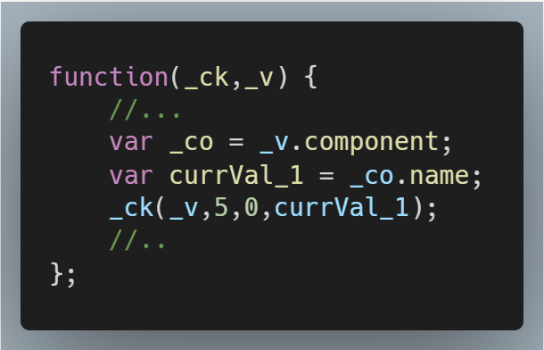
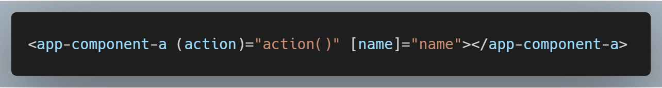
COMPONENT INSTANTIATION
NgModule
Declarations
ComponentA
View
ComponentA
Compile
ComponentA
Factory
Create
Dom Node
ComponentA
Instance
Render
Page
Element

Slide 11
COMPONENT INSTANTIATION
NgModule
Declarations
SomeComponent
View
Entry Components
SomeComponent
Compile
SomeComponent
Factory
Create
Dom Node
Component
Instance
SomeComponent
Host Factory
Render
Page
const componentFactory = this.cfr.resolveComponentFactory(component);
const componentRef = this.container.createComponent(componentFactory);
Element

Slide 12
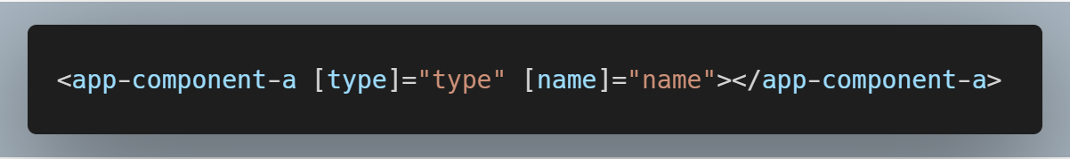
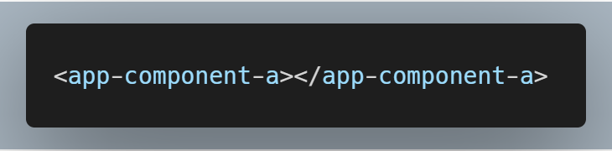
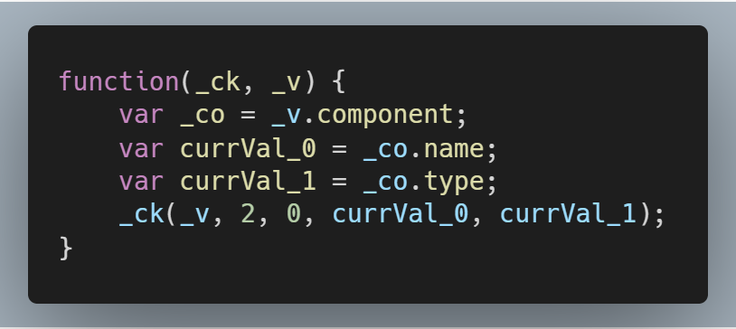
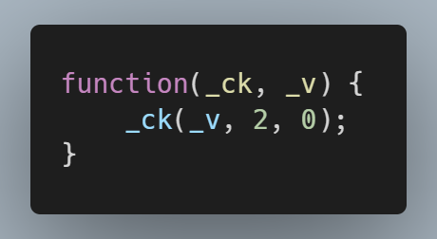

Slide 15

Thanks！

