Slide 1
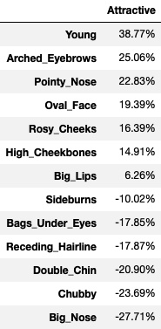
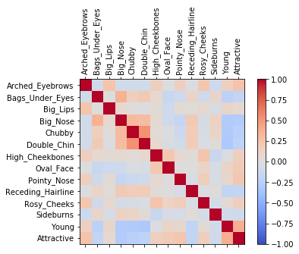
Attractiveness Correlation

Slide 2
Decision Tree – Training & Testing Scores
Positively Correlated Features
Positively Correlated Features Training Score: 0.7126251449913211
Positively Correlated Features Testing Score: 0.7099210266535044
Negatively Correlated Features
Negatively Correlated Features Training Score: 0.6542090672019348
Negatively Correlated Features Testing Score: 0.6515918065153011

Slide 3
Gini Impurity & Information Gain
Positively Correlated Features
Young Provides the best Information Gain
Gini Impurity Score - 0.5
Negatively Correlated Features
Big Nose Provides the best Information Gain
Gini Impurity Score – 0.5
Chubby is a close 2nd with a impurity score of 0.484

