Slide 1



NIGERIA TARIFF POLICY, 2023-2025
Tariffs Without a Strategy
Three sectors, three outcomes: refined petroleum, automobiles, and rice under Nigeria's tariff regime
Comparative case study • July 2026

Slide 2
GOVERNING THOUGHT
Tariff level doesn't predict import-substitution outcome. A credible domestic supply response does.
Refined petroleum
Automobiles
Rice / agriculture
~0.5% tariff
35-40% tariff
70% tariff
Fastest substitution, driven by Dangote Refinery
Heavy protection, only 29.0% aggregate capacity utilization
Heaviest wall, most persistent leakage, and the top-smuggled commodity
The variable that predicts outcomes isn't the tariff line. It's whether a credible domestic supply response exists behind it.
2

Slide 3
SECTOR COMPARISON
Three different policy tools, three different results
Sector | Effective tariff (2025) | Primary policy tool | Outcome
Refined petroleum | ~0.5% | Signaling: an approved-then-suspended duty, import license halts | Fastest import substitution, driven by Dangote Refinery
Automobiles | 35-40% | Sustained tariff differential (fully-built vs. CKD/SKD) | Protection without competitiveness: 29.0% aggregate utilization
Rice / agriculture | 70% | Sustained high tariff plus intermittent bans and waivers | Heaviest wall, most persistent leakage, top-smuggled commodity
Full sourcing: data/raw/{petroleum,automobiles,rice}/sources.md
3

Slide 4
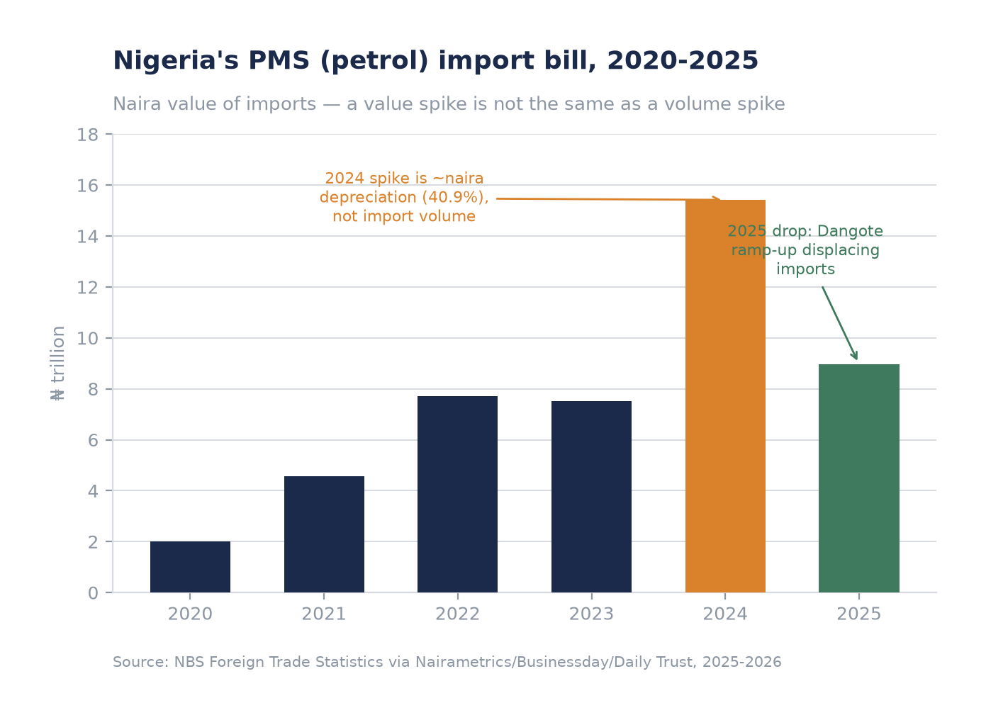
CASE I · REFINED PETROLEUM
Near-zero tariff, fastest substitution. Dangote Refinery is doing what policy didn't.
Petrol import bill fell 42% in 2025 (₦15.42tn to ₦8.96tn) as Dangote reached ~85% utilization of its 650,000 bpd refinery
The only dedicated petroleum tariff of the period, a 15% duty, was approved 21 Oct 2025 and suspended 13 Nov 2025, before ever taking effect
2024's naira-value spike (+105%) is mostly a currency story. The naira depreciated 40.9% that year.
Source: NBS Foreign Trade Statistics via Nairametrics/Businessday/Daily Trust, 2025-2026
4

Slide 5
CASE I · REFINED PETROLEUM
The substitution mechanism is real, but institutionally fragile
82M barrels
3 weeks
~79.5M barrel
allocated to Dangote Oct 2024-Oct 2025 under the naira-for-crude deal, 60% naira-denominated
how long the Oct 2025 15% import duty survived before being suspended amid industry pushback
reported NNPC supply shortfall to Dangote, Oct 2025-mid 2026. Dangote also has an active lawsuit disputing import-license enforcement.
Read this as a genuine structural shift with governance that's still catching up.
Sources: Nairametrics, Punch, ICIR Nigeria, Authority News, 2025-2026. See data/raw/petroleum/sources.md.
5

Slide 6
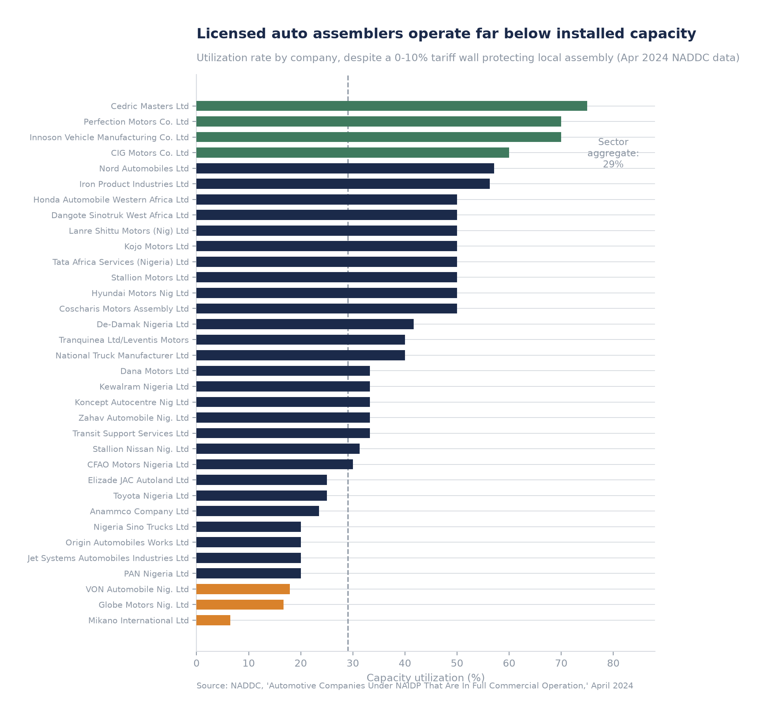
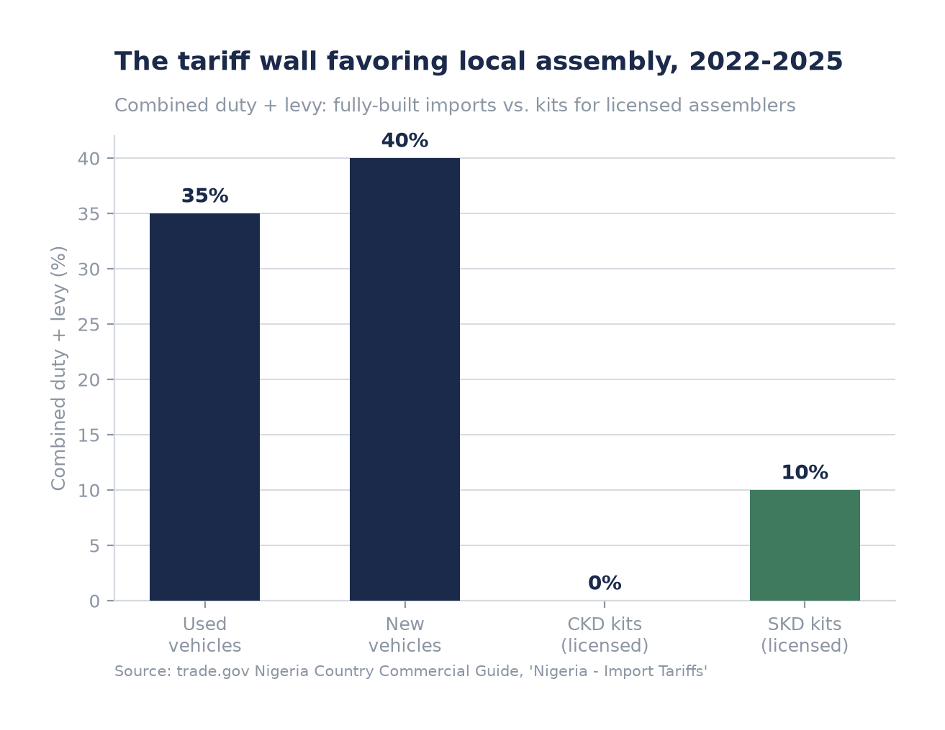
CASE II · AUTOMOBILES
A textbook tariff wall (0-40%) that hasn't produced scale
Source: trade.gov Nigeria Import Tariffs; NADDC, April 2024. Aggregate utilization verified at 29.0% (93,950 / 323,650 units/year).
6

Slide 7

CASE II · AUTOMOBILES
The policy has never had the force of law
The revised NAIDP was approved by Federal Executive Council in May 2023. That's an executive plan, not a statute.
The original NAIDP's ten-year statutory term lapsed in 2024. A successor 2024-2034 framework still awaited legal drafting as of March 2025.
As of October 2025, stakeholders, including NADDC's own Director-General, were still demanding passage of a “NAIDP Bill”
20 of 58 historically licensed assemblers had suspended operations by March 2025 (~$89.6M in stranded investment)
“Nobody wants to commit serious capital to the auto industry without adequate laws to protect their investments.”
Joseph Osanipin, NADDC Director-General, Oct 2025
Sources: The Guardian Nigeria, 27 Mar 2025; Vanguard, 10 Oct 2025. See data/raw/automobiles/sources.md.
7

Slide 8
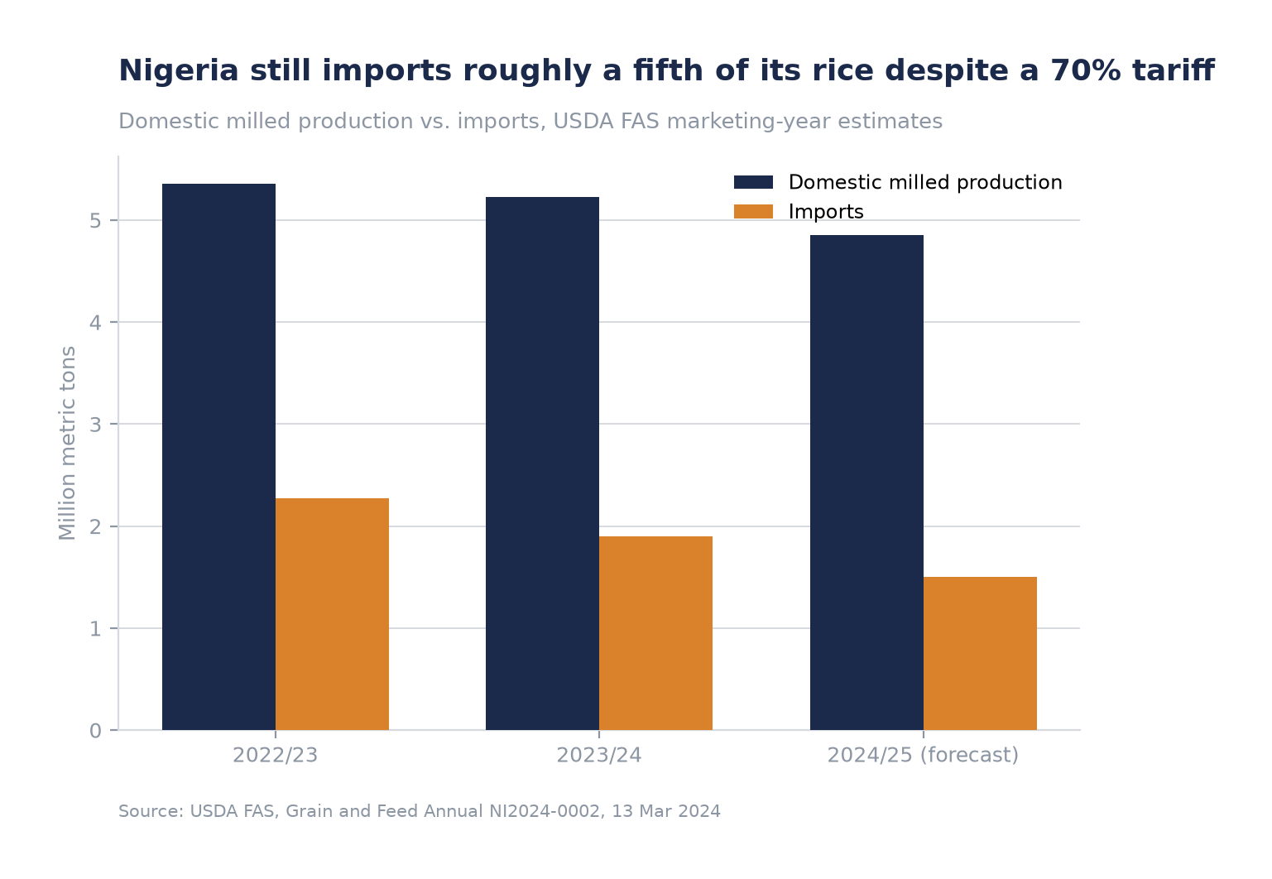
CASE III · RICE / AGRICULTURE
The heaviest tariff, and the most persistent leakage
70% combined duty and levy: among the heaviest in Nigeria's tariff schedule, roughly stable since 2013
Rice was the single most-smuggled commodity through Nigerian Customs in Q1 2025: 159 cases, 135,474 bags, ₦939M
The 2019 land-border closure remains only partially reversed. Rice stayed formally banned even after the Dec 2020 reopening.
Sources: USDA FAS Grain and Feed Annual, 13 Mar 2024; PRNigeria, 24 Apr 2025. See data/raw/rice/sources.md.
8

Slide 9
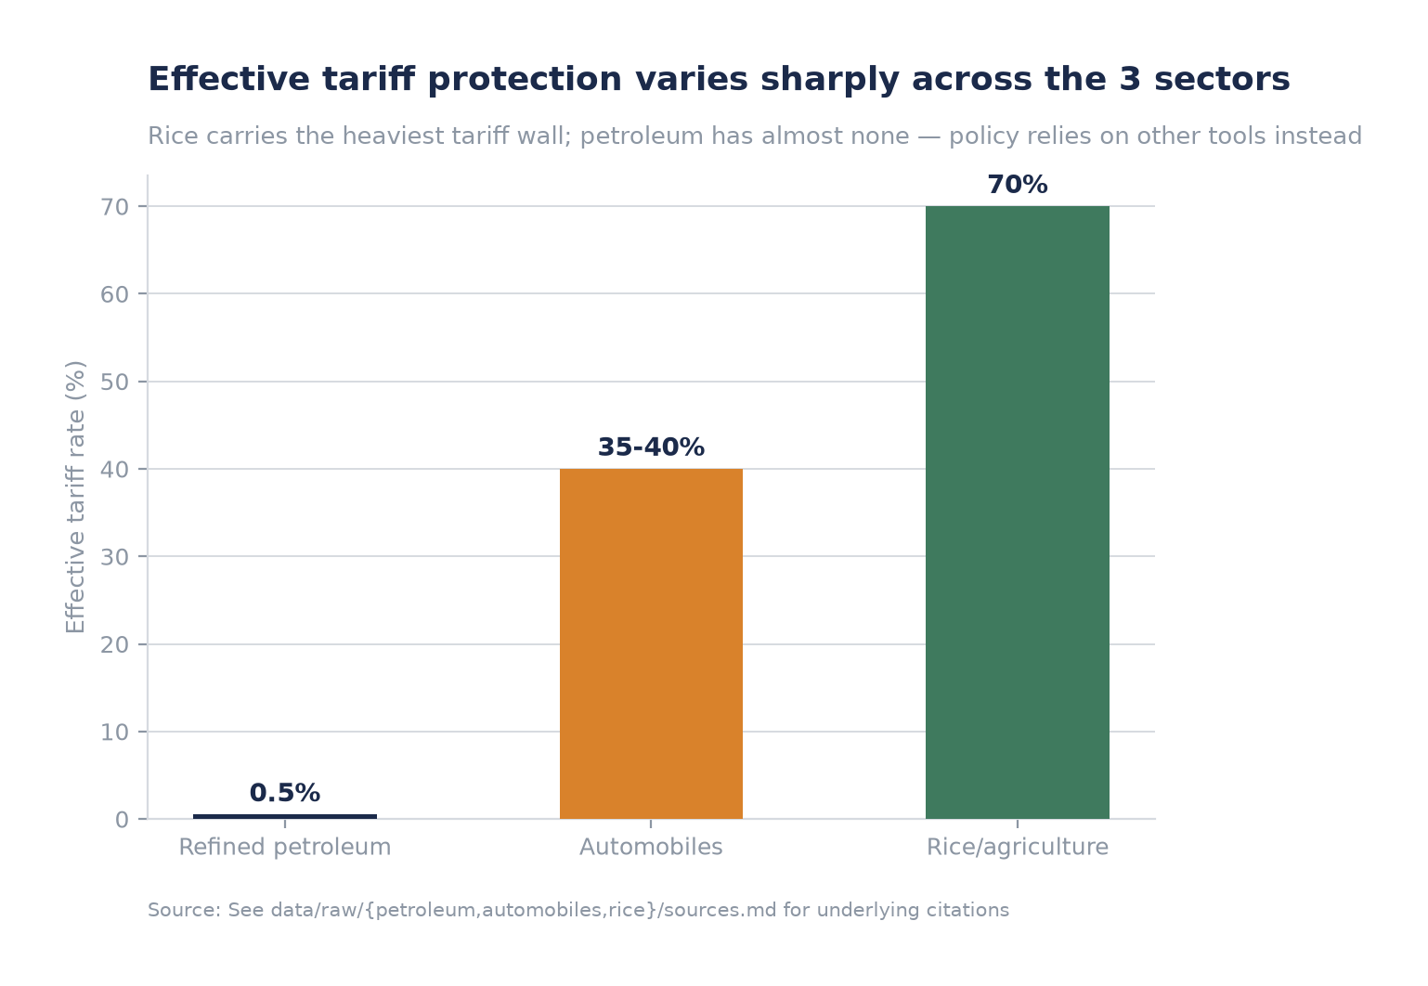
SYNTHESIS
Tariff level runs inversely to substitution outcome across all 3 sectors
Source: see data/raw/{petroleum,automobiles,rice}/sources.md for underlying citations.
9

Slide 10
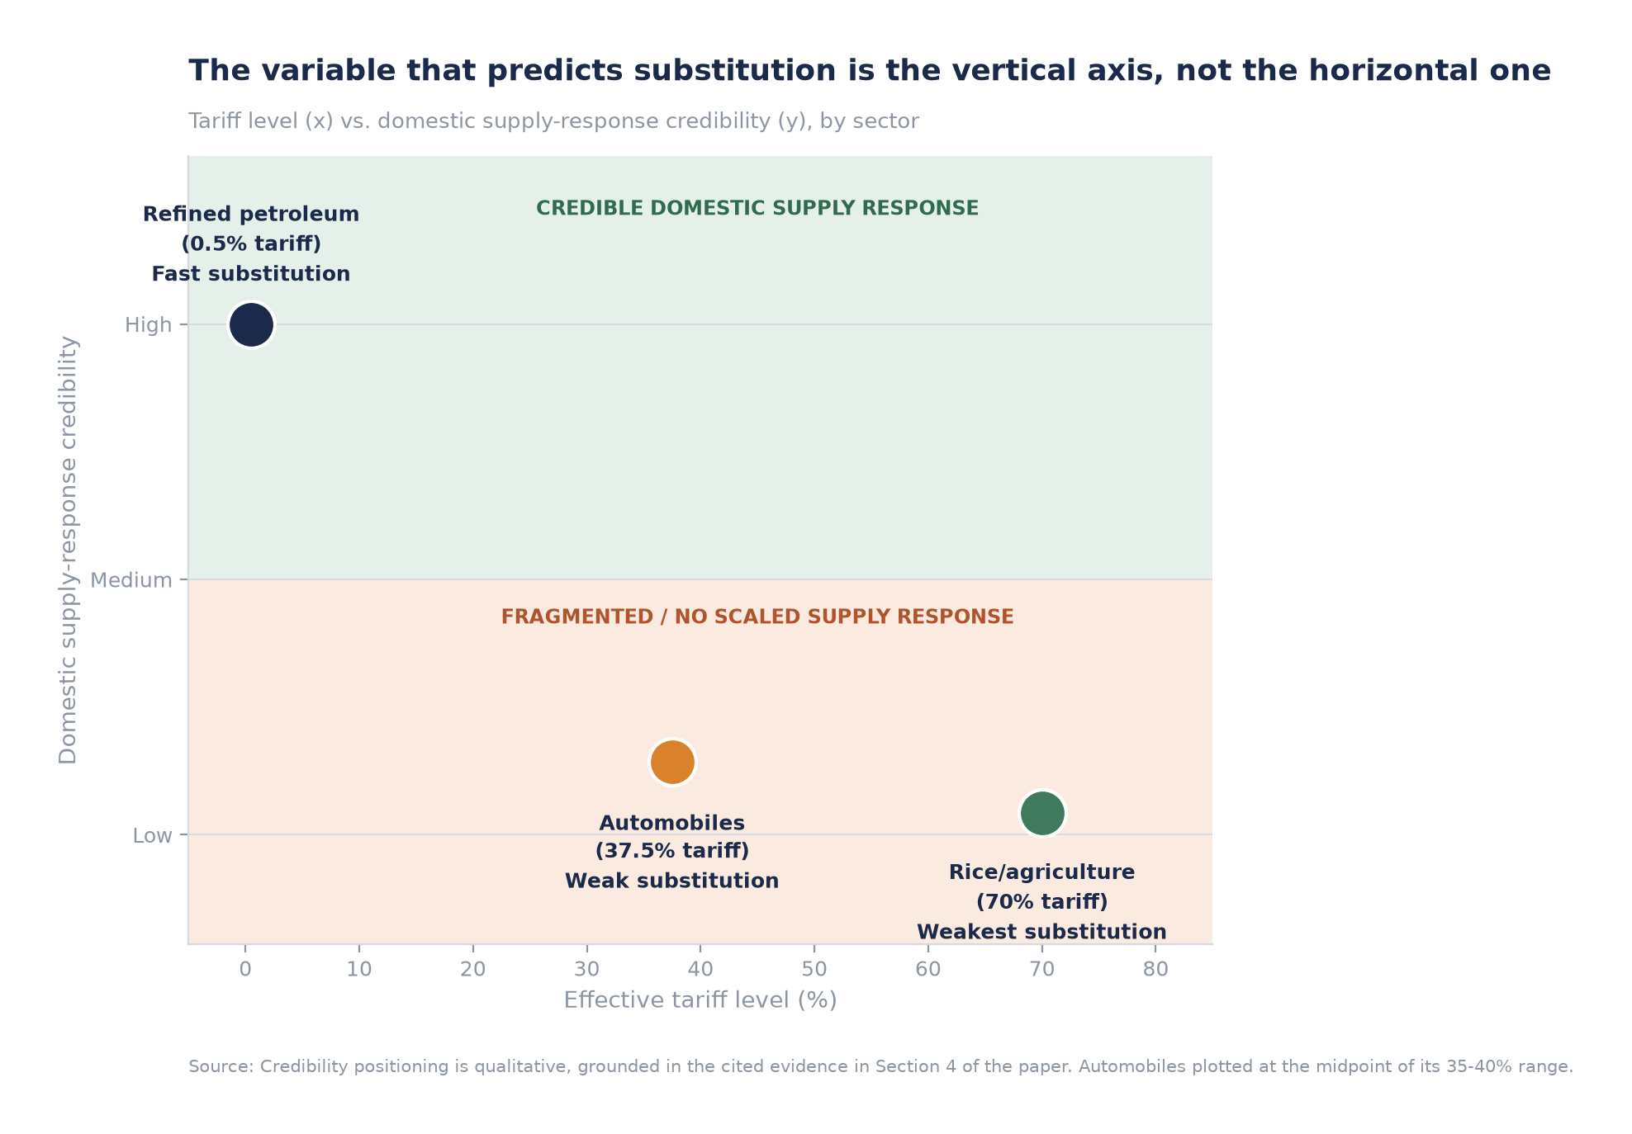
THE FRAMEWORK
The vertical axis predicts substitution. The horizontal one doesn't.
Credibility positioning is qualitative, grounded in the evidence in Sections 4-9. Automobiles plotted at the midpoint of its 35-40% range.
10

Slide 11

THE AFCFTA QUESTION
Commitment without a clear test. Well-evidenced only for rice.
Clear finding
Important non-finding
Rice sits on Nigeria's AfCFTA exclusion or long-timeline “sensitive” list, alongside flour, sugar, and cement. That's consistent with decades of food-security-driven protection.
No source, primary or secondary, states where refined petroleum or automobiles sit on Nigeria's AfCFTA schedule. A clean 3-sector AfCFTA comparison can't be made with confidence.
Nigeria gazetted its AfCFTA tariff schedule only in 2025, six years after signing. Within the 2023-2025 window, unilateral tools (subsidy policy, import bans, forex allocation) are doing far more work shaping sector outcomes than AfCFTA commitments.
Sources: Boysen (2024), The World Economy; WTO Trade Policy Review, Nigeria, Nov 2024; ITRC, 16 Apr 2025. See data/raw/afcfta/sources.md.
11

Slide 12


IMPLICATIONS
Three takeaways for reading Nigeria as a market
Don't read tariff schedules as a proxy for policy seriousness
Look for a scaled domestic supply response as the leading indicator
Treat AfCFTA as immature through 2025-2026, not decisive yet
The sector with almost no tariff is undergoing the most real structural change. The sector with the highest tariff has the weakest enforcement outcome.
A single, well-capitalized asset (Dangote) displaced more imports in 18 months than a decade of auto tariffs achieved for local assembly.
The schedule was only gazetted in 2025. Nigeria's unilateral tools remain the dominant lever for sector-level forecasting on this horizon.
12

Slide 13
APPENDIX
Full sourcing and underlying data
Raw research notes & full citations: data/raw/{petroleum,automobiles,rice,afcfta}/{notes.md,sources.md}
Structured datasets: data/processed/*.csv
Analysis & chart-generation code: models/{petroleum,automobiles,rice,sector_comparison}_analysis.py
Full paper and investment memo: paper/nigeria-tariff-policy-paper.md, memo/nigeria-tariff-investment-memo.md
Every figure in this deck traces to a named, dated source. Where sources conflicted, both figures are presented. See appendix notes in the paper.
13

