Slide 1
Lecture 5 Parts/design Choices (Part 1)

Slide 2
IR Sensor
Consists of IR LED(transmitter/emitter) and IR receiver(transistor type most likely)
Wavelengths much match between emitter and receiver
Pulsing high current to raise Signal/Noise ratio
Use voltage divider for receiver converting current signal to voltage signal

Slide 3
Specs for IR Emitter
Specs need to know when choosing an IR Emitter:
Wavelength
Voltage drop
DC Forward current
Pulsing current/timing
Viewing angle(full angle)
Radiant Intensity

Slide 4
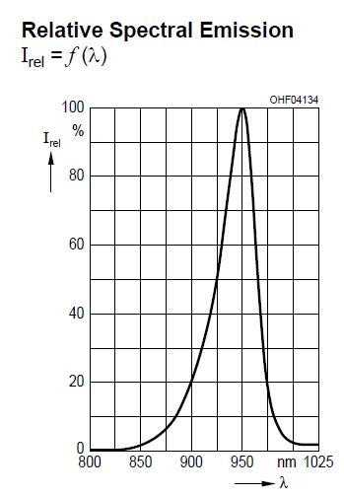
Wavelength
950nm and 850nm are the 2 most popular choices for IR emitter
You need to find IR receive that matches the wavelength of emitter in order to max power efficiency

Slide 5
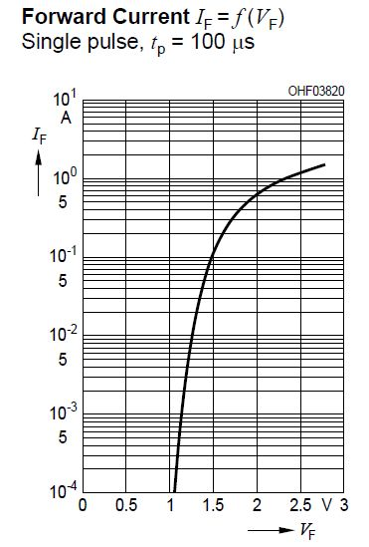
Voltage Drop
IR Emitter is essentially an LED that emits infrared
And LED is essentially an diode, and diode drops voltage
Voltage drop varies depends of the expected current
Examples:
- SFH4550 drops 1.5V @100mah
- SFH4545 drops 1.5V @100mah
- SFH4511 drops 1.3V @ 100mah(discontinued)

Slide 6
DC Forward Current
Means the max constant current that the IR emitter can safely handle(max limit)
Usually 100mah for typical 5mm diameter IR LED, 50mah for 3mm diameter IR LED. Some metal shield package version has even higher DC forward current
DC forward current somehow indicates the capability of IR Emitter when pulsing at high current

Slide 7
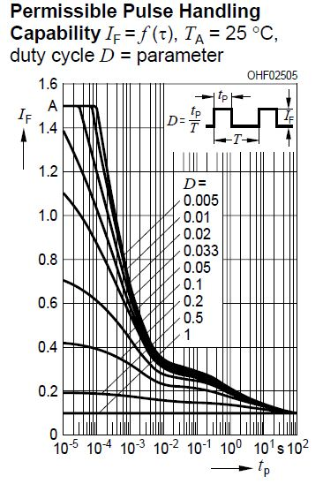
Pulsing Current
LED allows pulsing current higher than DC forward current during a short time period
Max Capability are different at different turn on time
Exceeding max cap will damage the IR LED
Should always check table to ensure your time/current choice for your design

Slide 8
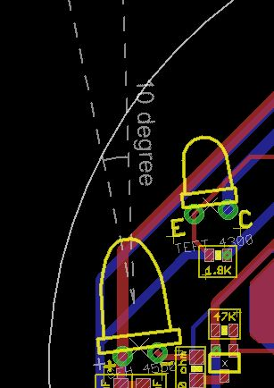
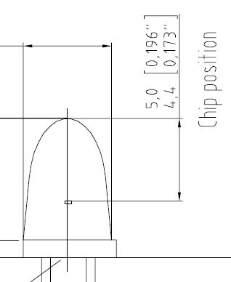
Viewing angle
Smaller angle is preferred for higher power intensity and more accurate distance detect, usually under 10 degree
Chip position indicates where the IR light starts to emit

Slide 9
Radiant Intensity
Indicates the power intensity per unit area
Varies between different models
The higher the better
850nm type has higher Intensity than 950nm in general
Example:
- SFH4550(850nm)6^{degree} 630mW/sr @ 100mA
- SFH4545(950nm)10^{degree} 550mW/sr @ 100mA
- SFH4511(940nm)8^{degree} 63mW/sr @ 100mA(discontinued)

Slide 10
Some other important facts
Package:
- T 1 ¾ is about 5mm diameter package
- T1 is about 3mm diameter package
Through hole preferred for the availability and efforts on mounting it on the mouse
Choices are pretty obvious when you use the filter on vendor’s site(ie. Mouser,digikey, etc) when you apply the preferred specs

Slide 11
IR Receiver
Viewing angles are always wider than emitter
Angles are between 30-60 degree
Receiver has sensitive wavelength range, as long as it covers the wavelength for IR emitter
The resistance of the resistor that serial with is based on your own test and preference. Resistance value will affect the max reading value and receiver charge/discharge time
Faster charging time saves pulsing time but could be too sensitive, slower charging time takes more time but less sensitive(less sensitive for ambient noise)

Slide 12
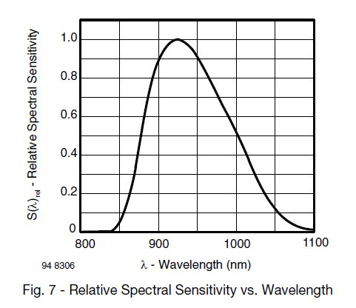
Matching wavelength
Emitter(SFH4545) Receiver(TEFT4300)

Slide 13
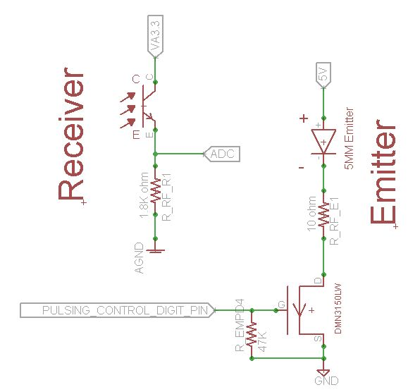
Circuit example

Slide 14
Power Supply
Use 2 lipo Batteries serial at 7.4V at V_bat
Use 2mm pitch JST male plug mount on PCB
2.54mm or 2mm pitch slide switches are usually used, pay attention with power rating
Large value tantalum capacitors are used to stabilized the power supply, pay attention of the max voltage and ESR(equivalent serial resistance) of tantalum capacitor

Slide 15
Power Supply(cont.)
3 different voltage usage in system
- v_bat for motor driver and voltage meter
- 5V for IR emitter and encoder power supply
- 3.3V for rest of the sytem
Current consumption level
- Motor(V_bat)>5V(emitter)>3.3V
Choice on Futura Kit Mouse
- 5V LVO regulator with 1A max output
- 3.3V LVO regulator with 400mah max output
Sufficient current with the regulator chosen above
The voltage drop for LVO regulator is as low as possible(especially for 5V regulator)

Slide 16
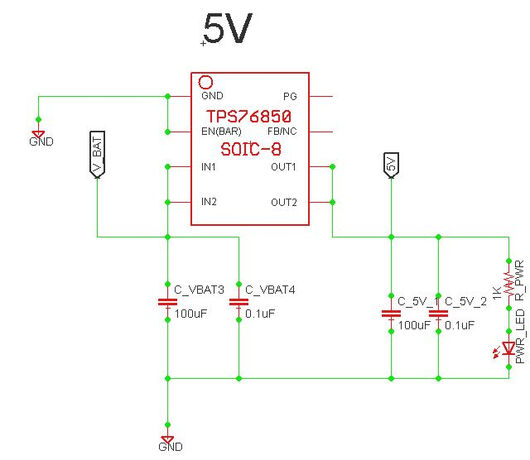
Power Supply(digital)
Add by pass cap before and after to stabilize supply
Add low pass cap before and after to filter out high freq. noise

Slide 17
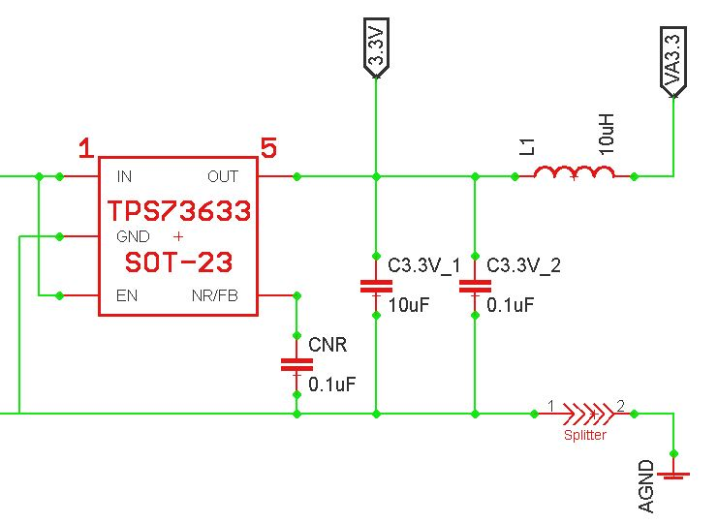
Power Supply(analog)
Separate ground is preferred to reduce the noise to analog device
Usually serial a inductor between supply and analog supply to stabilized the analog power supply

Slide 18
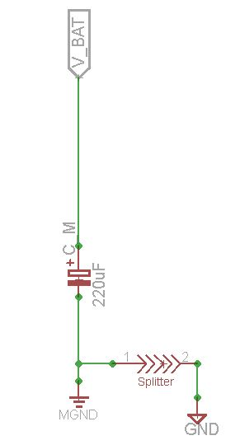
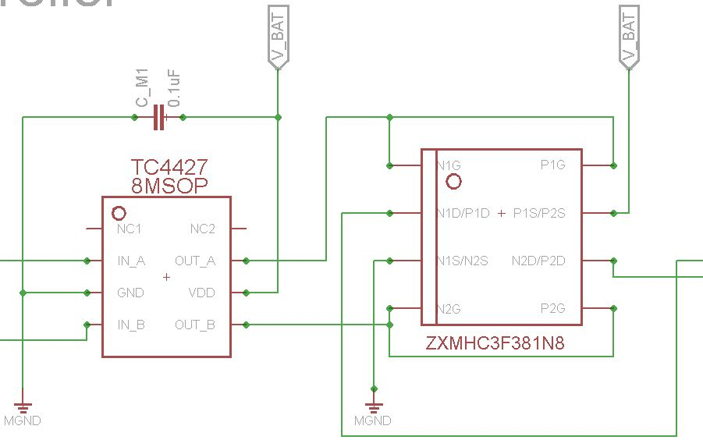
Power Supply(motor)
Tantalum cap to supply motor power(place very close to motor driver)
Low pass filtering cap very close to motor driver
Separate ground for motor

Slide 19
RCL selection
Smaller package leaves you more space on mouse, harder to solder, and higher ESR
Package on Futura Kit Mouse:
- 0603 resistor for IR Emitter(250mw rating, because of high current)
- 0402 resistor for rest of the system
- 1220(in) tantalum cap for 100uF 2917(in) tantalum cap for 220uF(motor supply)
0603 caps for rest of the system
1007 10uF Inductor
RCL availability in lab
- 0402 resistor stocked for all value you need for micromouse
- 0603 capacitor stocked for all value you need for micromouse
Pay attention of the max voltage of the cap and power rating for resistor

