Slide 1
Lecture 7 Curve Turn

Slide 2
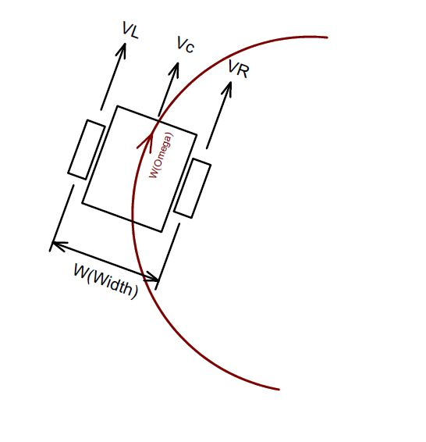
Basic Concepts
Keep speed with certain ratio between 2 wheels for mouse to make mouse turn at certain angular velocity
However this is not possible in real word
When on straight, VLs=VRs
When turn VLt>VRt
Motor can’t suddenly change speed from VLs to VLt, and VRs to VRt

Slide 3
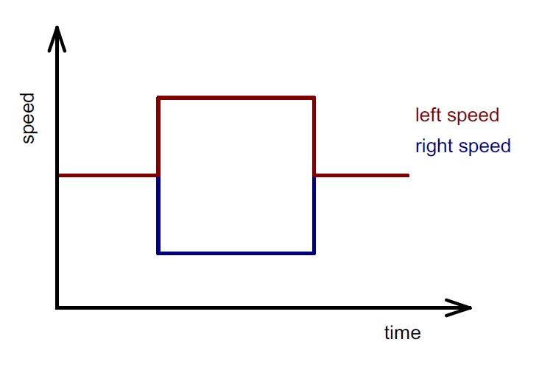
Diagram view
This is not possible in real world!

Slide 4
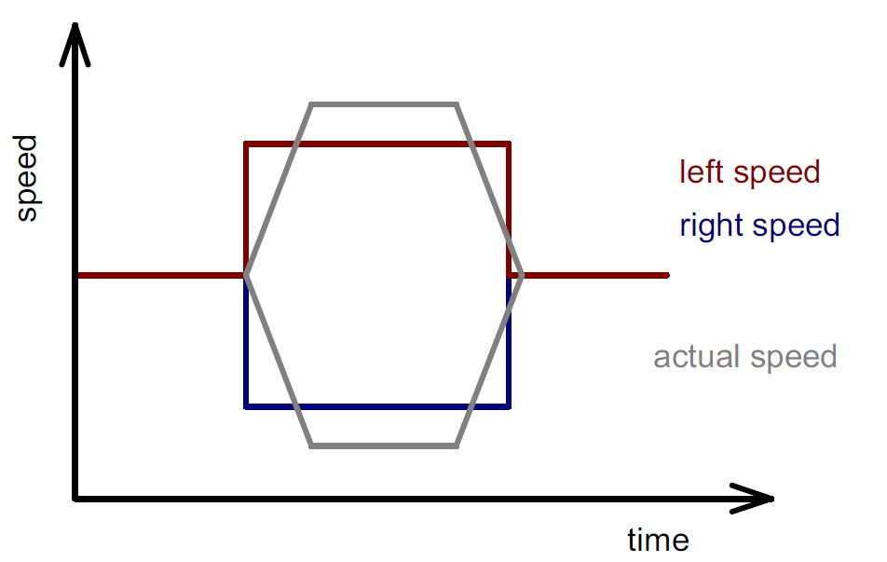
Alternative solution
Make one wheel accelerate, the other wheel decelerate to reach different speed gradually

Slide 5
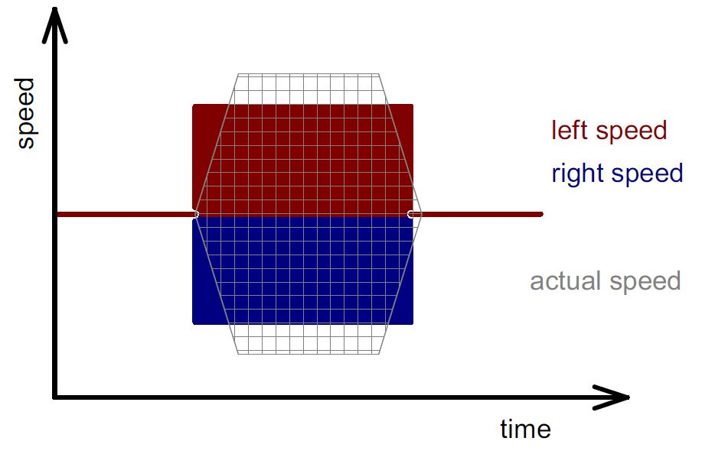
How to maintain same turn angle in this way?
All you need to do is just to keep the grey area equals to the sum of red and blue area to maintain the same turning angle

Slide 6
Some facts
The center speed of mouse remains constant when turning since VC = (VL + VR)/2
VR – VL is still the rotational feedback when turning
You can use the feedback from gyro to replace VR-VL to prevent slippage, however needs to be scale to fit the system with encoder ticks

Slide 7
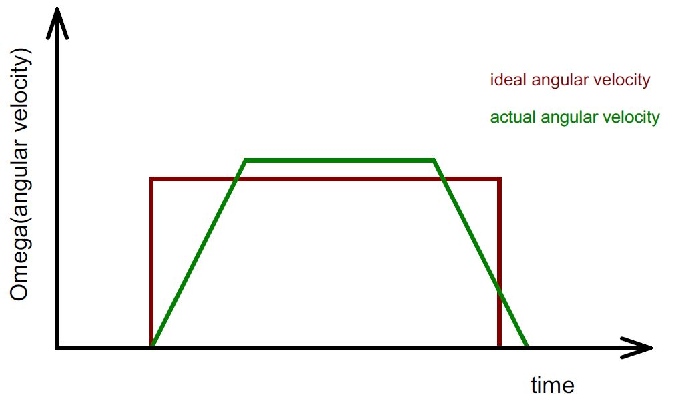
The view of angular velocity
W(omega) = VR – VL in our system
Diagram in angular velocity form is more straight forward since the center linear velocity of mouse doesn’t change during the turn

Slide 8
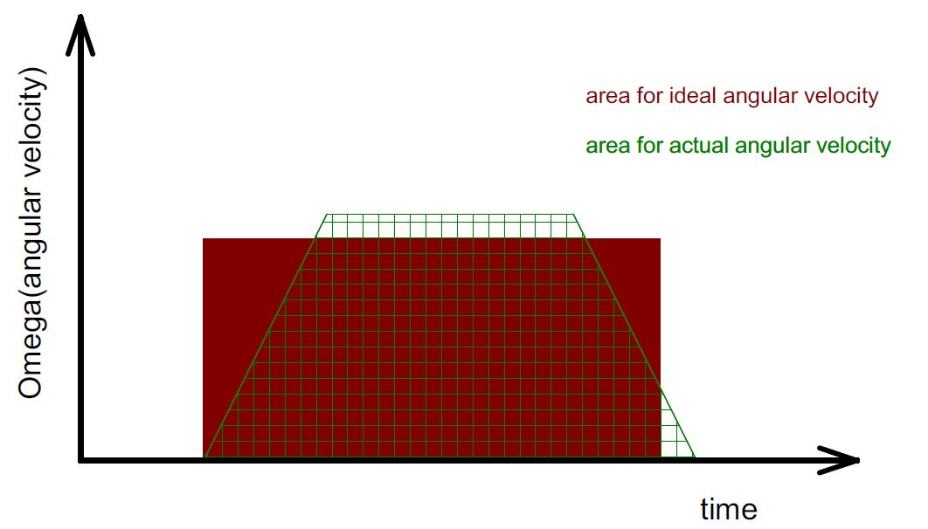
Keep the area same
As long you keep the area same between ideal and actual angular velocity, the mouse will turn with same angle you desired
Some extra time is usually needed for actual turn

Slide 9
How to design your profile?
Decide the max angular velocity W(omega)
Decide the angular acceleration (alpha)
Calculate the area for idea turn, make the actual turn area equals to it
Use matlab, excel to make your profile, and keep track of the position of the mouse at each millisecond, keep adjusting the input parameters, until the actual output curve for mouse exits at same location with idea curve
Apply the parameter decided from simulation profile to your mouse

Slide 10
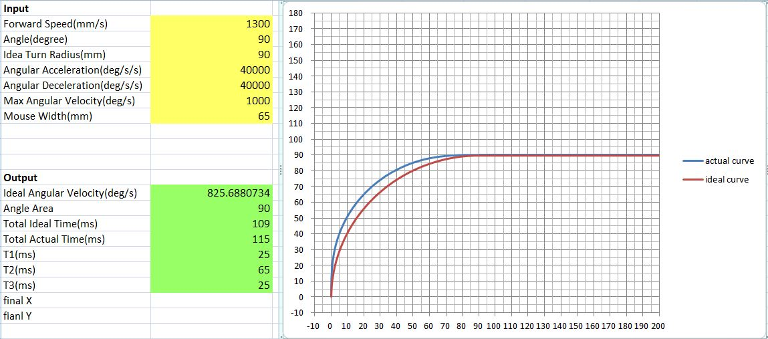
An example with excel

Slide 11
Demo with the simulation profile

Slide 12
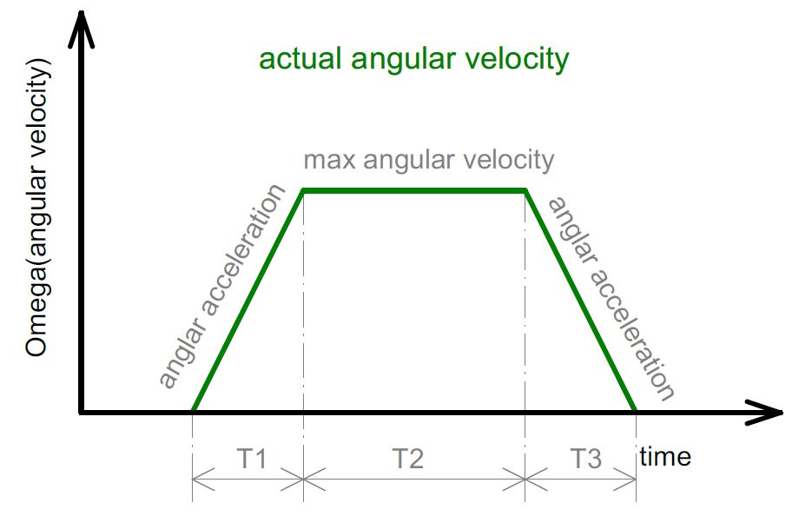

Slide 13
How to make it work on mouse?
Center forward linear velocity, turn angle, angular acceleration, max angular velocity are all know in this case.
Assume T1 = T3 to simplify the case where the slope(angular acceleration rate) are same
Calculate the corresponding angular velocity with T1, slope or max angular velocity at T1 and T3
The angular velocity is max angular velocity at T2

Slide 14
Sample code
Having this is your controller:
If currentSpeedW < targetSpeedW
{
currentSpeedW += accW
if currentSpeedW > targetSpeedW
currentSpeedW = targetSpeedW
}
else If currentSpeedW > targetSpeedW
{
currentSpeedW -= accW
if currentSpeedW < targetSpeedW
currentSpeedW = targetSpeedW
}

Slide 15
Sample cont.
The code for your turn function
Void turn(void)
{
if(is at T1 or T2)
targetSpeedW = maxAngularVelocity;
else if(is at T3)
targetSpeedW = 0;
}

Slide 16
Things need to know
The angular velocity has different sign between left turn and right turn
Record the system time in millisecond to keep track of you current time for curve turn.
The angular velocity you generate from provided excel profile generator is in degree/s unit, you need to convert to recognizable unit of mouse

Slide 17
Unit conversion for speed profile
Angular velocity in encoder format equals to:
wheelDistance*angularVelocity*Pi*oneCellDistance/cellLength/180/1000
Where
wheelDistance is distance between centers of the wheels
angularVelocity is the angular velocity in degree/s
OneCellDistance is the encoder counts per cell for one wheel
CellLength is the length of each cell, which is 180mm
/180 is divide 180 degree
/1000 converts from /s to /ms

Slide 18
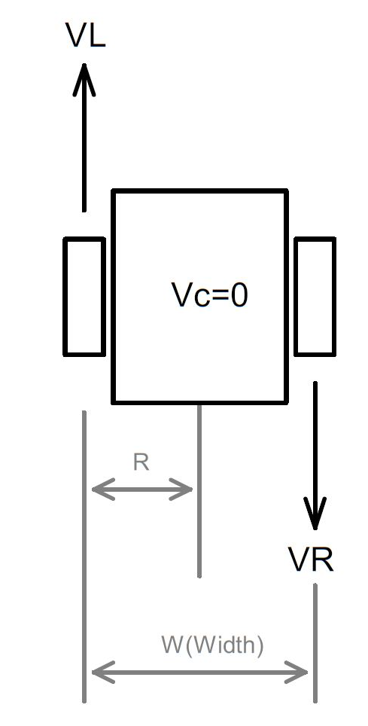
How to convert for gyro feedback
The intermediate unit between gyro and encoder is distance(meter)
Use pivot turn method to make conversion, where VL = -VR
Record the angle output from gyro when make a 180 degree turn(either directions), as “a”
Get distance value of
2*Pi*R which is Pi*W in SI unit then convert to encoder counts, as “b”

Slide 19
Unit Conversion (cont.)
You get the ratio between b and a as “Ratio” = a/b (usually a > b)
Now you can apply the ratio to the angular velocity read from gyro and have it easily convert to encoder format:
angularFeedback = aSpeed/Ratio
angularFeedback also equals VR-VL by definition in controller lecture
- Now you can only use gyro as rotational feedback for curve turn

Slide 20
Question?

