Slide 1
Lecture 2
Peripharals Hardware Introduction

Slide 2
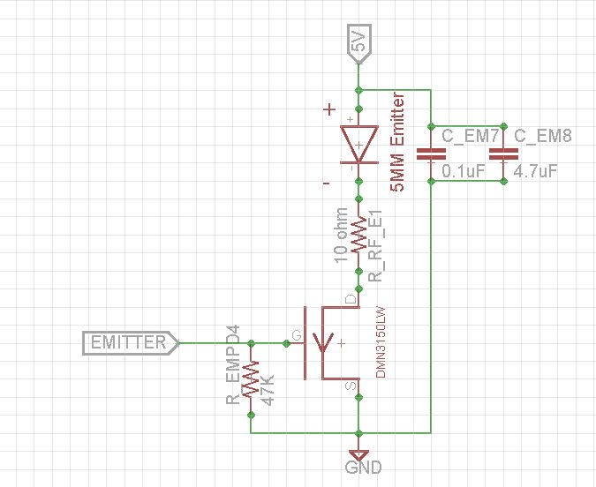
IR Emitter Single

Slide 3
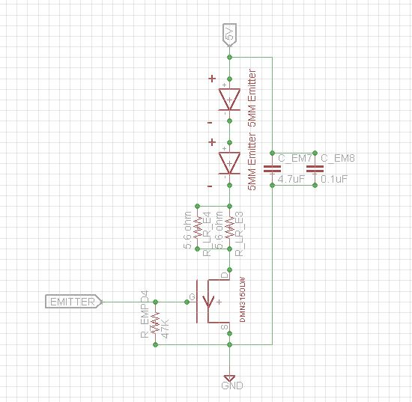
Emitter Serial

Slide 4
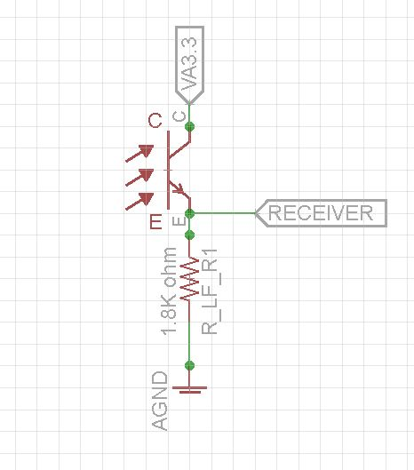
IR Receiver

Slide 5
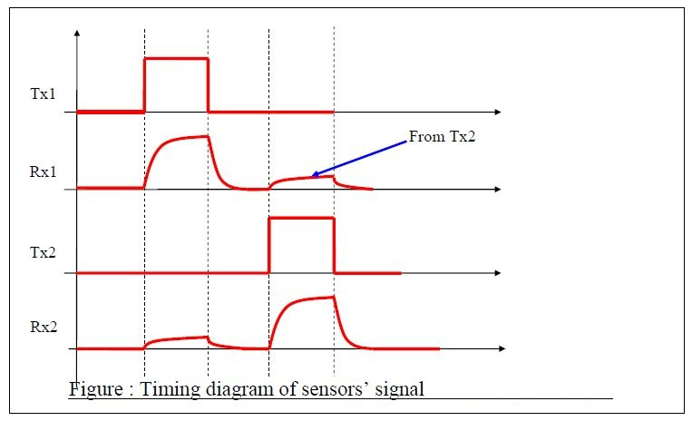
IR Sensor Pulsing Timing
Delay between each sensor reading until all residues are gone

Slide 6
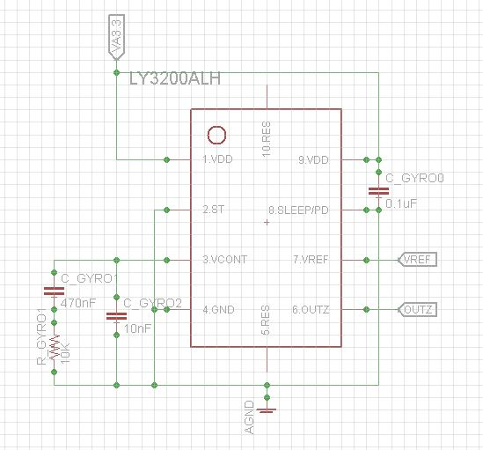
Gyro

Slide 7
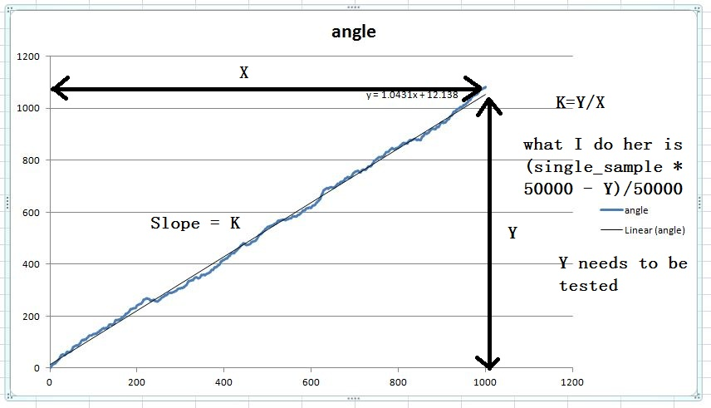
Gyro Zero Point Drift
The accumulated angled when mouse is mouse moving with gyro zero point drifting is increased linearly

Slide 8
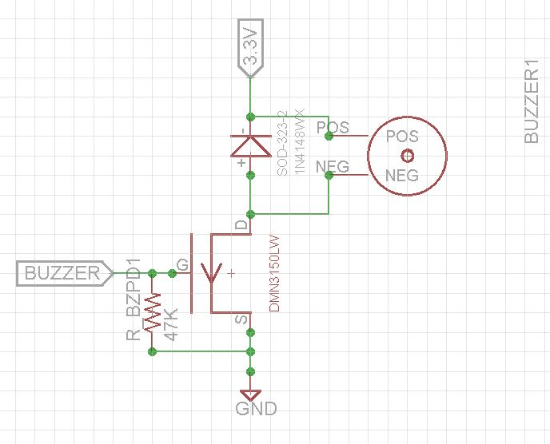
Buzzer

Slide 9
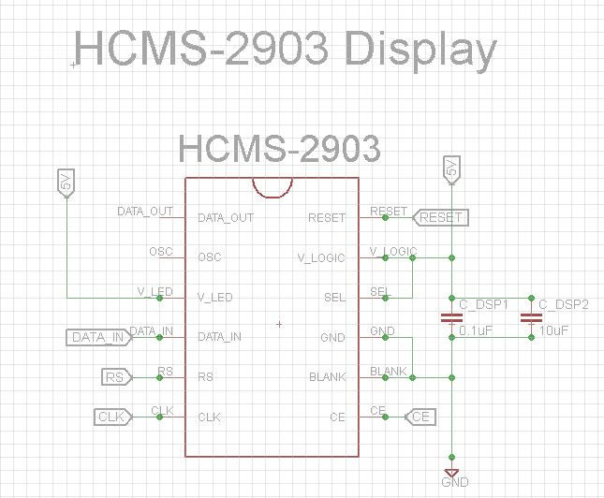
Display

Slide 10
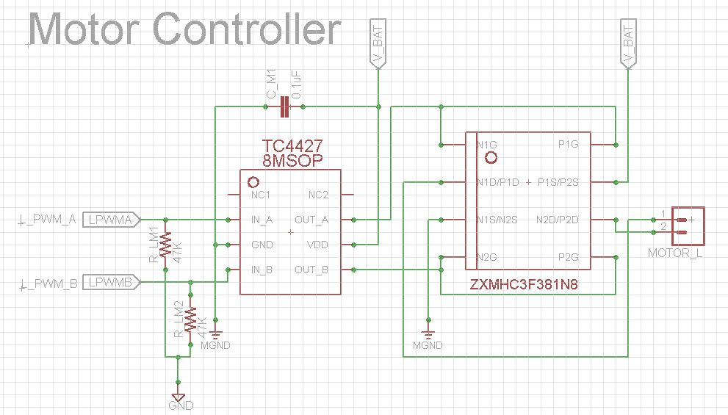
Motor Driver

Slide 11
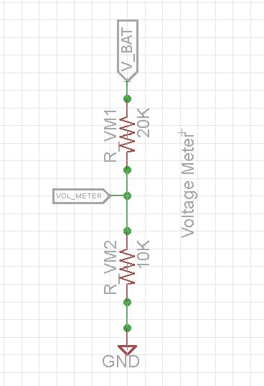
Voltage Meter
Keep track of the battery voltage to protect the batter from over discharging

Slide 12
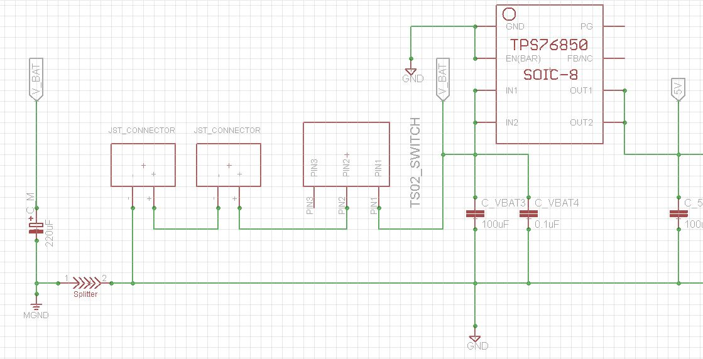
Power V_bat

Slide 13
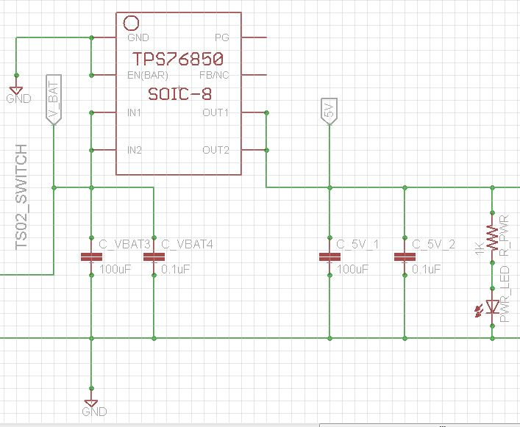
Power 5V

Slide 14
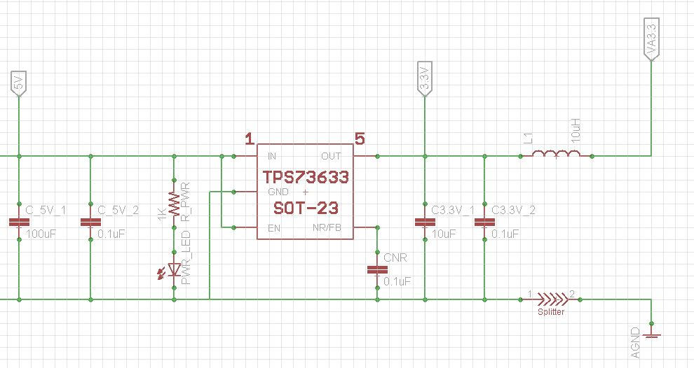
Power 3.3V

