Slide 1
Automatic Text Simplification with CNNs
Dominik Pfütze, Henny Sluyter-Gäthje,
Simon Untergasser, Tim Patzelt
Notes:
- final presentation on ATS with CNNs
-

Slide 2
Outline
Recap of our idea
Methods and Results
  Word embeddings
  Encoder
  Decoder
  End-to-end model
Conclusion
Notes:
- short recap of our idea for people who dont remember
- present methods and progress we made
- word embeddings
-encoder
-decoder
- end-2-end model
- conclusion over the whole project

Slide 3
Recap of our approach
Corpus: English and Simple English Wikipedia (EW-SEW data set)
  284.678 automatically aligned sentences¹
  Encoder: additionally same number of random sentence pairs from corpus
  max. length of sentence = 50
¹ Hwang et al, 2015, Aligning sentences from standard wikipedia to simple wikipedia
Notes:
English and Simple english wikipedia corpus with around 285.000 sentences, automatically aligned
- in order to present contrast to the encoder, we paired random simple and complex sentences
- we restricted the length of the sentences to 50 tokens, otherwise they are excluded

Slide 4
Recap of our approach
      Encoder (Siamese) – Decoder
        vs. End-to-End
Simple
Decoder,
“Deconvolution”
Encoder (CNN)
Simple
Complex
Encoder (CNN)
Encoder (CNN)
Decoder,
“Deconvolution”
Complex
Simple
Notes:
-investigate whether having both a complex and a simple sentence as input for a CNN improves over having only one sentence as input
- encoder should learn to preserve the information distinctive for a simple sentence
- siamese encoder = cnn with shared weights
- loss is calculated on output of both encoder
- decoder mirrors the encoder structure to produce a simple sentence
- as alternative to a siamese network we created “more trivial” end2end model with the same structure but it is just trained with complex sentences to produce simple ones

Slide 5
Word embeddings
Word2Vec¹ vs. FastText²
With Word2Vec we had a lot of unknowns
¹ Mikolov et al., 2013, Efficient estimation of word representations in vector space
² Bojanewski et al., 2016, Enriching word vectors with subword information
Notes:
- started with Word2Vec trained on google news corpus
- had a lot of unknowns without word embeddings ,they where replaced by random uniform vectors

Slide 6
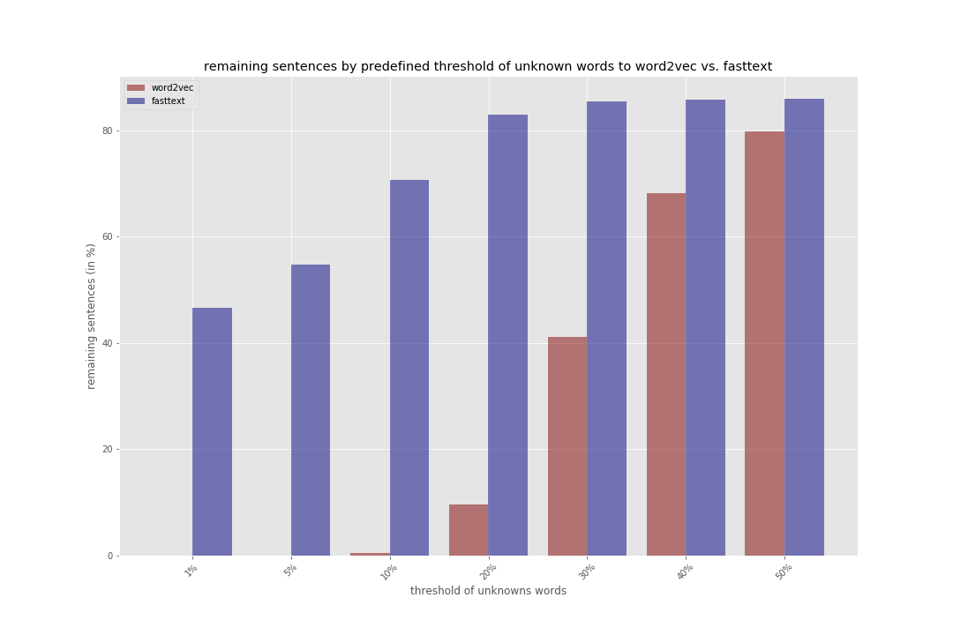
Notes:
- red is percentage of remaining sentences using word2vec
- blue percentage of remaining sentences using fasttext
-with word2vec there are at least 5% unknowns in every sentence → not good
-if we allow 10% unknowns we have almost no sentences left with word2ve and around 70% with fasttext

Slide 7
Word embeddings
Word2Vec¹ vs. FastText²
With Word2Vec we had a lot of unknowns
→ switched to FastText working with character n-grams (3≤n≤6) instead of words
¹ Mikolov et al., 2013, Efficient estimation of word representations in vector space
² Bojanewski et al., 2016, Enriching word vectors with subword information
Notes:
- we decided to switch to FastText and set the threshold for unknowns to 10% resulting in removing 30% of the sentences

Slide 8
Encoder¹
50 kernels with size 300 X 4 and
Padding = 1.5
Stride is always 1
average pooling
(w-ap)
50 kernels with size 50 X 4 and
Padding = 1.5
Input: 300 X 50
average pooling
(w-ap)
Feature map:
50 X 53
Feature map:
50 X 50
Feature map:
50 X 53
Feature map:
50 X 50
2 times (for simple and complex
sentences) with shared weights
First convolution layer
Second convolution layer (can be stacked arbitrarily often)
¹architecture inspired by Yin et al., 2015, Abcnn: Attention-based convolutional neural network for modeling sentence pairs
Notes:
- the structure of the encoder is inspired by the BCNN proposed by Yin et al. they use the network for nlp task as answer selection or paraphrase detection
-Input=initial word embeddings of size 300x400
- we apply 50 kernels of size 300x4 with 1.5 padding to them, resulting in a 50 x 53 feature map where each row is the result of one kernel slide over the input.
- column wise average pooling is applied to 4 consecutive columns such that the feature map becomes 50 x 50
- after that we apply again 50 kernes but with size 50x50, resulting again in a feature map of dimension 50x53 which is pooled again to 50x50
- the second convolution can be stacked many times because the dimensions of the input are preserved

Slide 9
Encoder
Loss: normalized euclidean distance of feature map (50x50) of simple and complex sentence
Layers: 2-4
Best result: mean similarity of 60% with 4 Layers
Similarity(x₁,x₂)= 1-loss(x₁,x₂)
Notes:
- we started with the normalized euclidean distance because it is a intuitive measure of how similar vectors are
- the distance is calculated on the 50x50 feature map of the simple and complex sentence
- we experimented with with 2 to 4 layers. yin et al used 3 layers in their paper but we had the best results with 4 layer.
-result not satisfying with 60% similarity

Slide 10
Encoder
Switched to cosine similarity as loss function
  Neglects magnitude of vectors but measures the orientation
  FastText is trained with cosine similarity
Layers: 4
Result: mean similarity of 97.57% after 100 epochs and >98% after 1000 epochs
Notes:
- after that we switched to cosine similarity as loss function because we thought it makes more sense to focus on the orientation of vectors and not the magnitude of them in a 300 dimensional space
- furthermore, fasttext is also trained with cosine similarity
- again 4 layers was the best results with 97.57% similarity after 100 epochs and >98% after 1000 epochs

Slide 11
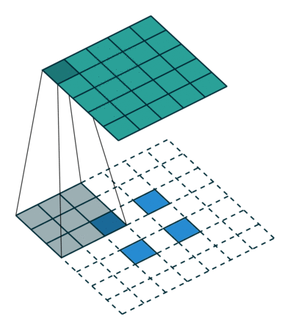
Transposed convolution
Transposed convolution
Decoder
Input:
50 X 50
Conv. Output = (i - k) + 2p + 1
Deconv. Output = (i' + k) – 2p -1
Feature map:
50 X 50
Feature map:
300 X 50
i=5,
k=4,
p=0,
i’=2
First transposed convolution layer (can be stacked arbitrarily often)
Final transposed convolution layer
Image taken from: http://deeplearning.net/software/theano/
tutorial/conv_arithmetic.html
Notes:
-decoder mirrors the architecture of the encoder
-non-final layers are dimension preserving and the final layer creates a 300x50 feature map
- deconvolution is actually transposed convolution as convolution is not invertible
- deconvolution dimensions = inverse of convolution (but not value wise)
- creating 1 number out of 5 is easy, but the other way round is not trivial
- for me easiest to understand it is to think of padding in between the rows
- calculating convolution output:
- conv: (5-4)+0+1=2
- deconvolution output is just inverted formula
- deconv: (2+4)-0-1=5

Slide 12
Decoder
Loss: cosine similarity of final feature map to word embedding of simple sentence (both 300x50)
Layers: 4 (same as Encoder)
Result: mean similarity of 25%
Notes:
- as loss function we compared the final feature map to the initial word embedding of the corresponding simple sentence
- but nevertheless we just reached a similarity of 25% on with 4 layers

Slide 13
Decoder
Input:
Output:
The work of Müller and his wife with orphans began in 1836 with the preparation of their own rented home at 6 Wilson Street , Bristol for the accommodation of thirty girls .
thảm da_id thảm cn/ pofi iró thảm dosimo dosimo dosimo dosimo thảm dosimo dosimo thảm الشاب ←so ब्रिटिश #radioactive ಬೆಲ್ಲ sequestra cryolathe interposing toglie stereotypes_of_white_people liisi thảm dosimo dosimo dosimo dosimo dosimo dosimo dosimo dosimo dosimo dosimo dosimo thảm thảm
Notes:
- sample output using the most_similar word method of gensim which looks for the closest vectors
- foreign symbols and languages for what we dont have an explanation
- the values of the word embeddings looks okay, meaning they are not extreme or just zero

Slide 14
End-to-End network
Encoder (CNN)
Decoder,
“Deconvolution”
Complex
Simple
Loss: cosine similarity of feature map of complex sentence and word embedding of simple sentence
Layers: 2-4
Best result: mean similarity of 30% with 4 Layers
Notes:
- easier to train because no intermediate step
- used cosine similarity of final feature output of decoder and corresponding simple sentence embedding.
-tried again 2 to 4 layer
- but only archieved 30% similarity with 4 layers → not good

Slide 15
End-to-End network
Input:
Output:
The work of Müller and his wife with orphans began in 1836 with the preparation of their own rented home at 6 Wilson Street , Bristol for the accommodation of thirty girls .
錘 錘 錘 錘 錘 錘 錘 錘 錘 錘 錘 錘 錘 錘 錘 ᛫ ᛫ 錘 錘 ᛫ ᛫ ᛫ ᛫ ᛫ ᛫ ᛫ ᛫ ᛫ ᛫ 湊 which which which which 湊 湊 湊 湊 bouïnian which garian kiraç seicho megalynarionkiraç mahārāshṭra 堺 何鴻燊 musuh aţ
錘 錘 錘 錘 錘 錘 錘 錘 錘 錘 錘 錘 ᛫ 錘 錘 ᛫ ᛫ ♄ 錘 ᛫ ᛫ 湊 湊 ᛫ ᛫ ᛫ ἕ ᛫ ᛫ 湊 ᛫ 湊 ᛫ 湊 湊 湊 湊 湊 bouïnian which garian kiraç seicho megalynarion kiraç mahārāsh
ṭra 堺 何鴻燊 musuh aţ
~
Notes:
- same as with decoder output
-probably something wrong with the embeddings

Slide 16
Conclusion
Data set is noisy!
  Additional information (co-reference)
  Simple sentence 1.5 times the length of complex one
  sometimes not really simplified matches
Maybe train word embeddings on our corpus
Encoder: very similar representation for simple and complex sentence
Decoder: cannot reproduce word embedding of simple sentence from feature map of complex one
End-to-end: cannot produce simple embedding from complex one
Notes:
- another insight is that we should not have used an already existing model but come up with our own structure
-future steps would include:
- training of word embeddings on our own corpus

Slide 17
Find out why Attention mechanism does not work
Problem: Output == NaN
Our suspicion:
exploding gradients → weights == NaN → Output == NaN
Solution: remove Attention because it is calculated on a sentence pair
→ final model should take only one sentence as input and output it in a simple form

