Slide 1
Hacker Space Festival 2009 @ /tmp/lab
Blender Game Engine
+
ODP Files
=
Sexy Presentation

Slide 2
Introduction
speaker : Kevin 'Kiniou' Roy
occupation : developer
main interests : multimedia (3D/2D, audio, controls)
member of /tmp/lab

Slide 3
Mini chronology of the project
Initial Idea (4-5 years ago)
  Build a presentation software with a 3D Cube with rotation to switch the slides.
  First attempt failed : No time and other personnal/professional projects.
Lately (2 months ago)
  I knew existence of Blender Game Engine (BGE) but never took it seriously.
  The video game Yo'Frankie has changed my mind about BGE (based on Big Buck Bunny movie from Apricot Project)
  I was already using Blender to create and export my models in my projects
  I needed a Presentation format => ODP
  So I dig further in BGE and ODP ... and voilà :)

Slide 4
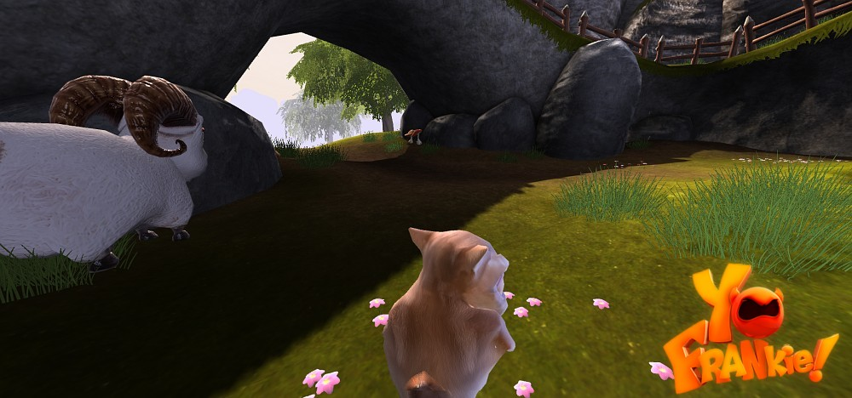
Yo Frankie Video Game with BGE

Slide 5
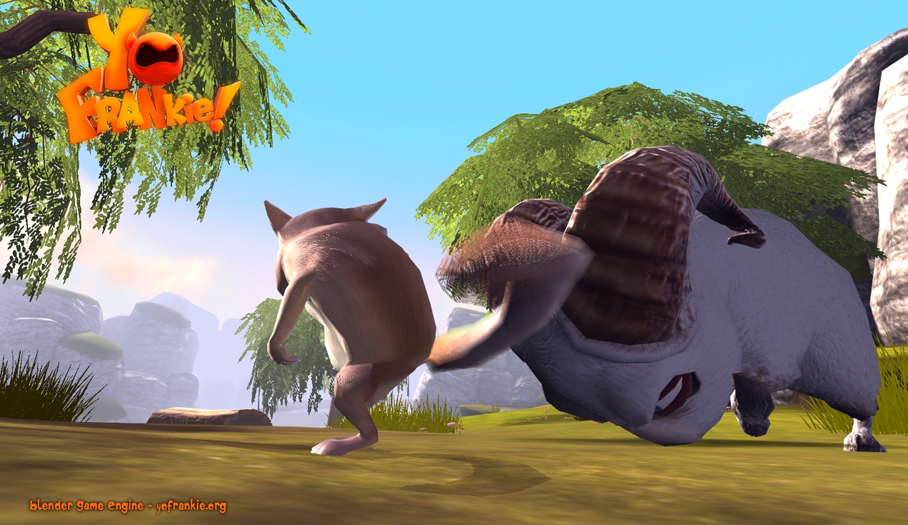
Yo Frankie Video Game with BGE

Slide 6
Plan
A Little Tour in the « Presentation World »
Blender
Blender Game Engine
OpenDocument Presentation
The Final Solution (but not the last)
Next Level
Demonstration

Slide 7
A little tour of « Presentation World »

Slide 8
What's the situation today?
Softwares
  OpenOffice
  KOffice
  Impressive : OpenGL Renderer for PDF only
  ReportLab PythonPoint : Python scripting to create PDF
  and many others I surely forgot ...

Slide 9
What's the situation today?
Formats
  PDF
    good text formating
    « portable » like in its name
  XML
    many document formats use it ( OpenDocument , Tex ...)
    many ways (and corresponding library) to parse it

Slide 10
How can we make things more attractive ?
Interactivity
  device controlers : sensors , webcam , remote control , joystick ...
  audio : sounds on actions, ambient music ...
Realtime 3D effects and animations
  Statistics Charts animations
  Zoom, slide, bounce on presentation objects
  Other Effects
Notification
  Notes Subtitles
  Mouse pop-up

Slide 11
Which way to attractiveness ?
Game engines
  Physics computed in realtime
  3D/2D facilitators (Load 3D Scene Files , Play Animations ...)
  Many multimedia formats supported (generally)
  Input devices (mice , joysticks , keyboards , remote controls)
Possible Engines
  Ogre3D
  Irrlicht
  CrystalSpace
  Quake
  Blender

Slide 12
Blender

Slide 13
What is Blender?
Complete 3D tools suite
  Modeler
  Animations
    Graphical control with IPOs
    Bezier Curves
    Actions
  Rendering
    single frame
    raycasting
    ...
Scripting
    Python
    Lua (in developpement)
Game Engine embedded

Slide 14
My choice in 5 points
Open Source !!!
Quick Prototyping
    robot simulation
    physics tests
    network simulation with messages
Game Engine is User Friendly
    boxes to link to other boxes
Scriptable with Python
I'm already a Blender User :)

Slide 15
Automate Blender with Python
Create and modify Blender Objects
    almost every parameters in v2.49
    all in v2.5
Export/Import into/from other formats
    3D formats : 3DS , C4D , COLLADA , SKETCHUP ...
    2D formats : PNG , JPEG ...
    and whatever you would like to export
Control the Game Engine behaviour

Slide 16
Blender
Game Engine

Slide 17
How BGE works?
External part shipped in Blender suite
Can be started with « blenderplayer » utility or inside Blender
Each objects of a 3D Scene have interaction properties
  physics (static , rigid bodies , soft bodies , dynamics )
  user-defined variables pythonized
BGE is realtime-clocked
  it can wake up its element parts at a certain rate of tics per seconds

Slide 18
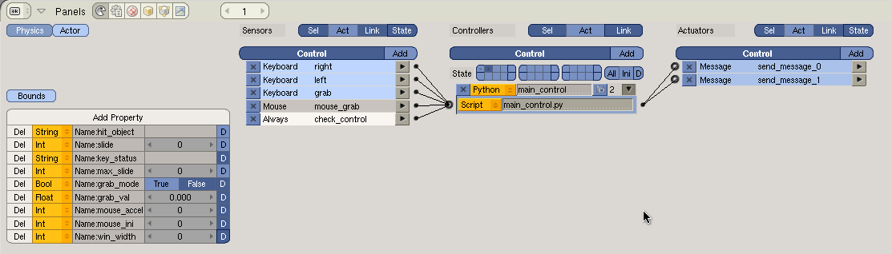
Components
There are 3 type of elements in BGE
  Sensors
  Controllers
  Actuators
Each objects own this 3 components

Slide 19
Components
Sensors
  Start element of a BGE object
  They can detect some form of input
  If a condition is met, it trigger the controller linked to them
  Possibles Sensors
    Detect Objects distance
    Get mouse/keyboard state
    Get messages from other objects
    Test properties value
    Timer
    ... etc

Slide 20
Components
Controllers
  They are used to link sensors and actuators together
  They allow basic or complex control on how sensors states will interact with actuators
  Possible Controllers:
    Boolean (AND,OR,NOR,NAND,XOR ...)
    Condition
    Python script

Slide 21
Components
Actuators
  End element of a BGE element
  An actuator carry out an action if the parent controller linked is true
  Possible actions:
    Play object IPO Animation
    Create Object
    Set game states
    Send messages between objects
    ... etc

Slide 22
Miscellaneous
Realtime Physics Engine
  interaction between objects in the scene
  soft bodies (make some jelly in 3D !!!)
Video Texture
  Mirror
  Play Video (FFMPEG)

Slide 23
OpenDocument
Presentation

Slide 24
Why this format?
Open format
Zipped file with xml settings and formatting information
Free creation
  OpenOffice.Org
  KOffice

Slide 25
How to extract informations from this format ?
XML parser
  SAX, DOM ...
UNO library
  openoffice python library to retrieve and format OpenDocument information
  needs openoffice installed and runnable when script is called
odfpy
  XML DOM parser to retrieve OpenDocument elements
  Young library => it misses features

Slide 26
Final Solution
(but not the last)

Slide 27
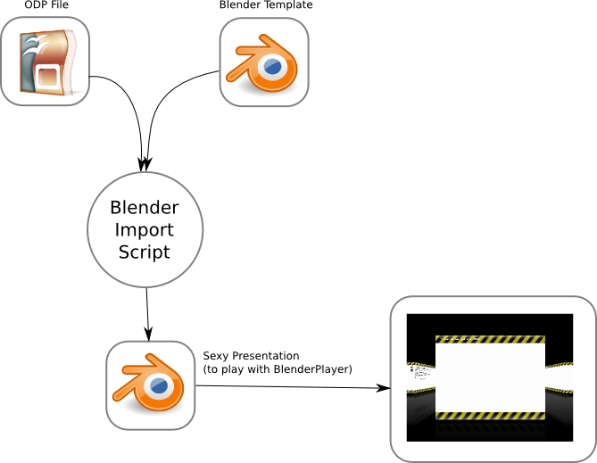
Final Solution (but not the last)

Slide 28
Next Level

Slide 29
Next Level
Correct Bugs
  Clean this ugly code !!!
  Better content formatting
Nice to have
  Modular choice of game engines
Contents
  More interactive (or just funnier) template

Slide 30
Demonstration

