Slide 1

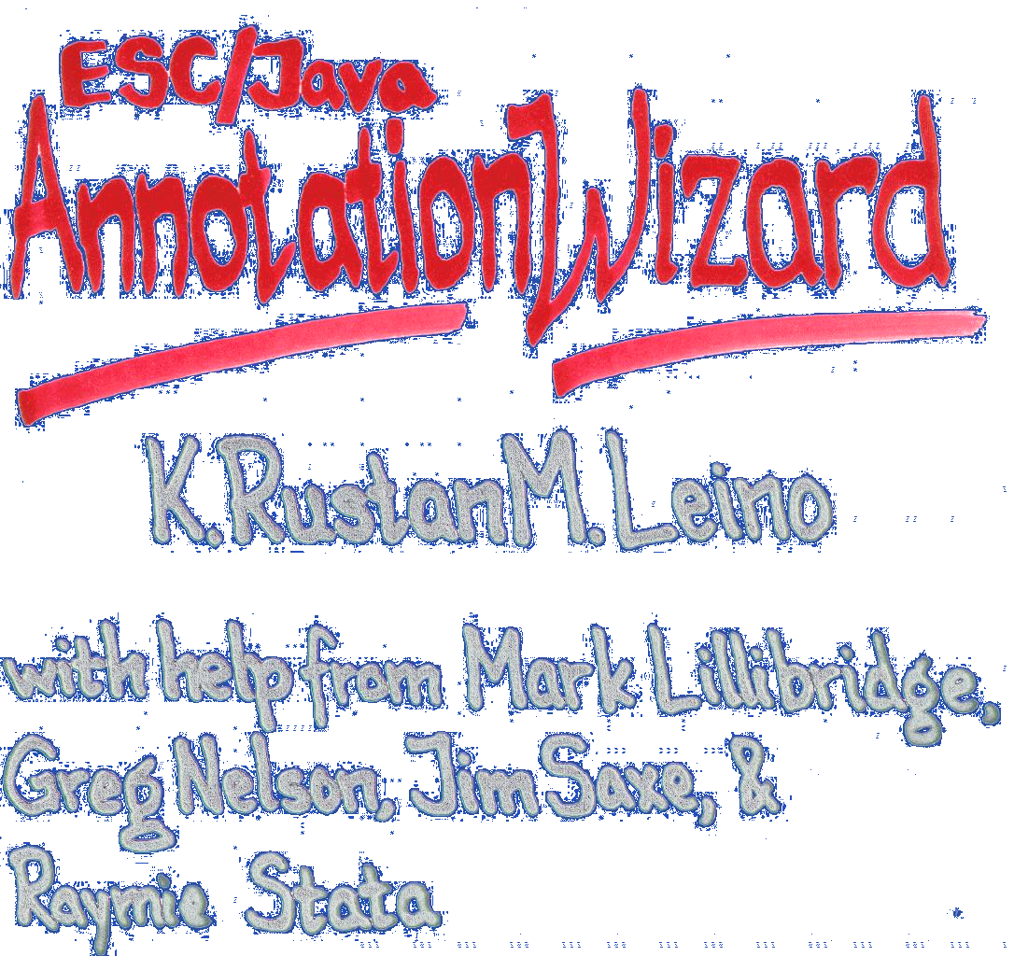


escj 28

Slide 2

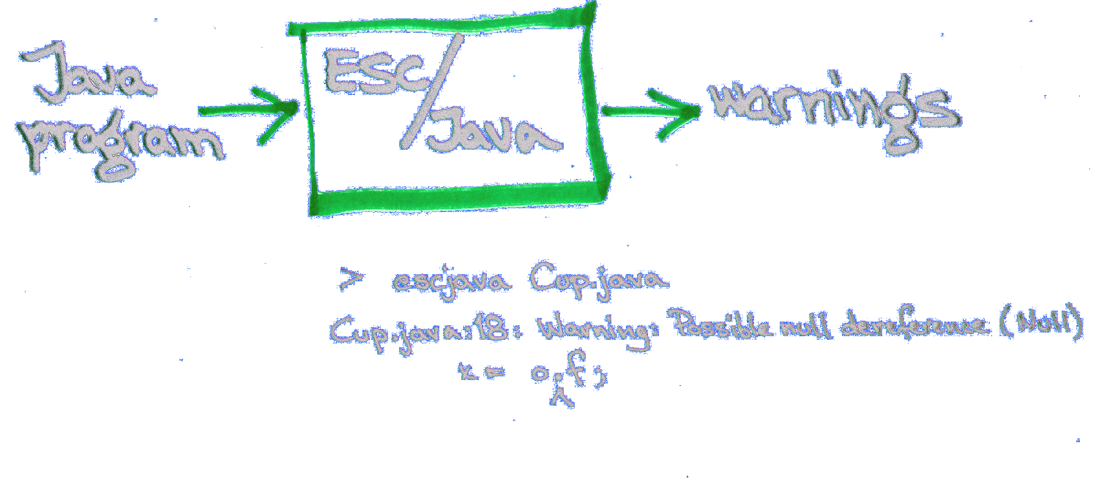

Slide 3
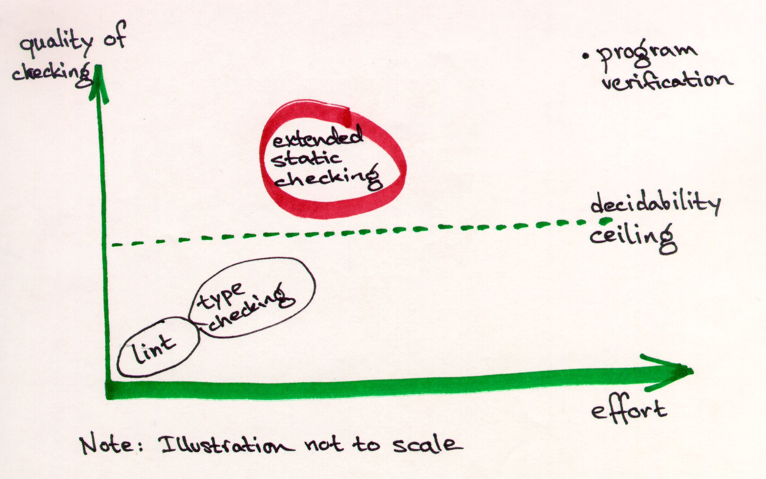
Static checkers

Slide 4
Type checking vs. extended static checking
Type checking
E.s.c.
Are annotations needed?
How many annotations per variable/method?
Escape hatch for when annotation gets too complicated?
yes
yes
1
0 -- many
dynamic casts
assume, nowarn

Slide 5


Slide 6

Annotation assistant

Slide 7

Annotation assistant

Slide 8

Annotation assistant

Slide 9
Annotation assistant

Slide 10
Annotation assistant

Slide 11
Annotation assistant

Slide 12
-suggest switch
Use simple (possibly bogus) heuristics
Cup.java:18: Warning: possible null dereference (Null)
x = o.f;
^

Slide 13
-suggest switch
Use simple (possibly bogus) heuristics
Cup.java:18: Warning: possible null dereference (Null)
x = o.f;
^
Suggestion: perhaps declare ‘o’ as ‘non_null’

Slide 14
Annotation wizard design
repeat
call ESC/Java -suggest on sources;
distill output into update instructions;
act on update instructions
until quiescence

Slide 15
Update instructions
insert “/*@ … */” at 6,12 in Cup.java
else “/*@ nowarn … */” at 28,17 in Client.java

Slide 16
Pachyclient case study
~11,000 lines of code
~650 methods
43 files
110 minutes (2.5 minutes to compile)
13 iterations
971 annotations

Slide 17
How were the 110 minutes spent?
Iteration Warnings Minutes
0 392 14
1 256 12
2 136 10
3 78 9
4 42 8
5 24 8
6 20 7
7 11 7
8 6 7
9 3 7
10 2 7
11 1 7
12 0 7
-------- -------- --------
TOTAL: 13 971 110

Slide 18
What became of the 971 warnings?
non_null
  instance fields 304
  parameters 219
  local variables 108 (later: 27)
  static fields 5
postcondition RES != null 49
requires 0 <= x 2
ensures 0 <= RES 2
invariant 0 <= x 1
no heuristic
  null related 47 (29 for ‘null’)
  negative related 16
suggestion in different file 169
annotation inserter gives up 49

Slide 19
Did the wizard help?
null and negative checking only
  warnings on unannotated code: 938
  warnings on wizard-annotated code: 274
all checking (but heuristics only for null and negative)
  warnings on unannotated code: >1100
  warnings on wizard-annotated code: 488

Slide 20
What kinds of warnings remain?
Null 121 (83)
NonNull 131 (83)
NonNullInit 5
IndexNegative 15
NegSize 2 (1)
Cast 111
Pre 48
IndexTooBig 32
Post 14
ZeroDiv 7
Invariant 2
(Numbers in parentheses indicate how many of the warnings have
annotation suggestions in libraries.)

Slide 21
Annotating libraries
Suggestion [359,52]: perhaps declare method 'getText' in /tmp_mnt/bill/r/dlusers14/sanjay/srcjava1.1/files/../files/jdk-114.zip: java/awt/TextComponent.class with 'ensures RES != null;'

Slide 22
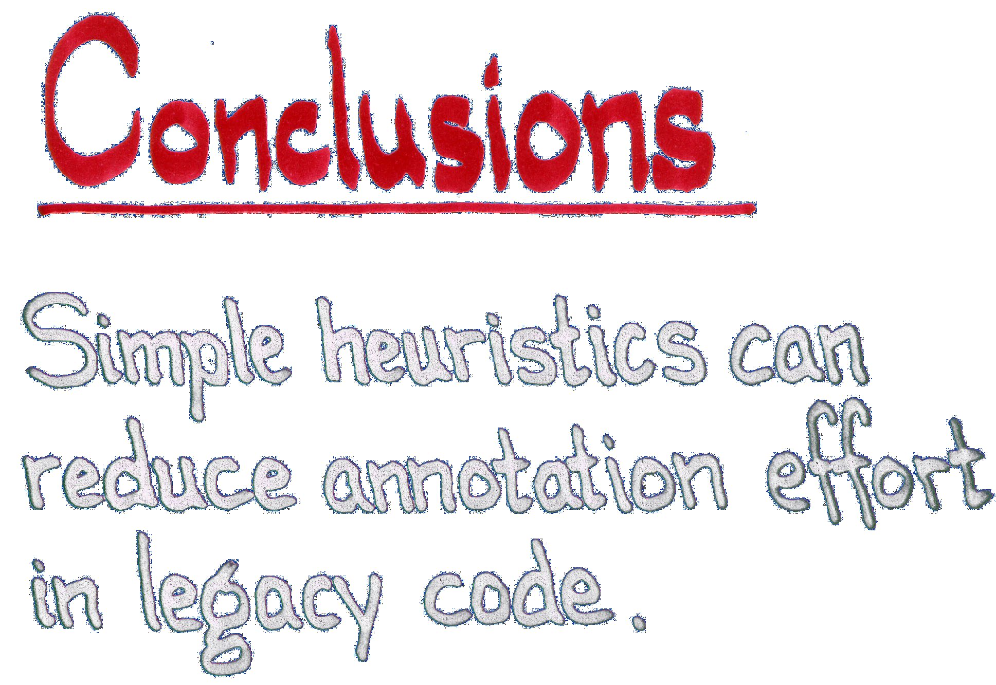

Slide 23
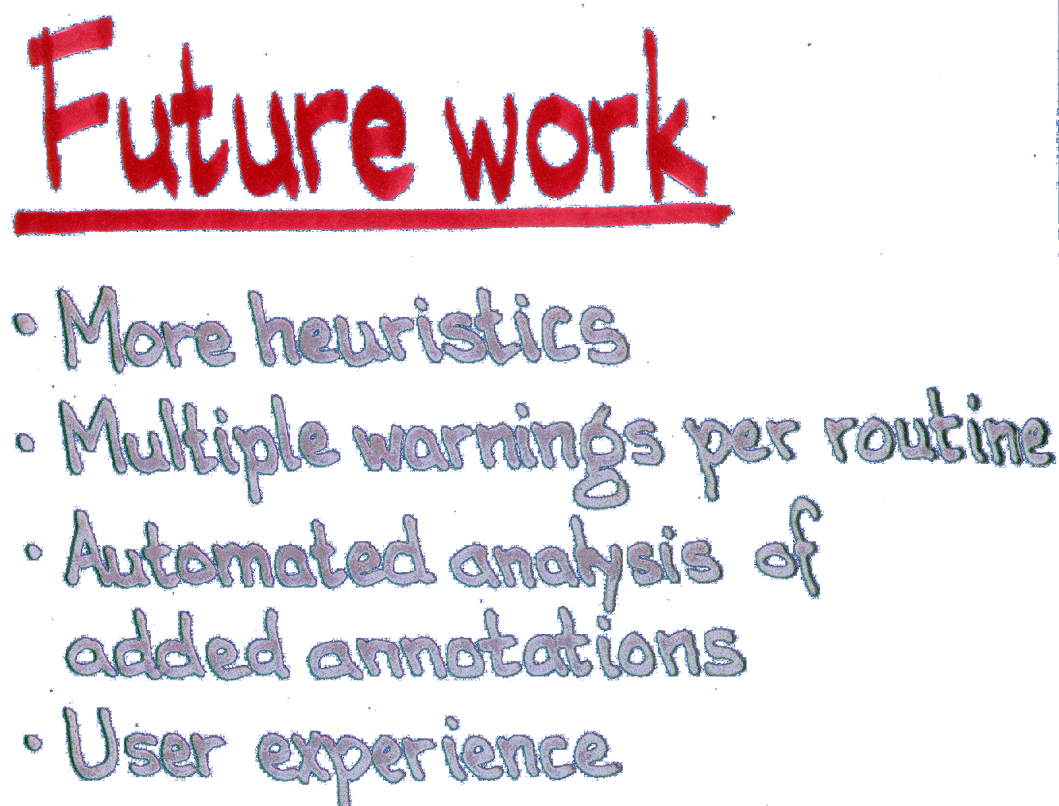

Slide 24




Slide 25
Compaq Research
Harder questions

