Slide 1
Sense Tile
The Sense Tile project is intended to support large-scale experiments with complex multimedia sensing and processing at terabyte scales.
The proposed equipment consists of a rich and reusable sensor platform easily deployable into the built environment for easy experimentation and representative of platforms suitable for wider uses, together with data storage and processing capacity and associated high-speed interconnect.

Slide 2
Sense Tile-challenges
The delivery of this facility will allow the research teams to attack problems on a scale and in a manner not previously possible. The key research challenges this facility will address include:
  dealing with uncertainty in sensor systems.
  robust management of large (multi-terabyte) sensing data on heterogeneous platforms.
  interaction and activity recognition.
  sparse signal analysis.
  coding and securing sensor interactions.

Slide 3
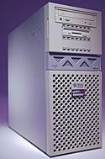

Sense Tile Architecture
Sensor
board
Clusters ( Server farms )
Communication layer
Sensor
board
Sensor
board
Sensor
board
Sensor
board

Slide 4
Sense Tile-unit architecture
The system can be deployed as a two separate parts.
The SenseTile Unit captures, processes and relays all of the following sensor inputs. All data to be streamed to the network.
The SenseTile Unit is capable to perform measurement as follow :
audio, audio/ultrasonic, temperature, pressure,humidity, IR photodetector.

Slide 5
Sense Tile-board bandwidth
Audio/Ultrasonic. Ultrasonic signal processing, at least 50kHz bandwidth required ( sampling 96KHz, 192 kbyte/sec).
Temperature range: -25°C - +85°C with accuracy ±0.5°C; sampling rate 0.2 Hz.
Pressure range: 500mbar – 1500mbar with accuracy 2%; sampling rate 0.2 Hz.
Humidity range: 10% - 95 % with accuracy 2%
Minimum for 1audio channel low sampling is about 8 Gb/day, and for 4 channels high sampling is about 64 Gb/day.
For non audio sensors 2Gb/day.

Slide 6
Sense Tile-Simulator
A Verification-centric Software Development Process for Java

Slide 7
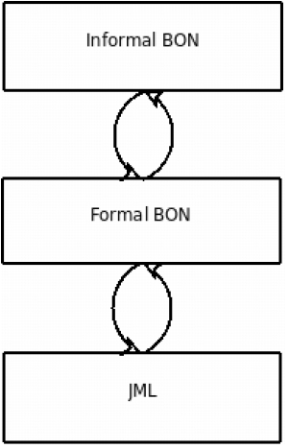
Sense Tile-Refinement process
Continuous refinement process

Slide 8
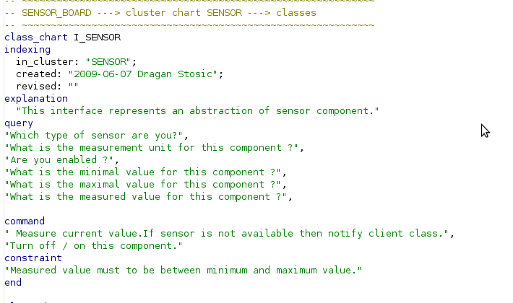
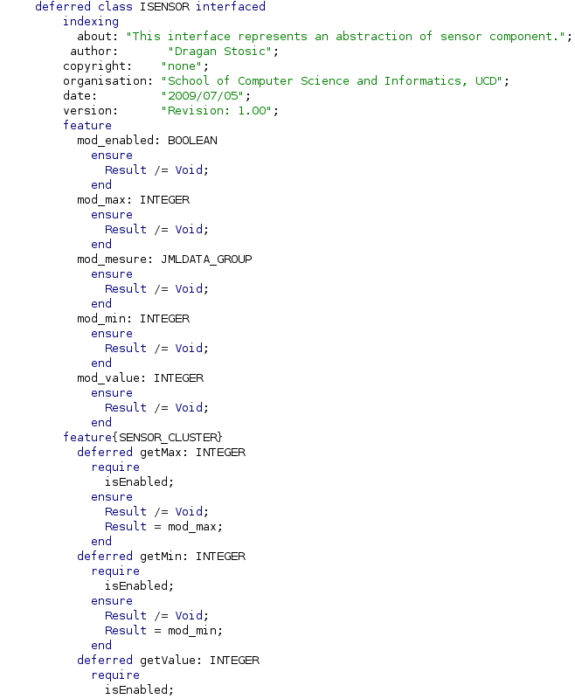
Sense Tile-From Informal To Formal

Slide 9
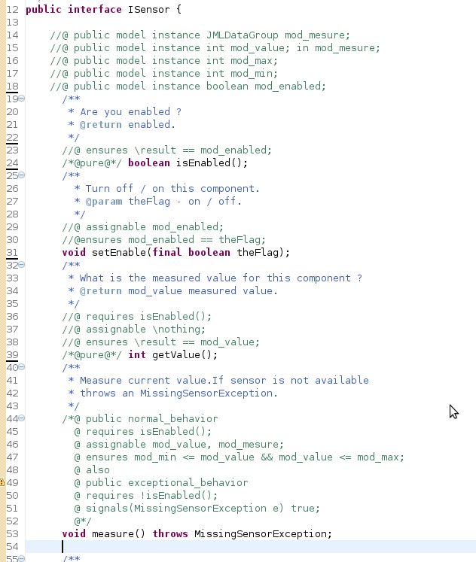
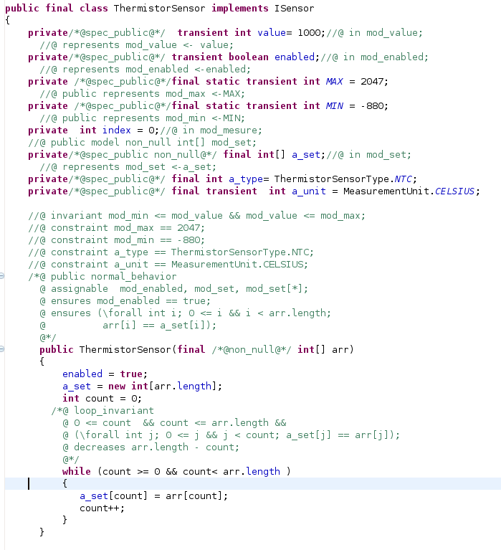
SenseTile-Implementation

Slide 10
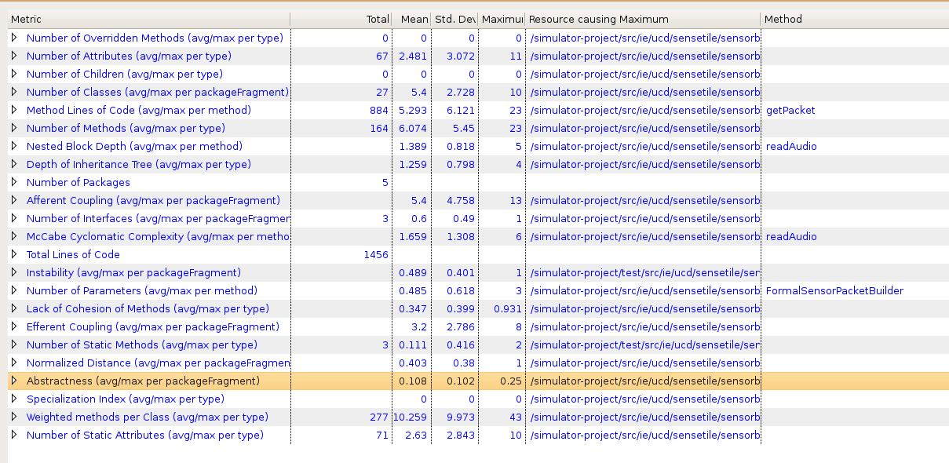
Sense TileSimulator-Metrics

Slide 11
Thank You !

Slide 12
Sense Tile-transfer data
Transfering data from sensor board to PC–USB communication.
Transfering data from PC to server farm: wirelles communication.

Slide 13
Sense Tile-data caracteristics
Streaming data access.
Applications need streaming data access.
Batch processing rather than interactive user access.
Large data sets and files: gigabytes size
High aggregate data bandwidth
Write once – read many: a file once created, written and closed need not be changed – this assumption simplifies coherency.
Conclusion: A map/reduce application fits perfectly with this model.

Slide 14
Sense Tile
A Multi-purpose Infrastructure for Network Applications

