Slide 1


FINAL PROJECT
IS 537-Theory & Practice of Data Cleaning
Dishay Shah, Kinjal Shah

Slide 2

About this Dataset:
Netflix is one of the most popular media and video streaming platforms.
They have over 8000 movies or tv shows available on their platform, as of mid-2021, they have over 200M Subscribers globally.
This tabular dataset consists of listings of all the movies and tv shows available on Netflix, along with details such as - cast, directors, ratings, release year, duration, etc.
SCHOOL OF INFORMATION SCIENCES

Slide 3
Understanding the Dataset:
There is a single dataset that is being used, the netflix1.csv.
This file was obtained from Kaggle and it is an already cleaned version of another file.
The information consists of materials that Netflix added between 2008 and 2021.
The earliest content dates back to 1925, and the most recent is from 2021.
SCHOOL OF INFORMATION SCIENCES

Slide 4
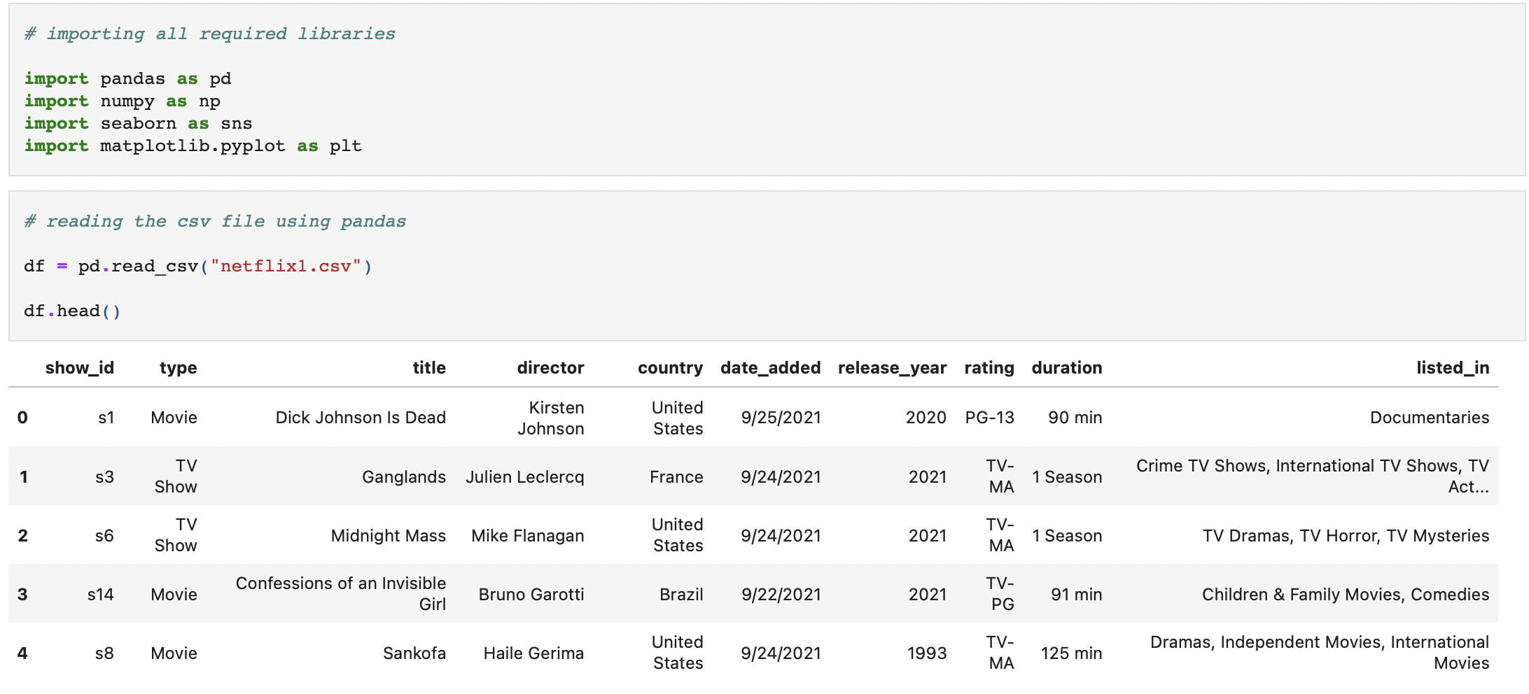
Reading this Dataset:
The first Step in the Data Cleaning process is reading the given Dataset.
On importing all the required libraries and reading our dataset we get the given result
The variables of this data set are also observable in the given snippet.
SCHOOL OF INFORMATION SCIENCES

Slide 5
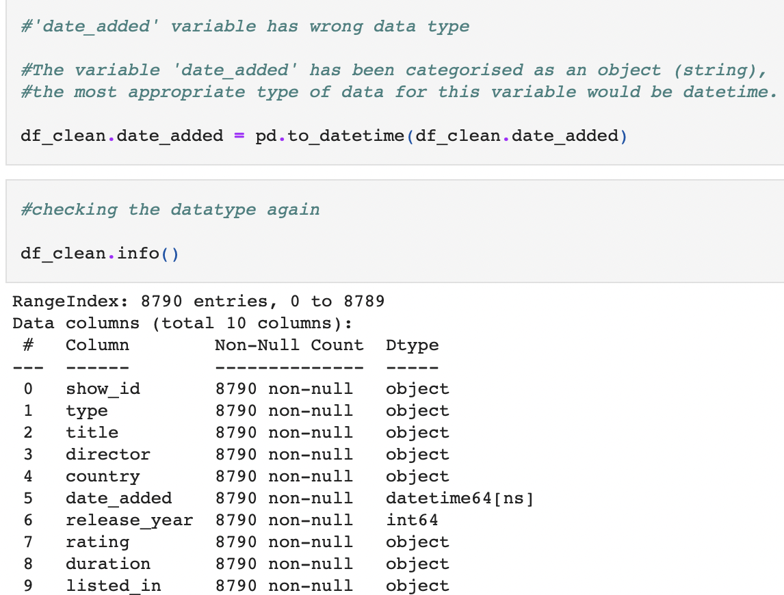
Studying the Dataset:
The next step in the Data Cleaning process is studying the given Dataset.
Here we observed that the variable 'date_added' has been categorised as an object (string) but the most appropriate type of data for this variable would be datetime.
We Converted the ‘date_added’ variable to datetime as shown in the snippet.
SCHOOL OF INFORMATION SCIENCES

Slide 6
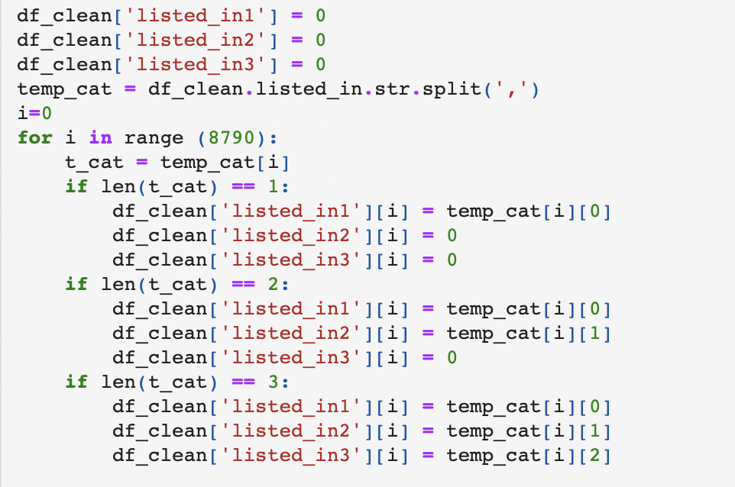
Cleaning the Dataset:
The 'listed_in' variable can have several categories per media.
We would like to create new variables to be able to extract this and correctly filter the data.
SCHOOL OF INFORMATION SCIENCES

Slide 7
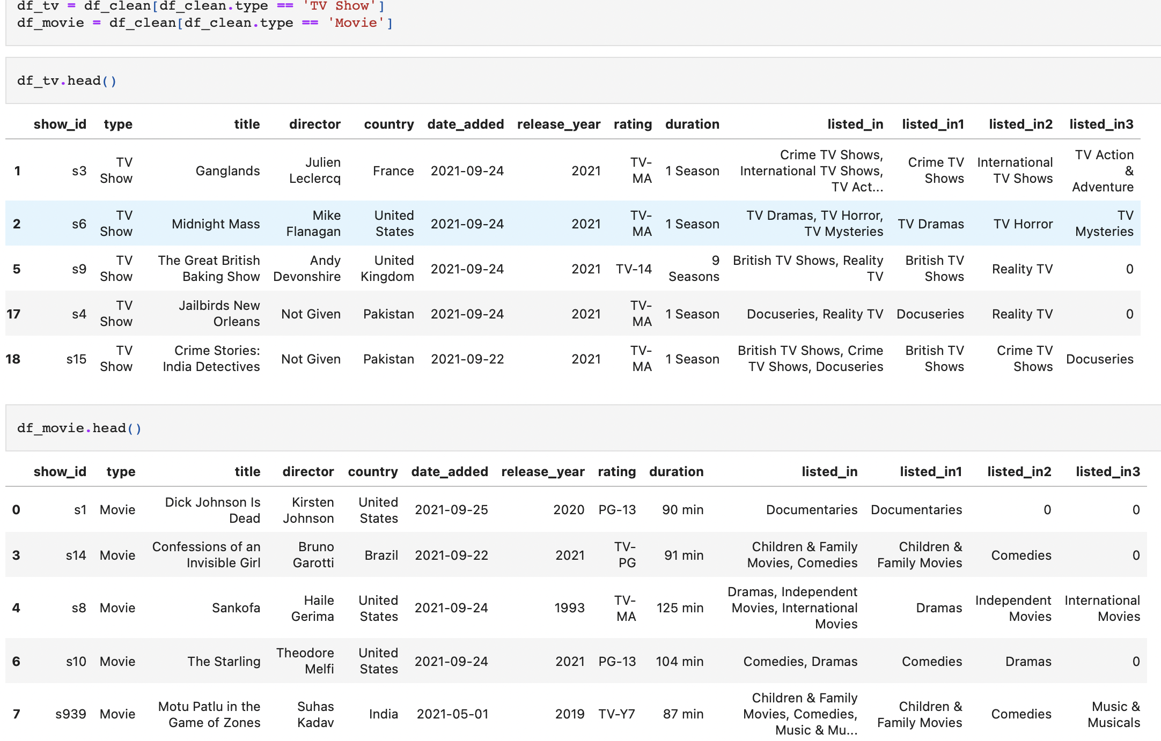
Splitting the Dataset:
We observed that There are two different types of observations in a single data set i.e TV Shows and Movies.
The solution would be to split the dataset into two as shown in the snippet
SCHOOL OF INFORMATION SCIENCES

Slide 8
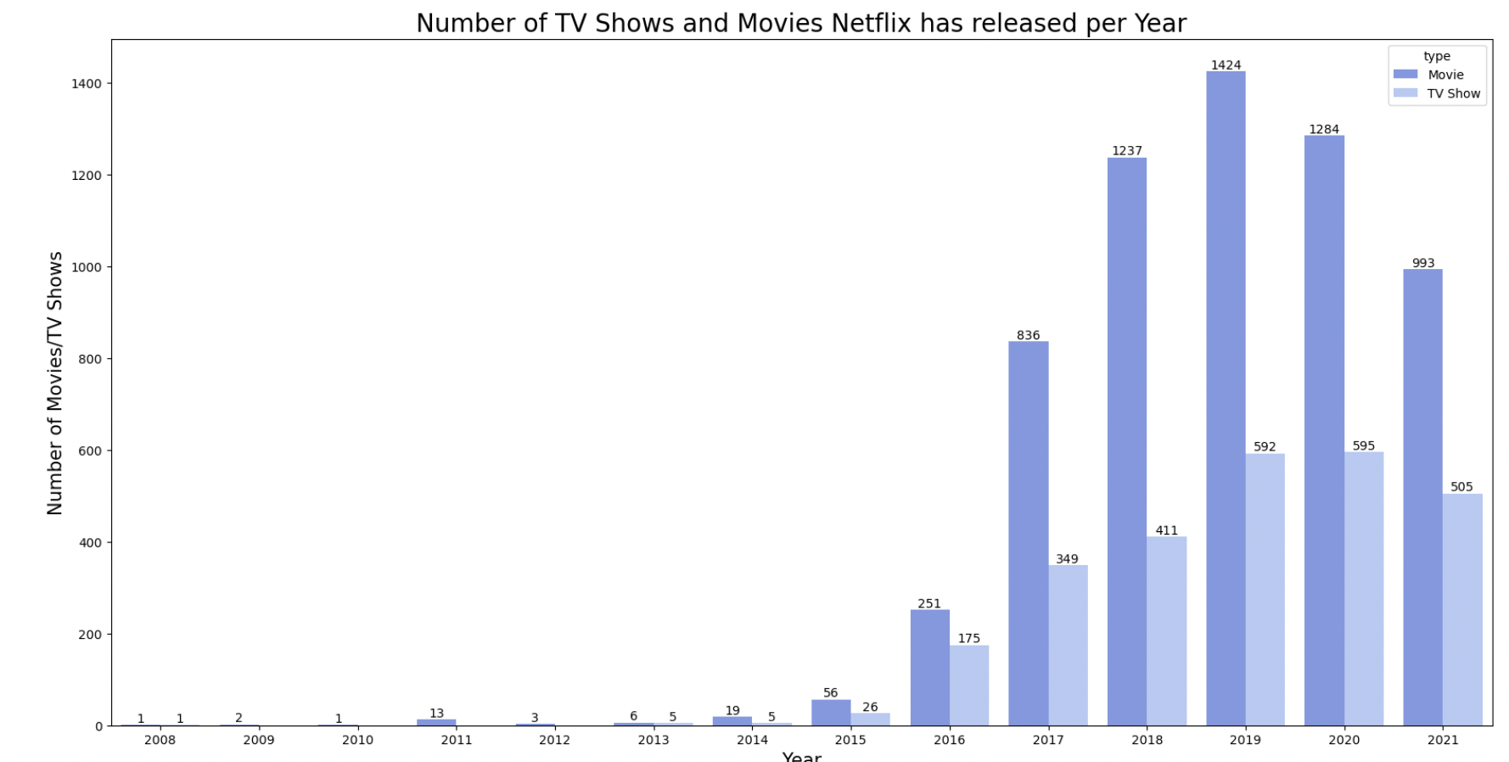
Analyzing the Data:
It seems like for both TV shows and Movies there has been a steady increase since the start of 2008; the only big drop happening in 2021 possibly due to the economic impact of COVID.
Before 2017, the number of TV Shows and Movies brought to the streaming service was on par.
However, after 2017 the company started introducing more movies into the service more than doubling TV Shows in the amount of content.
SCHOOL OF INFORMATION SCIENCES

Slide 9
Conclusion:
By testing this interesting dataset for cleaning and analyzing, we learned how important it is to follow all the steps before actually going forward with cleaning the data.
Understanding the data (format(csv, json), row-column count …)
Studying the data (datatypes, categorical/numerical…)
Which language/tool to use to clean and analyze
SCHOOL OF INFORMATION SCIENCES

Slide 10
Thank you!
Any questions?

