Slide 1

Online Multimedia Sharing And Searching Portal

Slide 2
Defination
This website is aim to provide
Movies , Videos , And Live Television
on user’s computer or mobile devices.
Multimedia Sharing is one of the important part of the website.

Slide 3
Scope
Search Movie
Access global movie database
Search Videos from different platforms
Live channel broadcasting
On demand movies / shows
New upcoming movie details and trailers
Like/Share/Comment/Download/Upload
Premium membership
Link with cloud for online storage
Social Linkups for Registration and login

Slide 4
System Information
Front End :-
- Boostrap
Back End :-
-PHP Laravel Framework
Database :-
-MySQL
Api :-
-IMDB, YouTube, Daily Motion, Drive, Other Social websites
Mail Server :-
-smtp.gmail.com

Slide 5
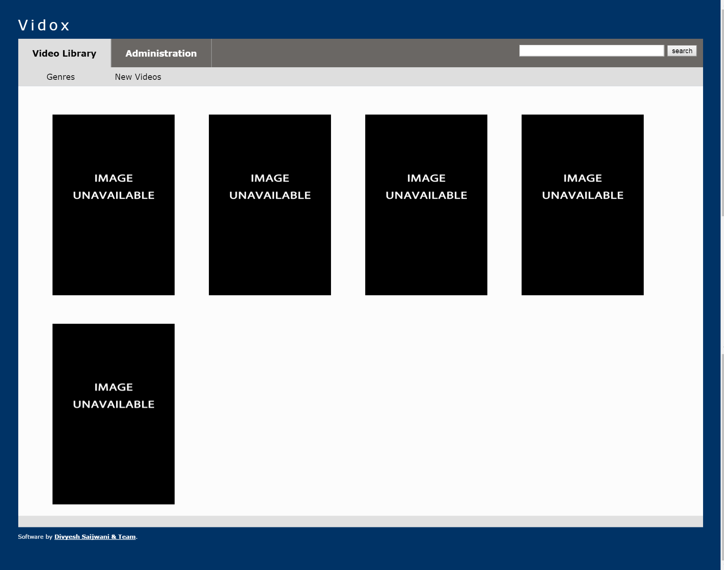
Screen Design

Slide 6
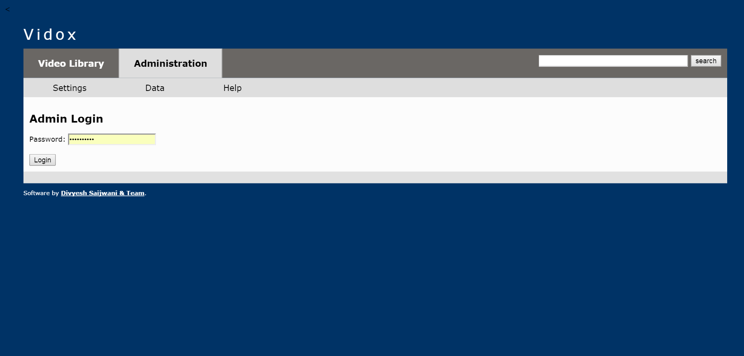
Screen Design

Slide 7
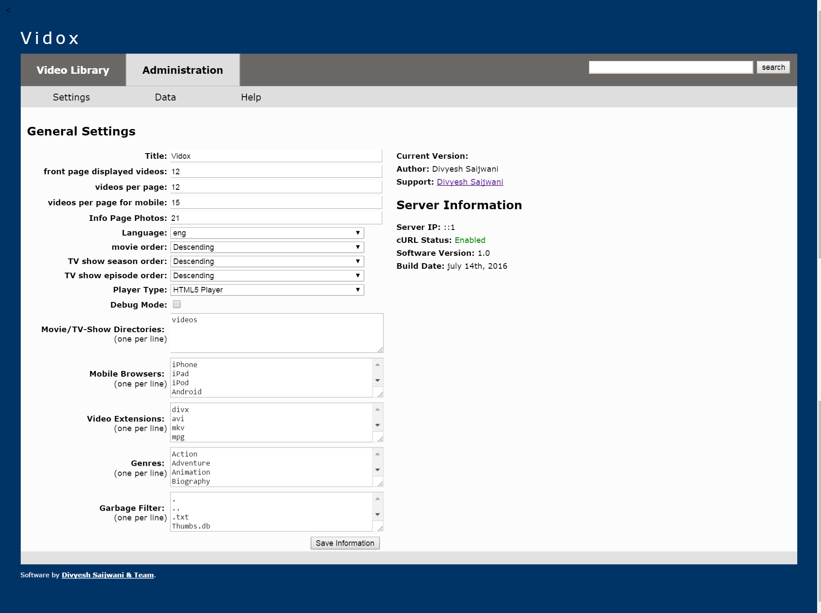
Screen Design

Slide 8
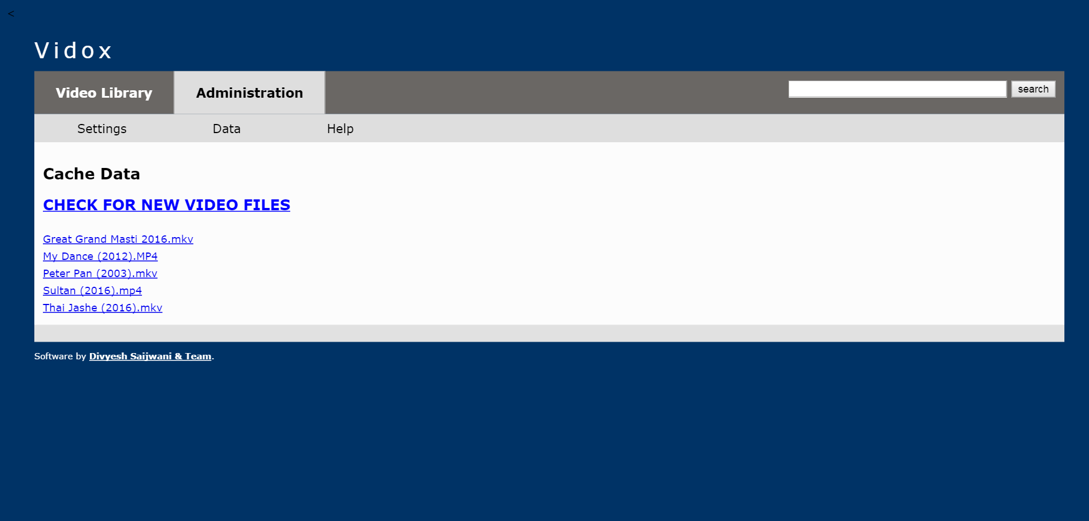
Screen Design

Slide 9
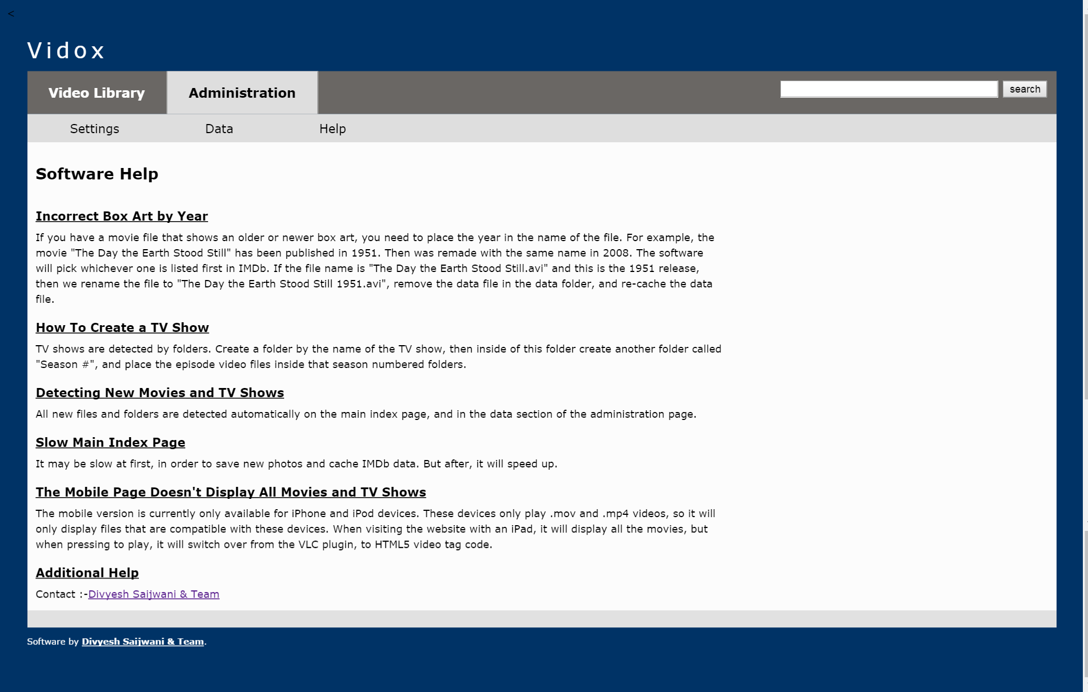
Screen Design

Slide 10
Working
https://www.youtube.com/watch?v=OX_zs7ioSbM&feature=youtu.be
Go to this link and view this.

