Slide 1
Resume Parser : An automated approach for skill extraction and intelligent analysis
AWS-AIA INTERN 2025
© 2024 Cognizant | Private

Slide 2

Presentation Outline
Project Overview
Objectives
Technologies and Platforms used
Workflow Diagram
Implementation Details
Results and Analysis
Challenges Faced
Scope for improvement
What you can do as an Admin ?
Analyse the uploaded resumes
View top skills possessed by candidates
View each candidate’s resume
Analyse languages spoken by candidates
Analyse the amount of candidates with UG or PG degree
Sort candidates based on particular skills
Fetch the JSON/CSV object with anonymised profiles

Slide 3
Project Overview
The Resume Parser project is an intelligent system designed to automate candidate data extraction from PDF resumes. Using Python and tools like pdfminer, faker, and uuid, it cleans raw text, then applies regex and pre-trained LLMs to extract key details such as name, email, phone number, and categorized skills (e.g., Technical, Non-Technical).
Each profile is uniquely identified and returned as a structured JSON object, ensuring data is machine-readable and anonymized for secure use.
This system streamlines resume processing by converting unstructured formats into structured profiles for faster screening and analysis.
It empowers HR teams with quicker candidate filtering, enhanced skill matching, and robust analytics supporting scalable integration into larger recruitment workflows.

Slide 4
Objectives
Automate Resume Screening by extracting key candidate information such as name, email, phone number, skills, and experience.
Convert Unstructured Data to Structured Format (e.g., JSON/CSV) for easy integration with databases and HR systems.
Accurately Identify Technical and Non-Technical Skills using Skill Dictionary .
Enhance Recruitment Efficiency by minimizing manual review and standardizing resume data.
Enable Skill Classification by grouping extracted skills into categories such as Technical and Non – Technical Skills .
Improve Candidate Searchability by storing parsed data in searchable formats for faster shortlisting.

Slide 5
Technologies and Platforms used
Programming Language : Python v3.10
Text Extraction : PDFMiner.six
Skill Extraction : Regular Expressions
Name Extraction : AWS Bedrock
Summarisation : Gemini API – Flash 2.5
Cloud Storage : AWS S3
Cloud Processing : AWS Lambda
Event Notification : AWS SES
Dashboard and Visualisation : HTML , CSS , JavaScript , Flask
Platforms used :
VS Code
Spyder
AWS
Jupyter Notebook
Git Hub
Gemini Ai Studio

Slide 6
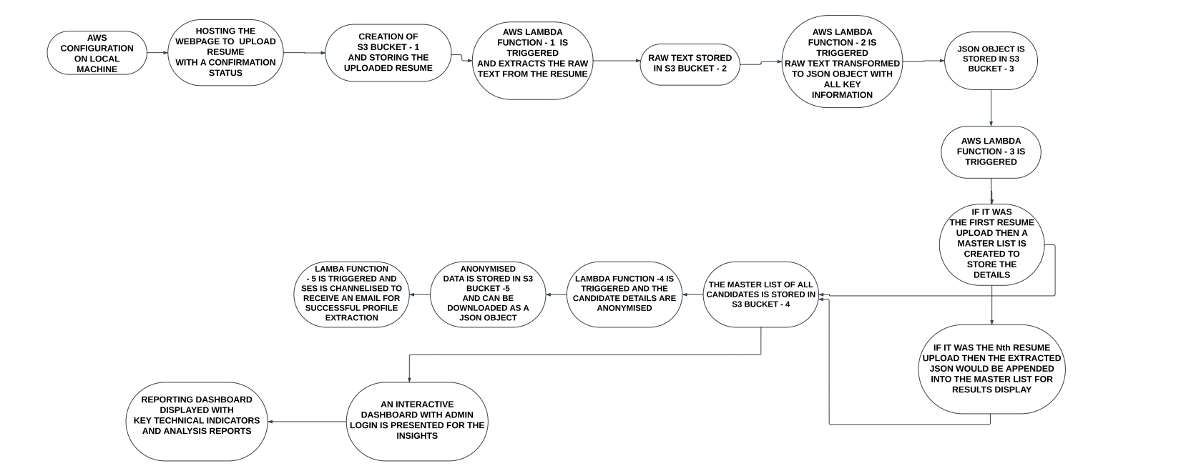
Workflow Diagram

Slide 7
Implementation Details
Module [1]
Accept a resume in PDF format on the website hosted from their respective local system .
Store the text in an S3 bucket
Display the confirmation status of successful upload
Module [2]
Triggering the lambda function on a new upload
Extract the text from the resume using pdfminer
Normalize the text and store it in a s3 bucket for further processing
Module [3]
Trigger a lambda function
Extract skills using regex and skill dictionary
Extract contact details and assign a unique id to each candidate
Store the extracted information in a s3 bucket

Slide 8
Implementation Details
Module [4]
Combine all the extracted data from the profiles parsed .
A complete document type JSON object is made available to retrieve canidate profiles .
Anonymization is performed for the retrieval of candidate profiles .
Module [5]
Uploaded resumes are made visible with each candidate’s profile
Dashboard is available to analyse skill clusters.
A skill cloud is made available to visualize the available skills among the candidates .
Reports like languages , daily resume upload count , Undergraduate vs Postgraduate are also visualized .

Slide 9
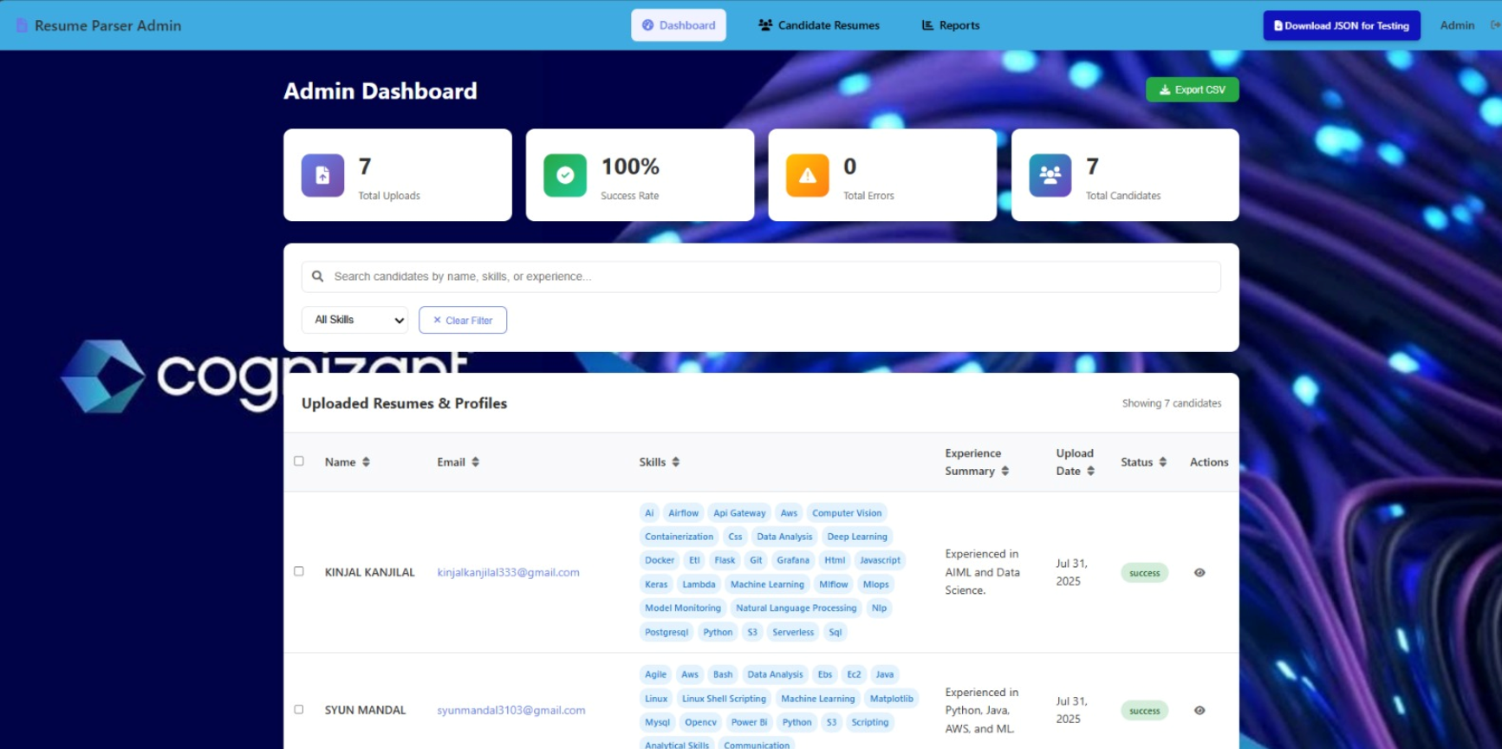
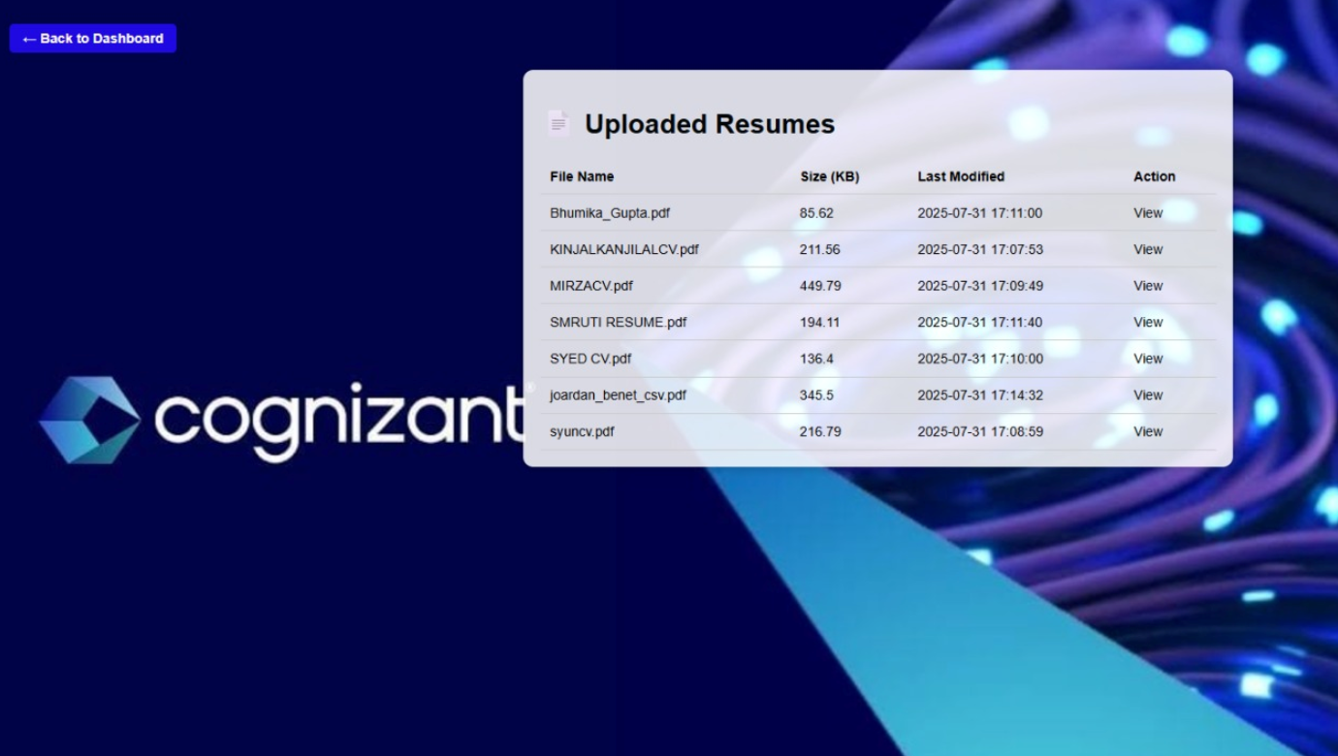
Results and Analysis
Dashboard :
Resume Uploads:
Fig 1 : Dashboard Report for all the successfully parsed resumes
Fig 2 : View Resume action for the candidates

Slide 10
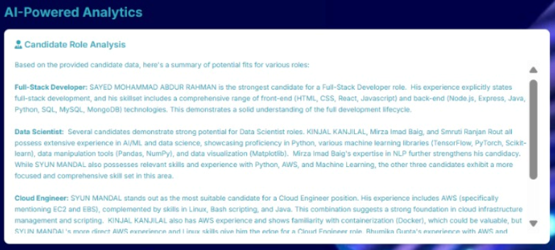
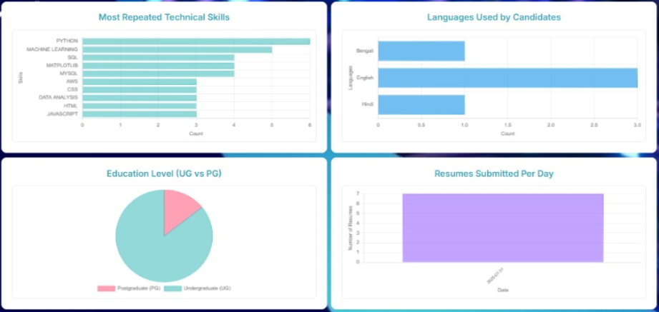
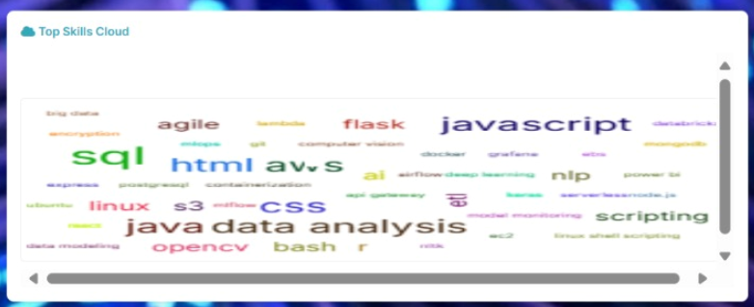
Results and Analysis
Canidate Analysis:
Candidate Reports:
Skill Cloud : :

Slide 11
Challenges Faced
Platform Challenges :
It was difficult to upload the zipped file for AWS Lambda Layers as the packages we needed are not visible in Windows OS , as it masks the binary files .
PyMuPDF package had some issues with AWS lambda , as initially it did not work , later on shifted to pdfminer.six.
For the name extraction , sometimes Gemini API had a downtime .
NLP Challenges :
The NLP model SpaCy is trained on western data , so it was not good with the Named Entity Recognition .
NLP was to be implemented for identifying the candidate names from the resume’s text , but it was unable to currently identify , as the names were Indian .

Slide 12
Scope for Improvement
Integrate or train NLP for more advanced entity recognition,on cover letters or categorizing job titles.
Implement some other methods for various resume format acceptance . (jpeg , png , jpg , docx )
Resume scoring or Candidate Ranking
Automated Skill Dictionary expansion
Reasons for the implementation gaps
Time Constraints
Frontend Expertise
NLP impotency (SpaCy)
.

Slide 13
Project Contributors
Project Created by :
Kinjal Kanjilal
Mirza Imad Baig
Syun Mandal
Smruti Ranjan Rout
Sayed Mohammad Abdur Rahman
Mentored By – Pechi Muthu

Slide 14


Thank you
© 2024 Cognizant | Private

