Slide 1
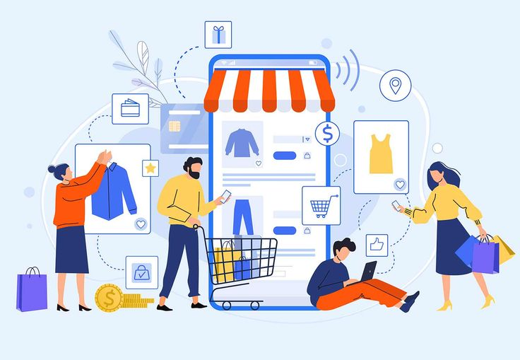
Exploring E-commerce Dynamics: Insights and Strategies
By Kinjal Gaikwad

Slide 2
Introduction :
Welcome to the Clothing Sales Data Analysis spanning from March 2022 to June 2022.
This analysis endeavors to explore sales data from multiple clothing retailers, excluding Amazon, focusing on categories, currencies, and customer insights. It aims to evaluate stock movements, profitability comparison between different platforms (like Shiprocket and INCREF), and pricing comparisons across channels such as Myntra and Ajio.
Additionally, the analysis will propose cost-cutting measures, particularly in optimizing delivery options, and seek to derive predictive models for future sales and profitability.
By delving into customer preferences over time, including factors like size, color, and platform-specific pricing, we aim to uncover actionable insights that can shape strategic decisions and elevate sales strategies for improved performance.

Slide 3

Problem Statements:
Analyze monthly sales by category, currency, and customer.
Assess stock levels to understand product movement.
Compare profitability using Shiprocket and INCREF data.
Evaluate referral fees and fulfillment rates.
Compare prices across channels like Amazon, Myntra, Ajio.
Propose cost-cutting measures, especially in delivery options.
Leverage data to build a predictive model for future sales volume and profits.
Provide insights into customer preferences over time, considering factors like Size, Color, and Platform-specific pricing.

Slide 4
Below Mentioned Points Covered During Assignment
Category Wise Sales by State
Sales by Month and Category
Relationship between Sales ,Qty and SKU
Sales by fulfillment
Qty by size and category
Shipment status breakdown by service level
Sales by size
Stock by category
Sales by city
Key influencers of sales eg., category
Price Comparison within different channels.
State wise total sales , Gross Sales and qty

Slide 5

Power BI Live Report
Click here to follow link

Slide 6
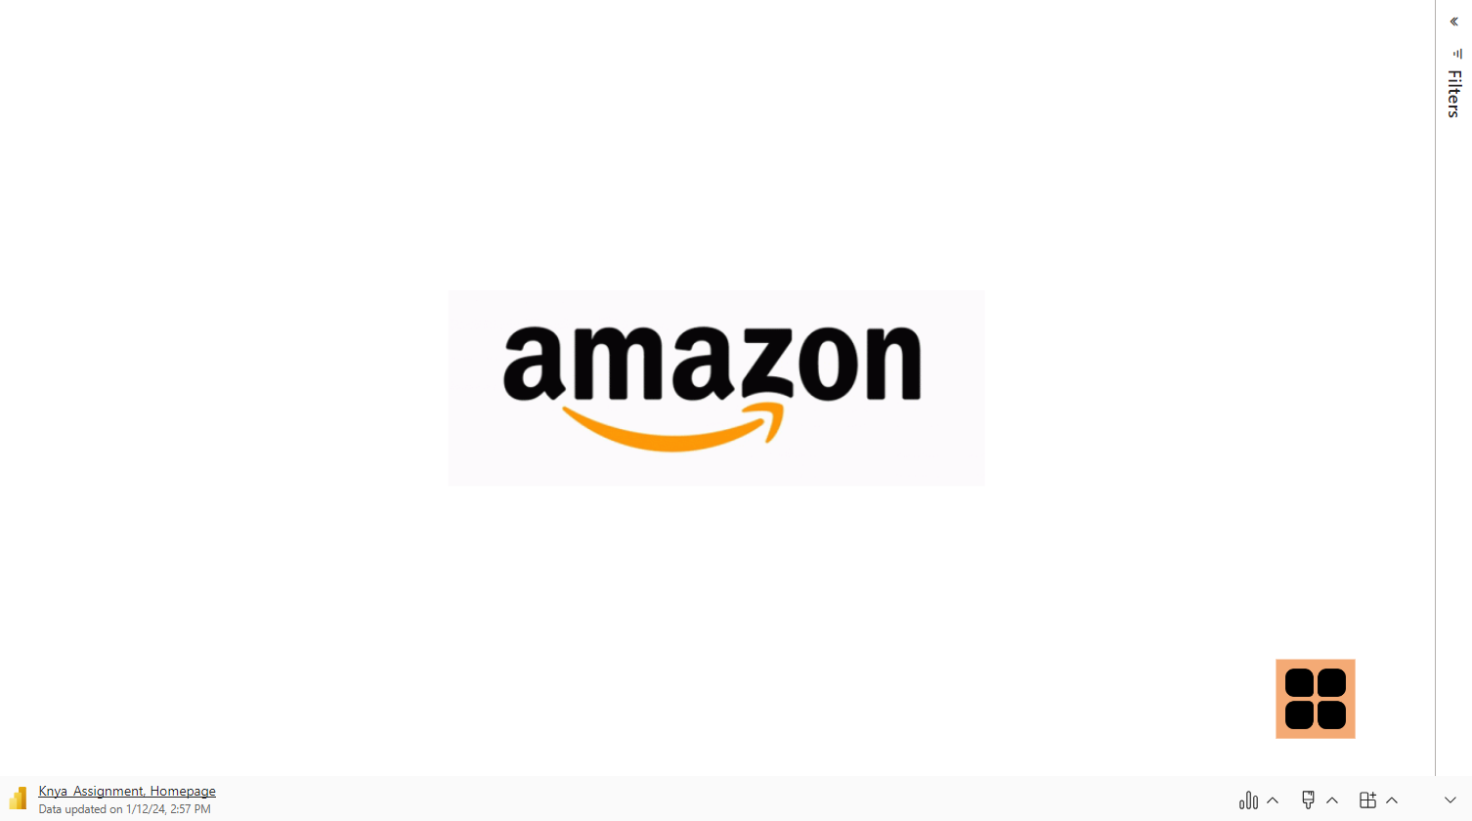

Slide 7
Monthly Variation:
March: Kurta sales dominated, followed by Western Dress and Set categories.
April: Set category had the highest sales, followed by Kurta and Western Dress.
May: Kurta sales were notable, along with Top and Western Dress categories.
June: The Set category experienced a significant surge in sales, overshadowing other categories.
Category Insights :
Consistent Performers: Kurta and Western Dress categories displayed consistent sales across multiple months.
Varying Trends: Other categories like Set, Blouse, and Top showed varying sales trends over the months.
Unusual Spike: The Set category notably surged in June, showing a substantial increase compared to previous months.

Slide 8
Seasonal Variations or Market Trends:
Preference Changes: Certain categories, like Kurta, maintained steady sales, suggesting stable consumer preferences.
Unexpected Patterns: June saw a surprising spike in the Set category, indicating a potential shift in market demand or specific promotions.
Future Projections:
Predictive Insights: Use these trends to forecast future sales. Analyze the June trend in the Set category to predict potential performance in upcoming months.

Slide 9

Stock Breakdown:
JNE3405-KR-XXL constituted 0.51% of the total stock.
This item holds a very small portion of the inventory, suggesting limited importance or demand relative to other products
Top Performing Products:
J0230-SKD-M generated the highest sales amount: $527,699.20.
JNE3797-KR-L had the highest Quantity Count: 773 units.

Slide 10

Glance By Status:
With a staggering count of 77,804 units, the 'Shipped' status outshone all others by a wide margin. In contrast, 'Shipped - Damaged' struggled with the lowest count of just 1 unit.
'Shipped' took the lion's share at 60.32% of the total count across all 13 statuses, showing its dominant presence among various order statuses.
The range of quantities across these statuses was vast, fluctuating between 1 unit and the impressive 77,804 units attributed to the 'Shipped' status.

Slide 11



'Shipped' topped the charts with the highest total sum of $50,324,255. Following behind were 'Cancelled' at $6,919,284.30 and 'Pending' at $430,271.
Within the 'Shipped' status, 'Expedited' contributed significantly, comprising 63.99% of the total sum of amounts.
Looking at averages, 'Shipped' maintained the highest average sum of $25,162,127.50, trailed by 'Cancelled' at $3,459,642.15 and 'Pending' at $215,135.50.
The category 'M' led the way with the highest sum of $13,906,754.37, remarkably 6,677.41% higher than 'Free', the lowest at $205,192.77.
'M' accounted for 17.69% of the total sum of amounts across all categories.
The sum of amounts varied across sizes, spanning from $205,192.77 to $13,906,754.37.

Slide 12

Key Insights :
🌎 Geographical Sales: Maharashtra State and Bengaluru saw heightened sales, while Lucknow had comparatively lower performance.
📦 Order Status Breakdown: Among 128,975 orders, 77,804 were shipped, and 28,769 successfully reached buyers.
👕 Size & Category Demand: Medium and Large sizes were sought after across various categories.
🔝 Top April Sales: April 2022 marked a peak, notably in the Set category, with Set, Kurta, and Western Dress leading.
📍 Regional Variance: The dashboard highlighted sales disparities across different cities, indicating regional preferences.
💰 Total Business Metrics: $78.59M Revenue, 120K orders, selling 117K units in 9 categories. Amazon sales: $50.32M, Merchant sales: $24.27M, with 11 available sizes.

Slide 13
Recommendations:
🌟 Trendy Fashion Focus: Elevate sales across all states and cities by aligning with current fashion trends and preferences.
👗 Revamp Ethnic Styles: Inject freshness into Ethnic and Traditional dresses to revitalize their sales performance.
🗺️ Market Expansion: Explore new markets or regions, utilizing insights into preferences to expand and diversify your customer base.
💡 Enhanced Customer Experience: Personalize pricing or offers based on size or color preferences revealed by the data to improve customer satisfaction.
🚀 Sales Focus: Amplify promotional efforts around top-performing categories like Set, Kurta, and Western Dress to drive increased sales.
🎯 Monitor Lucknow Sales: Keep a close eye on Lucknow's sales performance, strategizing to boost its market presence.

