Slide 1



FinalProject_KinjalShah
View in Power BI
Last data refresh:
5/30/2025 6:19:42 PM UTC
Downloaded at:
5/30/2025 6:27:37 PM UTC

Slide 2
Scenario
The HR (Human Resource) department is the heart of every organization. From recruitment to compensation to performance appraisal and employee wellbeing, the HR department plays several roles in the enterprise. HR acts as a mediator or a bridge between the employees and the management or enterprise. Providing them access to the latest technology and the means to derive insights in real time will help reduce the workload.
Problem Statement
Market fluctuations and rapidly changing technology have affected the global market. Many published reports showed that around half of the employees wanted to change jobs. While some market researchers said that flexible working and job security were their primary factors, few admitted that a higher salary was their aim.
Different regions saw an increase and a decrease in salaries over the years. While the increase was to retain top-level professional employees, the pay cuts were due to market fluctuations and were resorted after the market conditions improved. HR people across the globe are hiring new employees , trying to retain and understand the needs of employees who got separated(those who left the company).
So, how does the HR department make these decisions in volatile market conditions? They rely on HR analytics to understand the existing situation and develop a new modern approach. For this requirement, you have been asked in your company to build a dashboard in Power BI considering the following challenges of HR people and provide an effective way to find the answers to their day-to-day questions.

Slide 3
Tasks
1. Use the HR dataset provided for this project and analyze that to understand the data and terms.
2. Load data into the Power BI Query Editor and perform the required actions.
3. Establish the required relationships (look at the hint section).
4. Create the required DAX columns and measures.
5. Create the report in Power BI.
6. Implement row-level security.
7. Publish the report in Power BI Service.
8. Create the dashboard in the Power BI workspace using the key visuals.

Slide 4
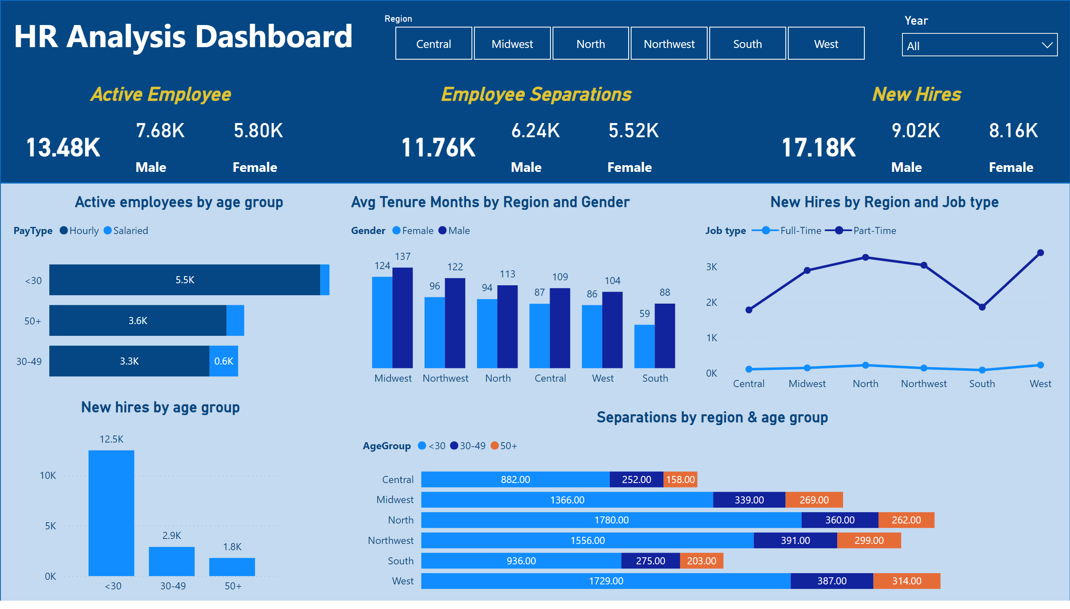
HR Data Analysis
Notes:
shape
No alt text provided
shape
No alt text provided
textbox
No alt text provided
Active Employee
No alt text provided
slicer
No alt text provided
slicer
No alt text provided
Employee Separations
No alt text provided
New Hires
No alt text provided
Active employees by age group
No alt text provided
New hires by age group
No alt text provided
Avg Tenure Months by Region and Gender
No alt text provided
Separations by region & age group
No alt text provided
New Hires by Region and Job type
No alt text provided

